Slide 2





Happy Spring!

Slide 3

APRIL
DSP of the Month
Heather Perkins
Jacob Jerricho
Carol Barnes
Jake is an exceptional DSP because he has compassion for others and tries to provide assistance to those in need.
Jake reads the ISP, ask questions and offer ideas to assist Individuals to achieve their goals and/or make a wish or dream come true. One of our Individuals that Jake first worked with loved fire trucks and ambulances (EMT's). Jake made arrangements for this gentleman to have a tour (which he has had many tours). This time he was able to see how ALL the equipment worked with a hands-on approach, including the defibrillator... oh what a happy day.
Another Individual and a peer were talking about a "guys-night out" on Bridge St. Jake made this happen. They were excited to be on Bridge St. eating wings, talking, walking and people watching without being with members of their prospective families. The other gentlemen that we provide services to are also planning or have attended "guys-night out" with Jake. He is in high demand.
My last example why Jake is an exceptional DSP (I have plenty) happened mid-March. Jake was assisting an Individual in his home (shared with his mother and a few small dogs, dogs that Jake has assisted to bath) to make dinner as a new service to his ISP. After working in the kitchen, Jake was asked to look at the wind damage to the side of the home. Jake showed our gentleman and assisted him to repair the skirting that was ripped off by the wind so no small animals could get underneath. This not only saved the skirting from further damage, but also eased the concern of the home's occupants, while teaching our Individual a new skill that increased his independence and self-esteem.
Jake is an exceptional DSP and a true asset to my team. He does not look for awards but deserves them. Thank you Jake!
Carol has been the glue of the home for three ladies for almost 8 months now. She has not missed a beat. She is the house manager and makes sure everyone is organized, fed, happy, and safe. She doesn't hesitate to pick up a shift, attend a doctor appointment, or go to the YMCA for some swimming. She has the best communication skills, kindness, and care that you would want in someone who is caring for your loved one. She is the epitome of a wonderful human, staff, and friend. I want her to know how appreciated she is and how thankful we are to have her. Thank you for everything that you do Carol, it does not go unnoticed.
Heather is always striving to help in any way needed; she fills in when needed, and the individuals in her group love her!! She is willing to staff anyone and makes them feel seen and heard! She goes above and beyond on a daily basis to make sure everyone has their needs met! As HPC manager at Active Day, I would love to have several Heather Perkins helping me staff our individuals, because I would know they are being taken care of in the way they deserve, with dignity and respect!!

Slide 4
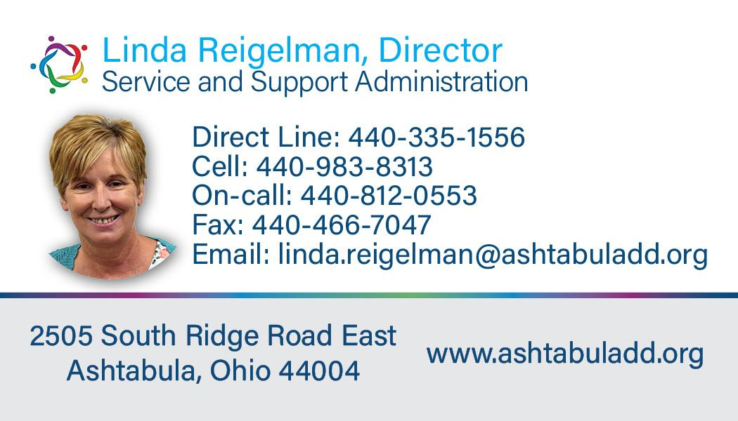
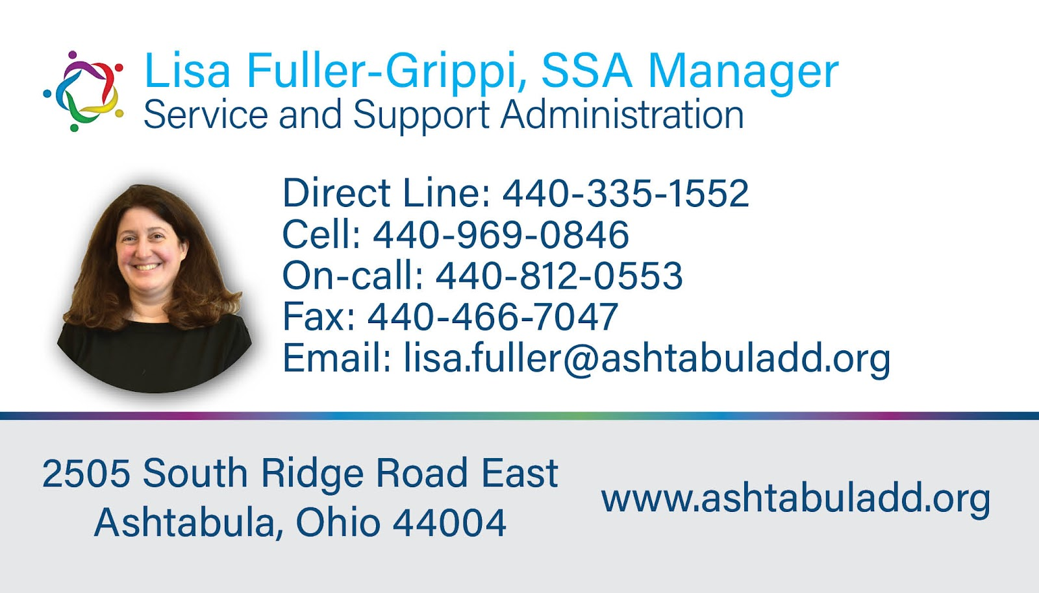

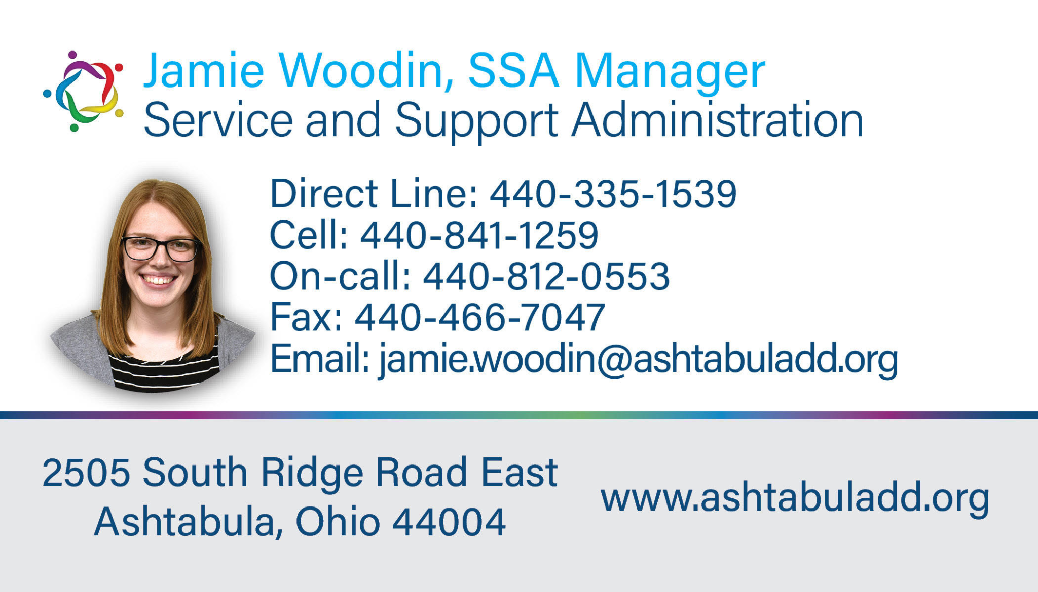
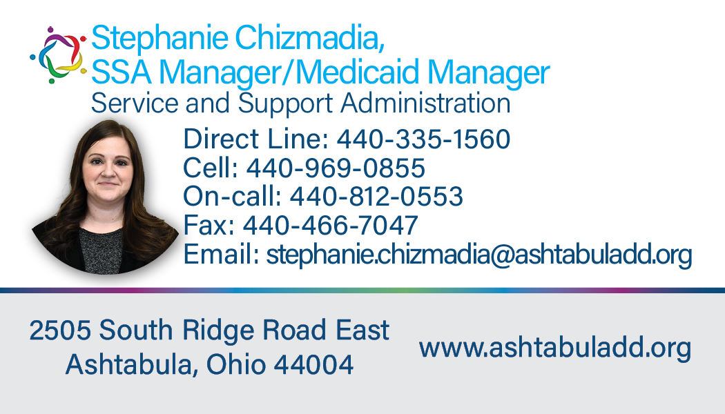
SSA Department

Slide 5

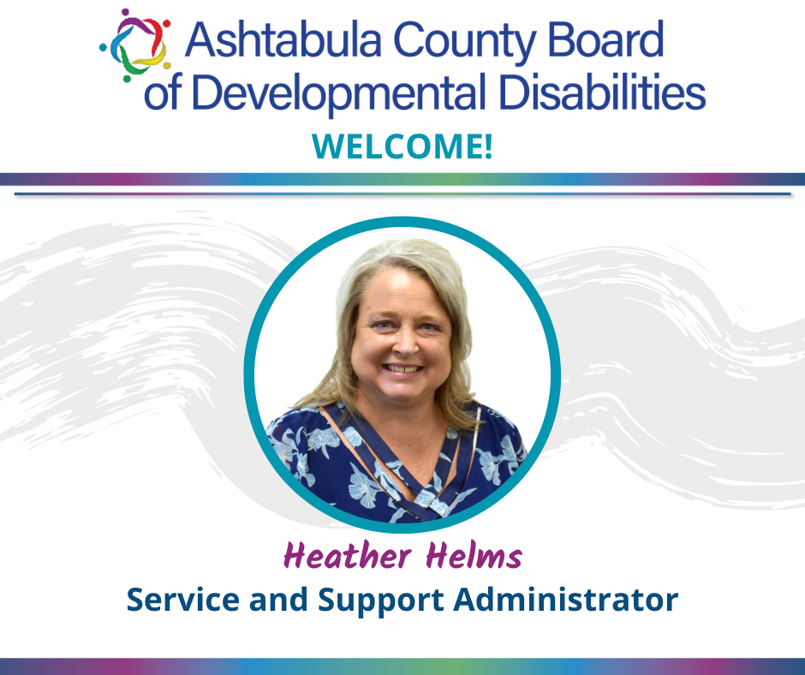
SSA Department
Notes:
Jamie

Slide 6

SSA Department
Individuals supported, and guardians should have received information regarding the implementation of the interRAI assessment tools.
The letter provided information about the new assessment tools, the assessment process, and timelines for when the new assessments may lead to new waiver budgets or provider payment rates. ﻿
Notes:
Stephanie

Slide 7
SSA Department
The interRAI assessment tools can be used in many ways, but Ohio will use them for these purposes:
To help inform new support levels for people on the waiver.
To help service and support administrators (SSAs) with person-centered planning.
To help set payment rates for providers based on a person’s needs for the IO, Level One, and SELF waivers.
More information about the interRAI assessments and the Waiver Modernization project can be found here:
https://dodd.ohio.gov/about-us/waiver_redesign/waiver+modernization/waiver+modernization
Notes:
Stephanie

Slide 8
SSA Department
The purpose of waiver services
Services exist to meet assessed needs, not maximize budgets
Funding should follow documented assessments
Focus on meaningful outcomes:
Employment
Community participation
Independence
Budgets are tools, not targets

Slide 9
SSA Department
The Problem: Budget Maximization
Common Patterns:
Automatically scheduling full-day services
Filling maximum waiver allocations
Services continuing without reassessment
Risks:
Services misaligned with goals
Reduced individual choice
System becomes unsustainable
When budgets become targets, services are built around funding—not people.

Slide 10
SSA Department
Sources of Need:
Functional assessments
ISP outcomes
Behavioral & medical supports
Employment goals
Guiding Questions:
What does the person truly need to succeed?
Which services best support those outcomes?
Shift the Mindset:
❌ “How many hours can we bill?”
✅ “What supports are necessary for success?”
Focus on Assessed Need

Slide 11

SSA Department
Outcomes, Sustainability & Partnership
Needs-Based Approach:
Provide supports required to reach outcomes
Blend employment, community, and natural supports
Reassess and adjust regularly
Why It Matters:
Ensures long-term system sustainability
Promotes equitable access for others
Builds credibility with oversight entities
Provider Partnership:
Document true support needs
Focus on individual outcomes
Use services strategically

Slide 12
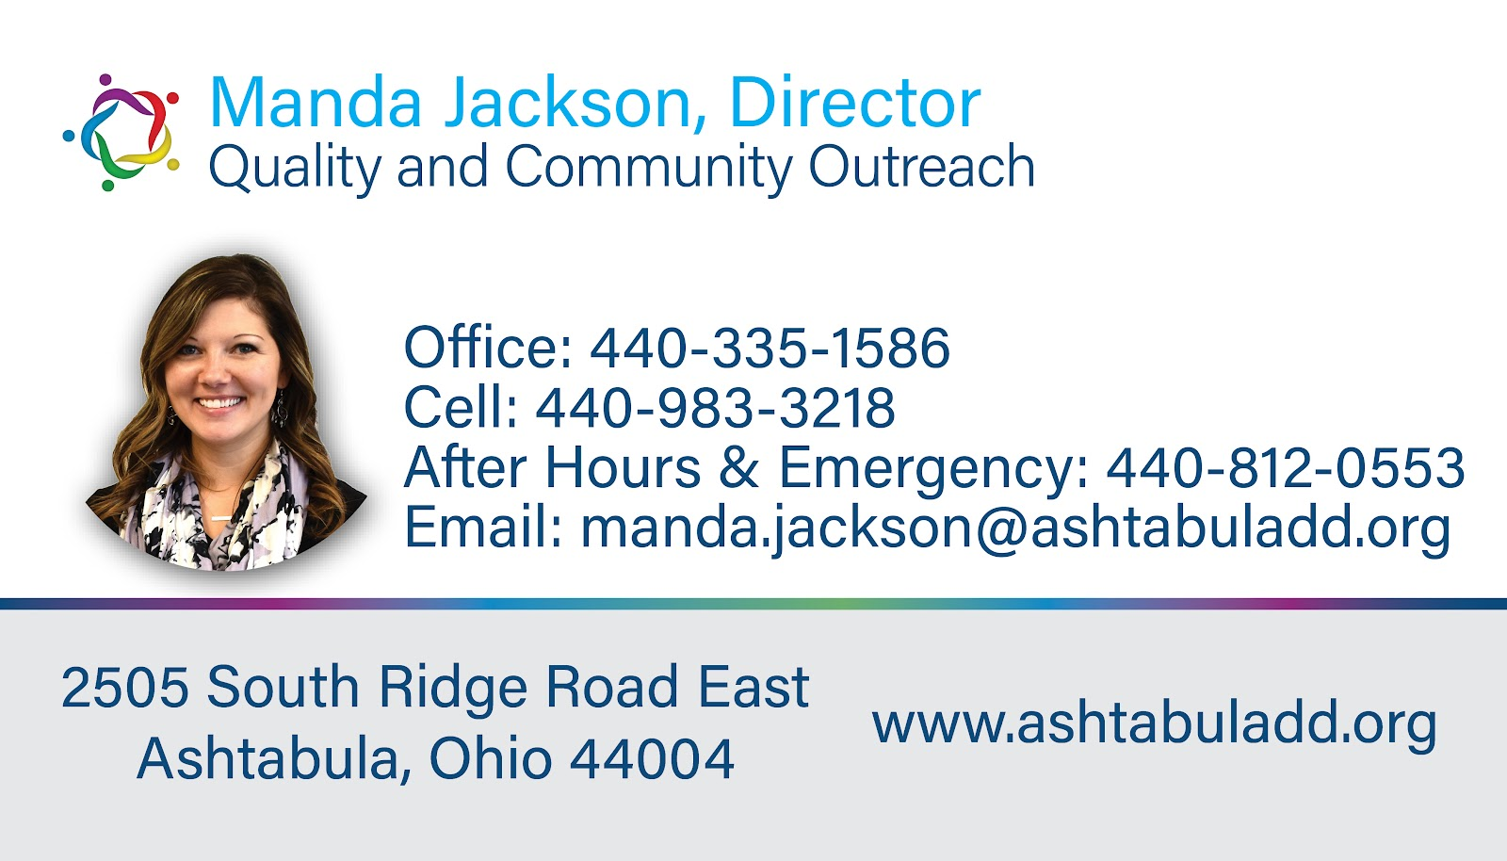

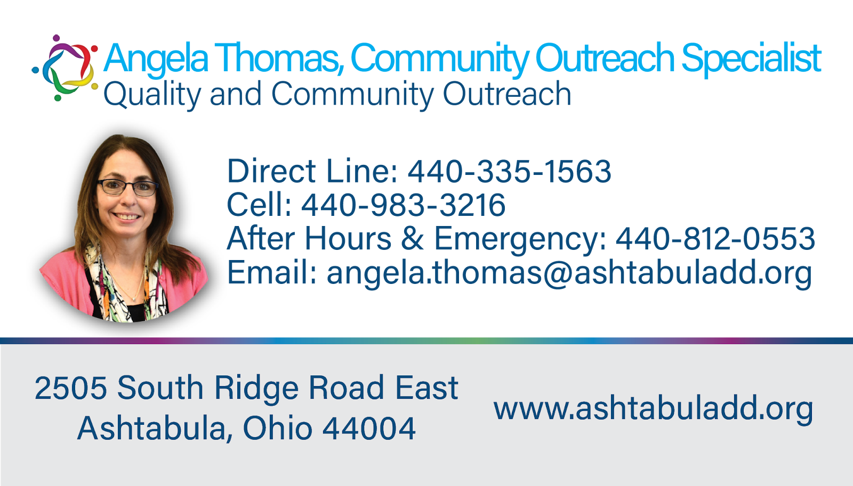
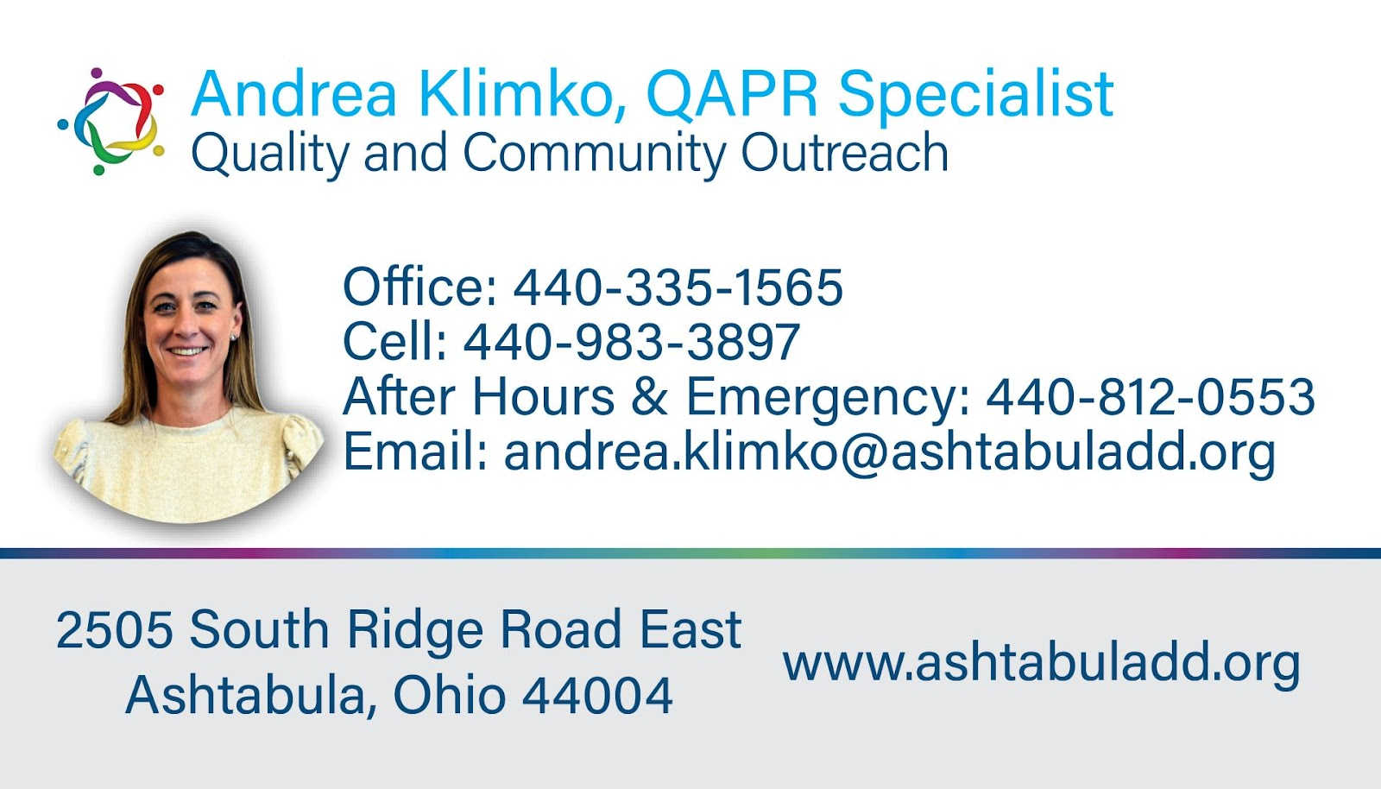

QCO Department
Questions?

Slide 13
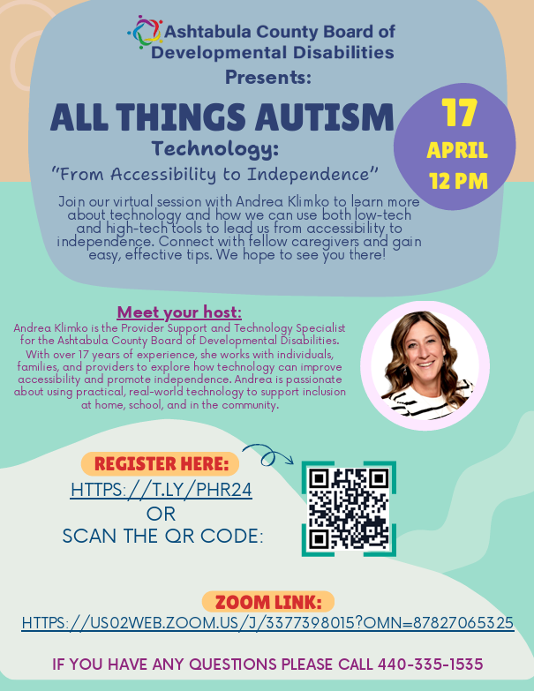
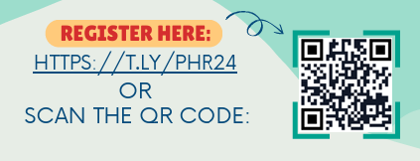
QCO Department
QCO Department

Slide 14


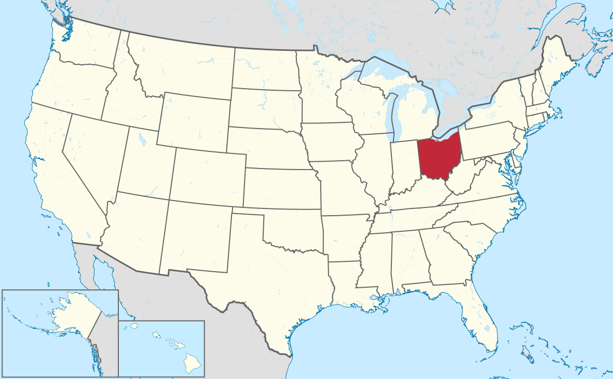
In May of 2018 Governor John Kasich signed the Technology First Executive Order, Making Ohio the first state in the country to place emphasis on expanding access to technology for people with developmental disabilities.

Slide 15

Creating increased independence and productivity through a combination of support from technology and trained professionals.
Tech First is a framework that uses technology as the first consideration when planning support for individuals and families.
This can be applied through:
Service planning
Community supported living
Organization culture
‹#›
Notes:
Technology First began as a movement but has transformed to a “framework for systems change where technology is considered
first in the discussion of support options available to individuals and families through person-centered approaches to promote
meaningful participation, social inclusion, self-determination and quality of life” (E.S., Tanis, 2019).
Technology First solves the most pressing challenges of our field today.
Technology First:
Promotes autonomy, self-direction, and community engagement
Address the direct care workforce shortages
Drives more efficient and effective practices –cost efficiency

Slide 16
What is Assistive Technology?
Assistive Technology includes assistive, adaptive, and rehabilitative devices and services that help maintain or improve an individual’s functioning and independence.
Importance of Assistive Technology
Assistive technology can completely transform someone’s life for the better. It reduces the need for formal health supports, long-term care, and the work of caregivers. Assistive devices make nearby environment more accessible for people with disabilities or disabling conditions.
QCO Department
Examples of Assistive Technology
Assistive technology (AT) devices enhance independence for individuals with disabilities through tools spanning mobility, vision, hearing, and cognitive support.
Examples include wheelchairs, screen readers, hearing aids, AAC devices, and ergonomic tools. They range from low-tech (pencil grips) to high-tech (eye-tracking), facilitating daily activities, communication, and education

Slide 17
ACBDD Tech Goals for 2026
Increase AT usage by 20% and RS by 15%.
Ensure all team members consider technology during the planning process.
Empower DSPs and providers to explore technology solutions through trainings.
Increase technology solutions and resource guide availability on our website.
QCO Department

Slide 18

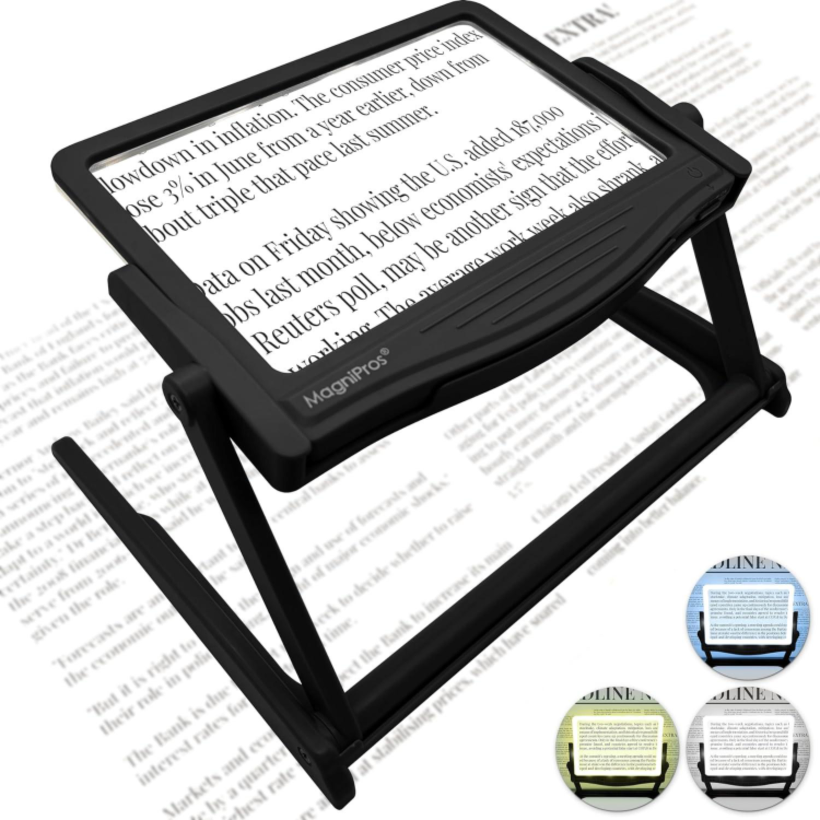

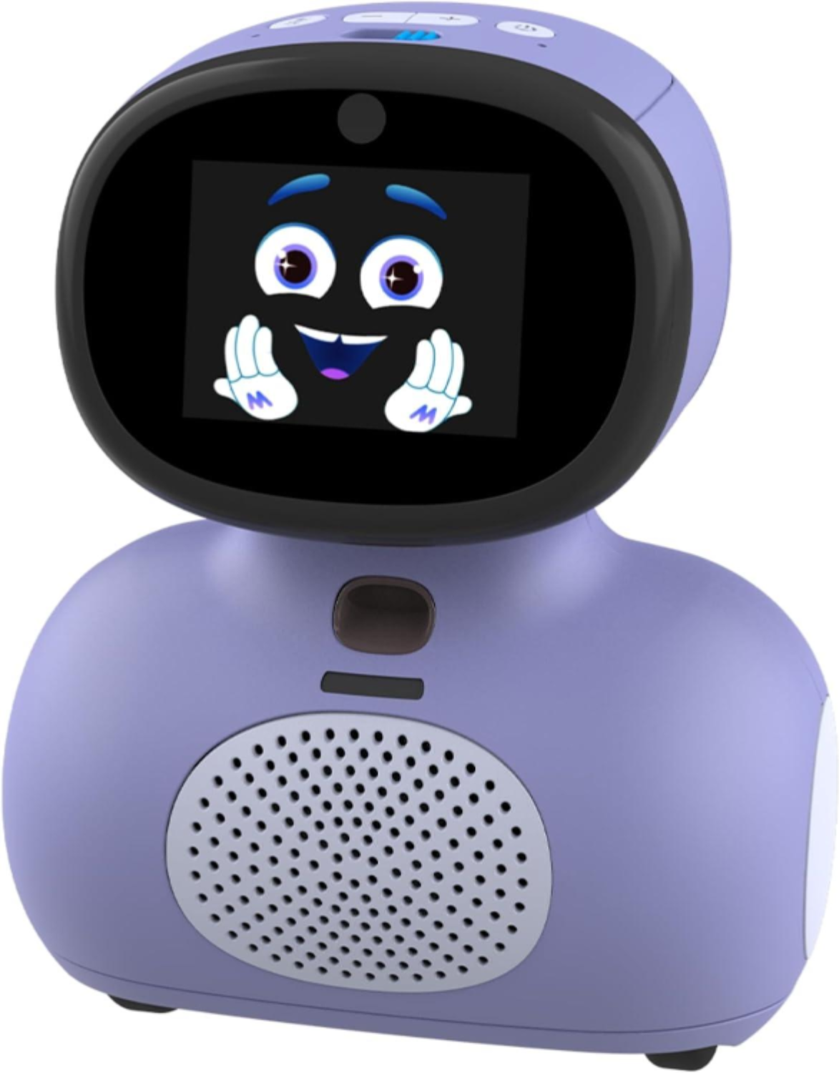

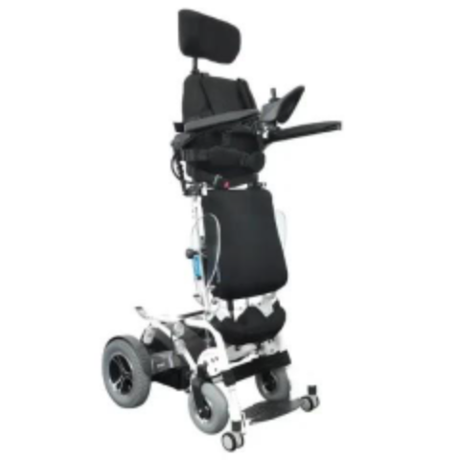

TECH Go Bag Inventory: 110 Items Available
QCO Department
TECH Hub Inventory: 65 items Available

Slide 19

May 27th, 2026
10:00 am-3:30 pm
DWELL, 1390 Community Park Drive, Columbus
$50 per person- Includes lunch
QCO Department
The 2026 Summit, is a professional conference designed specifically for DSPs, Frontline Supervisors, and Independent Providers.
This year, we are pleased to have major support from the Ohio Department of Developmental Disabilities (DODD):
50 registrations: free
125 registrations: half-price
Regular registrations: $50
All registrations include lunch and swag.
Notes:
The 12th Annual Summit is a professional conference designed specifically for DSPs, Frontline Supervisors, and Independent Providers. This year, we are pleased to have support from the Ohio Department of Developmental Disabilities.
In addition to our keynote plenary presentations, Lighthouse Cove and the Councils are pleased to bring you breakout sessions that address.
- Empowering People
- Disability History in the U.S.
- Pound Fitness
- Documentation 2.0: From Compliance to Impact
- Leadership

Slide 20
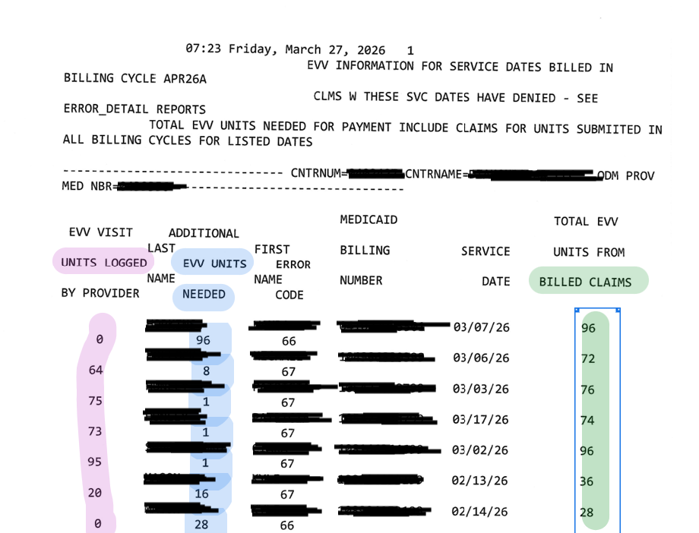
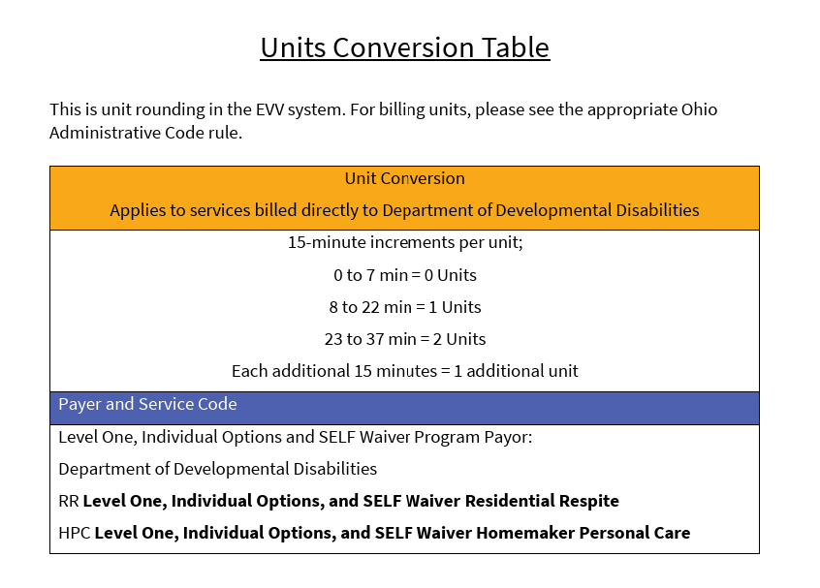
QCO Department

Slide 21
QCO Department
Reminders:
Information updates
Outcome tracking System reporting Extended
Go with the flow training series
Independent provider Cert fee reinstated (7/1/26)
Sandata Learn Updates
QCO Department

Slide 22
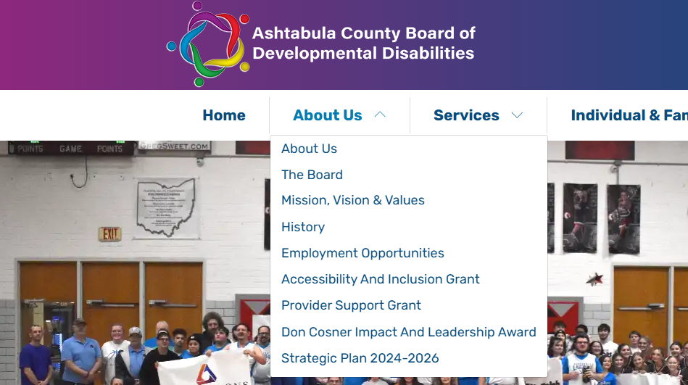
While creative proposals are encouraged, ACBDD has identified four priority funding categories for this year that align with our strategic plan. The board has placed further emphasis on grant requests related to advocacy efforts for 2026:
Transportation – Expanding access to reliable, safe, and flexible transportation options.
Employment—Increasing employment opportunities and supports for people with developmental disabilities.
Retention and Development of Direct Support Professionals (DSPs) – Strengthening the DSP workforce through training, recruitment, and retention initiatives.
Advocacy - Supporting people served in leading as independent of a life as possible.
QCO Department

Slide 23
Training Offered
MUI Refresher Training- As Requested
Initial Medication Certification Category 1- April 27 & 28, 2026
Initial Provider Training- May 13, 2026
Annual Provider Training- June 10, 2026
CPR/First Aid Blended Learning - June 2, 2026
Initial Medication Administration: Categories 2 & 3- April 20, 2026
Renewal Medication Certification Categories 1, 2 & 3 - April 21, 2026
AEGIS Crisis Prevention & De-Escalation- June 9, 2026
Provider Orientation- April 21, 2026
Provider Open Office Hours - Monthly on the First Tuesday
All classes listed above are open for registration on the Ashtabula County Board of Developmental Disabilities website under the Provider support tab. https://www.ashtabuladd.org/

Slide 24






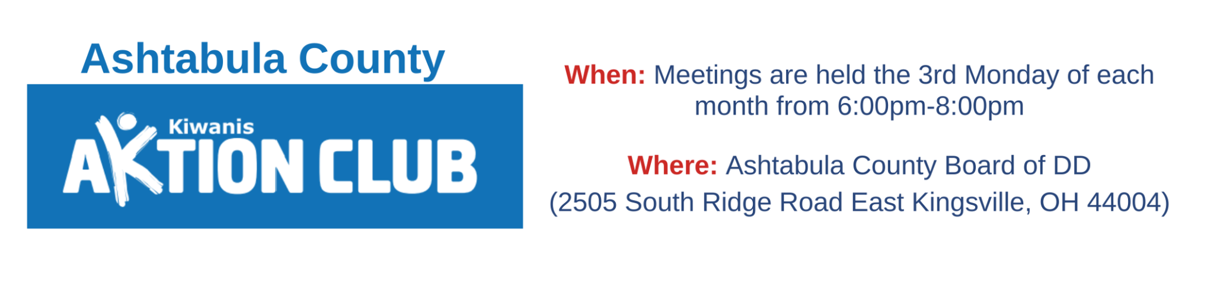
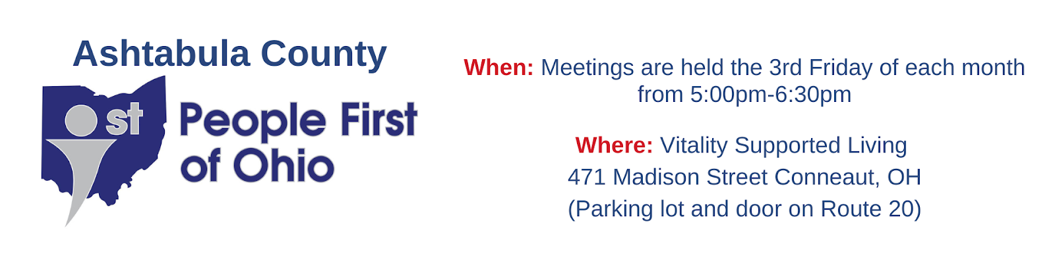
Community Inclusion activities
QCO Department
‹#›

Slide 25



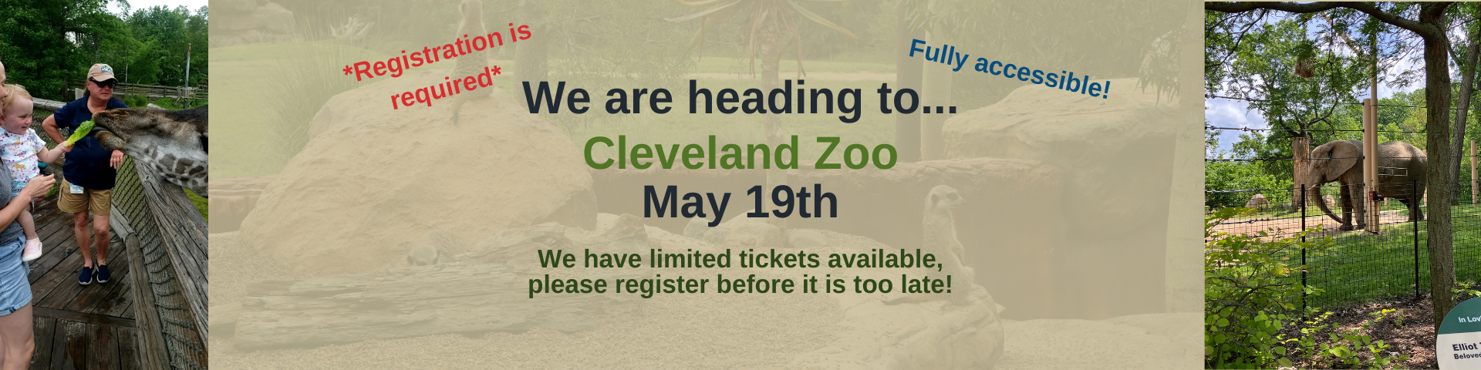
And So Much More!
QCO Department

Slide 26
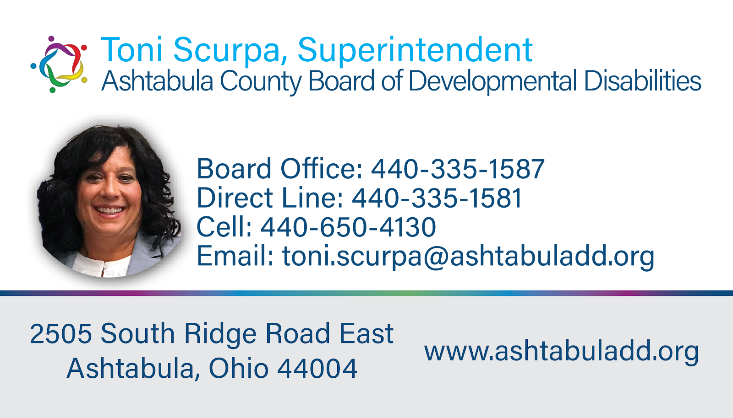

State, Federal and Local Updates
Superintendent Updates

Slide 27

OPEN MIC

Slide 28
Thank You!
Next Provider Meeting
May 14, 2026
In person

