Slide 1
2024-2025
NEISD CIIPs & DIIP
District Educational Improvement Council November 6, 2024

Slide 2

TABLE OF CONTENTS
01
02
03
04
OVERVIEW
District and
Campus Onboarding
Plan4Learning Platform
Campus Cohorts # 1, 2, and 3
& District Offices
Questions & Feedback
Next Steps
Table Top Review Session in October
Addressed by all departments listed in the DIIP
NEISD Board Presentation
Monday, November 11, 2024

Slide 3
What is Plan 4 Learning?
Plan4 Learning is designed by educators for educators to simplify the improvement planning process by streamlining key steps and ensuring compliance across the board. With that taken care of campus are free to align with a common vision, identify key needs, and develop strategies to impact results.
NEISD began our partnership with P4L in 2021-2022
Campus Cohort #1 (6 Title campuses; 1 Non-Title campus)

Slide 4

NEISD DISTRICT BOARD GOALS

Slide 5
NEISD District Scorecard
01
02
03
04
STUDENTS
STAFF
STAKEHOLDERS
STEWARDSHIP
Scorecard Adoption June 2022
We value our employees and invest in their growth.
We collaborate with students, families and community members to support learning.
We plan and manage funds and resources responsibly.
We support students in a multitude of way to nurture their learning.

Slide 6
District and Campus CNA
Texas Education Code (TEC) Sec. 11.252 under DISTRICT-LEVEL PLANNING AND DECISION-MAKING requires a Comprehensive Needs Assessment (CNA) for districts and schools in Texas:
Purpose: Identify needs, determine the school's direction, and develop improvement plans.
Areas of focus: Includes areas such as student performance, demographics, technology, discipline, curriculum, professional development, school culture, and family and community involvement.
Data sources: Stakeholders consider data such as student and teacher demographics, student performance data, surveys, and teacher evaluations.
Student groups: Must disaggregate data by all student groups served by the district, including categories of ethnicity, socioeconomic status, and populations served by special programs.
Academic achievement: Must be based on academic achievement information about all students in the school, particularly those who are failing or at risk of failing to meet state academic standards.

Slide 7




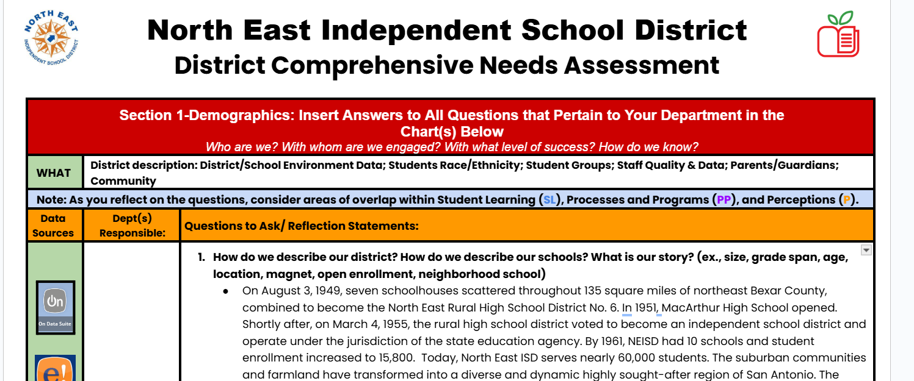


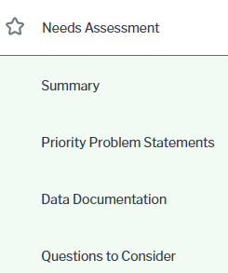

Comprehensive Needs Assessment
CNA completion: All campuses and district office.

Slide 8
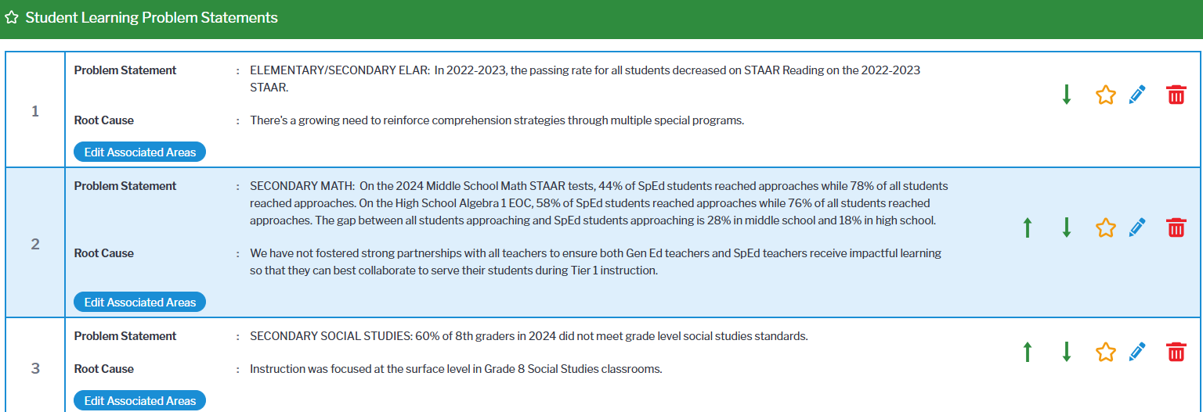
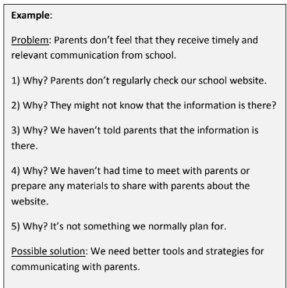
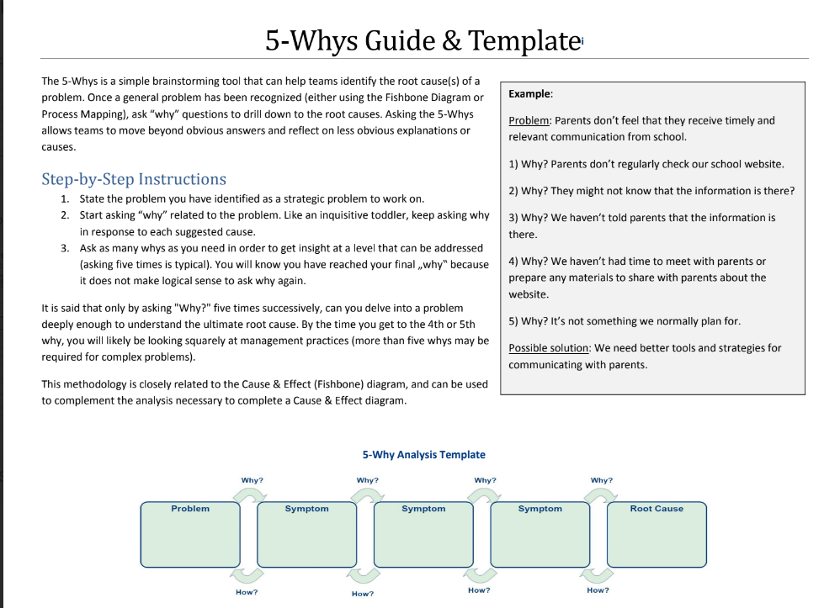
Problem Statements & Root Causes
The 5-Whys

Slide 9
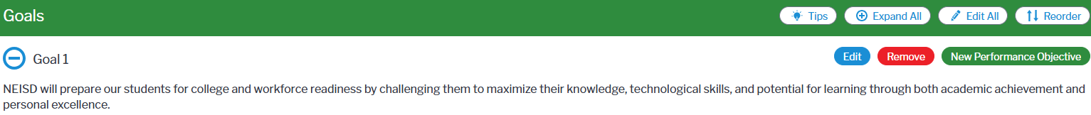
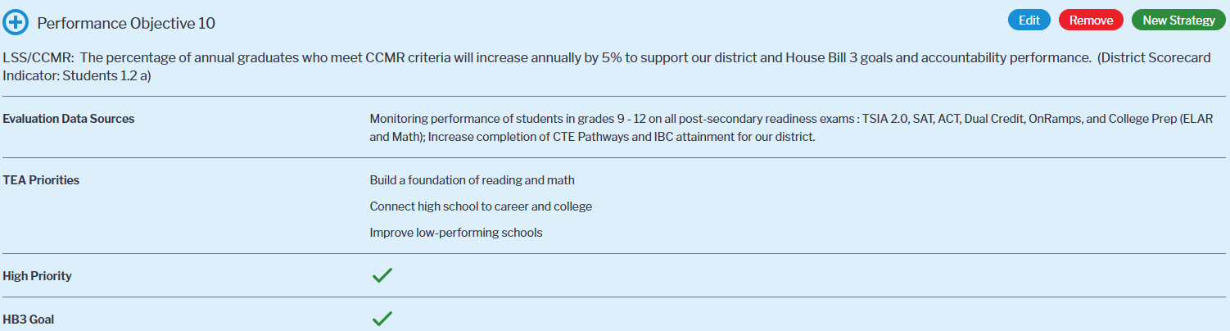
NEISD District Board Goals District Scorecard Indicators

Slide 10
CAMPUS COHORTS 1, 2, & 3
COHORT # 1
(22-23)
COHORT # 2
(23-24)
COHORT # 3
(24-25)
7 Campuses
25 Campuses
38 Campuses

Slide 11

C&I DEPARTMENTS
ELEMENTARY/
SECONDARY C&I
SPECIAL EDUCATION
LEARNING SUPPORT SERVICES
TECHNOLOGY SERVICES

Slide 12
NEISD DEPARTMENTS
(ONBOARDING 24-25)
HUMAN RESOURCES
PUPIL PERSONNEL
HEALTH SERVICES
FINE ARTS
PE/HEALTH

Slide 13
Plan4Learning District & Campus Plans
Campus Instructional Improvement Plan Webpage Review (Oak Grove Elementary)
District Instructional Improvement Plan
(LSS Webpage)

Slide 14
THANK
YOU
QUESTIONS?

