Slide 1

Winship-Robbins School District
2022-2023 Adopted BUDGET REPORT
Dawn Carl
Superintendent/Principal

Slide 2
Winship-Robbins Elementary School District
TABLE OF CONTENTS
2022-23 Adopted Budget Report
Budget Introduction Page 3
General Fund Revenue Assumptions Page 4
State Priorities Page 5
General Fund Revenues Pages 6 - 7
General Fund Expenditures Pages 8 - 10
General Fund Balance Page 11
Revenues Versus Expenditures Page 12
Other Funds Page 13
Multi-Year Assumptions and MYP Pages 14 - 15
Enrollment- ADA Trend Page 16

Slide 3
Winship-Robbins Elementary School District
INTRODUCTION
2022-2023 Adopted Budget Report
The County Office, under AB1200, requires districts to document and include written budget assumptions in the budget package submitted for approval to the district Board of Trustees. Each district should advise the Board, by way of budget documents, accompanied by a brief narrative, of the financial condition of the district. This report will provide the required information for the Board to certify the district’s ability to meet its financial obligations.
The Adopted Budget Report is presented by fund and major object account classification, reflecting 2021-2022 “Estimated Actuals” in columns A-C and the Proposed 2022-2023 “Budget” in columns D-F. The final column reflects the percentage of variance between the 2021-2022 Estimated Actuals and the proposed 2022-2023 Budget.
This report contains information and estimates that reflect the information contained in the Governor’s May Revision State Budget proposal.

Slide 4
Winship-Robbins Elementary School District
General Fund Revenue Assumptions
2022-2023 Adopted Budget Report
Local Control Funding Formula
Based on Projected 2022-2023 ADA of 107
Property Taxes = $905,205– $864,322 In-Lieu = $40,833
State Aid = $1,014,221
Other State and Federal Funding
Unrestricted Lottery = $163 per Annual ADA
Restricted Lottery = $65 per Annual ADA
Federal No Child Left Behind (Title I $18,217 & Title II $2,705)
REAP funding is projected at $15,905

Slide 5
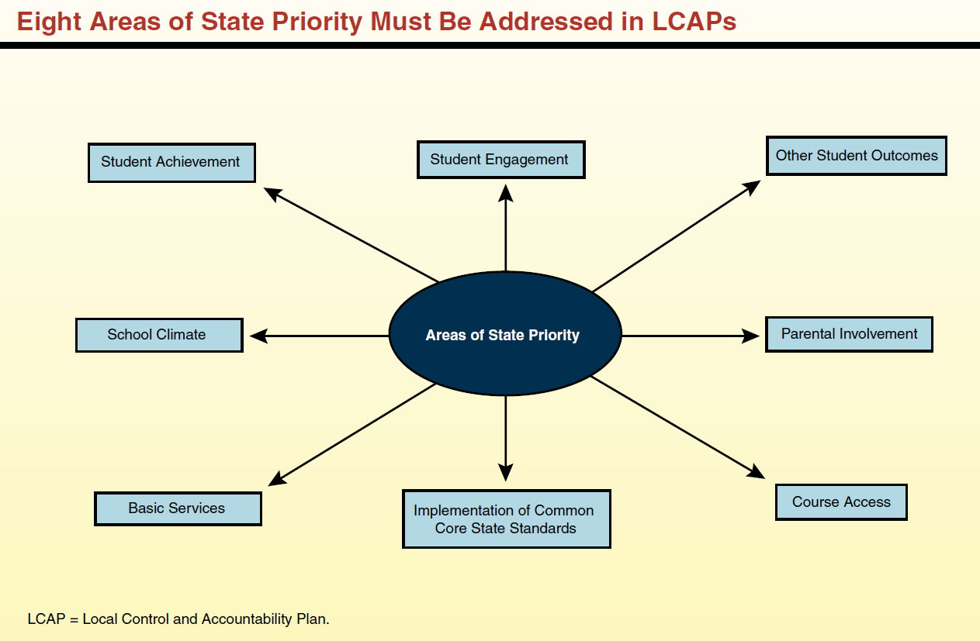
Eight State Priorities
2022-2023 ADOPTED BUDGET REPORT
Schools Services of California

Slide 6
Winship-Robbins Elementary School District
GENERAL FUND REVENUE SOURCES
2022-2023 Adopted Budget Report
The largest part of the revenue (58%) comes from Local Control Funding and is to be aligned to meet the eight state priorities. These priorities are on the previous slide.
The district will continue to receive federal funds for specific purposes and must continue to follow federal regulations. Federal funds consist of Title I, Title II and REAP.
Other state funds consist of Mandated Costs, Lottery, Expanded Learning Opportunity Program (ELOP), One-time Universal Prekindergarten Planning and Implementation (UPK), and One-time In-Person Learning (IPI).
Local resources include leases, interest, donations, local grants, special education funds, and charter fiscal oversight fees.

Slide 7
Winship-Robbins Elementary School District
GENERAL FUND REVENUE SOURCES
2022-2023 Adopted Budget Report
Local Control Funding Formula $1,371,411
This budget source is based on 22/23 projected ADA of 107. The LCFF calculator reflects a 6.56% COLA.
Federal Revenues $46,827
This revenue source includes Title I, Title II, and REAP. The $297,835 reduction in revenue is due to one-time Covid19 funds, the removal of REAP Carryover and the removal of Nutrition revenue due to the district contracting services with another district.
Other State Revenues $198,971
This revenue includes Unrestricted and Restricted Lottery, Mandated Costs, ELOP, One-time IPI, and One-time UPK Planning and Implementation funds. The $290,169 reduction in revenue is due to the removal of one-time Covid19 funds, the removal of Nutrition revenue due to the district contracting services with another district, and the removal of Water Well funds.
Other Local Revenue $733,948
This revenue includes Interest, Rental Income, Special Education, and Charter Fiscal Oversight revenue. The $36,337 increase in revenue is due to an increase in oversight revenue.

Slide 8
Winship-Robbins Elementary School District
GENERAL FUND EXPENDITURES
2022-2023 Adopted Budget Report
Salaries and benefits represent 72% of the District’s total budget.

Slide 9
Winship-Robbins Elementary School District
GENERAL FUND EXPENDITURES
2022-2023 Adopted Budget Report
    CERTIFICATED SALARIES - $564,102
          Salary projections are based on 8 certificated FTE; and 1 management FTE, (.7 FTE Principal; .3 FTE Superintendent). The expenditure has a net decrease of $19,452 due to savings from replacing 2 certificated FTE at lower step and column placements.
          CLASSIFIED SALARIES - $462,532
          Salary projections are based on 12.5 FTEs and known staffing needs, including extra-duty and overtime. The expenditure has a net decrease of $10,067 due to moving 2 classified positions to the Child Development fund and adding an additional custodial position.
          EMPLOYEE BENEFITS - $430,024
          Benefits are based on projections that reflect the changes in the above salary expenditures. 2022-2023 STRS rate is 19.10%. 2022-2023 PERS rate is 25.37%. There is a net increase of $24,341 mainly due to the increase in the PERS rate from 22.91% to 25.37%
    BOOKS AND SUPPLIES - $129,661
    Projected instructional materials and supplies expenses include core and supplemental instructional materials, custodial and maintenance supplies, and technology related expenditures. This expenditure is reduced by $56,419 primarily due to the removal of one-time Covid19 related expenditures and food expenditures.
    SERVICES, OTHER OPERATING EXPENSES - $391,798
    Projected services and other operating expenses include professional development for classroom staff, classroom on-line instructional and intervention programs, maintenance, custodial repair, drinking water delivery, and servicing expenses and utilities. This expenditure has a net increase of $13,384 primarily due to the increase of Nutrition service expenditures and the decrease of REAP services due to the removal of REAP Carryover.

Slide 10
Winship-Robbins Elementary School District
GENERAL FUND EXPENDITURES
2022-2023 Adopted Budget Report
    CAPITAL OUTLAY - $55,000
    This includes budget for new concrete to existing portables and new air conditioners.
    OTHER OUTGO - $0
    The district is expecting revenue from the County office and not Excess Costs due to a decrease in total district program costs.
    INTERFUND TRANSFERS IN/OUT - $68,279
    Projected inter-fund transfer out to Child Development Fund.
    CONTRIBUTIONS TO RESTRICTED PROGRAMS $292,965
    Contributions to restricted programs are projected to total $292,965 and include contributions to Child Nutrition, Special Education, and Routine Restricted Maintenance. There is a $46,966 increase in contributions due increases in Cafeteria, Special Ed., and Routine Restricted Maintenance.

Slide 11
Winship-Robbins Elementary School District
GENERAL FUND BALANCE
2022-2023 Adopted Budget Report
The estimated ending balance for the 2022-2023 year is $3,240,923. Of this amount, $101,656 has been designated for economic uncertainties as required by the State of California.

Slide 12
Winship-Robbins Elementary School District
REVENUES vs. EXPENDITURES
2022-2023 Adopted Budget Report

Slide 13
Winship-Robbins Elementary School District
OTHER FUNDS
2022-2023 Adopted Budget Report
Student Activities Fund – 2022-2023 ending fund balance is projected to be $1,270
Child Development Fund – 2022-2023 ending fund balance is projected to be $6,359
Deferred Maintenance Fund – 2022-2023 ending fund balance is projected to be $19,753
Special Reserve Fund - 2022-2023 ending fund balance is projected to be $413,354
Capital Facilities Fund (Developer Fees) - 2022-2023 ending fund balance is projected to be $13,240
County Schools Facilities Fund - 2022-2023 ending fund balance is projected to be $0

Slide 14
Winship-Robbins Elementary School District
MULTI-YEAR PROJECTION (MYP) ASSUMPTIONS
2022-2023 Adopted Budget Report
Winship-Robbins Local Control Funding for the future two years has been calculated using projected ADA of 107 in 23/24 and 24/25. All one-time revenues and expenditures have been removed.
Expenditure adjustments are as follows:
Certificated Step & Column increases are projected for 23/24 & 24/25.
Classified Step & Column increases are projected for 23/24 & 24/25.
Benefits Net increases to cover the Step & Column increases along with decreases in PERS and UI in 23/24 & 24/25. STRS rates are projected to be 19.10% in 23/24 & 24/25. PERS rates are projected to be 25.20% and 24.60% in 23/24 & 24/25, respectively. UI rates are projected to be 0.20% in 23/24 & 24/25.
Supplies Decreased Restricted Lottery supplies and Non-capitalized Kitchen equipment and applied a CPI rate of 3.14% to Unrestricted supplies in 23/24. Applied a CPI rate of 1.97% to Unrestricted supplies and kept Restricted supplies flat in 24/25.
Services Increased services in 23/24 & 24/25 by a CPI rate of 3.14% and 1.97%, respectively, while the budgets for Title and ELOP services remained flat in 23/24 & 24/25.
Capital Outlay Removed one-time capital projects expected to be completed in 22/23. No planned capital project expenditures in 23/24 & 24/25.
Other Outgo No adjustments.
Transfers-Out Inter-fund transfers to Child Development Programs to balance fund .
Contributions Contribution to Routine Restrict Maintenance; contribution to balance special education; and contribution to balance child nutrition services.
Other Sources/Uses No adjustments.

Slide 16
Winship-Robbins Elementary School District
Enrollment – ADA TRENDS
2022-2023 Adopted Budget Report
*For first 4 years, CBEDS enrollment used. For the current year, projected enrollment used.

