Slide 1
How to use this Deck
Multiple Sections – use all at once or choose
Overview
Is Change Really Needed
The New Test
Old School, New School Test Question examples
Understanding Scores
Multiple levels of Depth
Optional simplified versions of some slides
Talking points provided in the Notes
Customizable and Editable
Add your school’s logo
Change colors to match
Change wording for your audience - you know your audience best! Check carefully for wording that will resonate or wording that will offend.

Slide 2
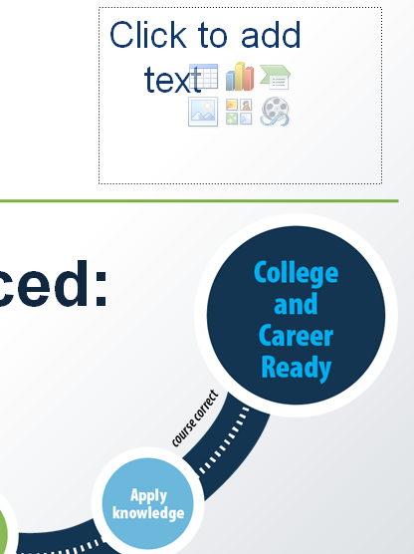
How to use this Deck
To pick the slides you want to use:
Choose View Tab - choose Normal
In the slide list on left, right-click on the slide you don’t want – select “Hide Slide” at the bottom of the menu
To Brand with School Logo and Colors
Look for insert box on cover slides
Cut and past logo there

Slide 3
How to use this Deck
To change color scheme
Click View tab  click Slide Master choice
Titles: Select slide  highlight header text  click Home tab  choose text color  return to View tab
Body: Select slide  highlight body text  click Home tab  choose text color  return to View tab
Green line: Select slide  highlight line  click Home tab  select Shape Outline  choose color  return to View tab
When all changes are made click Slide Master tab  click Close Slide Master view
The changes should apply to all slides in the deck.
The colors on the Graphics will not change.

Slide 4
New Future, New Test
Notes:
Welcome
This spring marks a new milestone, the transition from our old state testing program to the new _____________ test.
This is the final step in our transition to the new standards that began with changes in curriculum.

Slide 5
We’re Preparing for a New Future
Our students will live and work in the world of tomorrow
We had to update our curriculum to match the demands students will face
Tomorrow’s need? Workers who are:
Adaptable
Can apply knowledge to unpredictable problems
Can find information, assess its value and integrate it to arrive at creative solutions

Slide 6
Out with the Old – In with the New
New Curriculum
New Teaching
New Learning
New Test
Notes:
Implementation of the new test is the final step in a multi-year process.
First we remodeled our curriculum to ensure students are gaining the skills they will need to maximize their potential in college and in the workforce of tomorrow.
Second, our teachers have been learning new methods for delivering the curriculum – methods that engage students to develop the critical thinking and problem solving skills they will need.
Third, we implemented the curriculum in our classroom, engaging our in this new learning.
And now we have a test that measures student progress toward mastering the new curriculum and provides information for targeting improvement.

Slide 7
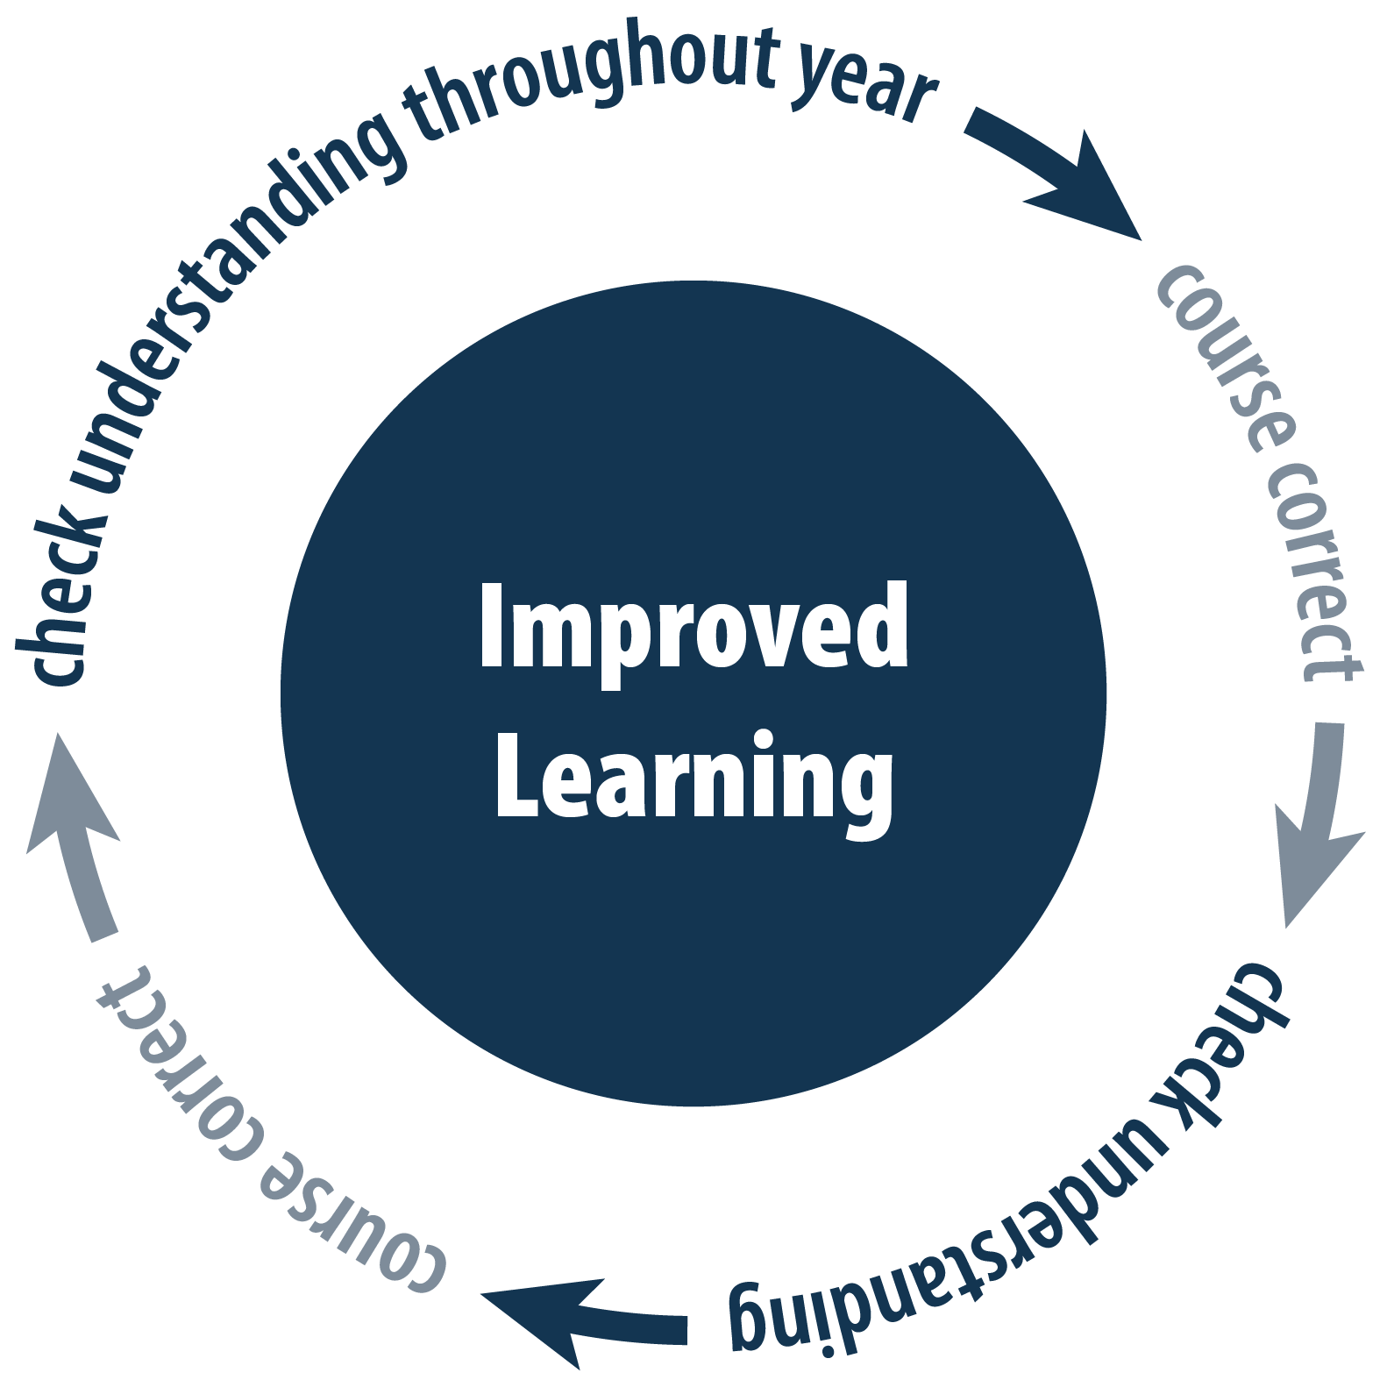
A New Approach
Notes:
Assessment is a critical component our new learning system. By checking understanding through out the year, teachers gain critical information to help modify their teaching and target areas for improved learning for students.

Slide 8
Checking Progress – 3 ways
Classroom assignments
Classroom assessments
Rigorous Tasks
Frequent checks for understanding
Optional midyear tests provided by Smarter Balanced
The Annual State Test
Notes:
The Annual test Is just one piece of information we use to check progress.
Teachers check student progress throughout the year by reviewing samples of student work on classroom assignments and task activities, and by measuring progress with tests they have designed.
OR <if using the Interim System> …..designed, and with optional mid year assessments that are drawn from questions written from the Annual test.

Slide 9

The Annual Test – worth the time?
Like your yearly well check up at the Pediatrician, the annual test:
Provides a consistent evaluation– Is my child meeting expected milestones?
Allows you to follow growth – even if you relocate!
Gives you and your child’s teacher information you can act on – Does my child need focused support?
Notes:
So why do we also need the annual test ?
The annual test can play the same role as your child’s regular well check with your pediatrician –
It is your opportunity to learn if your child is meeting expected milestones and growing on path – and if not, to take action to help your child grow.
In addition, aggregate results provide parents and the community a way of holding school leaders accountable – Is our school/district helping students grow as expected and develop the skills they will need?

Slide 10
Is change really needed?

Slide 11
Varied Expectations
Prior to this, most states developed their own goals, called standards, and contracted for their own tests*
Huge variability was found in the rigor of those standards – as much as 3 to 4 grade levels in some cases†
† Gary W. Phillips, “International Benchmarking: State and National Education Performance Standards.” American Institutes of Research, 2014.
5 6 7
5 6 7
5 6 7
Notes:
A couple of quick facts to frame the situation:
In past years, information available to parents was not comparable –
every state had its own standards and some were as much as 3 or 4 grade levels different than other states.

Slide 12
High School Diploma did not mean College Ready
Percent of Freshmen Not Ready for Credit-Bearing Coursework in Math and English
10%
Highly selective 4-year public institutions
10%
50%
30%
Less selective 4-year public institutions
Students in public institutions
75%
Non-selective public two-year institutions
60%
“Beyond the Rhetoric: Improving College Readiness Through Coherent State Policy. Southern Regional Education Board, June 2010.
Notes:
Note: This slide is ALTERNATE #1 – More complex presentation of the information.
60 % of students going on to college needed to take remedial courses.
Tuition or Fees are charged for those courses same as other college courses, but students do not earn credit toward a degree.
Student only get to the starting line for a degree once these courses are passed.

Slide 13
High School Diploma did not mean College Ready
Approximately 60% of all students entering higher education—who had earned high school diplomas—required some remedial instruction.
Notes:
Note: This slide is ALTERNATIVE #2 – a simplified version of the previous slide.
60 % of students going on to college needed to take remedial courses.
Tuition or Fees are charged for those courses same as other college courses but students do not earn credit toward a degree.
Student only get to the starting line for a degree once these courses are passed.

Slide 14
Weaknesses & Missing Skills
Colleges and career training programs reported weaknesses in HS grads
Reading complex technical and informational texts
Writing well-supported arguments
Solving non-routine problems
Analyses showed critical higher order skills were needed for college and the workforce
Problem solving
Critical thinking
Systems thinking
Information/ ICT literacy
Notes:
Higher order skills are the skills of tomorrow. We need to ensure our students are prepared to:
< Cite examples from the slide>

Slide 15
Yet old tests focused on lower level skills
Even looking at tests from 17 states reputed to have higher standards and more difficult tests found that:
Only 21% of English Language art items required “higher order thinking skills” and
Fewer than 2% of mathematics items required “higher order thinking skills”*
* Estimating the percentage of students who were tested on cognitively demanding items through the state achievement tests. RAND Corporation, 2012
Notes:
Even states with the highest standards and more difficult tests were not requiring students demonstrate these higher order skills.
<Cite Evidence from the slide>
But its ok, because we have shifted and now have a test that will help us understand how students are progressing toward gaining higher order skills.

Slide 16
The New Test
Notes:
So what does the new test look like?

Slide 17
Assesses Desired Skills
Problem Solving Perseverance
Application of Knowledge
Listening
Reading Complex Texts
Research
Notes:
Students are challenged to demonstrate that they can apply what they know.

Slide 18
Provides Better Information
Computer Adaptive Testing (CAT) = increased accuracy
What is CAT :
Answer Correctly  Harder Question
Answer wrong  Easier Question
How:
Students get the questions right for them – up to 2 grade levels above or below grade
Before, for those at the top and the bottom we couldn’t tell – How far ahead? How far behind?
Notes:
The test is given on line.
The test is adaptive, providing a harder question if students answer correctly and an easier one if they answer incorrectly. This way we can hone in on what a student knows and can do with fewer questions. It is a better use of their time.
Once a student has taken about 2/3 of the test if their estimated achievement level is clearly at the lowest or highest level, the question pool is expanded to include questions as much as two grade levels above or below the student’s grade level. This helps provide a measure of how far ahead or how far behind a student is so that classroom learning can be targeted to help each student grow from where they are.

Slide 19
Old School, New School
How test questions have changed
Notes:
Hundreds of teachers participated in creating the new test – writing test items, reviewing items for content, bias and accessibility, and helping to set the level of score achievement that represents proficiency. Teacher involvement means test questions more closely resemble class room work.
NOTE: The best way to see the test questions is to go to the Practice Test website and take a test. All problem types are represented and all embedded accessibility features can be viewed. To do so, skip the next 6 slides (see directions on suppressing slides in the How-to section at the beginning of this deck) – the 7th slide following this on provides a hyper link to the Practice Test.
OPTION 1: Go to slide with hyper link to Practice test. #26
ALTERNATE: Let’s look at just a few examples of test questions to see what is different.
<review next six slides>

Slide 20
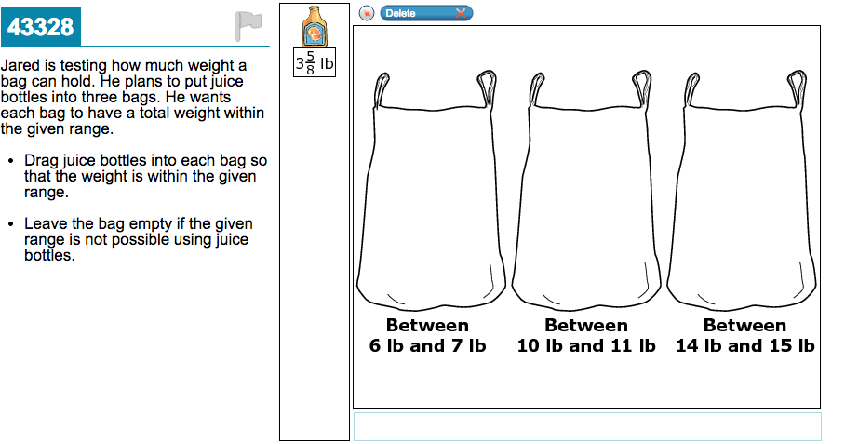
More Engaging - 4th Grade Math
Click and Drag animation
Notes:
Some of the new items are interactive; something that is possible because of the technology.

Slide 21
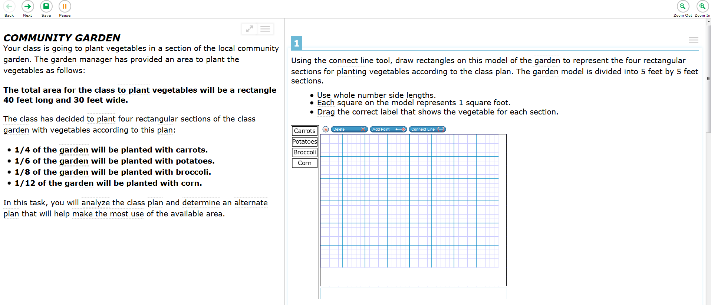
Challenging Tasks – 5th Grade Math Example
“Analyze the class plan and determine an alternative that will help make the most of the available area “
Drawn from real life
Requires multiple steps
No one right answer
Notes:
Performance tasks are a new item type that asks students to work through a more challenging scenario, to analyze information, to apply knowledge and to propose original solutions.
When students work on a performance task, it is the only testing they will see in that test session. The tasks are designed to engage students for a period of time.

Slide 22
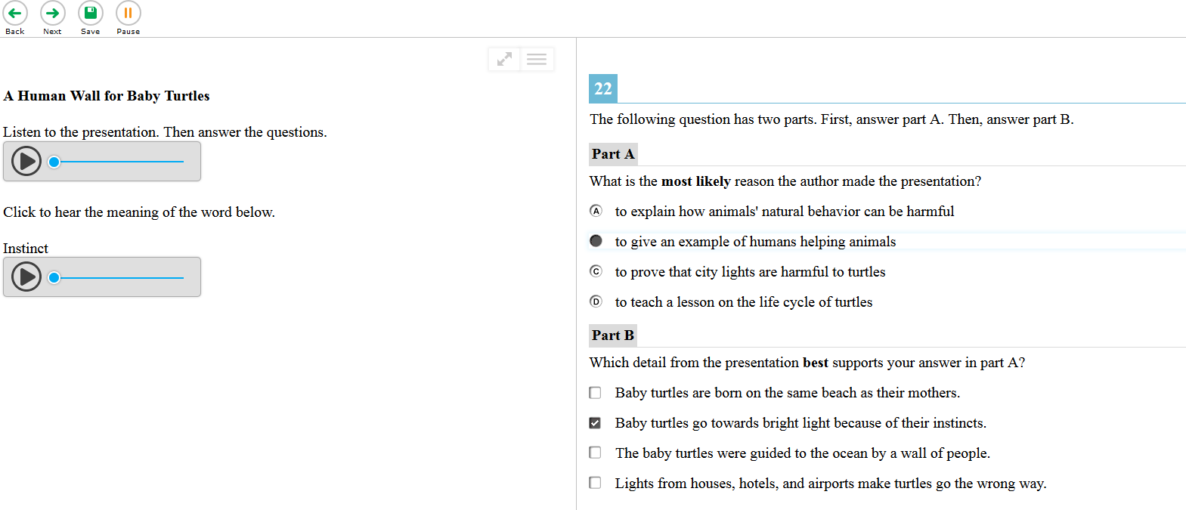
Listening Questions – 7th Grade ELA
Listen to the presentation
Audio glossaries for words above grade level
Asks students to provide evidence for answers
Notes:
Students are assessed for their ability to listen, a skill that has not traditionally been assessed.
Engaging with a variety of media during the test is another aspect where the test more closely resembles real life and can be more interesting for students.

Slide 23
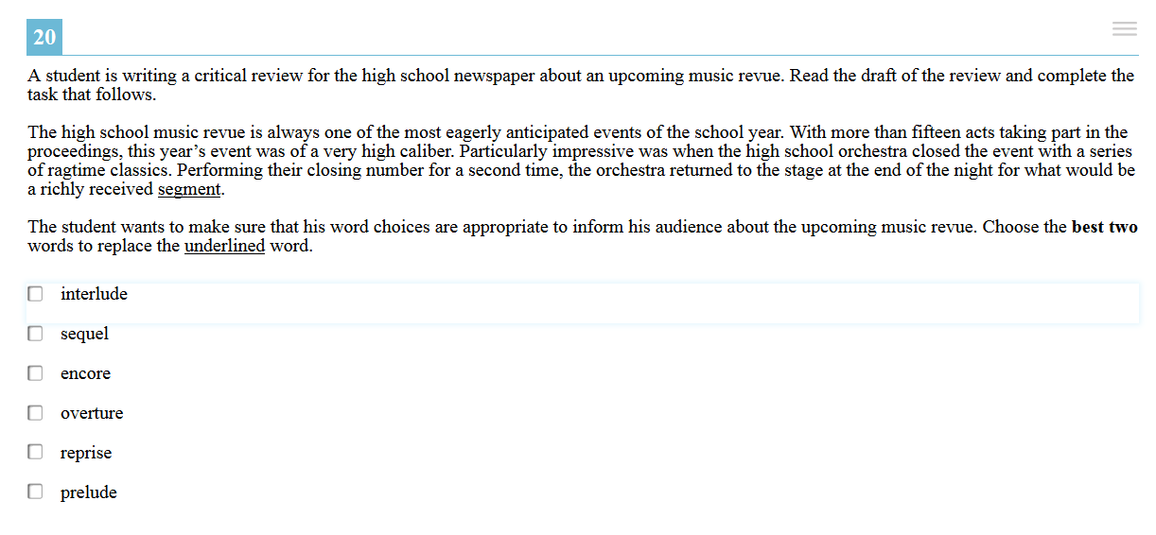
Meaning in Context – 11th Grade ELA
Choose the best two words to replace the underlined word
More than one answer
Notes:
Test questions used to exist in a vacuum.
I’m sure we have all seen a question where we are presented a “bare” word and were asked to pick from among four other words, the one with the closest meaning.
New questions assessing similar knowledge are presented within context. Meaning can be derived from surrounding text, and response selection is more challenging and nuanced because the selected word(s) must work within the context.

Slide 24
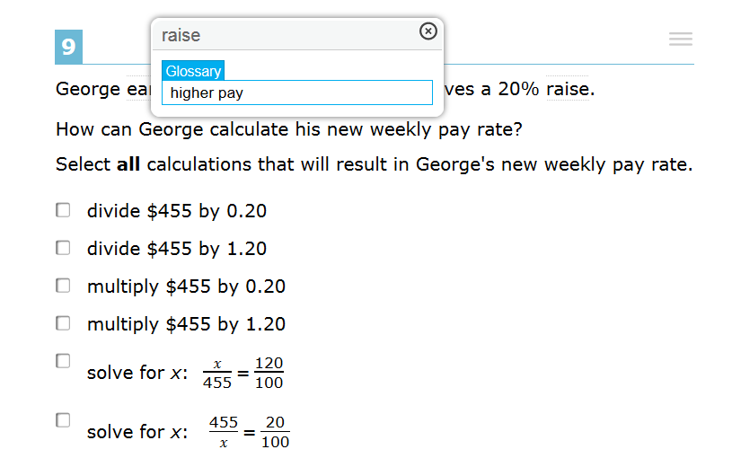
Unique Accessibility Features – Example: Pop Up Glossary
Roll cursor over shadowed words –glossary pops up
Notes:
Technology allows for a unique level of accessibility for this test.
Accessibility features are provided to allow students to show what they know by removing challenges stemming from unrelated issues. An emerging reader might be a very strong math student, for example. We want to give each student the opportunity to demonstrate all they know and can do.
There are three types of tools or supports:
The first type is a set of universal accessibility tools, such as a digital notepad or the English glossary feature illustrated in this slide. These universal tools will be available to all students.

Slide 25
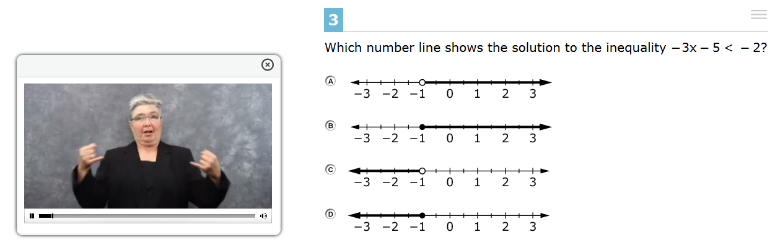
Unique Accessibility Features – Example: American Sign Language Videos
Notes:
A second set of tools are Designated supports, such as a translated pop-up glossary, which will be made available to students for whom a need has been identified by school personnel familiar with each student’s needs and with testing resources.
And a third type, Accommodations will be available to students with a documented need noted in an Individualized Education Program (IEP) or 504 plan. These accommodations include Braille and closed captioning or American Sign Language illustrated above, among others.
More information about these three types of supports can be found in the Universal Accessibility and Accommodations Guidelines and FAQs at the SmarterBalanced.org website.
All features embedded in the technology can be viewed when taking the Practice Test.

Slide 26
Practice Test (click here)
Live Look at the Test
Notes:
NOTE: This slide provides a link (click on Practice Test) to the practice test where items can be viewed in their interactive form. When the time is available, reviewing test questions live provides a more engaging demonstration than reviewing the preceding screen shots.
Even if you choose to review the screen shot slides instead, this slide may be used to highlight the availability of the Practice test . Encourage Parents to check it out for themselves.

Slide 27
Understanding Scores
Notes:
At this point the presentation may be divided and the scoring section broken out for use on a separate occasion.
If using the deck in one sitting, consider suppressing slide 31 – score report video – to abbreviate the presentation.
If a two session presentation is desired, the video is essential to fully presenting on the score topic.

Slide 28
Results: Last Year’s vs. This Year’s
It’s Like Apples and Oranges – you can’t compare
The old test measured different skills

Slide 29

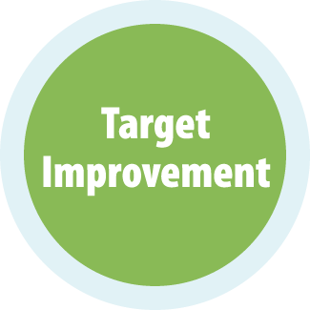
Overall Scores – 2 Areas, 4 Levels
English Language Arts – Mathematics
Exceeded the Standard
Met the Standard
Nearly Met the Standard
Has Not Met the Standard
Notes:
Students will receive one of four score levels.
Students scoring in the two top levels are on a path to be college and career ready at high school graduation.
Students scoring below the “Met the Standard” level will need further development to get on path.
Elementary & Jr. High: We are in a transition year – More students are likely to need further development to meet the new standards . But its ok, as students spend additional time in class rooms employing the new curriculum and teaching, results will improve.
High School: We are in a transition periods – Results may show more students are likely to need further development to meet the new standards. But it’s ok – students still have another year to continue to progress. They are now on a focused path to gaining these skills.
Public colleges and universities in several states have decided to use the results of the Grade 11 ___________exams to help determine whether admitted students are ready to proceed directly to entry-level, credit-bearing courses and can skip the placement tests that are typically administered. In all of these cases colleges will continue to use their existing admissions criteria.
<insert state specific policy>

Slide 30
Additional Scores – 3 levels, 8 topics
English Language Arts
Reading
Writing
Speaking & Listening
Research/Inquiry
Above Standard
Above Standard
At/Near Standard
At/Near Standard
Mathematics
Concepts & Procedures
Problem Solving
Communicating Reasoning
Modeling & Data Analysis
Below Standard
Below Standard
Notes:
The new test will also provide information on students’ progress on eight separate subsets of skills.
These scores are stated in three levels and provide information that can be used to target improvement.
If the scores show your child might need assistance in a particular area, talk with your child’s teacher. We have access to resources that can help him or her develop and would be happy to share them with you.
NOTE: If asked why 3 levels instead of 4 : Students are not asked enough questions in each separate area to provide a more precise score. To provide that, we would need to gather more data by asking additional questions in each area. Since few are in favor of a longer test……..

Slide 31
A Video Presentation
Understanding the Smarter Balanced Individual Student Report *
*presenter must be logged in to the Digital Library
Notes:
Use this video to provide a better understanding of the student score report.
Length: 7 minutes
At this time the presenter must be logged into the Digital Library to access the video.

Slide 32
A Framework for Interpretation
It’s a beginning – this year’s score is your baseline.
It’s a transition – results may show fewer students have the skills right now, but we are on the right path.
It’s the information we need – to help prepare kids for college and careers.
Notes:
Note: These are critical takeaways for parents. Each point should be given due emphasis.

Slide 33
It’s just one snapshot of progress in a process of continual improvement
Notes:
Remember, the test scores are just one measure of progress – be sure to look at your child’s class work, projects, and writing assignments to see all the ways your child is growing.

Slide 34
We’re on the right Path

