Slide 1

Winship-Robbins School District
2024-2025 Adopted BUDGET REPORT
Dawn Carl
Superintendent/Principal

Slide 2
Winship-Robbins Elementary School District
TABLE OF CONTENTS
2024-25 Adopted Budget Report
Budget Introduction Page 3
General Fund Revenue Assumptions Page 4
State Priorities Page 5
General Fund Revenues Pages 6 - 7
General Fund Expenditures Pages 8 - 10
General Fund Balance Page 11
Revenues & Transfers In Versus Expenditures & Transfers Out Page 12
Other Funds Page 13
Multi-Year Projection Pages 14 - 15
Enrollment- ADA Trend Page 16

Slide 3
Winship-Robbins Elementary School District
INTRODUCTION
2024-2025 Adopted Budget Report
The County Office, under AB1200, requires districts to document and include written budget assumptions in the budget package submitted for approval to the district Board of Trustees. Each district should advise the Board, by way of budget documents, accompanied by a brief narrative, of the financial condition of the district. This report will provide the required information for the Board to certify the district’s ability to meet its financial obligations.
The Adopted Budget Report is presented by fund and major object account classification, reflecting 2023-2024 “Estimated Actuals” in columns A-C and the Proposed 2024-2025 “Budget” in columns D-F. The final column reflects the percentage of variance between the 2023-2024 Estimated Actuals and the proposed 2024-2025 Budget.
This report contains information and estimates that reflect the information contained in the Governor’s May Revision State Budget proposal.

Slide 4
Winship-Robbins Elementary School District
General Fund Revenue Assumptions
2024-2025 Adopted Budget Report
Local Control Funding Formula
Based on 3-Prior Year Average ADA of 99.34 for 24/25
Property Taxes = $1,087,373– $1,046,235 In-Lieu = $41,138
State Aid = $1,041,767
Other State and Federal Funding
Unrestricted Lottery = $177 per Annual ADA
Restricted Lottery = $72 per Annual ADA
Federal No Child Left Behind (Title I $23,582 & Title II $3,388)
REAP funding is projected at $17,030

Slide 5
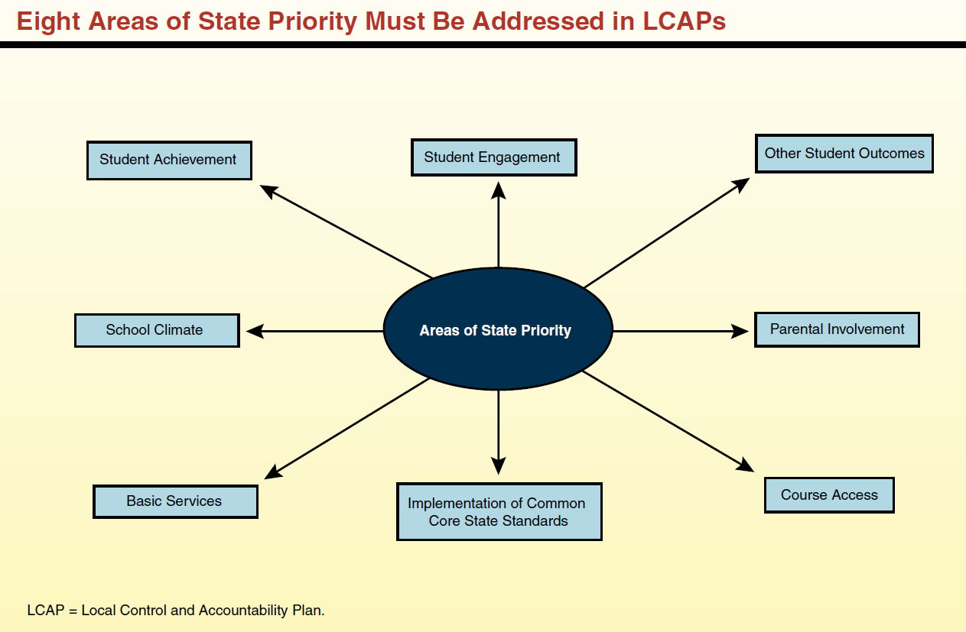
Eight State Priorities
2024-2025 ADOPTED BUDGET REPORT
Schools Services of California

Slide 6
Winship-Robbins Elementary School District
GENERAL FUND REVENUE SOURCES
2024-2025 Adopted Budget Report
The largest part of the revenue (47%) comes from Local Control Funding and is to be aligned to meet the eight state priorities. These priorities are on the previous slide.
The district will continue to receive federal funds for specific purposes and must continue to follow federal regulations. Federal funds consist of Title I, Title II, Child Nutrition, and REAP.
Other state funds consist of Mandated Costs, Lottery, Expanded Learning Opportunity Program (ELOP), Child Nutrition, Prop 28, Special Education Mental Health, Special Education Early Intervention Preschool, and California Community Schools Partnership Program (CCSPP).
Local resources include leases, interest, donations, local grants, and charter fiscal oversight fees.

Slide 7
Winship-Robbins Elementary School District
GENERAL FUND REVENUE SOURCES
2024-2025 Adopted Budget Report
Local Control Funding Formula $1,476,461
This budget source is based on the 3-Prior Year Average ADA of 99.34 for 24/25. The LCFF calculator reflects a 1.07% COLA.
Federal Revenues $154,000
This revenue source includes Title I, Title II, Child Nutrition and REAP. The $33,813 reduction in revenue is due to removal of carryover for REAP, Title I, and Title II.
Other State Revenues $510,390
This revenue includes Unrestricted and Restricted Lottery, Mandated Costs, ELOP, Child Nutrition, Prop 28, Special Education Mental Health, Special Education Early Intervention Preschool and CCSPP. The $84,549 net increase in revenue is due to the addition of CCSPP revenue and the removal of one-time UPK Planning and Implementation, CalSHAPE grant funds and Lottery carryover.
Other Local Revenue $999,510
This revenue includes Interest, Rental Income, and Charter Fiscal Oversight revenue. The $207,980 decrease in revenue is due to the removal of Local Revenue Reimbursements from the County Office, Preschool fees, and Medi-Cal Mini Grant funds.

Slide 8
Winship-Robbins Elementary School District
GENERAL FUND EXPENDITURES
2024-2025 Adopted Budget Report
Salaries and benefits represent 69% of the District’s total budget.

Slide 9
Winship-Robbins Elementary School District
GENERAL FUND EXPENDITURES
2024-2025 Adopted Budget Report
    CERTIFICATED SALARIES $834,181
          Salary projections are based on 9 certificated FTE; and 1 management FTE, (.7 FTE Principal; .3 FTE Superintendent). The expenditure has an increase of $68,593 due to the addition of 1 certificated FTE and step and column increases.
          CLASSIFIED SALARIES $709,997
          Salary projections are based on 13.1 FTEs and known staffing needs, including extra-duty and overtime. The expenditure has an increase of $65,537 due to the addition of 0.97 classified FTE, step and column increases and an increase in days for the new Community Liaison position filled mid-year of 23/24.
          EMPLOYEE BENEFITS $610,227
          Benefits are based on projections that reflect the changes in the above salary expenditures. 24-25 STRS rate is 19.10% & 24-25 PERS rate is 27.05%. The increase of $61,235 mainly due to changes listed in the above salary expenditures along with the PERS rate increase from 26.68% in 23-24 to 27.05% in 24-25.
    BOOKS AND SUPPLIES $173,835
    Projected instructional materials and supplies expenses include core and supplemental instructional materials, custodial and maintenance supplies, and technology related expenditures. This expenditure is reduced by $55,136 due to the removal expenditures related to one-time funds for UPK P&I & AMIM. Additionally, carryover for Lottery and REAP was removed.
    SERVICES, OTHER OPERATING EXPENSES $761,960
    Projected services and other operating expenses include professional development for classroom staff, classroom on-line instructional and intervention programs, Expanded Learning Opportunity Program services, maintenance, custodial repair, nutrition, drinking water delivery, and utilities. This expenditure has a decrease of $107,328 primarily due to the removal of one-time joint use lease expenditure for the community hall parking lot and reduction in supplemental and concentration related services.

Slide 10
Winship-Robbins Elementary School District
GENERAL FUND EXPENDITURES
2024-2025 Adopted Budget Report
    CAPITAL OUTLAY $10,000
    The $549,039 decrease is due the removal one-time equipment purchases along with completion of tennis court, marquee, and fencing projects in 23/24.
    OTHER OUTGO $44,676
    The increase of $36,748 is directly related to the increase in Special Education Excess Costs.
    INTERFUND TRANSFERS IN/OUT $0
    No change.
    CONTRIBUTIONS TO RESTRICTED PROGRAMS $354,107
    Contributions to restricted programs include contributions to Child Nutrition, Special Education, Routine Restricted Maintenance, California Community School Partnership Program and Preschool.

Slide 11
Winship-Robbins Elementary School District
GENERAL FUND BALANCE
2024-2025 Adopted Budget Report
The estimated ending balance for the 2024-2025 year is $3,493,939. Of this amount, $157,244 has been designated for economic uncertainties as required by the State of California.

Slide 12
Winship-Robbins Elementary School District
REVENUES & TRANSFERS IN vs. EXPENDITURES & TRANSFERS OUT
2024-2025 Adopted Budget Report

Slide 13
Winship-Robbins Elementary School District
OTHER FUNDS
2024-2025 Adopted Budget Report
Student Activities Fund – 2024-2025 ending fund balance is projected to be $1,329.
Child Development Fund – 2024-2025 ending fund balance is projected to be $3,883.
Deferred Maintenance Fund – 2024-2025 ending fund balance is projected to be $20,227.
Special Reserve Fund - 2024-2025 ending fund balance is projected to be $427,201.
Capital Facilities Fund (Developer Fees) - 2024-2025 ending fund balance is projected to be $13,684.
County Schools Facilities Fund - 2024-2025 ending fund balance is projected to be $0

Slide 14
Winship-Robbins Elementary School District
MULTI-YEAR PROJECTION (MYP) ASSUMPTIONS
2024-2025 Adopted Budget Report
Winship-Robbins Local Control Funding for the future two years has been calculated using Current Year ADA of 97.76 in 25/26 and 97.76 in 26/27. No changes in Federal ,State, and Local revenues as all one-time funds were removed in 23/24.
Expenditure adjustments are as follows:
Certificated Increase in 25/26 due to the addition of longevity stipends for 3 eligible certificated staff Step & Column increases. Step and Column increase are projected for 26/27.
Classified Step & Column increases are projected for 25/26 & 26/27.
Benefits Increased to cover the changes listed above along with increases in PERS in 25/26 & 26/27. STRS rates are projected to be 19.10% in 25/26 & 26/27. PERS rates are projected to be 27.60% and 28.00% in 25/26 & 26/27, respectively.
Supplies Decreased supplies related to one-time AMIM funds and removed one-time curriculum expenditures related to restricted Lottery While applying a CPI rate of 2.86% to unrestricted supplies in 25/26. Decreased supplies related to one-time Educator Effectiveness Block Grant funds while applying a CPI rate of 2.87% to Unrestricted supplies and kept restricted supplies flat in 26/27.
Services Increased services in 25/26 by applied CPI rate of 2.86% along with the removal of Title II related service. Increased services in 26/27 by applied CPI rate of 2.87% and removed services related to one-time Educator Effectiveness Block Grant funds.
Capital Outlay No adjustments.
Other Outgo No adjustments.
Transfers-Out No adjustments.
Contributions Contribution to Routine Restrict Maintenance; contribution to balance special education; contribution to balance child nutrition services; contribution to balance Preschool; and contribution to California Community Schools Partnership Program by required 1/3 match requirement.
Other Sources/Uses No adjustments.

Slide 16
Winship-Robbins Elementary School District
Enrollment – ADA TRENDS
2024-2025 Adopted Budget Report
*For first 4 years, CBEDS enrollment used. For the current year, projected enrollment used.

