Slide 1

Winship-Robbins School District
2019-2020 Adopted BUDGET REPORT
Dawn Carl
Superintendent/Principal

Slide 2
Winship-Robbins Elementary School District
TABLE OF CONTENTS
2019-2020 Adopted Budget Report
Budget Introduction Page 3
General Fund Revenue Assumptions Page 4
State Priorities Page 5
General Fund Revenue Sources Pages 6 - 7
General Fund Expenditures Pages 8 - 10
General Fund Balance Page 11
Revenues Versus Expenditures Page 12
Other Funds Page 13
Multi-Year Assumptions and MYP Pages 14 - 15
CBEDS- ADA Trend Page 16

Slide 3
Winship-Robbins Elementary School District
INTRODUCTION
2019-2020 Adopted Budget Report
The County Office, under AB1200, requires districts to document and include written budget assumptions in the budget package submitted for approval to the district Board of Trustees. Each district should advise the Board, by way of budget documents, accompanied by a brief narrative, of the financial condition of the district. This report will provide the required information for the Board to certify the district’s ability to meet its financial obligations.
The Adopted Budget Report is presented by fund and major object account classification, reflecting 2018-2019 “Estimated Actuals” in columns A-C and the 2019-2020 “Proposed Adopted Budget” in columns D-F. The final column reflects the percentage of variance between the 2018-2019 Estimated Actuals and the proposed 2019-2020 Adopted Budget.
This report contains information and estimates that reflect the information contained in the Governor’s May Revision State Budget proposal.

Slide 4
Winship-Robbins Elementary School District
General Fund Revenue Assumptions
2019-2020 Adopted Budget Report
Local Control Funding Formula
Based on Projected 2019-2020 ADA of 112.31 (which includes 0.93 County Operated ADA)
Property Taxes = $759,327– $710,239 In-Lieu = $49,088
State Aid = $1,045,061
Other State and Federal Funding
Unrestricted Lottery = $151 per Annual ADA
Restricted Lottery = $53 per Annual ADA
Federal No Child Left Behind (Title I $21,741 & Title II $2,419)
REAP funding is projected at $23,092

Slide 5
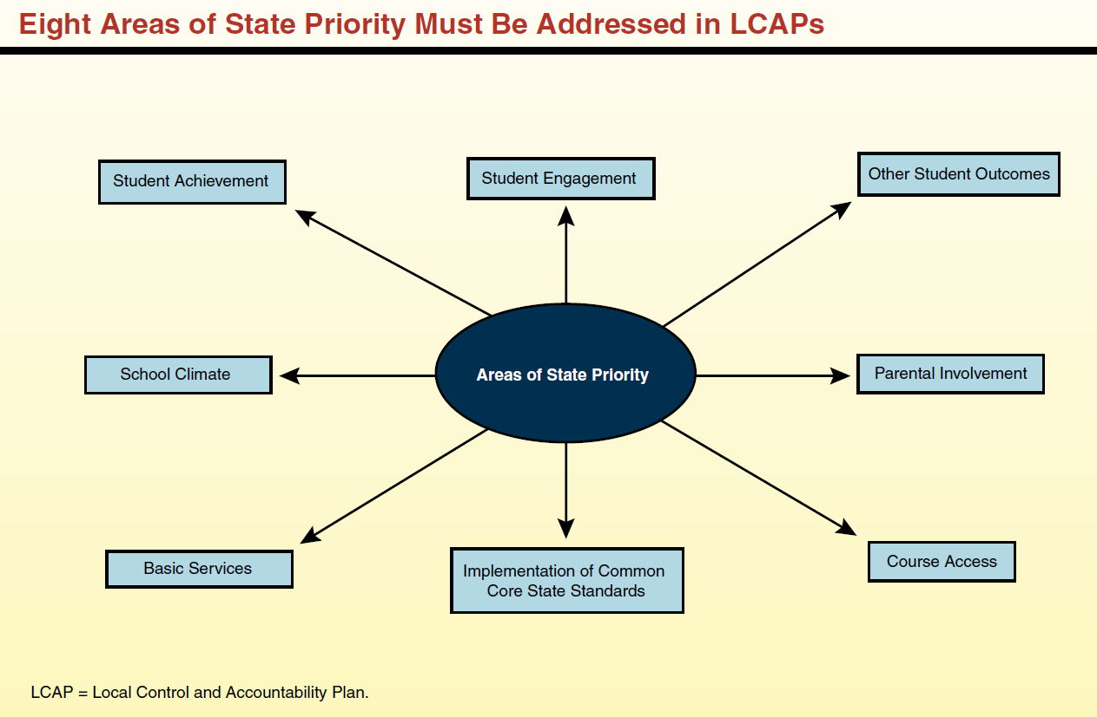
Eight State Priorities
2019-2020 ADOPTED BUDGET REPORT
Schools Services of California

Slide 6
Winship-Robbins Elementary School District
GENERAL FUND REVENUE SOURCES
2019-2020 Adopted Budget Report
The largest part of the revenue (60%) comes from Local Control Funding and is to be aligned to meet the eight state priorities. These priorities are on the previous slide.
The district will continue to receive federal funds for specific purposes and must continue to follow federal regulations.
Other state funds consist of child nutrition, mandated costs, lottery and miscellaneous other awards.
Local resources include interest, donations, local grants, special education funds, and charter fiscal oversight fees.

Slide 7
Winship-Robbins Elementary School District
GENERAL FUND REVENUE SOURCES
2019-2020 Adopted Budget Report
Local Control Funding Formula $1,286,972
This budget source is based on 19/20 projected ADA. Supplemental funds are calculated based on percentages of unduplicated student counts which include low income students, foster youth, and English learners. Currently, LCFF funding for Winship-Robbins is based on a projection of 19/20 P-2 ADA of 111.38 plus 0.93 of County Operated ADA. Winship-Robbins is expected to have an unduplicated percentage of 87.85%.
Federal Revenues $126,752
This revenue source includes Title I, Title II, REAP, and Child Nutrition funding.
Other State Revenues $93,621
This revenue includes Unrestricted and Restricted Lottery, Mandated Costs, and Child Nutrition.
Other Local Revenue $630,858
This revenue includes Interest, Rental Income, and Charter Fiscal Oversight revenue.

Slide 8
Winship-Robbins Elementary School District
GENERAL FUND EXPENDITURES
2019-2020 Adopted Budget Report
Salaries and benefits represent 61% of the District’s total budget.

Slide 9
Winship-Robbins Elementary School District
GENERAL FUND EXPENDITURES
2019-2020 Adopted Budget Report
    CERTIFICATED SALARIES - $586,835
          Salary projections are based on 8 certificated FTE; and 1 management FTE, (.7 FTE Principal; .3 FTE Superintendent).
          CLASSIFIED SALARIES - $464,383
          Salary projections are based on 9.45 FTEs and known staffing needs, including extra-duty and overtime.
          .
          EMPLOYEE BENEFITS - $384,257
          Benefits are based on projections that reflect a increase in salary expenditures. 2019-2020 STRS rate is 16.70%. 2019-2020 PERS rate is 20.733%.
    BOOKS AND SUPPLIES - $225,416
    Projected instructional materials and supplies expenses include core and supplemental instructional materials, custodial and maintenance supplies, and technology related expenditures. This expenditure is reduced by $19,183 primarily due to the removal of one-time supply and instructional material purchases.
    SERVICES, OTHER OPERATING EXPENSES - $350,812
    Projected services and other operating expenses include professional development for classroom staff, classroom on-line instructional and intervention programs, maintenance, custodial repair, drinking water delivery, and servicing expenses and utilities. This expenditure is reduced by $22,119 primarily due to the removal of several one-time, service expenditures related to maintenance and repairs, reductions in REAP, Classified Employee Professional Development grant, and MTSS expenditures.

Slide 10
Winship-Robbins Elementary School District
GENERAL FUND EXPENDITURES
2019-2020 Adopted Budget Report
    CAPITAL OUTLAY - $320,793
    This expenditure increased by $96,573 primarily due to the net effect of removing the one-time Capital Projects that were completed in 2018-19 including the HVAC, corporation yard, and then budgeting the electricity for the corporation yard project, asphalt repairs, new fencing, new windows, and the final solar Prop 39 project in 2019-20.
    OTHER OUTGO - $50,145
    Includes Special Education Excess Cost.
    INTERFUND TRANSFERS IN/OUT - $0
    This expenditure decreased in its entirety due to the district no longer providing a State Preschool program. The preschool will convert to a private pay program in the 2019-20 school year.
    CONTRIBUTIONS TO RESTRICTED PROGRAMS $334,676
    Contributions to restricted programs are projected to total $334,676 and include contributions to Shady Creek, Title I, Child Nutrition, Special Education, and Routine Restricted Maintenance. The increase of $30,624 is primarily related to the addition of a new RTI support aide for special education. There were also small increases in the contributions to Routine Restricted Maintenance and Title I due to step and column increases.

Slide 11
Winship-Robbins Elementary School District
GENERAL FUND BALANCE
2019-2020 Adopted Budget Report
The estimated ending balance for the 2019-2020 year is $2,332,267. Of this amount, $119,132.01 has been designated for economic uncertainties as required by the State of California.

Slide 12
Winship-Robbins Elementary School District
REVENUES vs. EXPENDITURES
2019-2020 Adopted Budget Report

Slide 13
Winship-Robbins Elementary School District
OTHER FUNDS
2019-2020 Adopted Budget Report
Child Development Fund – 2019-2020 ending fund balance is projected to be $4,961.50
Deferred Maintenance Fund – 2019-2020 ending fund balance is projected to be $18,996.41
Special Reserve Fund - 2019-2020 ending fund balance is projected to be $397,509.92
Capital Facilities Fund (Developer Fees) - 2019-2020 ending fund balance is projected to be $12,732.96
County Schools Facilities Fund - 2019-2020 ending fund balance is projected to be $1,447.61

Slide 14
Winship-Robbins Elementary School District
MULTI-YEAR PROJECTION (MYP) ASSUMPTIONS
2019-2020 Adopted Budget Report
Winship-Robbins Local Control Funding for the future two years has been calculated using projected ADA of 112.31 in 20/21 and 21/22 (which includes 0.93 of County Operated ADA in each year). All one-time revenues and expenditures have been removed.
Expenditure adjustments are as follows:
Object 1000 Step and Column were projected for both 2020/21 & 2021/22.
Object 2000 Step and Column were projected for both 2020/21 & 2021/22.
Object 3000 Increased to cover the above salary adjustments, and increased to cover the increases in PERS & STRS in 20/21 and 21/22. PERS rates are projected to be 23.6% for 20/21, and 24.9% for 21/22. STRS rates are projected to be 18.10% for 20/21 and 17.80% for 21/22.
Object 4000 Fiscal year 20/21 increased with CPI rate of 3.16%. Removed one-time 19/20 expenditures. Fiscal year 21/22 increased with CPI rate of 3.05%.
Object 5000 Fiscal year 20/21 increased with CPI rate of 3.16%. Removed one-time 19/20 expenditures. Fiscal year 21/22 increased with CPI rate of 3.05%.
Object 6000 Removed one-time capital projects expected to be completed in 19/20 including solar, new fencing and windows, asphalt repairs, and electricity to the corporation yard. Estimated costs for capital projects in 20/21 and 21/22 were included.
Other Outgo No adjustments.
Transfers-Out No adjustments.
Contributions Contribution to Routine Restrict Maintenance; contribution to balance special education and contribution to balance child nutrition services.
Other Sources/Uses No adjustments.

Slide 16
Winship-Robbins Elementary School District
CBEDS – ADA TRENDS
2019-2020 Adopted Budget Report

