Slide 1

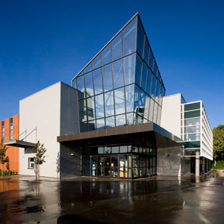
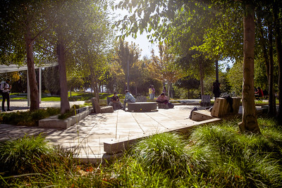
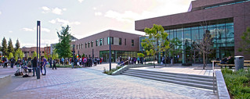
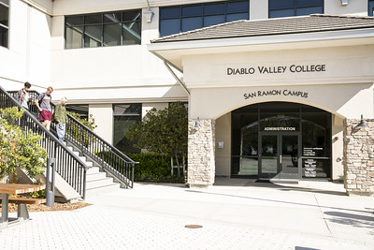
DIABLO VALLEY COLLEGE Enrollment Presentation 2026
Welcome & Connect ∙ welcome@dvc.edu ∙ 925-969-2106

Slide 2
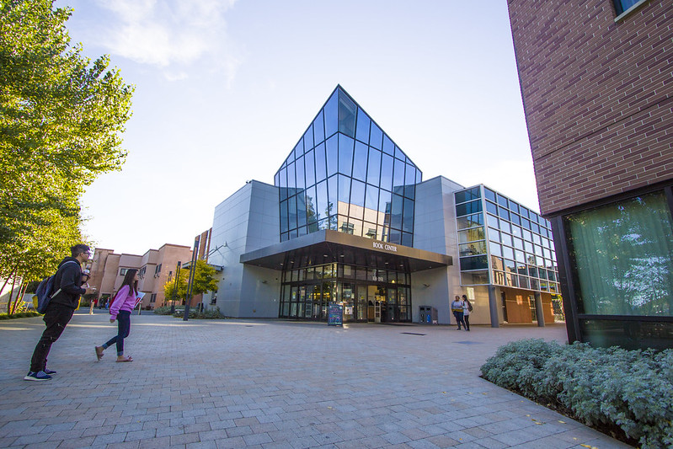
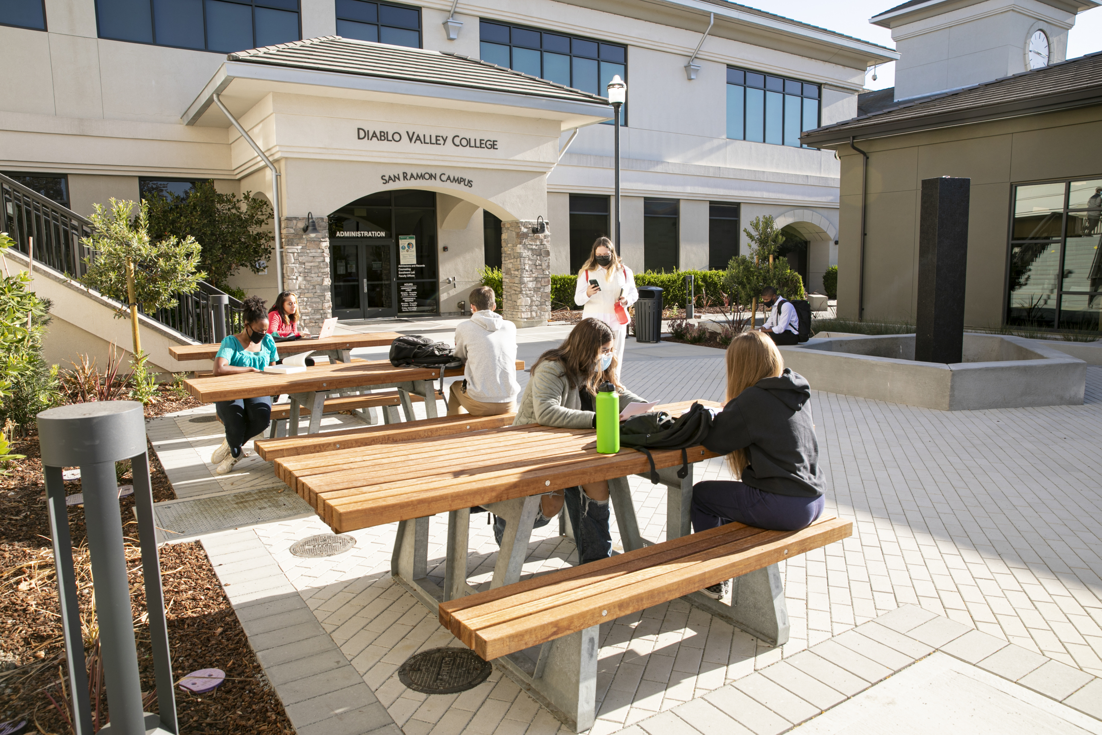
Pleasant Hill
Two Campuses
One College
San Ramon

Slide 3

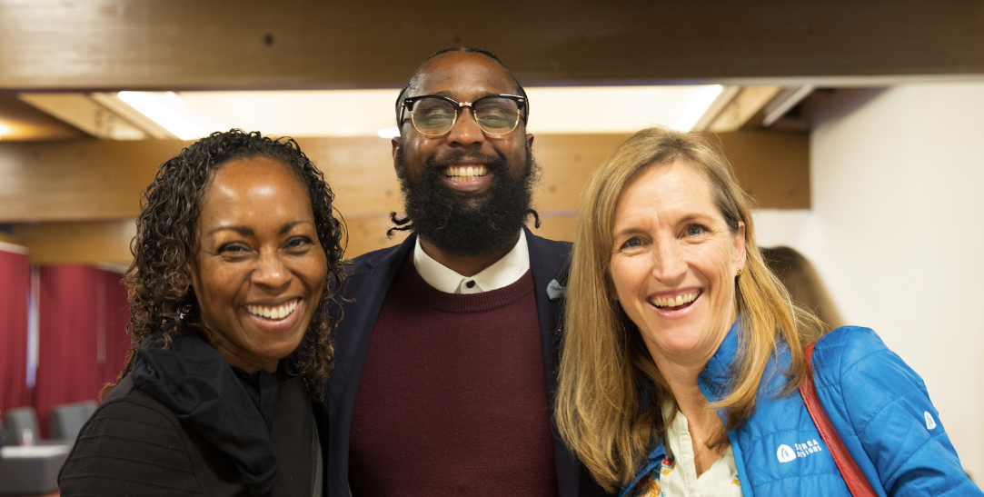
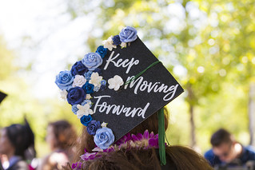
OUR COLLEGE
Diverse student population
International students from 60+ countries
Large student body
Award-winning faculty
Hands-on learning
Dedicated staff
Transfer to university
Career Pathways
Student Clubs & Organizations
Notes:
We have had students from: Indonesia, China, Peru, France, Nigeria, Thailand, Mexico, Brazil, Japan, South Korea, England, Germany, Latvia, Italy, Spain,
Student Population Numbers: 17,000 PER SEMESTER
Acres: 100, pond, large quad, café, Birds nest, large pool
University feel
Hands-on learning: 3-d printer, photography dark rooms, music studio, dental hygiene program, engineering labs,
International students choose DVC due its excellent reputation for academic and transfer
Award-winning faculty:

Slide 4
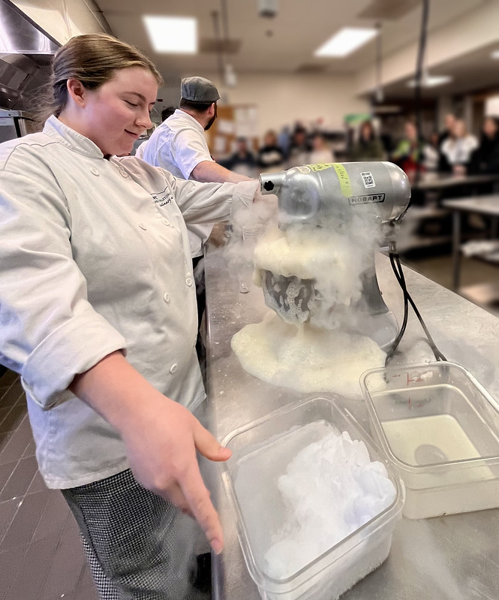
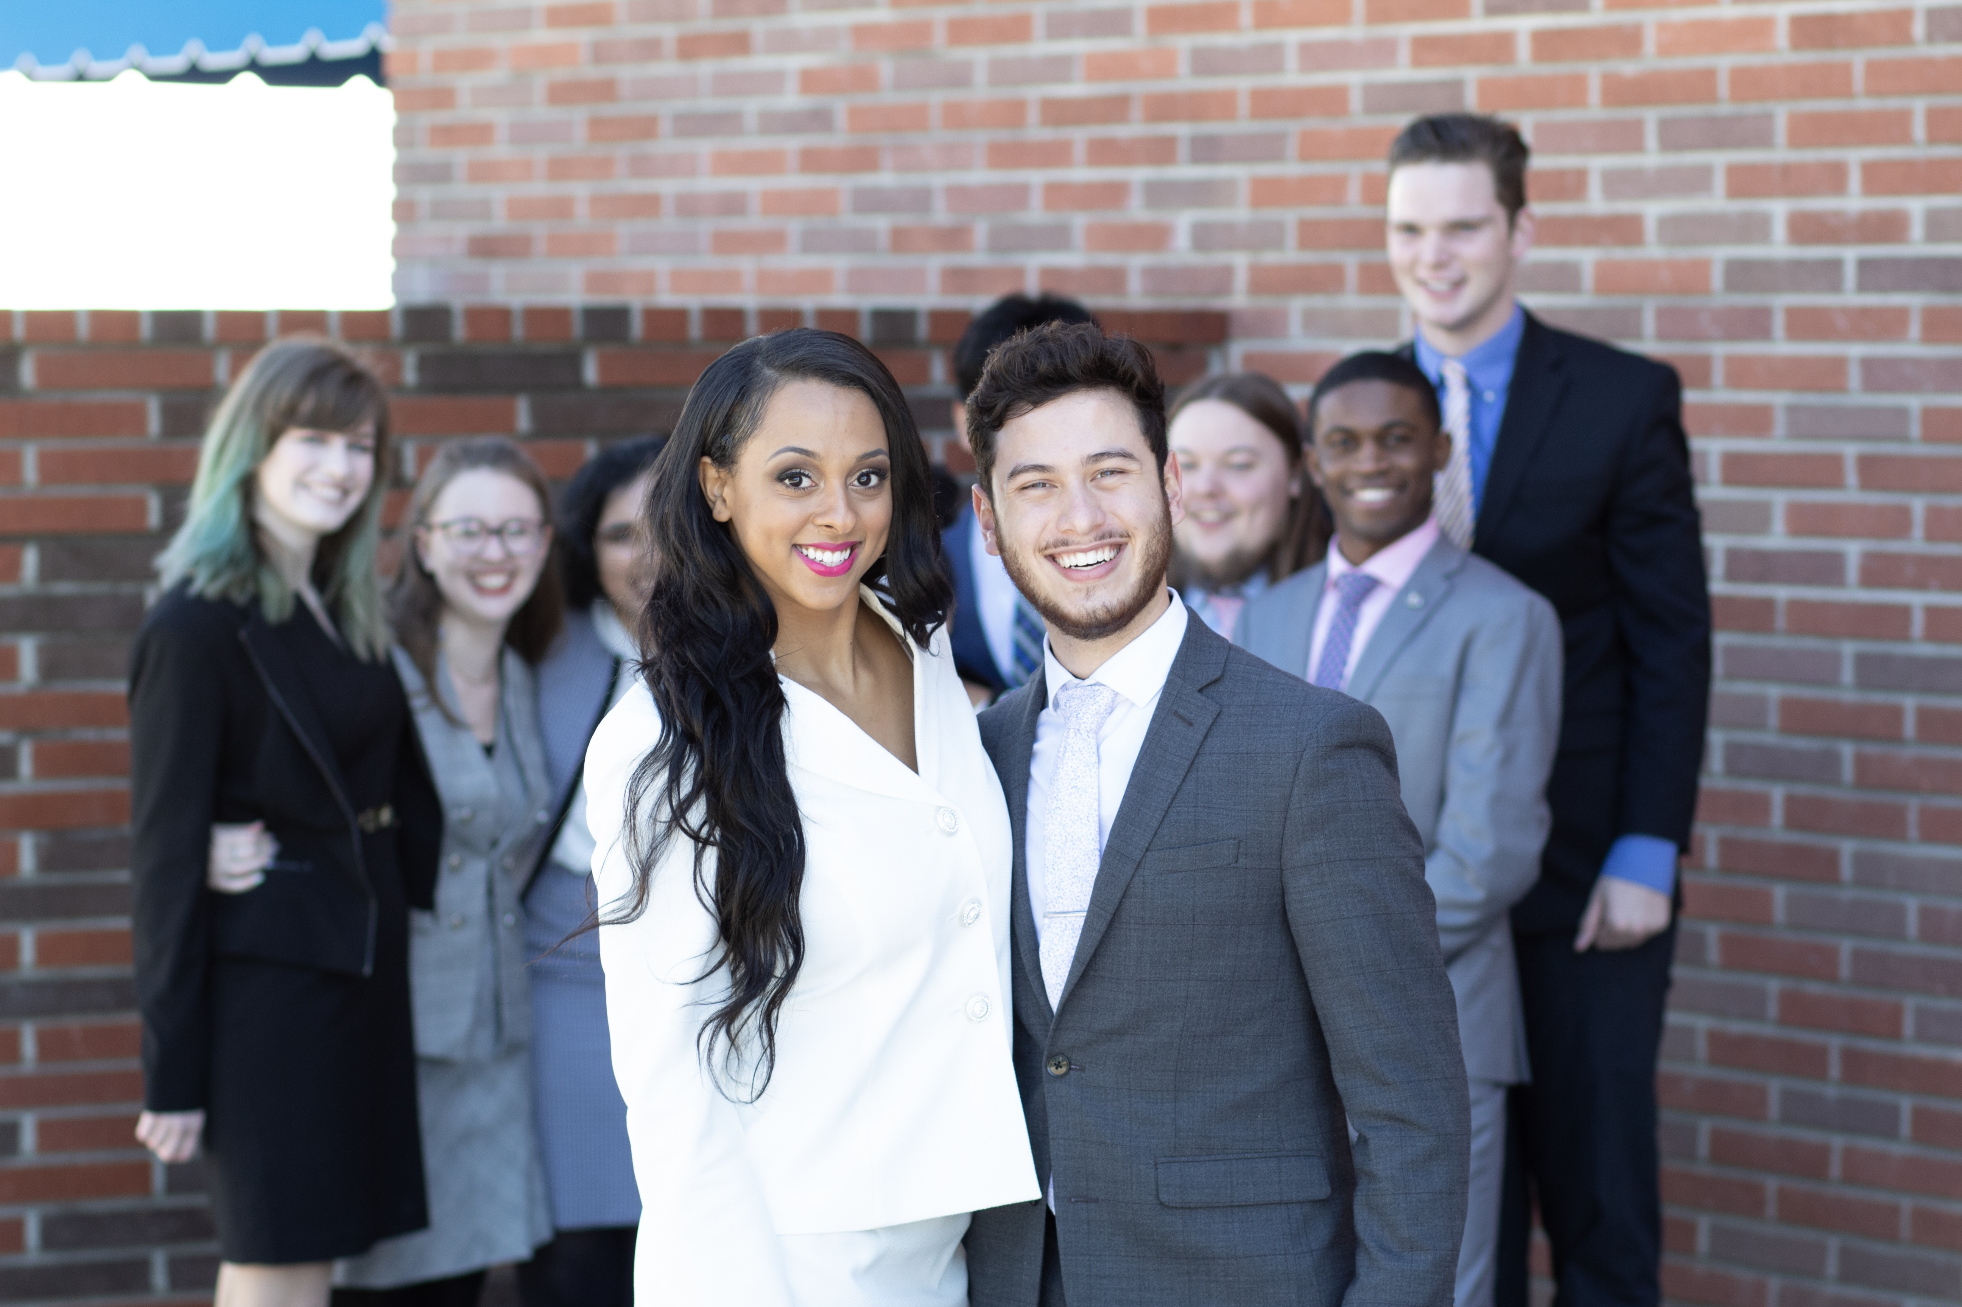
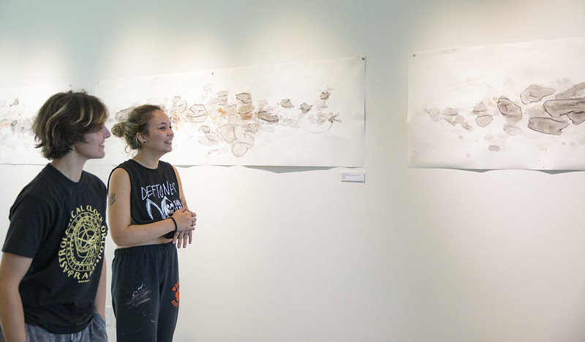


Highlights from Our Students
Student-Run Restaurant
Award Winning Speech and Debate Team
Student Art Gallery
Excellent Athletics Programs
Award-winning Student Newspaper
Notes:
Speech & Debate Team 2021: won the California State Championships; the speech and debate team at Diablo Valley College has been recognized as one of the most successful community college programs in the nation, earning numerous awards and accolades. Many of its team members have received scholarships to compete at top forensics programs across the country, with several competitors transferring to esteemed universities such as UC Berkeley, UCLA and UC Davis.;
https://www.dvc.edu/communication/news/inquirerawards2020.html

Slide 5
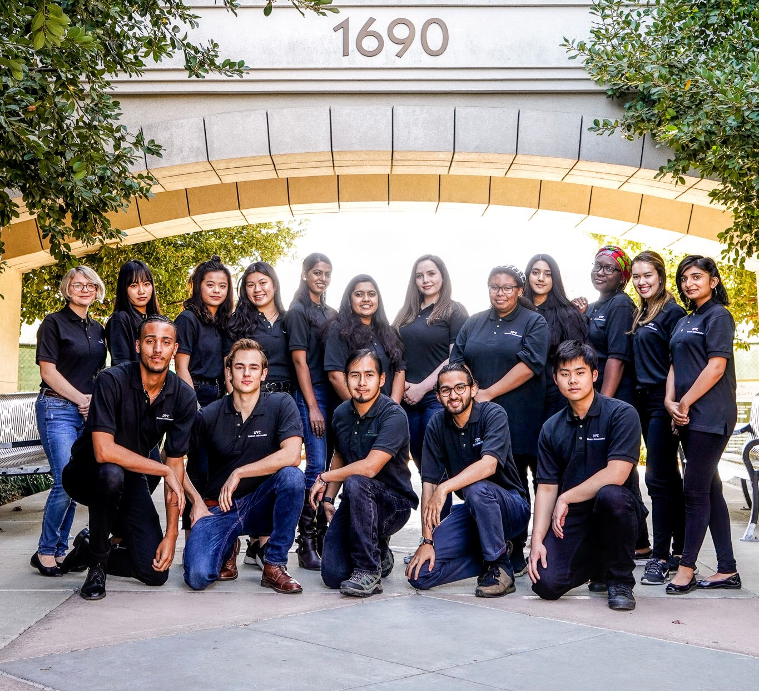
Student Ambassador Program
Benefits of Program
Conduct Campus Tours
Develop Leadership Skills
Represent DVC On & Off Campus
Develop Social Media Skills
Enhance Resume and Transfer Applications
Make a Real Difference in Students' Lives!
Paid positions are available at the
Pleasant Hill and San Ramon campuses

Slide 6

Paying for College
This Photo by Unknown Author is licensed under CC BY-NC-ND

Slide 7
DVC = Low Enrollment Fees * 12 units / 1 year (2 semesters) / Subject to Change
UC
$15,384
CSU
$6,838
DVC
$1,104
Notes:
ALL SUBJECT TO CHANGE ; base tuition fees .

Slide 8
Study for Free at DVC!
Full-Time
Free Tuition
Award

Slide 9
Complete
the FAFSA or Dream Act
Enroll in at least
12 units
Free Tuition
Be a CA resident or exempt from paying non-resident tuition fees (e.g., AB540)
Accept your Award through
InSite
Notes:
Students will get an email from Fin. Aid alerting them to “Accept the FTP” award in the financial aid tile. Students will not be granted free tuition if they do not accept the award in the financial aid tile

Slide 10
FAFSA vs. FREE TUITION PROGRAM (FTP)
FAFSA
FTP
Based on Household Income
NOT Based on Household Income
Notes:
Free tuition under FAFSA -

Slide 11
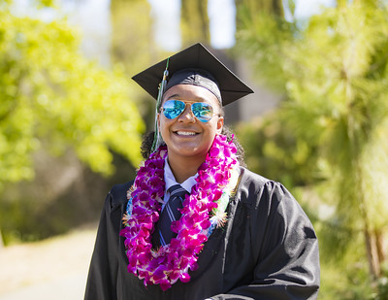


Enrollment Process for the Class of 2026

Slide 12

IEP or 504? Disability Support Services
www.dvc.edu/dss

Slide 13
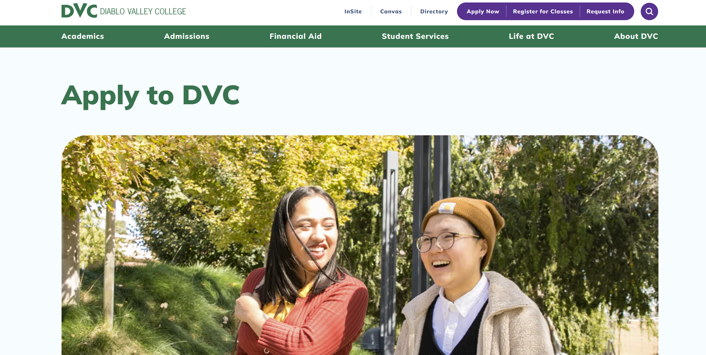
Important Steps to Enroll
Application
Orientation
Placements
Academic Advising
Registration
Steps 1-4 = PRIORITY REGISTRATION

Slide 14
REGISTRATION DATE: High School Seniors with completed enrollment steps
May 2026
MARK YOUR CALENDARS!

Slide 15
Step 1: APPLICATION:
Information Needed
Personal Email
Social Security Number
High School Transcript

Slide 16
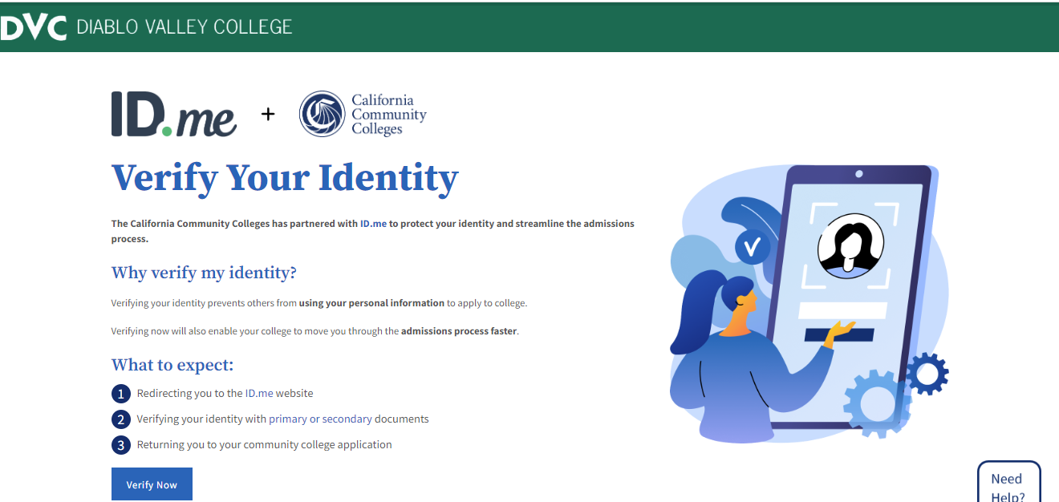
Step 1: APPLICATION & ID.ME
Information Needed
Personal email address
Social Security Number
Photo of your driver's license, passport, or passport card
Phone to take a selfie

Slide 17
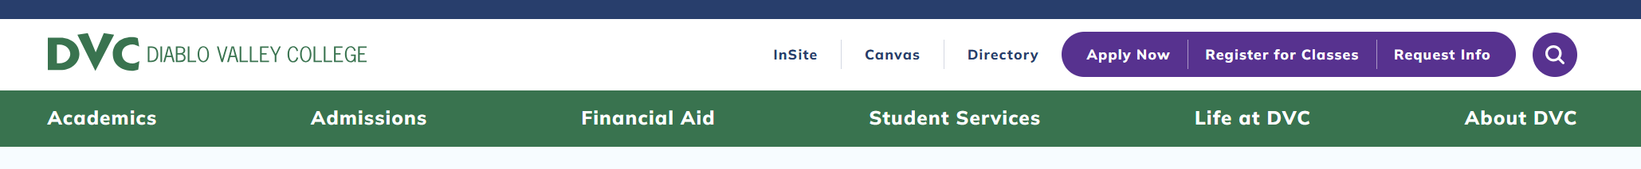
Step 1: APPLICATION
Apply online at www.dvc.edu
Write down this
information
Create a CCCApply account
Use a PERSONAL email (not school email)
Password
Note: The system is case sensitive!

Slide 18

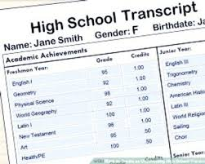
Step 1: APPLICATION
You need:
Social Security Number
High School Transcript

Slide 19
Step 1: APPLICATION
Submit Two (2) Applications
First Application
Spring 2026
High school student enrolling in a college class
COUNS 095/096 class during the spring semester (March or April)
Second Application
Summer 2026
First-time College Student

Slide 20

Step 1: Application
Why Two Apps?
Why Summer?
Change in your education status
High School Student
Spring 2026
College Student
Summer 2026
Summer application
sets you up
for fall semester

Slide 21
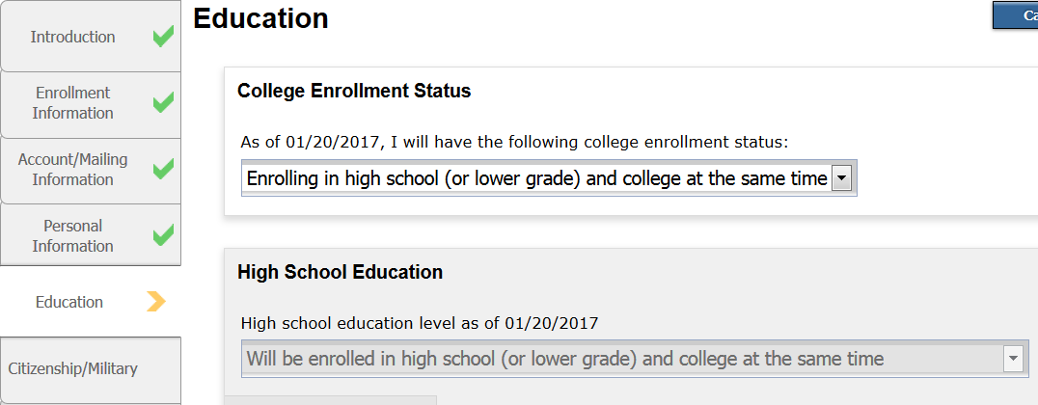
Step 1: APPLICATION
First application – SPRING 2026

Slide 22
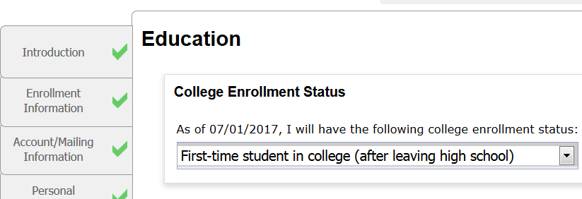
Step 1: APPLICATION
Second application – SUMMER 2026

Slide 23


After 24 Hours: Check and read your e-mail
DVC Account Information
DVC ID number (7-digits)
InSite username and password
InSite e-mail address
All DVC communication will be sent to your InSite Email

Slide 24


Step 2: ORIENTATION
Policies & Procedures
Support Services

Slide 25

Family Education Right to Privacy Act (FERPA)
Diablo Valley College employees
are prohibited from
sharing student information
with ANYONE other than the student.
ANYONE = Parent / Legal Guardian

Slide 26
Step 3: PLACEMENT
Unweighted Cumulative GPA
and
GPA = English placement
Math grade & Class (11th grade, 2nd semester) = Math placement
You need your high school transcript

Slide 27
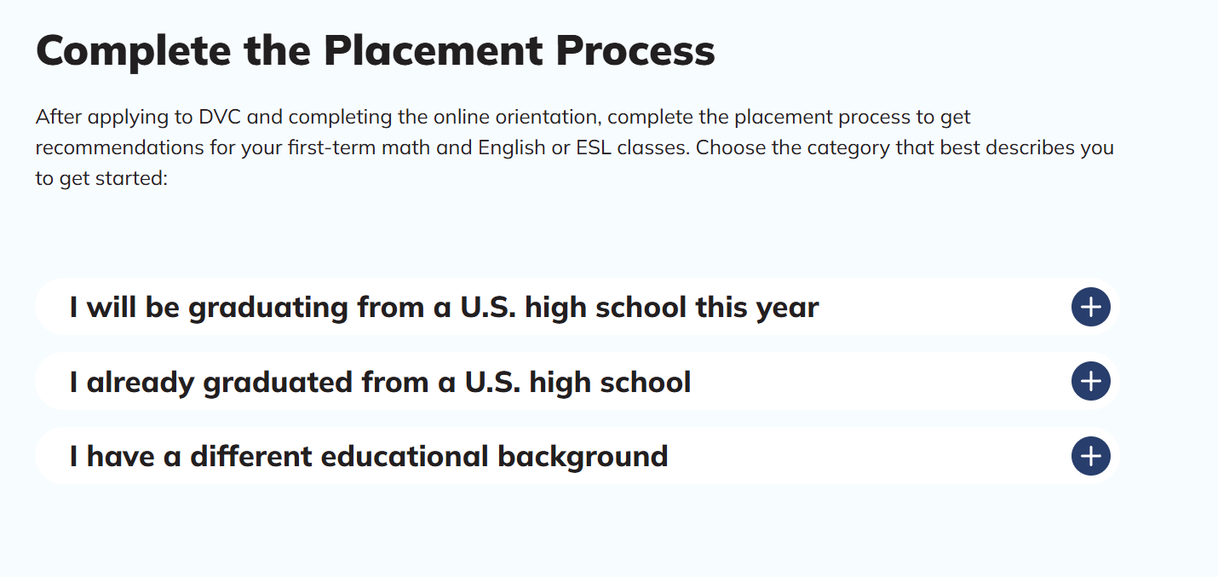
Step 3: PLACEMENT
Go to www.dvc.edu/placement

Slide 28

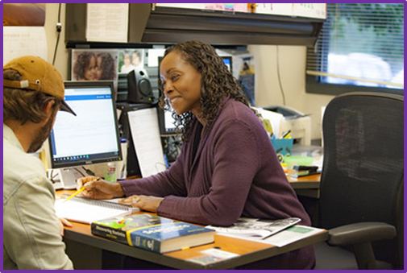
Step 4: Academic Advising
Counseling 95NC/96 Class: Spring 2026
Initial Academic Counseling Meeting
Create a partial Education Plan
Non-credit class
6 hours: 1 or 2 days

Slide 29

Registering for COUNS 095NC/096
Apply for Spring 2026
High school student enrolling in a college class
Complete a Special Admissions form
via Insite
You will need
Principal/designee email address
Parent/Legal Guardian email address

Slide 30
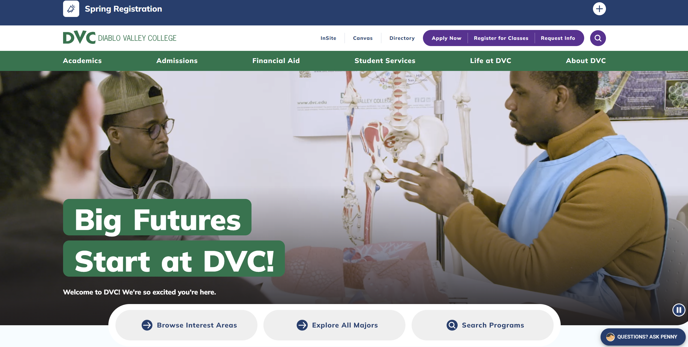
Registering for COUNS 095/096 - Special Admit form

Slide 31
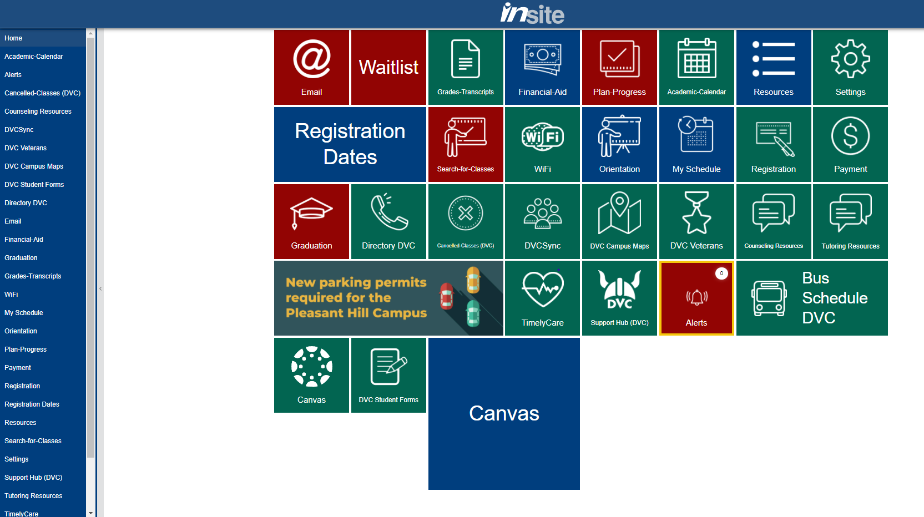

Slide 32
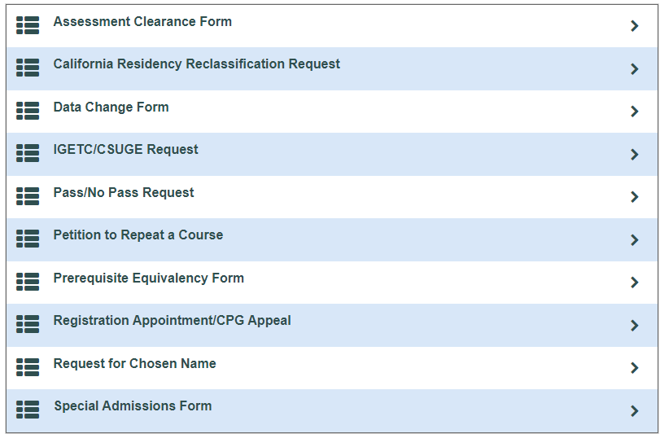
Registering for COUNS 095NC/096 - Special Admit form

Slide 33
Registering for COUNS 95
Apply for Spring 2026
Enrolling in High School and College at the Same Time
Complete Special Admissions Form
Via InSite Portal
Register for COUNS-095NC
After receiving the approval notice in your InSite email

Slide 34
5 Important Steps to Enroll
Application:
**Two applications: Spring 2026 and Summer 2026**
Orientation
English and Math Placements
Academic Advising (COUNS 095NC/096)
Register for Classes
May 2026

Slide 35
After COUNS 095…

Slide 36

Get Ready to Register
Create a schedule on InSite
Check for prerequisite requirements
Clear prerequisite before May th
Have a back-up plan

Slide 37
We are here to help!
Welcome and Connect Services
welcome@dvc.edu
925-969-2106

