Slide 1
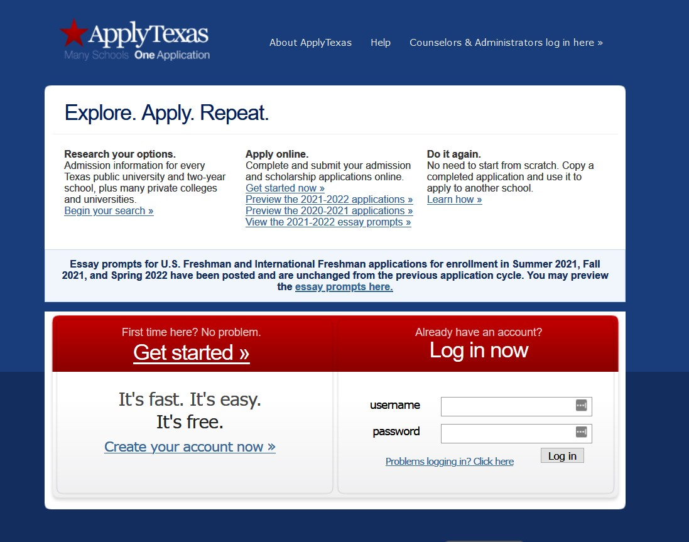
APPLY TEXAS
Create an account on the Apply Texas application website:www.applytexas.org
Click on “Create your account now” to begin.
YOUR COMPANY NAME

Slide 2
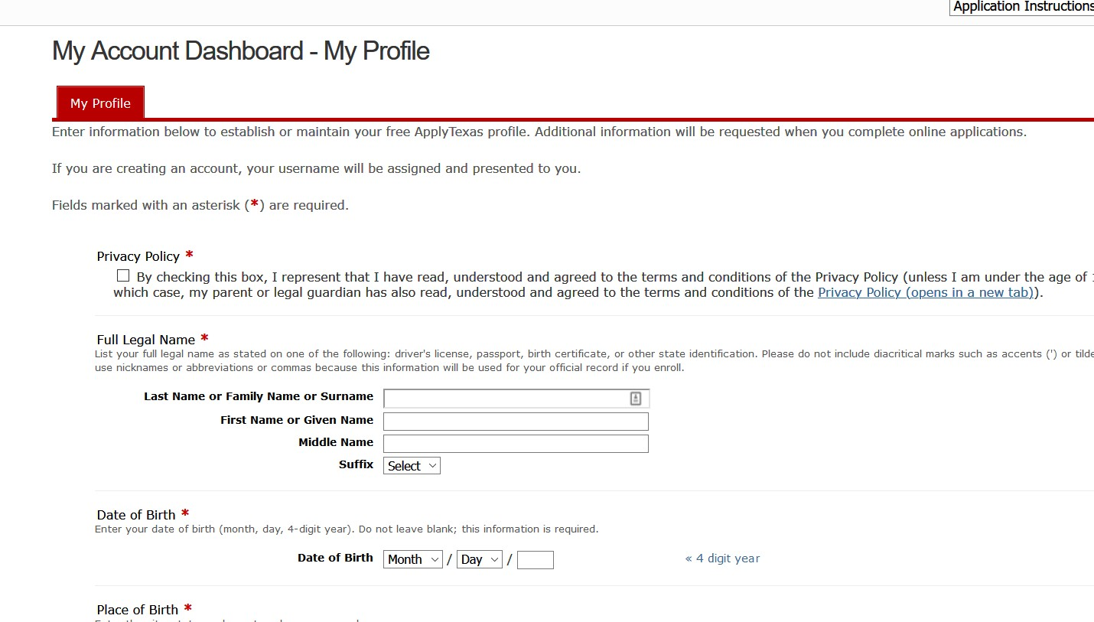
PROFILE
Agree to the Privacy Policy and enter in your personal information. It will take you several minutes to complete the My Profile page.
Please take your time and enter in your information accurately.
Enter your city of birth.
Select a State/Possession/Province only if you were born in the U.S. or Canada. Otherwise, leave the field set as “Select One” and select your country of birth.
Use the pull down menu to select your current grade level.
YOUR COMPANY NAME

Slide 3
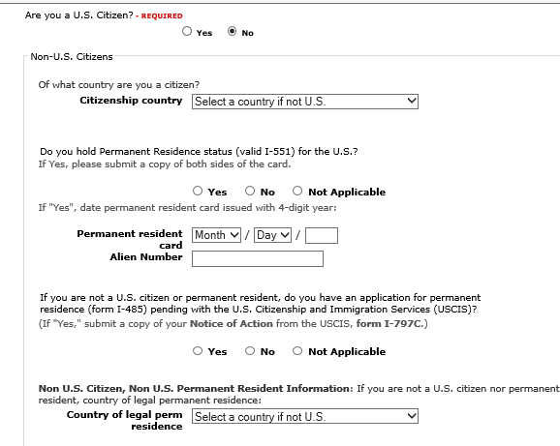
PROFILE
If you are a U.S. Citizen, answer “yes” and continue to the next question.
If you are not a U.S. citizen, additional questions will appear so that you can tell us more about your citizenship and residency.
Complete this section before you advance to the next question.
YOUR COMPANY NAME

Slide 4
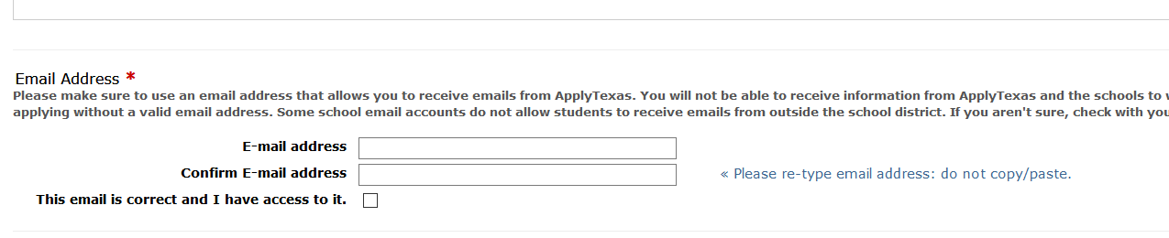
PROFILE
We recommend that you use a personal email address on your Apply Texas account as some school districts have security settings that will not allow students to receive emails from senders outside the district.
The email address you enter on your profile will become your Apply Texas account username. It will also be used by Apply Texas and colleges and universities to communicate with you.
  Please check the box below the email address to confirm that you have access to the email address you entered.

Slide 5
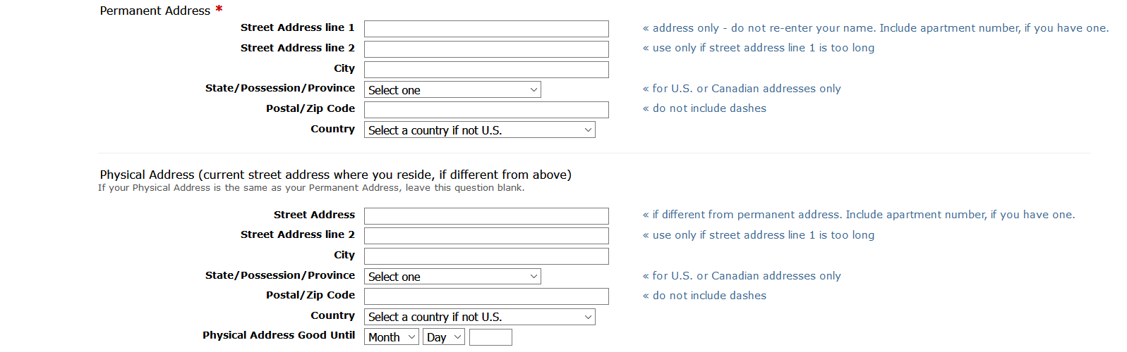
PROFILE
A permanent address is required for setting up an Apply Texas account and it is important that it be complete and correct, including an apartment number if applicable.
The State/Possession/Province field is used only for U.S. and Canadian addresses. A physical address is needed only if it is different than your permanent address.

Slide 6
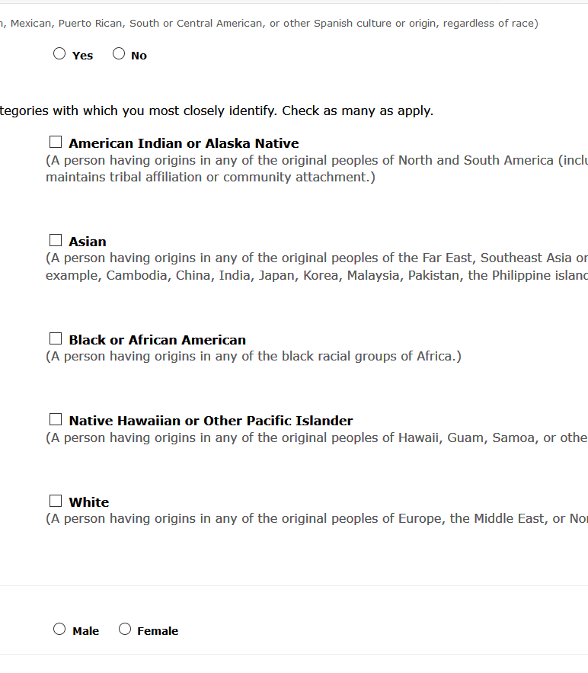
PROFILE
Answer the questions about Ethnicity and Race and Your Gender using the race and gender that you identify yourself as.
YOUR COMPANY NAME
7

Slide 7
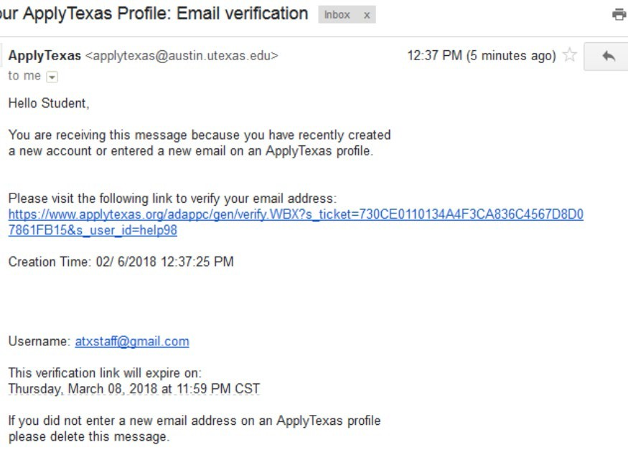
PROFILE COMPLETE
Please write down or photograph your information:
Application ID: located in the middle of the screen (number will be generated at completion)
Username: located on the upper left side of the screen
Password: the password you just created
You will receive an automated e-mail from Apply Texas titled “Your Apply Texas Profile."
This e-mail will be sent to the email address you enter on your profile. This email is NOT verification that the application has been completed or submitted.

Slide 8
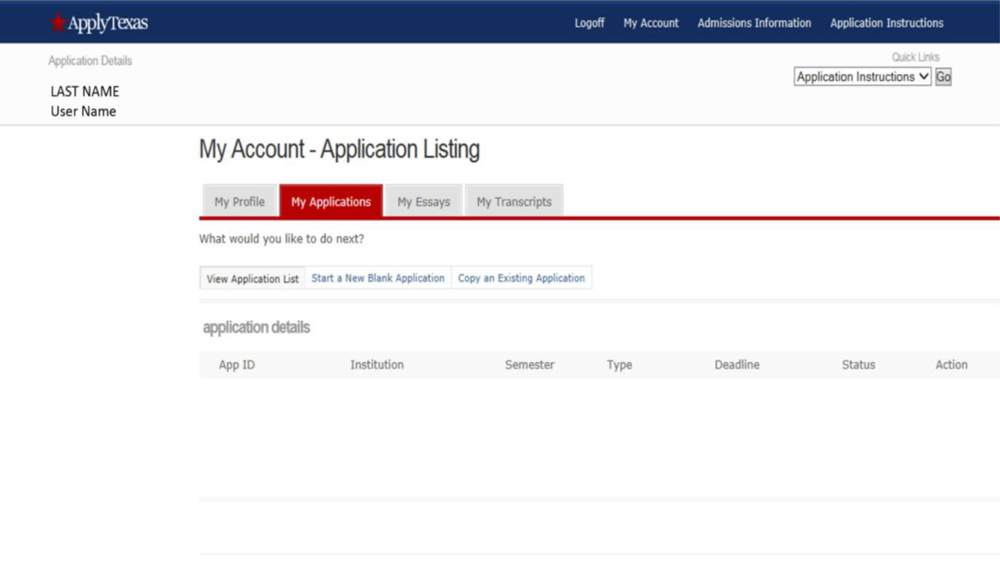
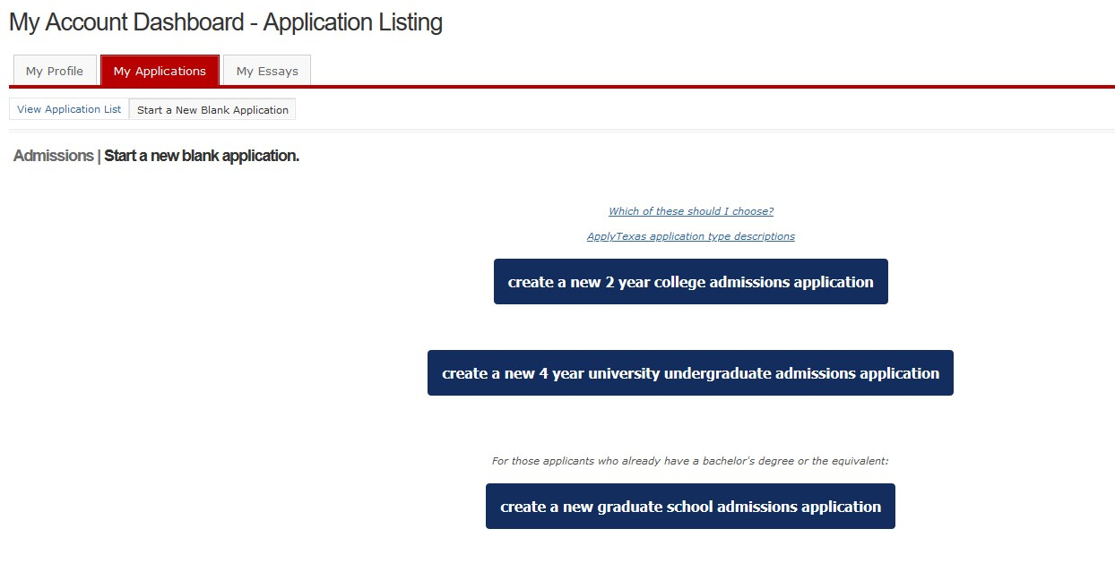
NEW APPLICATION
Click on the My Applications tab and the Start a New Blank Application link.
Select create a new 2 year college admissions application.

Slide 9
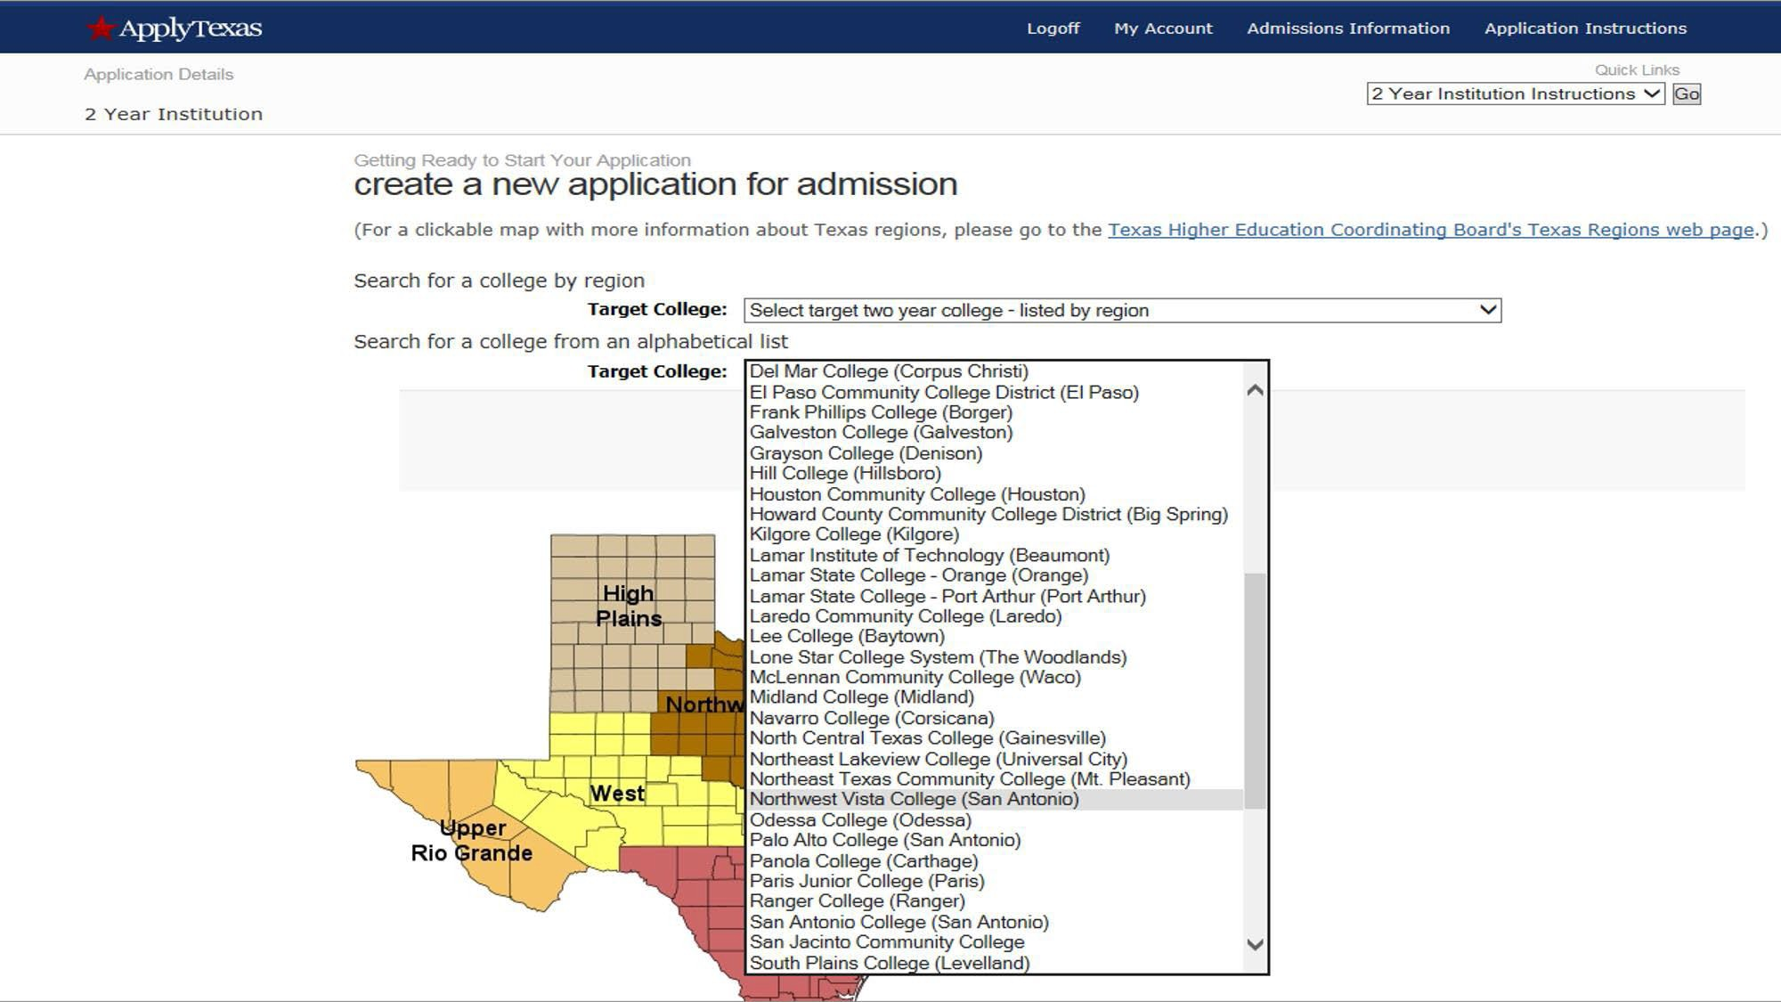
NEW APPLICATION
The first pull down menu organizes schools by Texas region;
The second lists institutions alphabetically use this one.
10

Slide 10
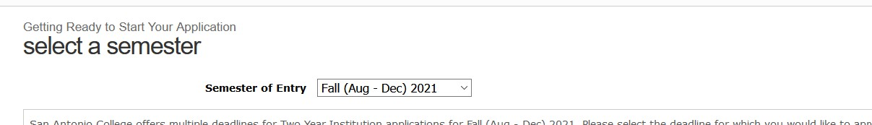
NEW APPLICATION
Select Semester
A pull-down menu is used to select a semester of entry.
Select Fall (Aug-Dec) 2021 as the Semester of Entry from the drop down menu.
Selecting the wrong semester of entry will impact the college’s evaluation of your participation in the program.

Slide 11
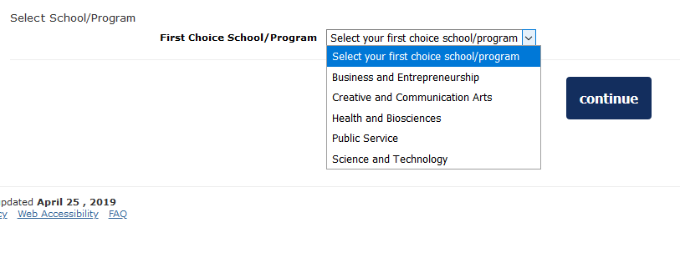
NEW APPLICATION
Select School
A pull-down menu is used to select a first choice school.
Select the your first choice school that aligns with your high school endorsement. Please choose correctly.

Slide 12
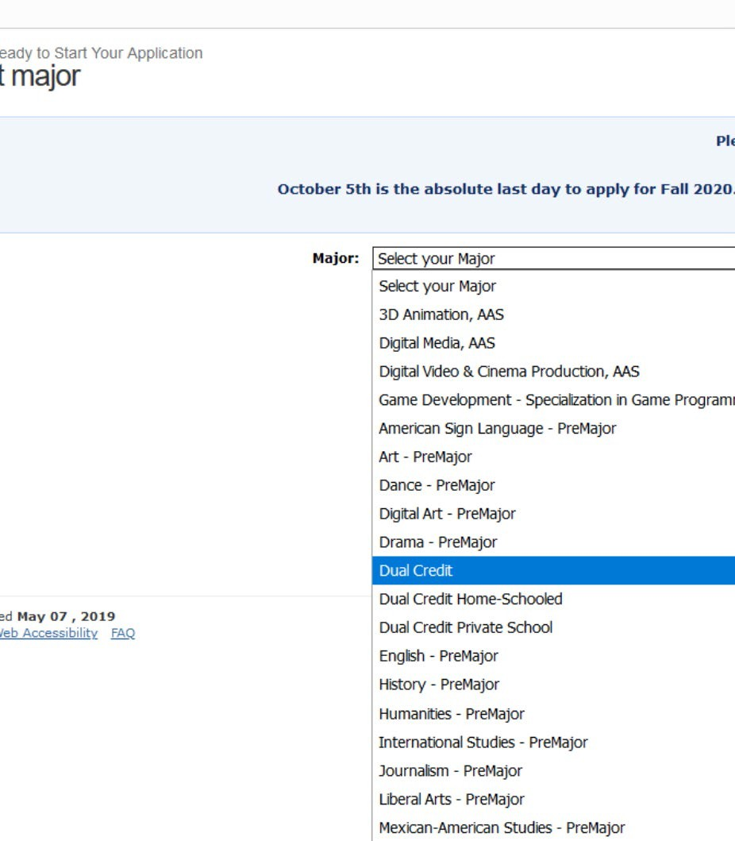
NEW APPLICATION
Select Major
A pull-down menu is used to select a major.
Select Dual Credit as your major.
Other dual credit options for the following depending on your HS program (ECHS or Homeschool student):
  Dual Credit Student-Home-School - If student is a home- schooled student
  Dual Credit Student-Private - If student attends a private high school
  Liberal arts- Travis ECHS & Brooks Collegiate Academy ECHS
  Biology/Pre-Nursing-HTECH at Fox Tech

Slide 13
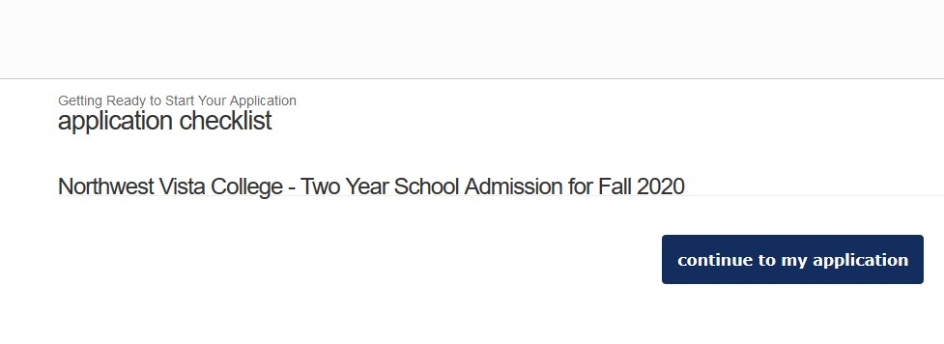
NEW APPLICATION
Application Checklist
Verify that you have selected the accurate application term (Fall 2021), then continue.
If the application term listed is incorrect, select “go back” to update the term.
San Antonio College
FALL 2021

Slide 14
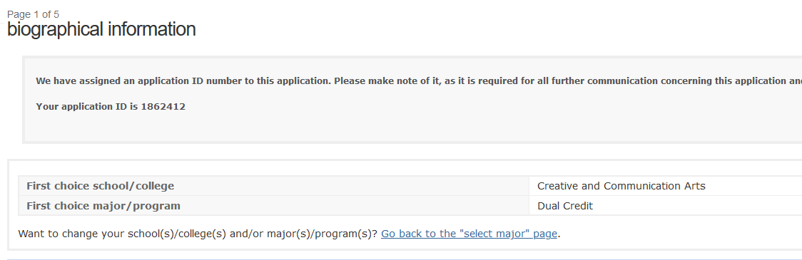
NEW APPLICATION
Biographical information
The information on this page will auto populate from the information you provided in your profile. Please scroll through and ensure all information listed is correct. Make sure the major listed is Dual Credit.
Please write down or photograph your information:
  Application ID: 1862412

Slide 15
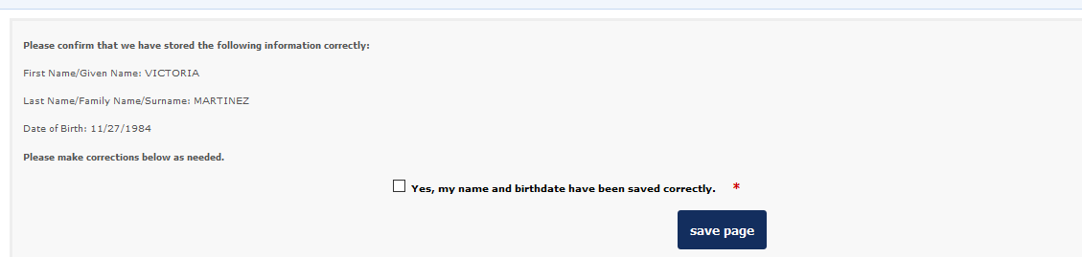
NEW APPLICATION
Biographical information
Check for accuracy! Make sure and confirm that your name and date of birth are correct.
Select “Yes, my name and birthdate have been saved correctly” and save page.

Slide 16
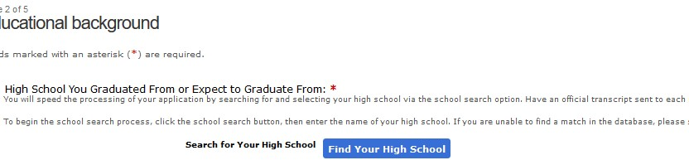
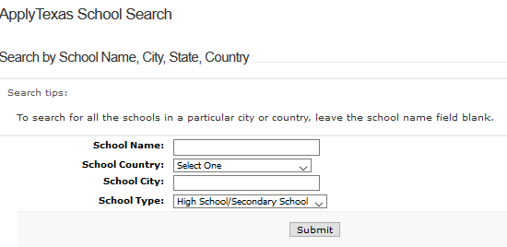
NEW APPLICATION
Educational Background
Click on “Find Your High School”. The search window will open where you will enter the name of your high school in the School Name field (leave all other fields blank) then click on Search.
Search Results will display high schools that match the school name you entered. From the list of results, select the high school with the correct name, address, and city.

Slide 17
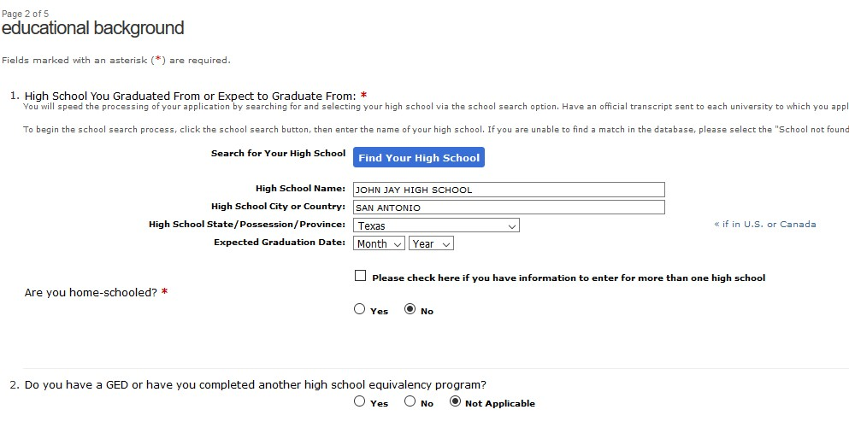
NEW APPLICATION
Educational background
High School Name, City, and State will auto populate. Enter your Expected Graduation Date.
Only answer YES to the question Are you home-schooled? if you are a home- schooled student.
May or June of what year?

Slide 18
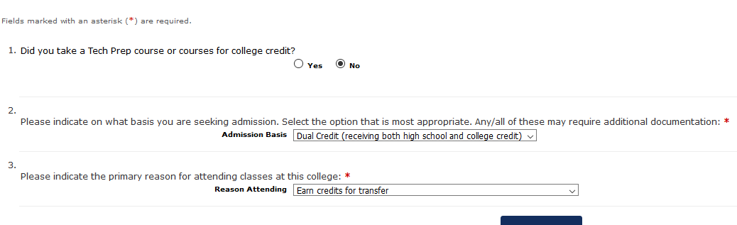
NEW APPLICATION
Educational background
Select Dual Credit (receiving both high school and college credit) as your answer. Selecting another option will affect your College's ability to consider your application for the program.
Select one of the following as your answer:
Earn a certificate (less than 2 years) (CTE programs)
Earn Associate Degree (2 years) (ECHS programs)
Earn credits for transfer (dual credit program)

Slide 19
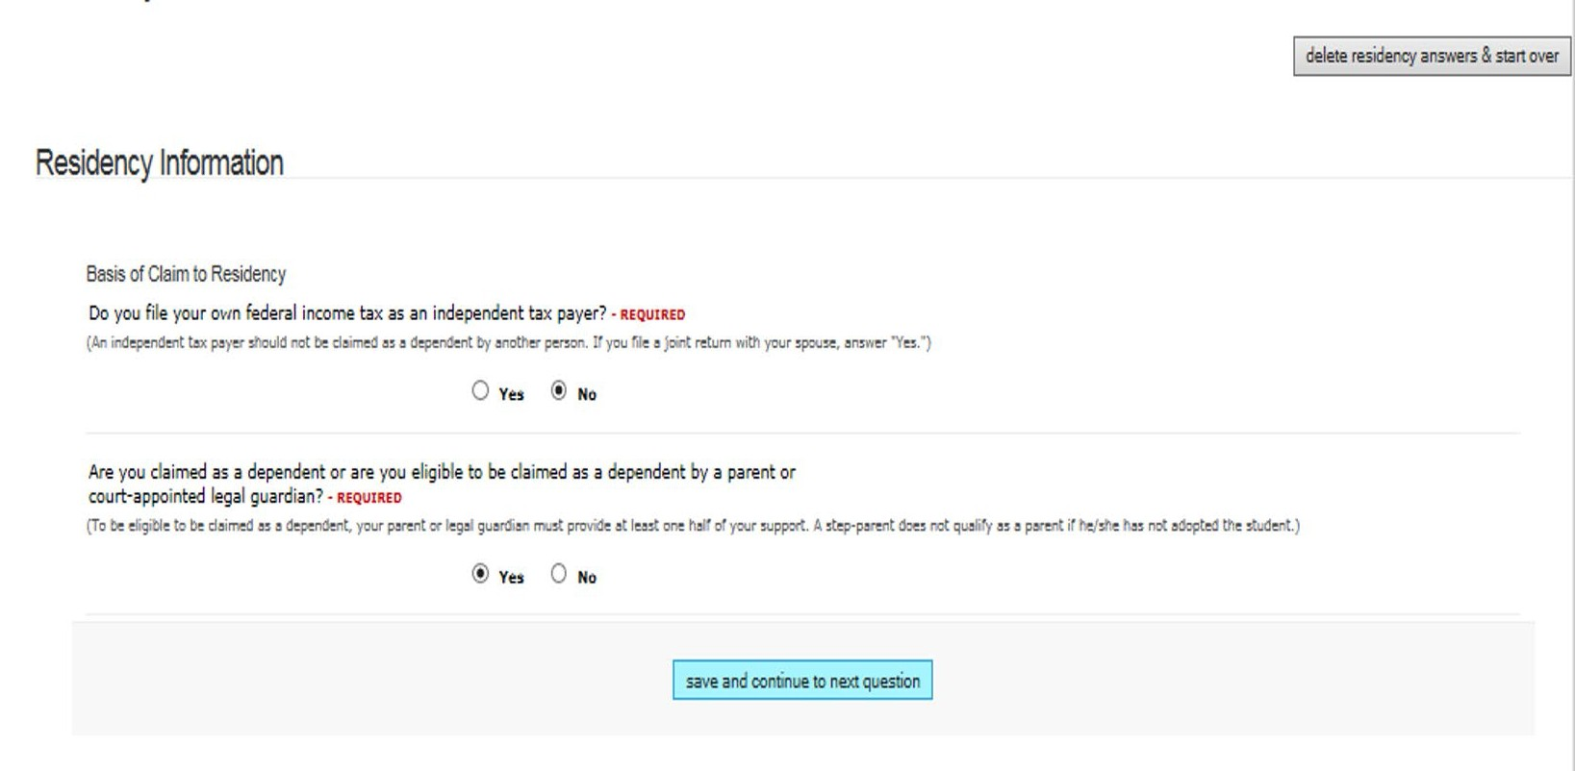
NEW APPLICATION
Residency Questions
If possible, have your parents or legal guardian guide you with the correct answers.
The following questions will be about Taxes , Employment, and State of Residency
Students are typically not independent tax payers. Please select “no”.
Students are typically eligible to be claimed as a dependent. Please select “yes”.
20

Slide 20
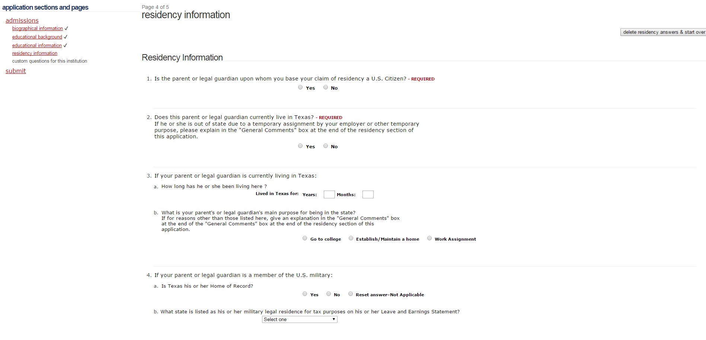
NEW APPLICATION
If you have lived in Texas all your life, estimate your parents age and enter as answer.
Got to college-your parent is only temporarily living in Texas to attend college and will be moving back out of state.
Establish /Maintain a home-Your parents lives in Texas and has established a permanent residence.
Work assignment-your parent is only temporarily living in Texas for a work assignment and will be moving back out of state.

Slide 21
NEW
APPLICATION
Residency information
Does your parent have a job in Texas?
Does your parent receive government assistance such as disability checks or food stamps?
Are your parents married? Yes or No? If you answered No, skip a. and b. you have completed all of the Residency questions.
Click save and continue to next question.
If you answered Question 7 as “Yes”, select Gainfully Employed from the drop down menu if one of your parents has a job in Texas.
How many years have your parents been married? This is just an estimate. If your parents have been married all of your life, enter your age for the answer to this question.

Slide 22
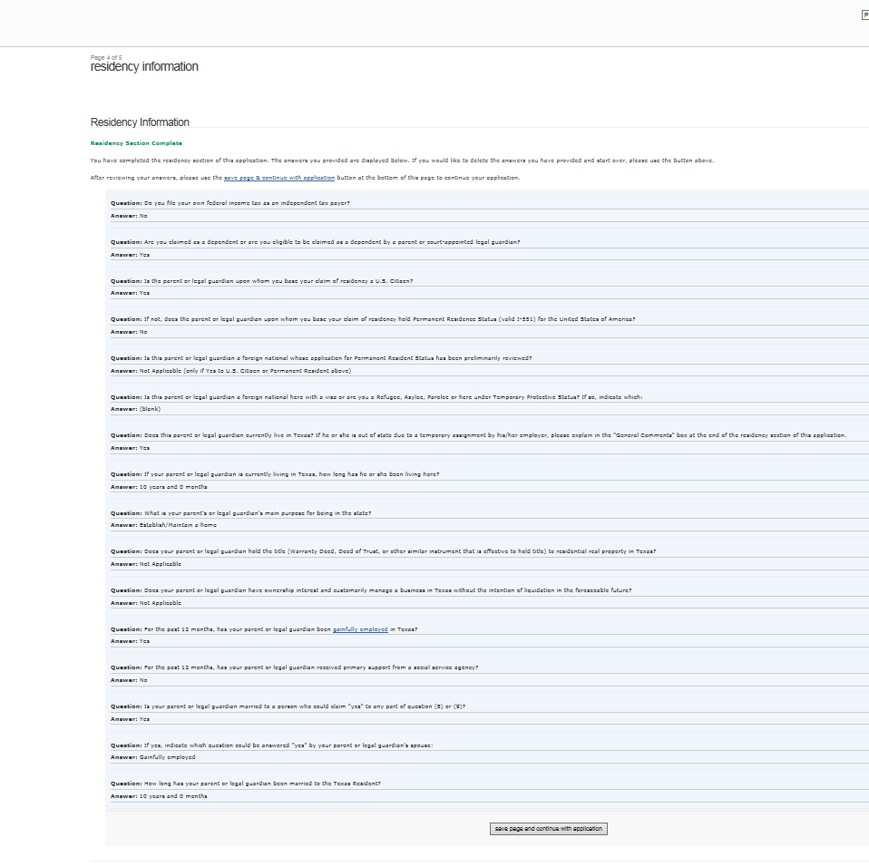
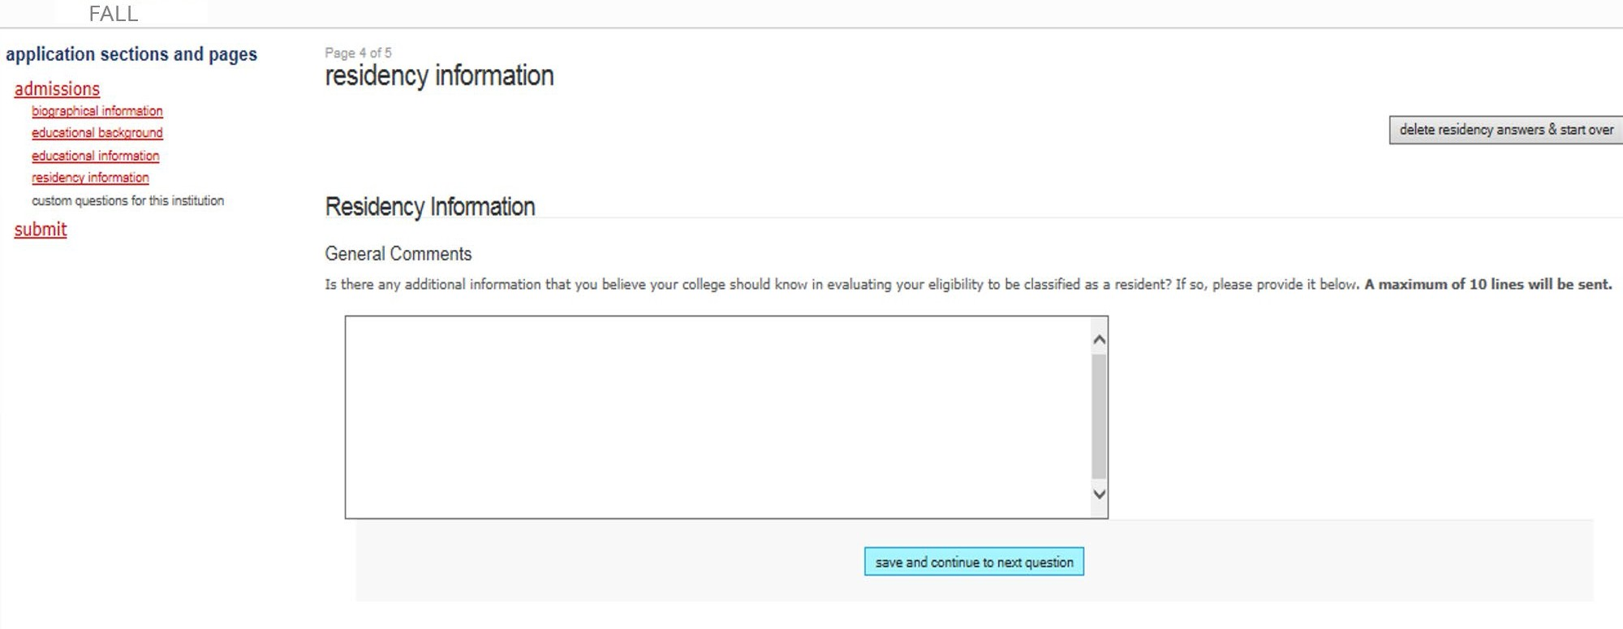
NEW APPLICATION
If you have lived in Texas all your life, estimate your parents age and enter as answer.

Slide 23
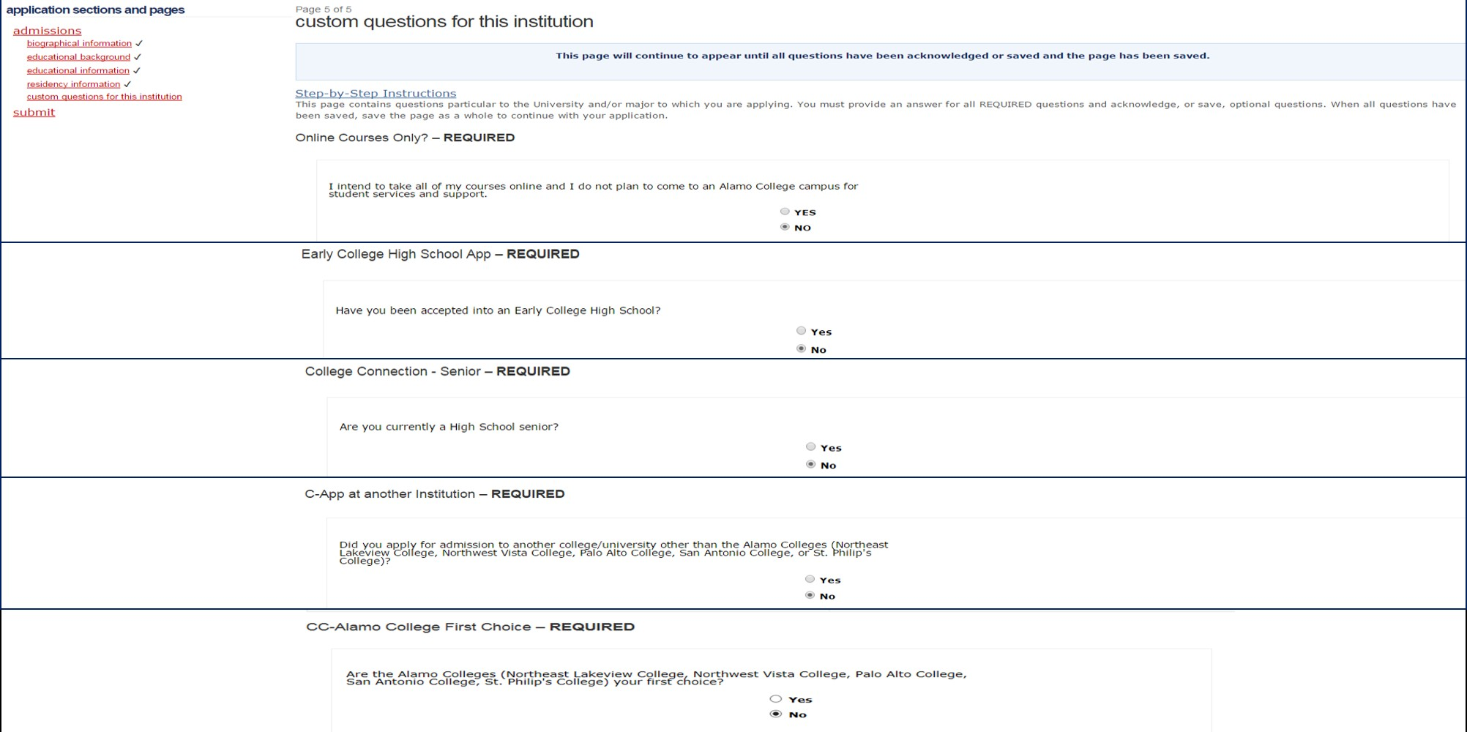
NEW APPLICATION
Custom Questions
24

Slide 24
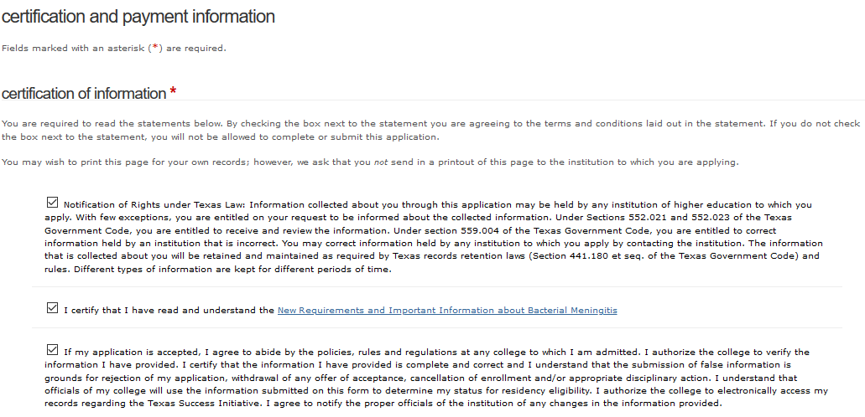
NEW APPLICATION
Certification of Information

Slide 25
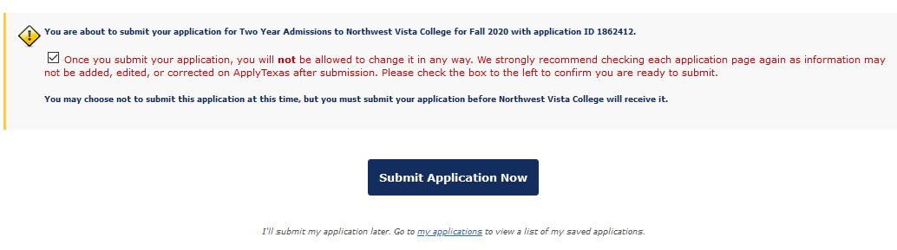
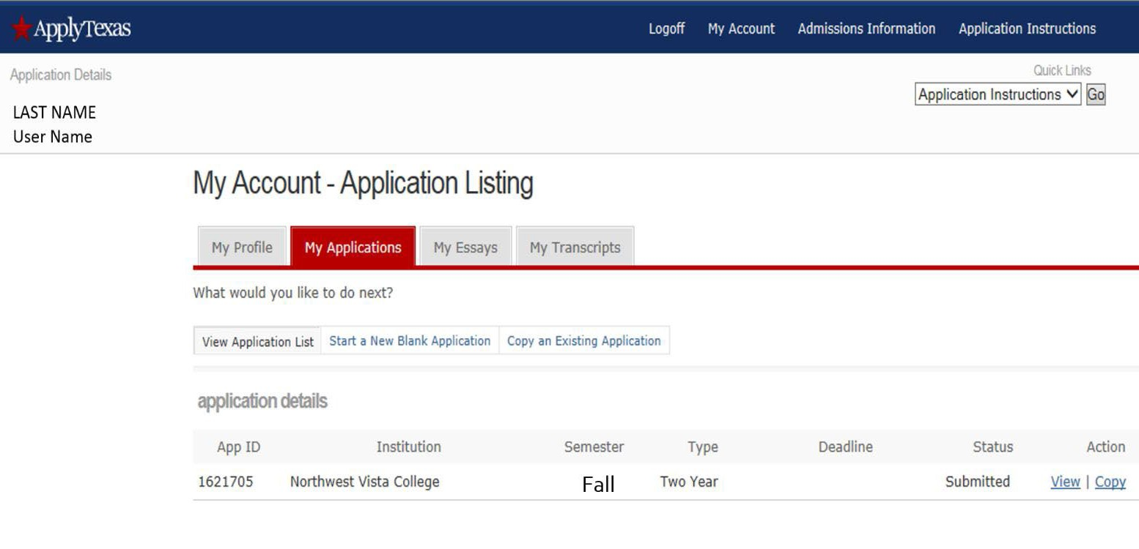
Write, print, or photograph the following
information for your records: Application ID
User Name Status
Note: Status must be “Submitted”. A status
of “Saved” means that your application has
not been sent to San Antonio College.
San Antonio College
Fall 2021

Slide 26

Congratulations on submitting your application to San Antonio College!
Your next steps:
Wait 3-5 days for your application to process
Complete Go FAARR and Test Prep Modules in ACES
Take the TSI exam OR request your official SAT/ACT scores

Slide 27

Contact High School Programs: 210-486-0177
sac-hsp@alamo.edu

