Slide 1

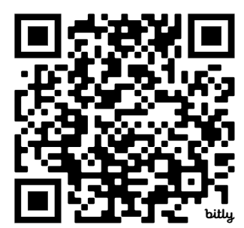
CAREER & TECHNICAL EDUCATION
NTO
Attendance
July 29, 2025

Slide 2
Attendance
bit.ly/45js9KW

Slide 3
01
Welcome to NEISD CTE
Welcome and Introductions

Slide 4
CTE Office
Phil Steinert | Senior Director
Shawn Jensen | Assistant Director
Jason Sandoval | Program Coordinator
Virena Merla | Instructional Specialist
Celina Ruiz | Bookkeeper
Melina Alves | Admin Assistant to Senior Director
Ana Avila | Admin Assistant to Assistant Director

Slide 5










Vision
Mission
Goals
We will build the future by aligning our teaching to industry needs so that our students are prepared to answer the call of the demands of our community’s economy and workforce.
  We will offer engaging and dynamic curriculum that inspires students to begin and remain in their career pathway throughout their educational career
  We will enhance student success by integrating Industry-Based Certifications into our curriculum, ensuring that graduates acquire relevant skills and qualifications necessary to be successful
  We will increase our number of completers by 50% over the next 3 years
  100% of students who complete a pathway will pass the IBC connected to their pathway

Slide 6


Name
Campus
What will you be teaching?
What’s your dream superpower?
Intros!

Slide 7

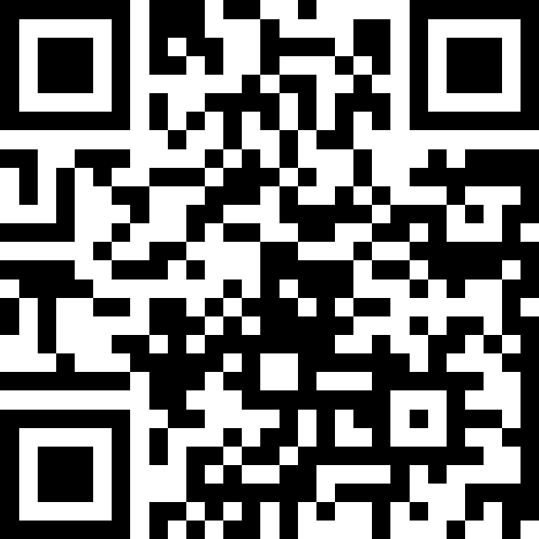


Do not edit
How to change the design
Join at slido.com
#1003590
Presenting with animations, GIFs or speaker notes? Enable our Chrome extension
Notes:
📣 This is Slido interaction slide, please don't delete it.
✅ Click on 'Present with Slido' and the joining instructions will appear when you get to this slide.

Slide 8

Do not edit
How to change the design
What was your previous teaching or professional experience before joining us?
Presenting with animations, GIFs or speaker notes? Enable our Chrome extension
Notes:
📣 This is Slido interaction slide, please don't delete it.
✅ Click on 'Present with Slido' and the poll will launch automatically when you get to this slide.

Slide 9
02
Instructional Resources
Google Classroom, Skyward, Curriculum, Launchpad

Slide 10

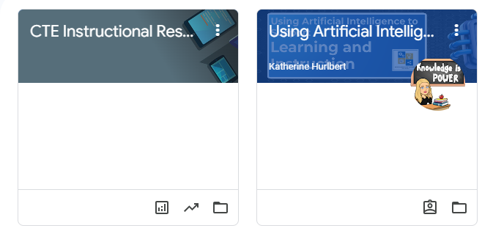
Google Classroom
Your Learning Management System (LMS)

Slide 11
Let’s Go to Google Classroom

Slide 12

Join the CTE Google Classroom

Slide 13
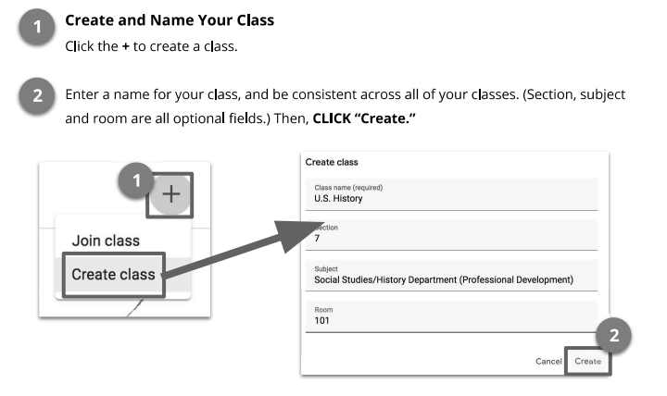
Creating and Setting up a Class

Slide 14
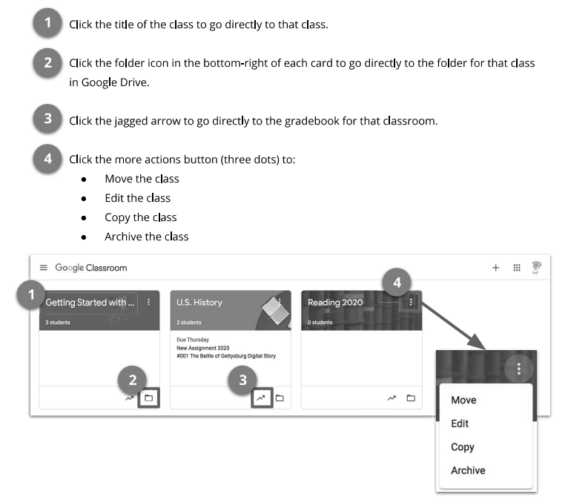
Google Classroom Homepage

Slide 15
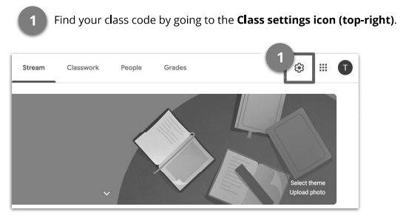
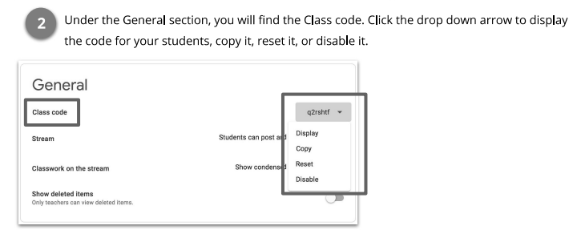
Adding Students

Slide 16
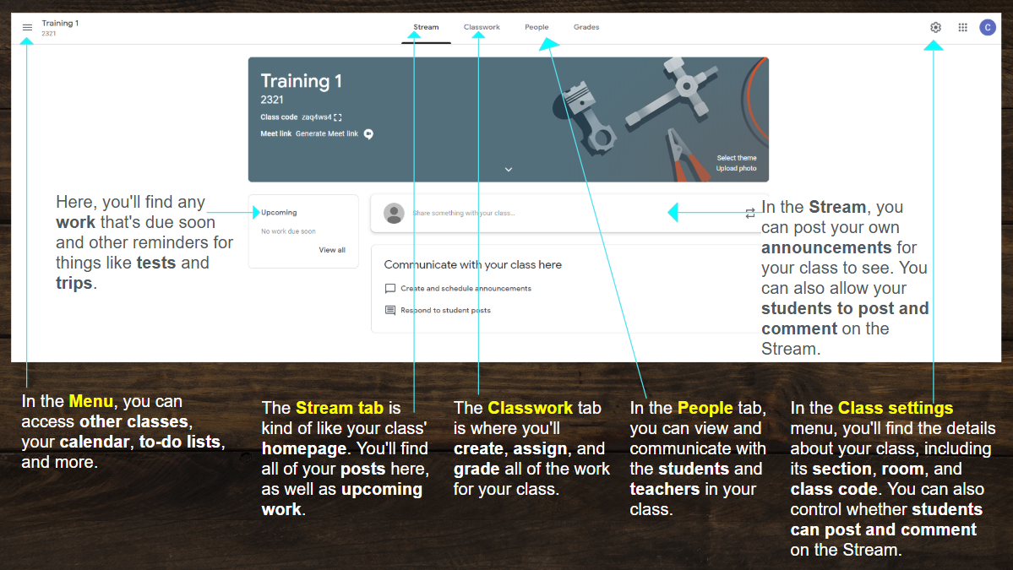
Navigating your class

Slide 17
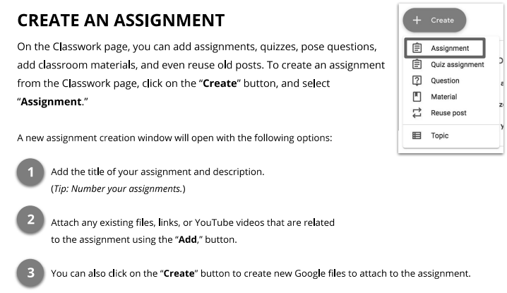
Creating Assignments

Slide 18
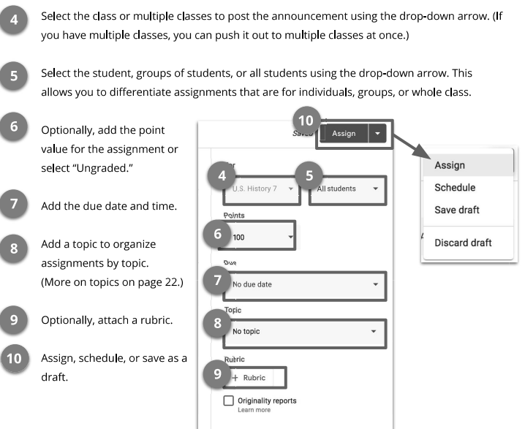

Slide 19
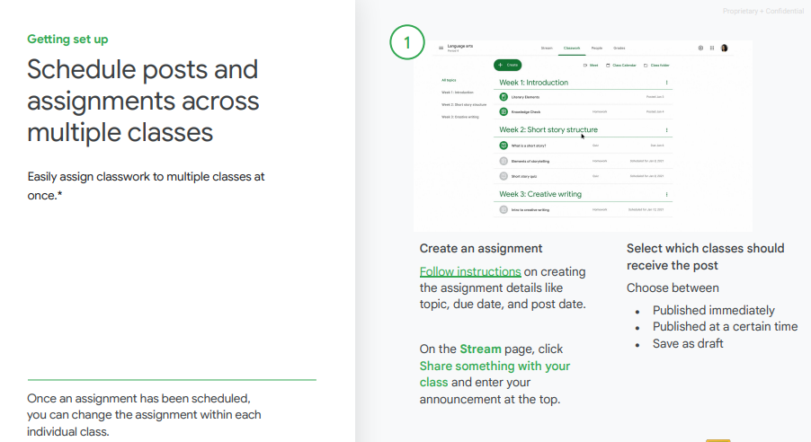
Schedule and post across multiple classes!

Slide 20
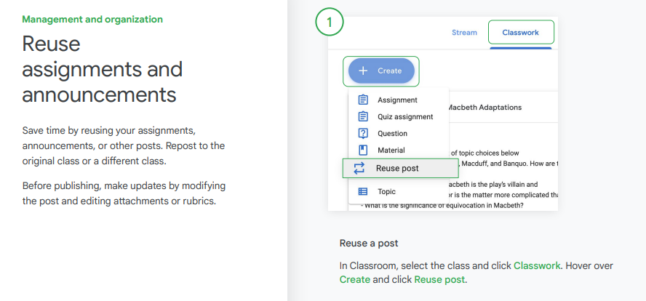
Reuse Assignments

Slide 21
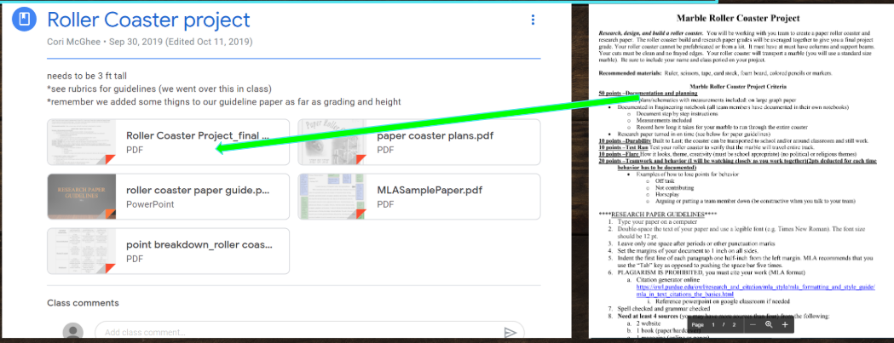
Example of a Project

Slide 22
Google Classroom Tips
Turn off comment capability from students
Turn off notifications
Include DETAILED Directions
Use Private Comments for Meaningful Feedback and Conversations with Students
Include learning intentions in every posted activity or assignment.
Include the Due Date (and Time)

Slide 23
Google Classroom Tips
Can attach multiples files, videos, and links to assignments - list all of the options for reaching the learning intention to differentiate instruction
Invite a colleague to join your class as a student and vice versa to learn together and see both the student and teacher side of Google Classroom.
Should always have an updated Google Classroom
Alternative HS - should have everything available, they are still a part of your class

Slide 24
Additional Resources
Cheat Sheet for Teachers
Google User Guide
Getting started with Google Classroom
ASK!
Dept. Chair
PLC Lead
Virena
FIND
OUT
MORE

Slide 25




Slide 26

Do not edit
How to change the design
How many grades should be taken in a week?
Presenting with animations, GIFs or speaker notes? Enable our Chrome extension
Notes:
📣 This is Slido interaction slide, please don't delete it.
✅ Click on 'Present with Slido' and the poll will launch automatically when you get to this slide.

Slide 27

To access the NEISD Secondary Grading Guidelines:
EIA Regulation Secondary Grading Guidelines .docx

Slide 28
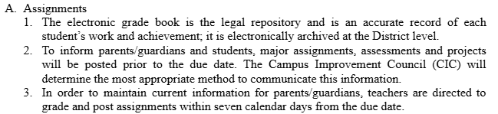
Secondary Grading Guidelines
Reporting Grades
1-2 Grades should be entered every week

Slide 29
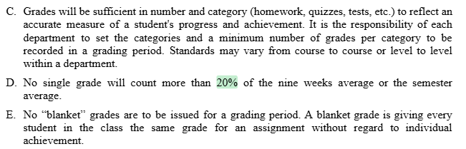
Secondary Grading Guidelines
Cannot give participation grades or for bringing in supplies

Slide 30

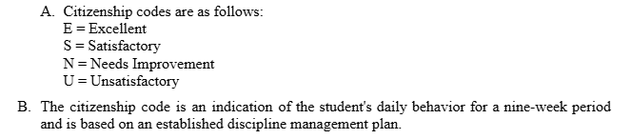
Citizenship
Citizenship should be entered at end of 9 week period

Slide 31
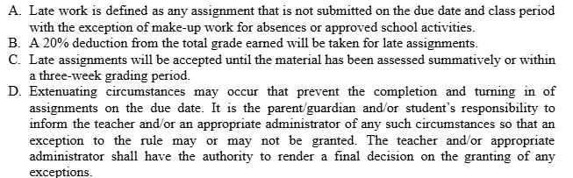
Secondary Grading Guidelines
Late Work

Slide 32
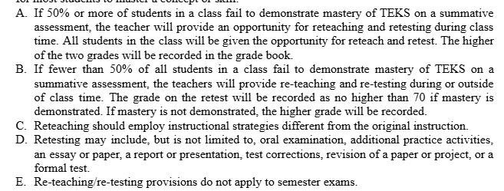
Secondary Grading Guidelines
RE-TEACHING AND RE-TESTING

Slide 33

Game Time!
Go to
wayground.com/join

Slide 34

Pause. Stroll. Scroll. Refresh.
Drinks and chips in Cafeteria
Visit vendors in hallway

Slide 35


Launchpad
All NEISD controlled apps
3rd party apps
Students must add their own apps if they are not already on the dashboard. All they do is click on the plus icon, type the name of the app, and click on add. Super easy!

Slide 36
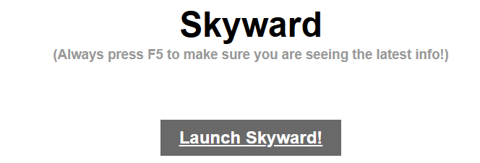
Grades in Skyward
https://skyward.neisd.net/

Slide 37

Smartfind Express
neisd.sfe.powerschool.com
This is where you will enter your absent days to get a substitute.

Slide 38
Let’s enter your first day out
Check out the
CTE Calendar
bit.ly/4lTCrqu
Subs - PD, competition, sick

Slide 39
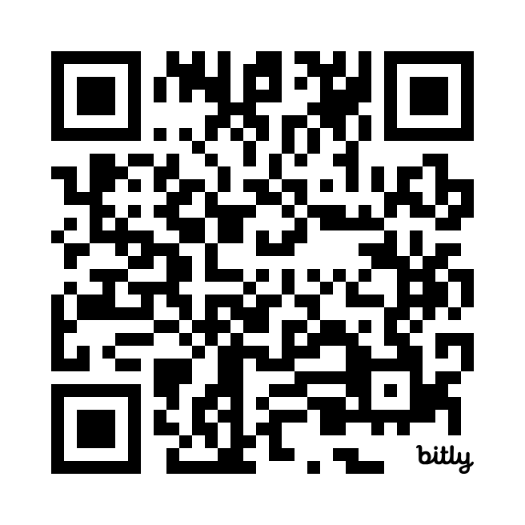
New Teacher Resource Guide
The Current Smore
IBC Smore

Slide 40

Curriculum
What are you teaching?
Where are my resources?
Let’s find your YAGs and
Unit Plans
You will get more info from your PLC Lead tomorrow.
Everyone needs access to the
CTE Teacher Shared Drive.

Slide 41

Do not edit
How to change the design
Audience Q&A
Break Time
Presenting with animations, GIFs or speaker notes? Enable our Chrome extension
Notes:
📣 This is Slido interaction slide, please don't delete it.
✅ Click on 'Present with Slido' and the questions from your audience will appear when you get to this slide.

Slide 42
03
CTE Program of Study
Jason Sandoval - Program Coordinator

Slide 43



What is a Program of Study?
a structured plan outlining the courses and requirements needed to complete a specific degree or certificate.
Agriculture, Food, and Natural
Resources
Architecture & Construction
Arts, Audio Visual Technology & Communications
Agribusiness Leadership & Communications
Animal Science
Agricultural Technology & Mechanical Systems
Environmental Natural Resources
Food Science & Technology
Plant Science
Architectural Drafting & Design
Carpentry
Electrical
HVAC & Sheet Metal
Plumbing & Pipefitting
Graphic Design & Interactive Media
Digital Communications

Slide 44



Program of Study Continued
Business, Marketing, & Finance
Education & Training
Health Science
Accounting & Financial Services
Business Management
Entrepreneurship
Marketing & Sales
Real Estate
Early Learning
Teaching & Training
Diagnostic & Therapeutic Services
Nursing Science
Biomedical Science

Slide 45



Program of Study Continued
Hospitality & Tourism
Human Services
Information Technology
Culinary Arts
Family & Community Services
Health & Wellness
Cosmetology & Personal Care Services
Cybersecurity
Programming & Software Development

Slide 46




Program of Study Continued
Law & Public Service
Manufacturing
Engineering
Law Enforcement
Robotics & Automation Technology
Manufacturing Technology
Welding
Engineering Foundations
Mechanical & Aerospace Engineering
Drone (Unmanned Vehicle)
Transportation, Distribution, & Logistics
Automotive & Collision Repair
Diesel & Heavy Equipment
Aviation Maintenance

Slide 47

Do not edit
How to change the design
What is your Program of Study?
Presenting with animations, GIFs or speaker notes? Enable our Chrome extension
Notes:
📣 This is Slido interaction slide, please don't delete it.
✅ Click on 'Present with Slido' and the poll will launch automatically when you get to this slide.

Slide 48
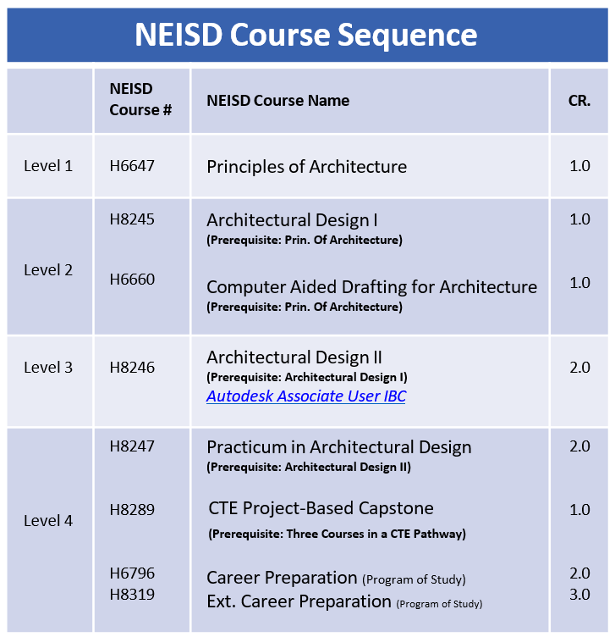
Typical Program of Study

Slide 49
Sample Four year Plan
Program of Study: Architectural Drafting and Design
Freshman Year | Sophomore Year | Junior Year | Senior Year
1. English I | 1. English II | 1. English III | 1. English IV
2. Biology | 2. Architectural Design I LV2 | 2. Physics | 2. Astronomy
3. Algebra | 3. Geometry | 3. Architectural Design II LV3 | 3. Pre-Calculus
4. W. Geography | 4. W. History | 4. Architectural Design II LV3 | 4. Gov’t./Economics
5. Lunch | 5. Lunch | 5. Lunch | 5. Lunch
6. Principles of Architecture LV1 | 6. Chemistry | 6. US History | 6. CTE Project Based Capstone LV4
7. Pep Squad | 7. Spanish II | 7. Dance | 7. Dance
8. Spanish I | 8. Dance | 8. Algebra II | 8. Senior Release

Slide 50
Do not edit
How to change the design
Why is Architectural Design II, two periods?
Presenting with animations, GIFs or speaker notes? Enable our Chrome extension
Notes:
📣 This is Slido interaction slide, please don't delete it.
✅ Click on 'Present with Slido' and the poll will launch automatically when you get to this slide.

Slide 51
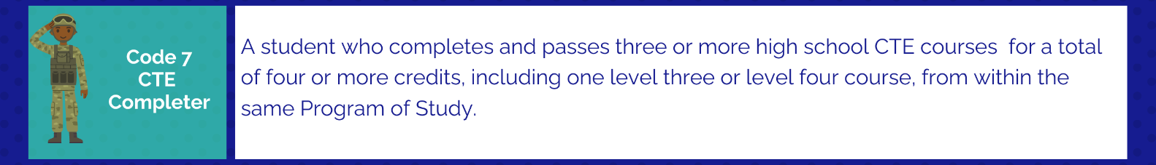
How can I complete a Program of Study/Pathway?
Example:
Architectural Drafting and Design
9th Grade: Principles of Architecture - 1 Credit
10th Grade: Architectural Design I - 1 Credit
11th Grade: Architectural Design II - 2 Credit
12th Grade: CTE Project Based Capstone (Optional)
    IBC Earned: Autodesk Associate User

Slide 52
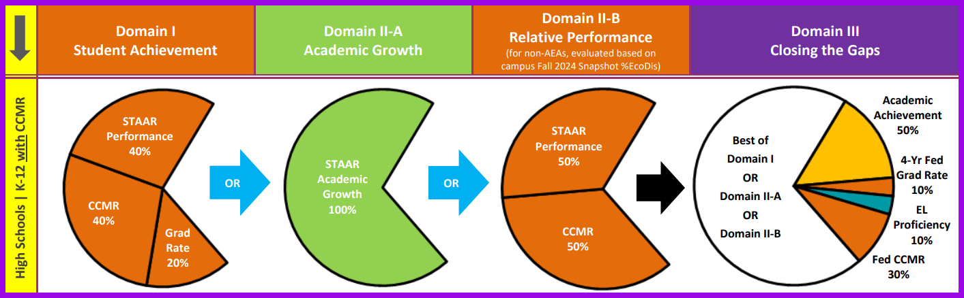
Why is it important?
CTE COMPLETERS =
ACCOUNTABILITY FOR CAMPUSES
DISTRICT DOLLARS
CCMR INDICATORS

Slide 53
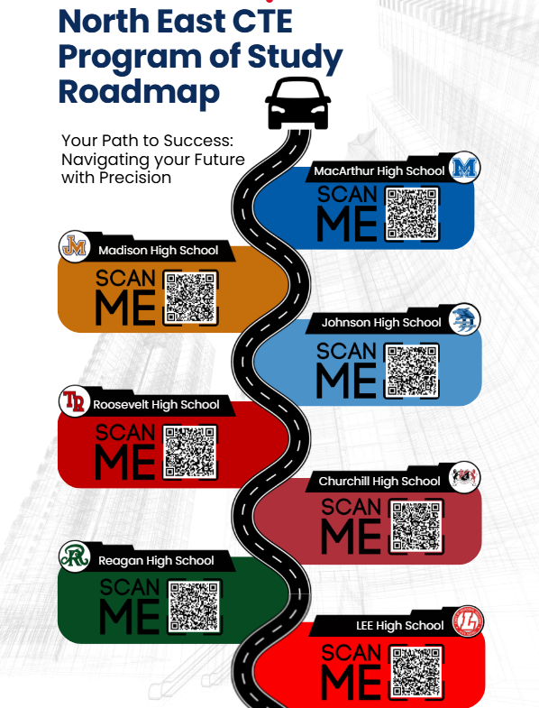
Roadmap to your Program of Study

Slide 54







CTSOs
Career and Technical Student Organization

Slide 55
Joining a CTSO offers numerous benefits for students
Skill Development: CTSOs help students develop essential skills applicable to various career paths. These include communication, problem-solving, teamwork, and leadership skills, which are highly valued by employers.
Career Exploration: CTSOs offer students opportunities to explore different career fields within specific industries. For example, DECA focuses on marketing, finance, hospitality, and management, while HOSA focuses on health science careers.
Networking Opportunities: CTSOs provide a platform for students to connect with industry professionals, mentors, and other students with similar career interests. These connections can be invaluable for internships, job placements, and future career advancement.
Leadership Development: CTSOs provide opportunities for students to take on leadership roles within the organization, allowing them to develop and practice leadership skills such as communication, delegation, and conflict resolution.

Slide 56
Joining a CTSO offers numerous benefits for students
Competition and Recognition: Many CTSOs offer competitions and recognition programs at local, state, and national levels. These events allow students to showcase their skills, receive feedback, and gain recognition for their achievements.
Community Engagement: CTSOs often engage with the local community through service projects and partnerships with businesses. This allows students to contribute to their community and gain experience in social responsibility.
Preparation for Future Success: By participating in CTSOs, students gain practical skills, valuable experience, and a network of contacts that can significantly enhance their prospects for future success in their chosen careers.

Slide 57
Student Side of CTSO
CTSO Video

Slide 58
CTSO Supplemental Pay
4 hours a month @ $25hr = up to $1,100 a year Aug-June
Participate in a TEA approved CTSO
Provide a Roster of at least 10 students who are registered in the organization.
Participate in competition, hold meetings, be involved in community service projects, and you must meet regularly with students outside normal work hours.
Request the Supplemental Pay Documentation form from Jason Sandoval - jsando1@neisd.net

Slide 59

Lunch
Food Trucks in Courtyard

Slide 60
04
The New Art and Science of Teaching Strategies

Slide 61

NASOT Strategies

Slide 62

What’s next?
What questions do you have?

Slide 63
See you tomorrow!
Do you have any questions?
vmerla@neisd.net
210-788-6453
210-407-0294

Slide 64
ICON PACK

Slide 65

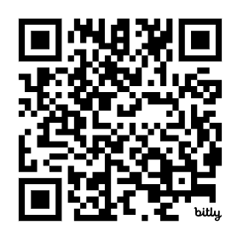
Day 2
bit.ly/4kXfB03

Slide 66
Welcome Back and Check-in

Slide 67
PLC Intros and Break Out

Slide 68
1st Day Activities

Slide 69

All About Me Presentation
Choose 3 emojis that describe you or your interests. Then introduce yourself using those emojis.
More ideas!!
CLASSROOM BINGO
Make printable and virtual bingo cards
Rock, Paper, Scissors Tournament

