Slide 1
Measuring Up
How Public Schools are Evaluated

Slide 2
“It’s not the strongest of the species that survive, nor the most intelligent, but the ones most responsive to change.”
Charles Darwin

Slide 3





History of Testing in Texas
Leadership North East Luncheon
November 20, 2017
TEAMS
TABS

Slide 4
Development of the State Assessment System
STAAR
2012
STAAR and EOC (3-8 and HS)
TAKS
2003
Changed to grades 3-11 began SSI initially in 3, 5 and 8
Inclusion of Students and of Subjects Tested
TAAS
1990
Changed to grades 3-8 and 10; Added Science and Social Studies
TEAMS
1986
Added grades 1, 7 and 11
TABS
1980
Reading, Math, & Writing Grades 3, 5, and 9
LNE
Level of Difficulty

Slide 5
2017 State Accountability Rating System
Index 1: Student Achievement
Index 2: Student Progress
Index 4: Postsecondary Readiness
Index 3: Closing Performance Gaps
System Safeguards
Distinction Designations

Slide 6
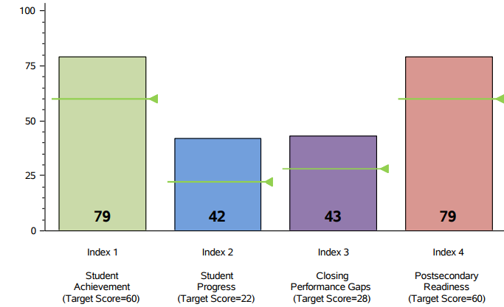
Accountability Summary
Performance Index Report
2016-2017
Accountability 2016 Comparison
+1
+1
+3
Source: Accountability Tables 2016-2017
Notes:
The next slides provide Academic Performance data. The data is based on the STAAR and EOC results. Those results are compiled into an extremely complicated accountability summary shown on this slide which lists the 4 indices.
Index 1 measures student achievement and the target for 16-17 was a 60. As you can see in green, NEISD scored a 79.
Index 2 measures student progress as compared to the previous year and the target was 22. NEISD received a score of a 42.
Index 3 measures closing the achievement gaps with a target of 28 and the district score of 43.
The last index measures postsecondary readiness. The target was 60. NEISD received a score of 79.

Slide 7


Accountability Summary Performance Index Report
Source: Accountability Tables 2016-2017

Slide 8
2017 District/Campus Accountability Ratings
North East Independent School District: Met Standard
Campus Rating | High | Middle | Elem | Total
Met Standard | 9 | 14 | 46 | 69 (100%)
Improvement Required | 0 | 0 | 0 | 0 (0%)
Source: Accountability Tables 2017
Notes:
The results of the calculations from the four indices give us our accountability rating for our district and our individual campuses. There are 2 possible ratings, met standard and improvement required. NEISD earned a met standard rating and all 68 of our campuses also earned a rating of met standard. We have 0 Improvement required schools for the 16-17 school year.
Last Year all campuses met standard.

Slide 9

The Implementation of House Bill 22
Collaborating to Build a Better Accountability System

Slide 10

State Accountability 2018 and Beyond
HB 3
81st Texas Legislature (2009)
Index 1: Student Achievement
Index 3: Closing the Gap
HB 2804
84th Texas Legislature (2015)
HB 22
85th Texas Legislature (2017)
Student Achievement
Index 2: Student Progress
Index 4: Postsecondary Readiness
Student Progress
Closing Performance Gaps
Postsecondary Readiness
Community and Student Engagement
Student Achievement
School Progress
Closing the Gaps
4 Indexes
5 Domains
3 Domains
2012 - 2017
2018 & Beyond
2018 & Beyond

Slide 11

A–F Accountability: Legislative Context
House Bill 22, 85th Texas Legislature
“The commissioner shall evaluate school district and campus performance and assign each district and campus an overall performance rating of”
A B C D or F
A-F ratings not in effect for campuses until 2018-2019 school year. For 2017-2018 school year, ratings of Met Standard and Improvement Required will be issued to campuses and Districts will receive A-F rating.

Slide 12


Next Steps: Implement Legislation

Slide 13


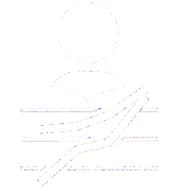
Three Domains: Combining to Calculate Overall Score
Best of Achievement or Progress
Minimum 30%
All districts and campuses can receive an “A” rating – no forced distribution.
The ratings should be based on stable criteria, so you can make apples-to-apples performance comparisons from year to year.
Domain I: Student Achievement
Domain II:
School Progress
Domain III:
Closing The Gaps
Notes:
Combine 3 domain scores to calculate overall score
Best of Domain I and II; Domain III minimum of 30% of overall score
Commissioner will assign each district and campus an overall performance rating of: A, B, C, D, or F.
A-F ratings not in effect for campuses until 2018-2019 school year. For 2017-2018 school year, ratings of Met Standard and Improvement Required will be issued to campuses and Districts will receive A-F rating.
All districts and campuses can receive an “A” rating – no forced distribution.
The ratings should be based on stable criteria, so you can make apples-to-apples performance comparisons from year to year.

Slide 14
Domain I: Student Achievement - Performance
Domain II:
School Progress
Domain III:
Closing The Gaps
Domain I: Student Achievement

Slide 15
The Purpose: It’s Not Just About the Numbers
By 2030, at least 60 percent of Texans ages 25-34 will have a certificate or degree.

Slide 16
STAAR Performance Labels
Performance Label | Definitions
Did Not Meet Grade Level | Students at this level have not passed since performance at this level indicates students are unlikely to succeed in the next grade or course without significant, ongoing academic intervention.
Approaches Grade Level | Students at this level are considered to have met at least the minimum passing standard.
Meets Grade Level | Students at this performance level have a high likelihood of success in the next grade or course.
Masters Grade Level | Students at this level are expected to succeed in the next grade or course with little or no academic intervention.

Slide 17
Domain I: Student Achievement - Performance
Level | STAAR Indicators | College, Career, and Military Ready Indicators | Graduation Indicators
Elementary | Approaches & Above Meets & Above Masters | None | None
Middle | Approaches & Above Meets & Above Masters | None | None
High | Approaches & Above Meets & Above Masters | AP/IB Exams Texas Success Initiative (SAT/ACT/TSIA) Complete College Prep Courses Dual Credit/OnRamps Courses Associates Degree Standards on Composite Indicators Industry Certification Admission to Post-Secondary Industry Certification Program Enlistment in Armed Forces | Graduation Rates
OnRamps in 2018-2019
School Year TBD
Foundation HS Plan Only
School Year TBD

Slide 18


Domain I: Student Achievement - Calculating Score
North East ISD
All Students
Total Tests
108,619
Average of 3
# Approaches Grade Level or Above
85,538
# Meets Grade Level or Above
56,752
78.8 + 52.3 + 24.8 / 3 = 51.9
# Masters Grade Level
26,950
% Approaches Grade Level or Above
78.8%
% Meets Grade Level or Above
52.3%
?
% Masters Grade Level
24.8%
Texas Higher Education Coordinating Board Goal
By 2030, at least 60 percent of Texans ages 25–34 will have a certificate or degree.
Student Achievement
Score

Slide 19
What Does This Mean for Planning?
Approaches
Meets
Masters
Did Not Meet Grade Level
Approaches Grade Level
Meets
Grade Level
Masters
Grade Level
1
2
3
Notes:
So let’s try to show, visually, what is happening during the phase in of the Level II standard.
Let’s look again at our general depiction of the 3 performance categories for STAAR – and then look at the phase in of the Level II standard.
What we can see is that the Level II – Phase 1 standard is actually below the final Level II standard. While students who score at least Level II – Phase 1 are considered to have passed the test, it is important to see that in the long run, a score that is the equivalent of Level II – Phase 1 will be considered a failing score.
Similarly, we can see that when we move to Level II – Phase 2, students will be able to achieve a passing status on the test with what, ultimately, will be considered a failing score.
Only when we arrive at the Final Level II standard will we have fully implemented the overall design of STAAR – with the corresponding descriptions of the relative level of preparedness of students scoring within each Performance Level in STAAR (Level I, Level II and Level III).

Slide 20
Domain II: School Progress - Growth
Domain I: Student Achievement
Domain III: Closing
The Gaps
Domain II:
School Progress

Slide 21


Domain II: School Progress - Two Aspects to Progress
Student Growth
Relative Performance
Two Aspects to Progress:
Student Growth (Elementary and Middle)
Relative Performance (Elementary, Middle, and High)
Decision Point:
Best of the two?
Average of the two?

Slide 22
Domain II: School Progress – Student Growth

Slide 23


Domain II: School Progress – Student Growth
Accelerated Growth
Distance between the Masters standard on current-year and Meets standard on previous-year tests
Expected Growth
Distance between the Meets standard on current-year and previous-year tests

Slide 24
What Does This Mean for Planning?
Approaches
Meets
Masters
Did Not Meet Grade Level
Approaches Grade Level
Meets
Grade Level
Masters
Grade Level
1
2
3
Notes:
So let’s try to show, visually, what is happening during the phase in of the Level II standard.
Let’s look again at our general depiction of the 3 performance categories for STAAR – and then look at the phase in of the Level II standard.
What we can see is that the Level II – Phase 1 standard is actually below the final Level II standard. While students who score at least Level II – Phase 1 are considered to have passed the test, it is important to see that in the long run, a score that is the equivalent of Level II – Phase 1 will be considered a failing score.
Similarly, we can see that when we move to Level II – Phase 2, students will be able to achieve a passing status on the test with what, ultimately, will be considered a failing score.
Only when we arrive at the Final Level II standard will we have fully implemented the overall design of STAAR – with the corresponding descriptions of the relative level of preparedness of students scoring within each Performance Level in STAAR (Level I, Level II and Level III).

Slide 25

Domain II: School Progress – Student Growth
Suggested Scoring for Student Growth
STAAR Scale Score | Masters
 | Meets
 | Approaches
 | Does Not Meet
 | 3rd Grade
Masters
Meets
Approaches
Does Not Meet
4th Grade
Exceeds +1 Point Awarded
For exceeding expected growth
Meets +1 Point Awarded
For meeting expected growth
Maintains +.5 Pts Awarded
For maintaining proficiency but
failing to meet expected growth
Limited +0 Pts Awarded
For falling to a lower level

Slide 26
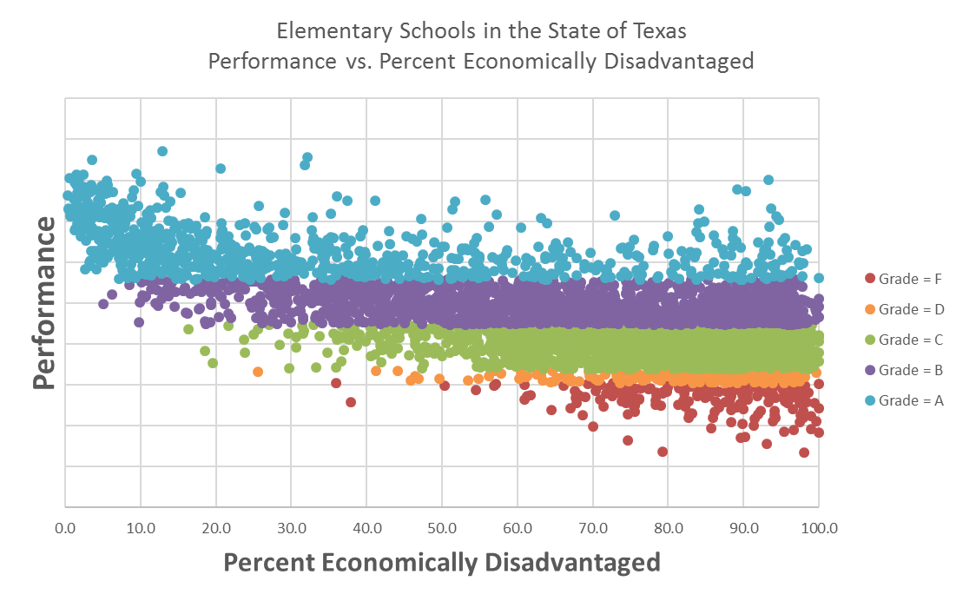
State Accountability 2018 and Beyond
Domain II: Student Progress – Relative Performance
Greater numbers of campuses receiving an ‘A’ will have lower percentages of Economically Disadvantaged students.
Grades assigned solely on performance
A (20%)
B (35%)
C (35%)
Greater numbers of campuses receiving an ‘F’ will have higher percentages of Economically Disadvantaged students.
D (5%)
F (5%)

Slide 27
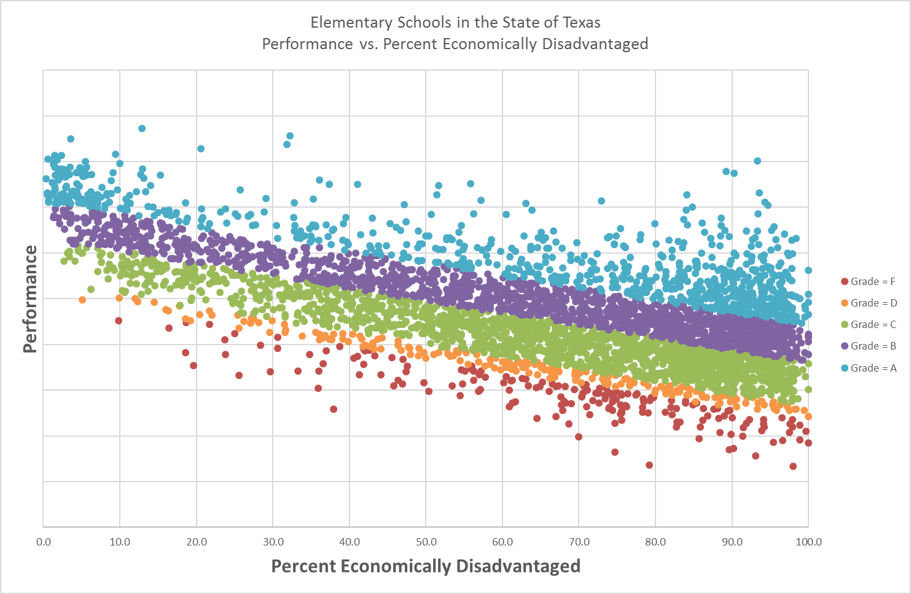
State Accountability 2018 and Beyond
Domain II: School Progress – Relative Performance
Performance is independent of the Economically Disadvantaged percentage on the campus.
A (20%)
B (35%)
C (35%)
D (5%)
F (5%)

Slide 28
Domain III: Closing the Gaps - Ensuring Educational Equity
Domain I: Student Achievement
Domain II: School
Progress
Domain III:
Closing
The Gaps

Slide 29

Domain III: Closing the Gaps - Ensuring Educational Equity
Domain 3
Closing the Gaps
Attempt to Align Two Accountability Systems: State and Federal

Slide 30
Domain III: Closing the Gaps - Ensuring Educational Equity
Student Groups
All Students
African American
Hispanic
White
American Indian
Asian
Pacific Islander
Two or More Races
Economically Disadvantaged
Current and Former Special Education
Current and Monitored English Learners
Continuously Enrolled/Non-Continuously Enrolled
Indicators
Academic Achievement in Reading, Mathematics, Writing, Science and Social Studies
At or Above Meets Grade Level Performance in Reading and Mathematics
Growth in Reading and Mathematics (Elementary and Middle Schools)
English Learner Language Proficiency Status
Graduation Rates
College, Career, and Military Readiness Performance
Student Achievement
Student Success
Student Progress
TELPAS Progress

Slide 31
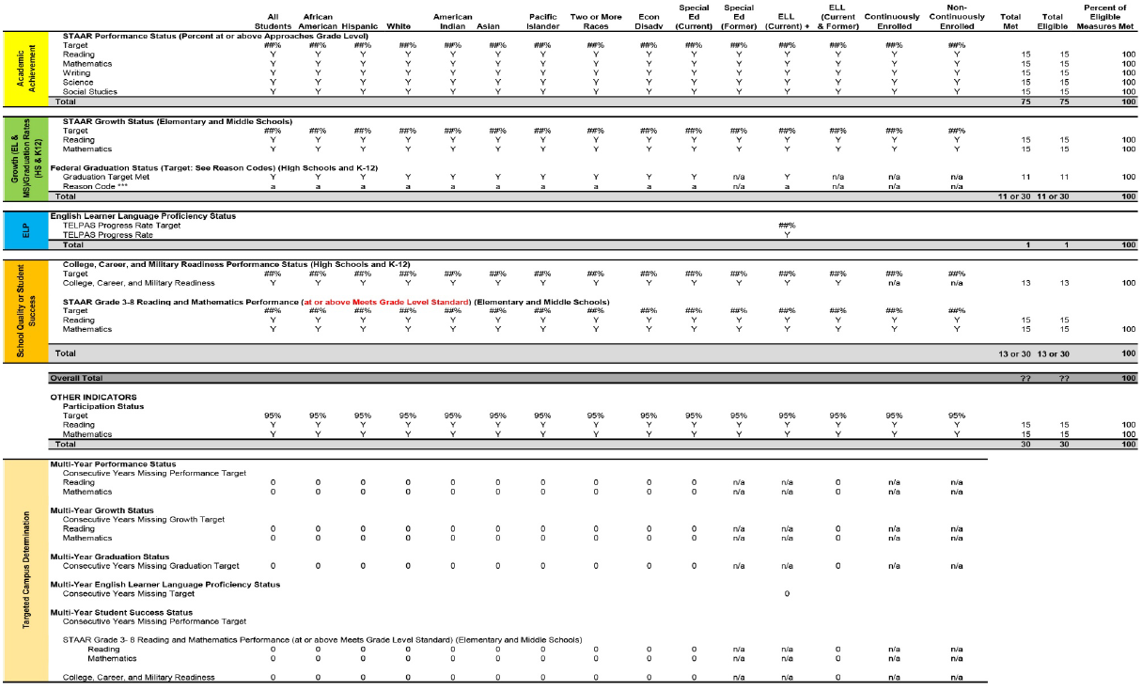
State Accountability 2018 and Beyond
Domain III: Closing the Gaps

Slide 32
Three Domains: Combining to Calculate Overall Score
Domain I: Student Achievement
Domain II:
School Progress
Domain III:
Closing The Gaps
Districts: A-F ratings
Campuses: Met Standard or Improvement Required
Notes:
Combine 3 domain scores to calculate overall score
Best of Domain I and II; Domain III minimum of 30% of overall score
Commissioner will assign each district and campus an overall performance rating of: A, B, C, D, or F.
A-F ratings not in effect for campuses until 2018-2019 school year. For 2017-2018 school year, ratings of Met Standard and Improvement Required will be issued to campuses and Districts will receive A-F rating.
All districts and campuses can receive an “A” rating – no forced distribution.
The ratings should be based on stable criteria, so you can make apples-to-apples performance comparisons from year to year.

Slide 33
Timeline for Implementation of HB 22
HB 22 passed
(May 2017)
Rules finalized for 3 domain system
(Spring 2018)
3 domain system preliminary ratings released
(August 2018)

Slide 34
“Not everything that can be
counted counts. Not everything that counts can be counted.”
Albert Einstein
Both

Slide 35

Questions

Slide 36

NORTH EAST INDEPENDENT SCHOOL DISTRICT DISTRICT COMPREHENSIVE NEEDS ASSESSMENT 2017 – 2018 and DISTRICT INSTRUCTIONAL IMPROVEMENT PLAN 2017 – 2018
Mission Statement
We challenge and encourage each student to achieve and demonstrate academic excellence, technical skills, and responsible citizenship.
Board Goals (BG)
NEISD will prepare our students for college and workforce readiness by challenging them to maximize their knowledge, technological skills, and potential for learning through both academic achievement and personal excellence.
NEISD will provide and maintain safe, supportive, and equitable learning environments for our students.
NEISD campuses will serve as centers for community involvement.
NEISD will develop and promote positive relationships through communication, involvement, and partnerships with our community.
NEISD will emphasize character development and civic responsibility.
NEISD will continue to use best practices in its efficient and effective management of District resources.
NEISD will recruit and retain exemplary employees committed to student excellence, best practices, and professional growth.
NEISD will foster a culture of health and wellness among our students, staff, and community.
Transformation Goal
Participate in the district transformation process by ensuring the continued development of all the specific results implemented and evaluated throughout the previous three years of implementation.
Ongoing monitoring of District Instructional Improvement Plan will be completed by all responsible persons a minimum of one time per semester to determine if strategies are resulting in intended improvement of student performance.

Slide 37
District Instructional Improvement Plan School Year 2017 – 2018
Section | Board Goals | Target Areas | Performance Objectives / Strategies | Measureable Evaluation Criteria | Timeline | Responsible Person(s) | Cost / Resources Per Year
Human Resources (HR)
19-1 | 7 | Human Resources | Recruit and retain exemplary employees through: conducting Job Fairs (17 teacher job fairs and 4 classified job fairs) requiring background and criminal history check ensuring that highly effective employees are hired arranging with colleges to have 200+ student teachers in place for the 2017-2018 school year offering recurring training for employees continuing recognition programs (Trinity Prize, Teacher of the Year, Service Awards, and Retirement Reception) soliciting feedback and evaluating training to ensure effectiveness and relevance | 100% of all professional and classified positions will be filled with highly qualified personnel by August 15, 2017 100% criminal background checks on candidates and employees | June 2017 – July 2018 | Executive Director for Human Resources | Local funds ($46,300)
19-2 | 7 | Human Resources | Use efficient and effective management of District resources to maintain class sizes of 22:1 for grades K-4 using the following strategies: develop appropriate staffing ratios based on instructional campus needs meet on a continuous basis to monitor and review class sizes and shift resources whenever possible using staffing discretionary funds submit a class-size waiver to the Texas Education Agency (TEA) for identified classes over the recommended 22:1 ratio for grades K-4 | 100% of classes with more than 22:1 will submit a class- size waiver to the TEA | June 2017 – July 2018 | Staffing Committee, Human Resources Department, Performance and Planning Department | Staffing Discretionary Funds
NORTH EAST INDEPENDENT SCHOOL DISTRICT
DISTRICT INSTRUCTIONAL IMPROVEMENT PLAN 2017 – 2018
Page 25

Slide 38
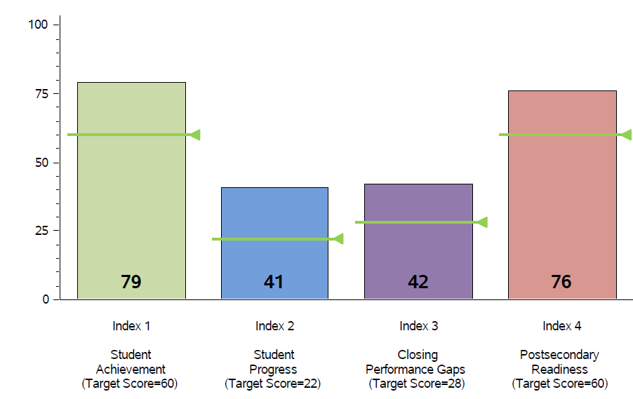
Accountability Summary
Performance Index Report
2017
2016
Source: Accountability Tables 2016-2017
Notes:
The next slides provide Academic Performance data. The data is based on the STAAR and EOC results. Those results are compiled into an extremely complicated accountability summary shown on this slide which lists the 4 indices.
Index 1 measures student achievement and the target for 16-17 was a 60. As you can see in green, NEISD scored a 79.
Index 2 measures student progress as compared to the previous year and the target was 22. NEISD received a score of a 42.
Index 3 measures closing the achievement gaps with a target of 28 and the district score of 43.
The last index measures postsecondary readiness. The target was 60. NEISD received a score of 79.

Slide 39

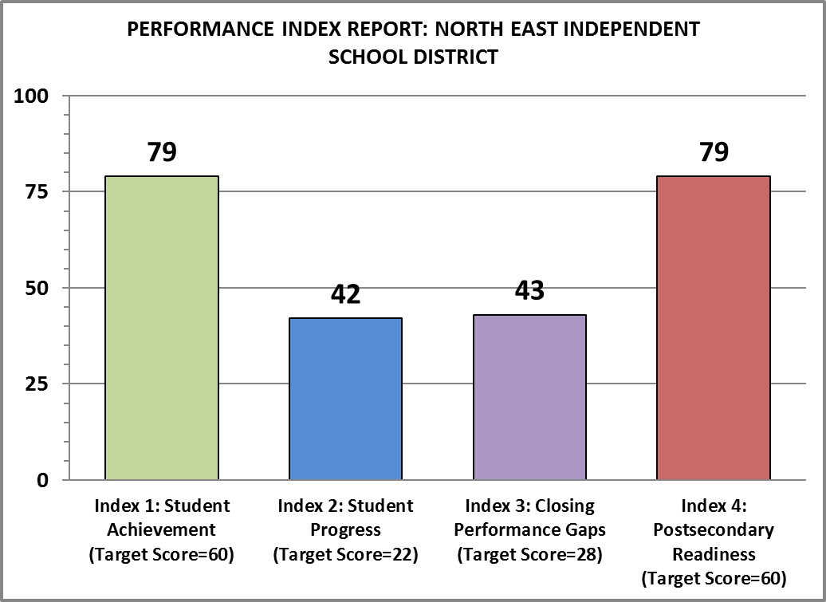
State Accountability 2017 Rating North East Independent School District
2017 District Accountability
Accountability 2016 Comparison
+1
+1
+3
Source: TEA Preliminary Accountability Tables (Aug 7, 2017)

Slide 40
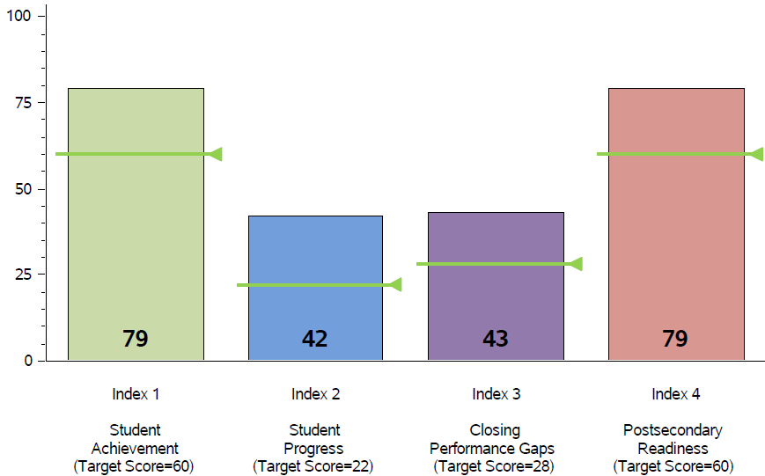



Accountability Summary
Performance Index Report
2017
79
79
75
76
Target 60
43
Target 60
42
41
40
Target 22
Target 22
Accountability 2016 Comparison
+1
+1
+3
Source: Accountability Tables 2016-2017
Notes:
The next slides provide Academic Performance data. The data is based on the STAAR and EOC results. Those results are compiled into an extremely complicated accountability summary shown on this slide which lists the 4 indices.
Index 1 measures student achievement and the target for 16-17 was a 60. As you can see in green, NEISD scored a 79.
Index 2 measures student progress as compared to the previous year and the target was 22. NEISD received a score of a 42.
Index 3 measures closing the achievement gaps with a target of 28 and the district score of 43.
The last index measures postsecondary readiness. The target was 60. NEISD received a score of 79.

Slide 41
Student Achievement Domain Component | Option A | Option B | Option C | ATAC/ APAC Option
STAAR | 30% | 40% | 45% | 33%
CCMR | 50% | 40% | 45% | 33%
Graduation Rate | 20% | 20% | 10% | 33%

Slide 42
Domain I: Student Achievement - Calculating Score
Texas Higher Education Coordinating Board
By 2030, at least 60 percent of Texans ages 25–34 will have a certificate or degree.
Student Achievement
Score
A
All Students
Total Tests
3,212
# Approaches Grade Level or Above
2,977
Average of 3
# Meets Grade Level or Above
1,945
92.7 + 60.6 + 27.3 / 3 = 60.2
# Masters Grade Level
878
% Approaches Grade Level or Above
92.7%
% Meets Grade Level or Above
60.6%
% Masters Grade Level
27.3%

Slide 43
Domain II: School Progress – Student Growth

Slide 44
State Accountability 2018 and Beyond
Domain II: School Progress – Student Growth
STAAR Progress Measure – comparison of student’s gain score with a progress target.
Gain score – the difference between student’s current years score and previous year score.
Expected progress target – distance between prior year Meets standard and current year Meets standard.
Accelerated progress target – distance between prior year Meets standard and current year Masters standard.
Classifications | Student gain score is:
Limited Growth | Less than the expected progress target.
Expected Growth | Greater than the expected progress target.
Accelerated Growth | Significantly greater than the accelerated progress target.

