Slide 1

NEISD
DEIC House Bill 3: Early Literacy, Math, and CCMR

Slide 2
INTRODUCTION
Background Information
Early Literacy and Mathematics
College, Career, and Military Readiness
Have you ever tried to move a piece of string by pushing from one end? It’s a difficult thing to do. The end can be elusive and difficult to control. Even if you succeed in moving it, you tend to wind up with a scrunched string cluster – and very little, if any, movement at the other end of the string. It’s time for us to pull the string instead of push it! - John Fesseden, Lead4Ward

Slide 3
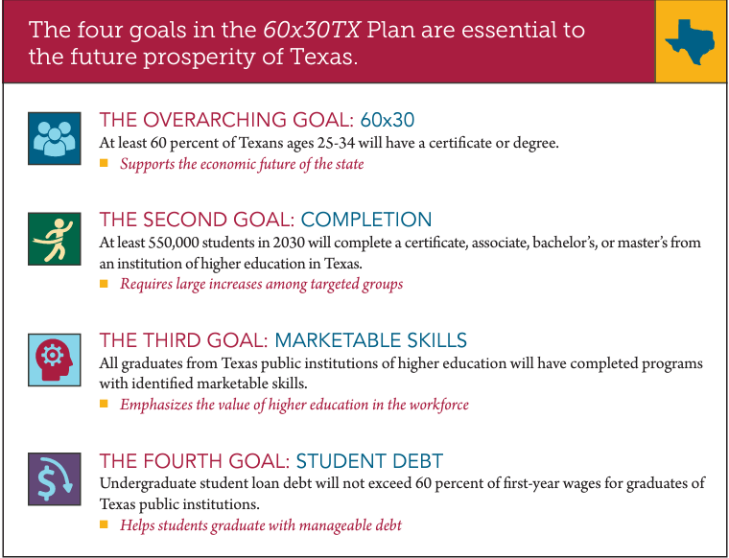
Texas Higher Education Strategic Plan: 2015 - 2030
Main Objectives
Goal 1: Designed to increase the percentage of 25 - 34-year-olds in Texas who hold a certificate or degree
Goal 2: Supplying graduates of all ages from two- and four-year institutions and educating a skilled workforce in Texas
Goal 3: Charges two- and four-year public institutions with documenting, updating, and communicating skills
Goal 4: By 2030, undergraduate student loan debt will not exceed 60 percent of first-year wages for graduates of Texas public institutions.
https://reportcenter.highered.texas.gov/agency-publication/miscellaneous/thecb-60x30-strategic-plan/

Slide 4

Early Literacy and
Early Math

Slide 5
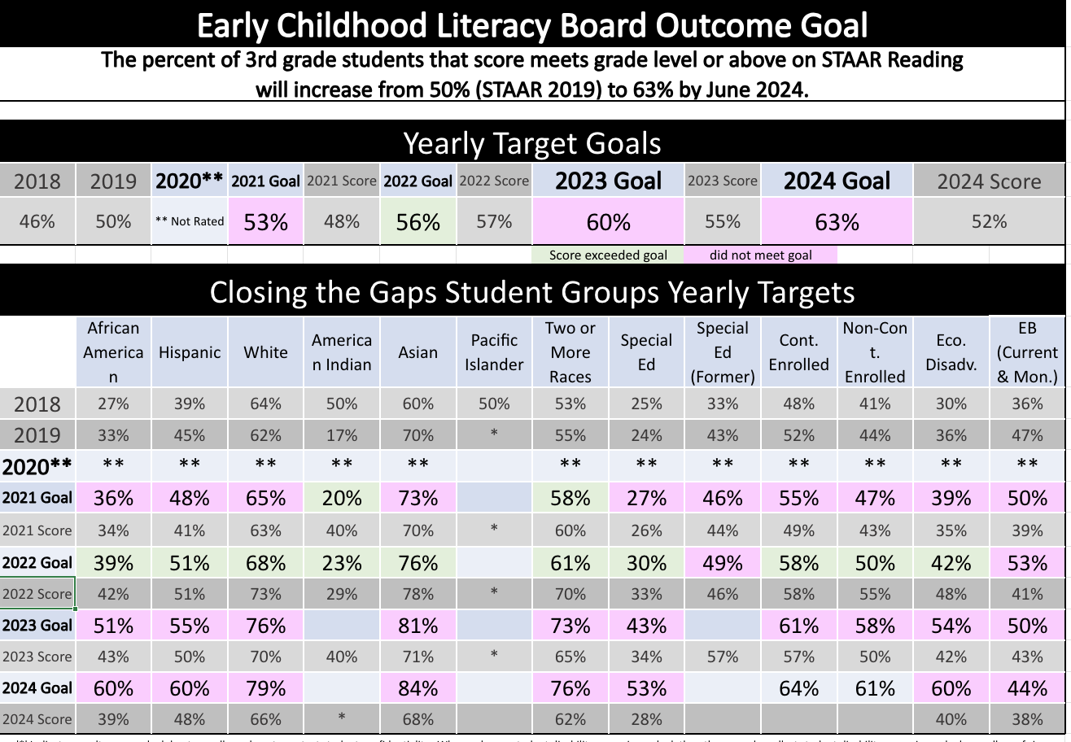
Early Literacy Board Outcome Goal

Slide 6
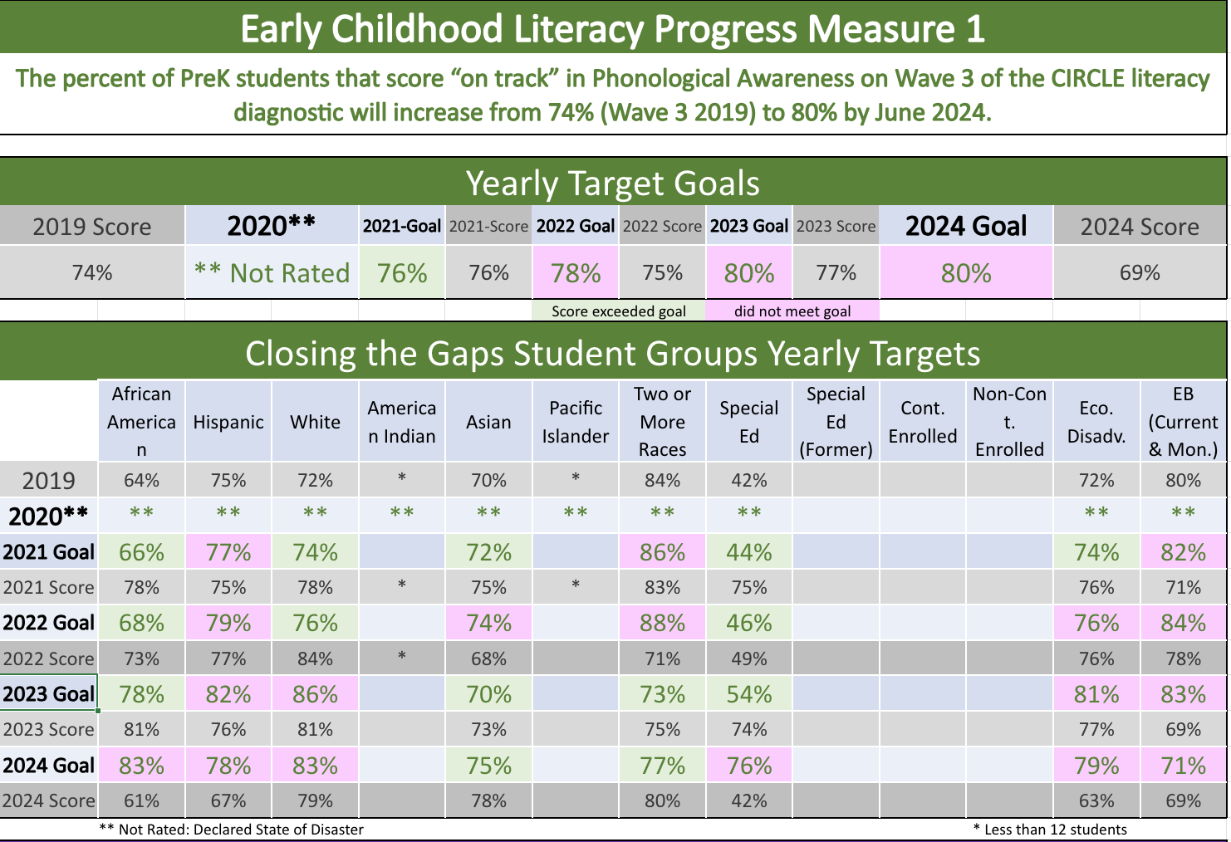
Early Literacy Board Progress Measure 1

Slide 7
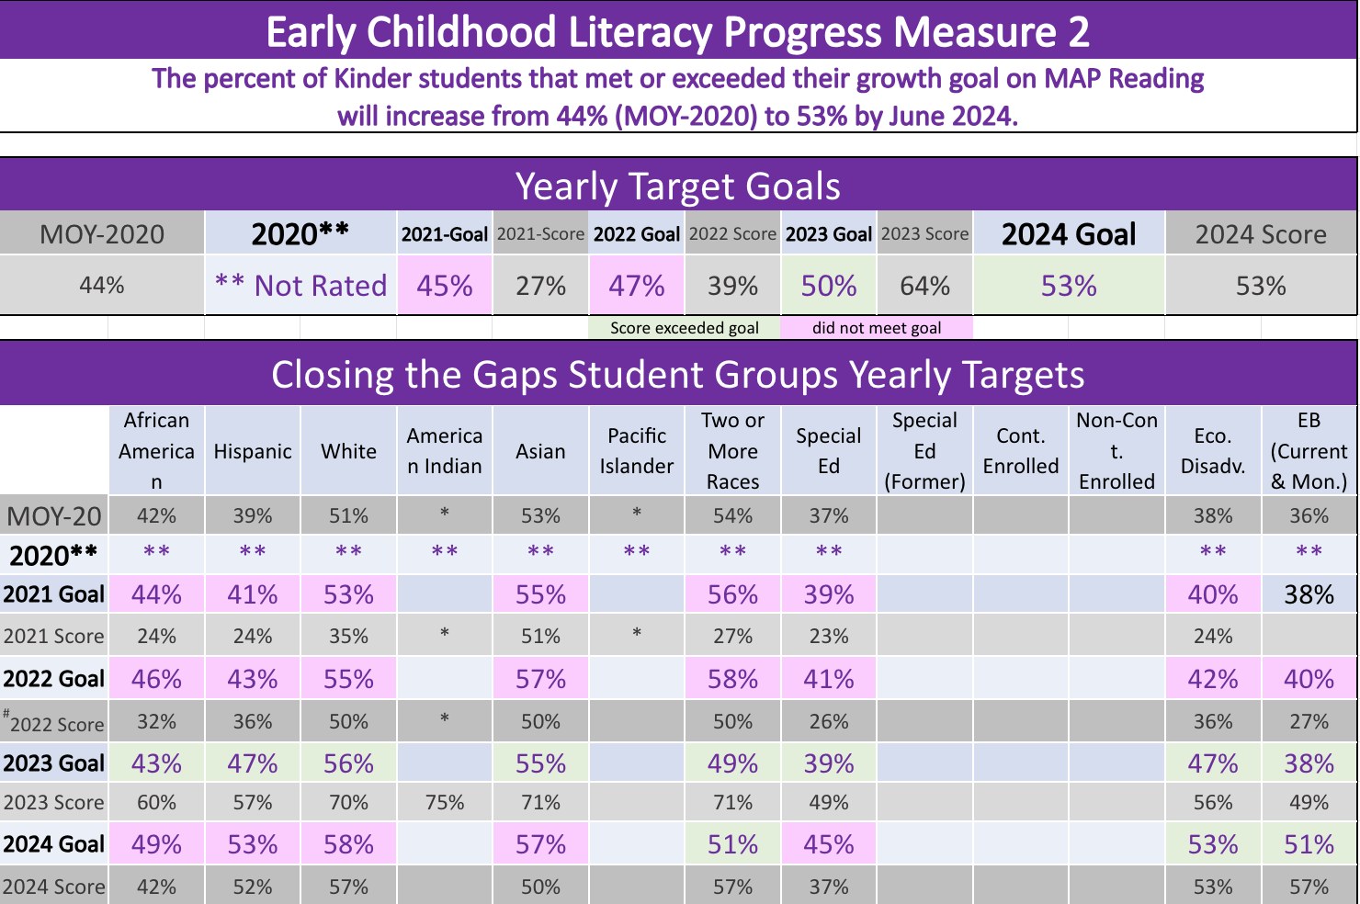
Early Literacy Board Progress Measure 2

Slide 8
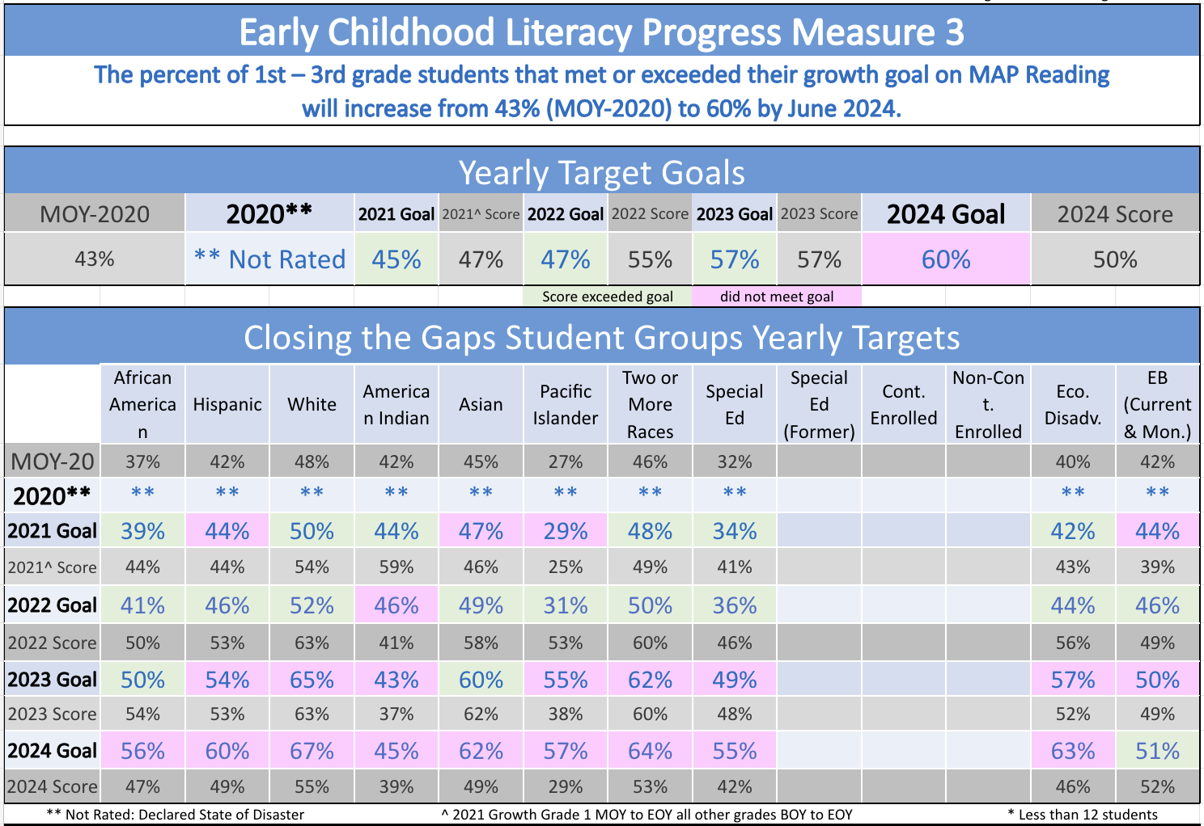
Early Literacy Board Progress Measure 3

Slide 9
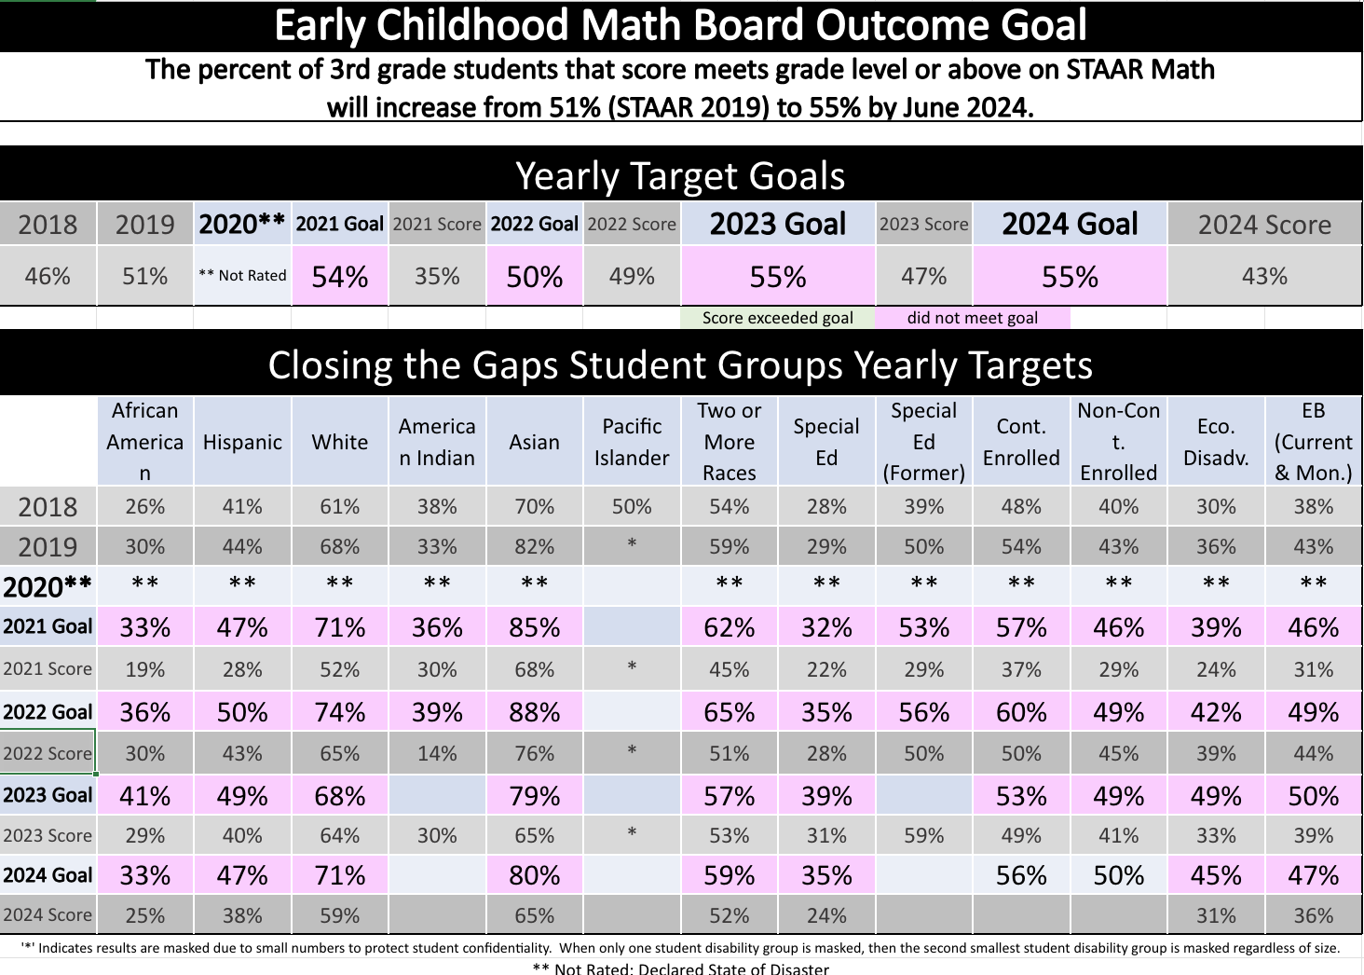
Early Math Board Outcome Goal

Slide 10
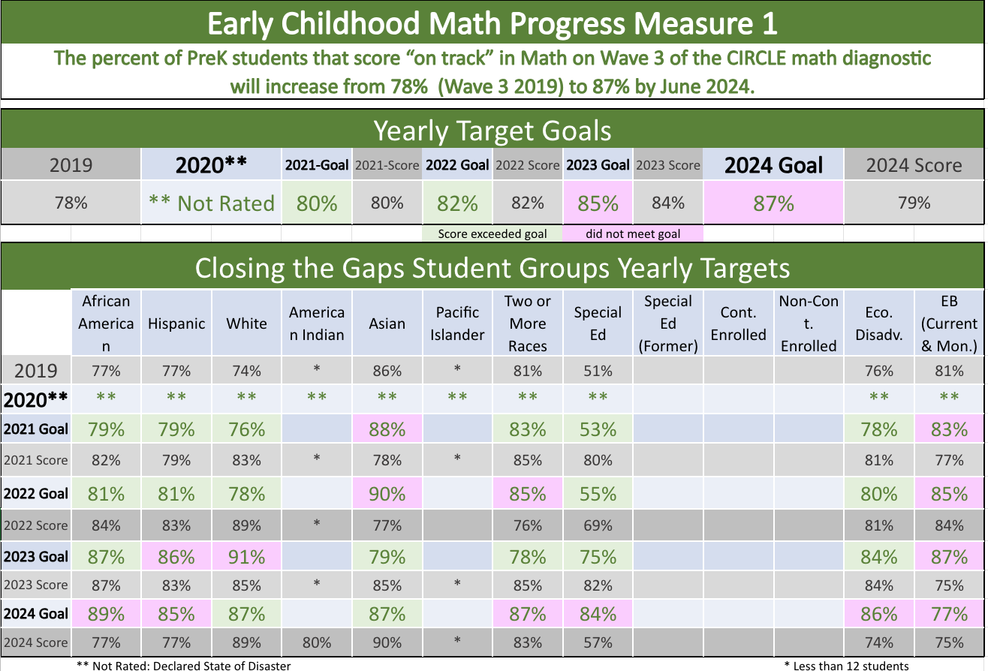
Early Math Board Progress Measure 1

Slide 11
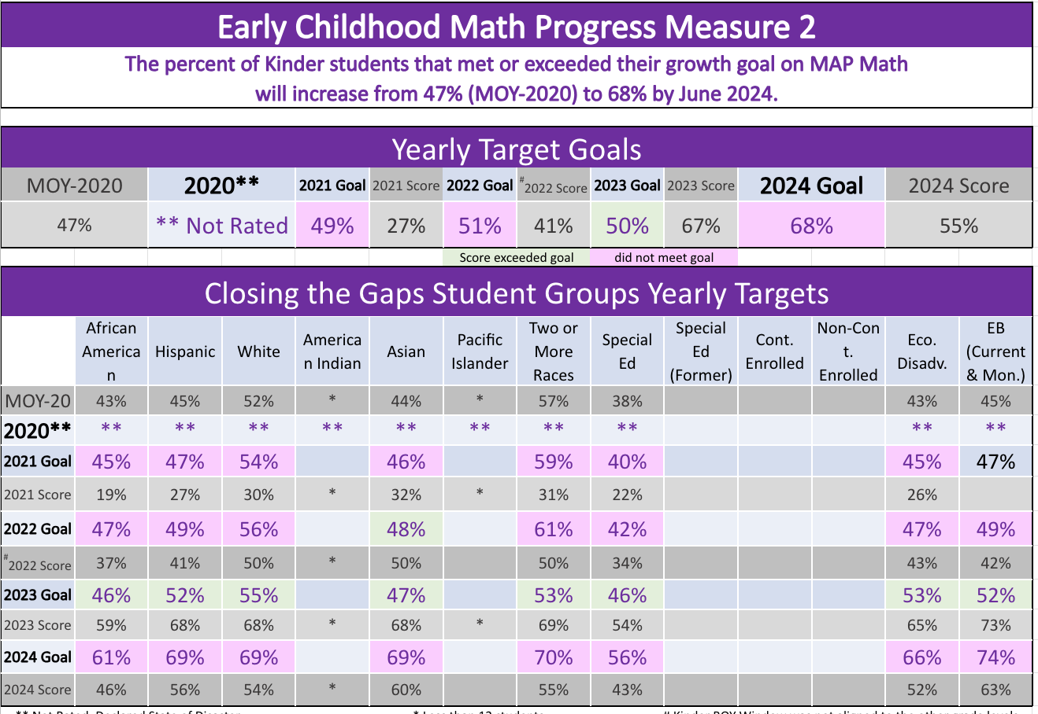
Early Math Board Progress Measure 2

Slide 12
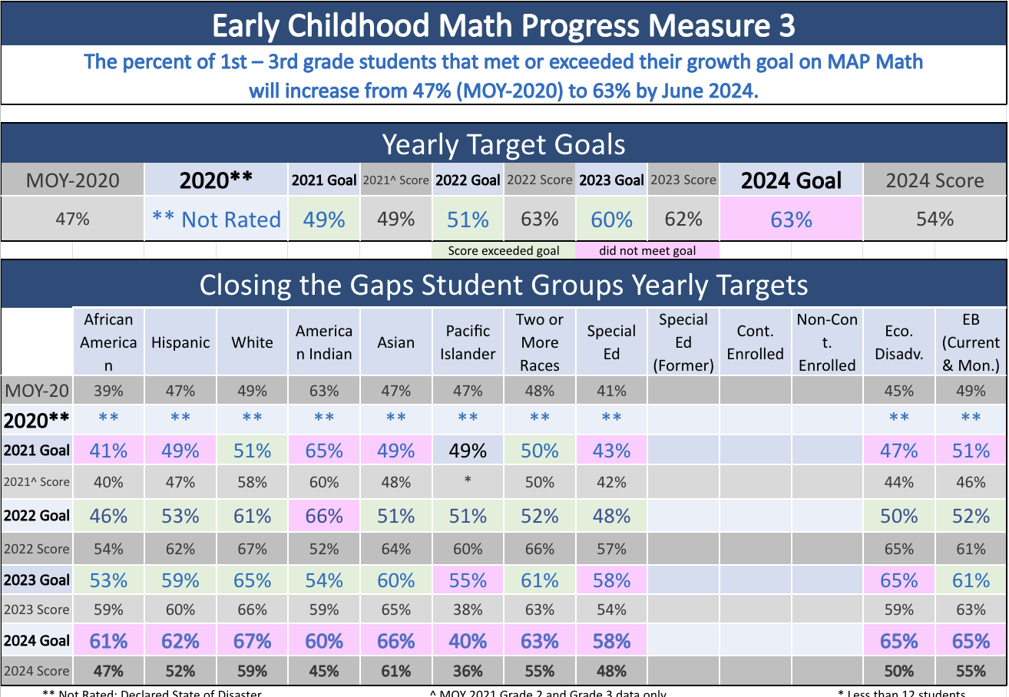
Early Math Board Progress Measure 3

Slide 13
College, Career, and Military Readiness

Slide 14
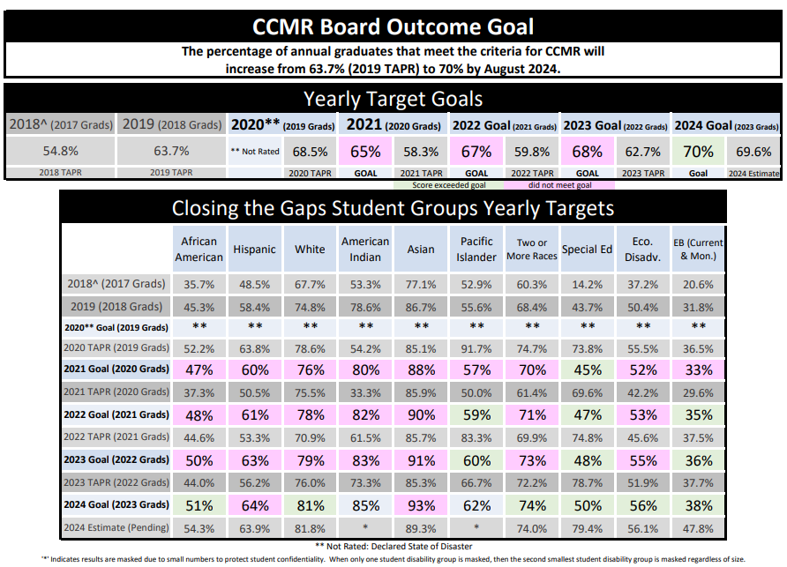
CCMR Board Outcome Goal

Slide 15
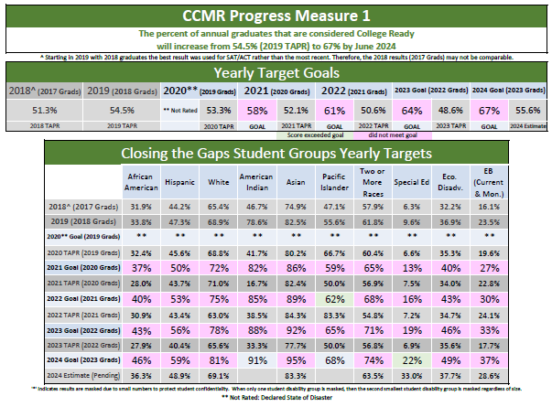
CCMR Progress Measure 1

Slide 16
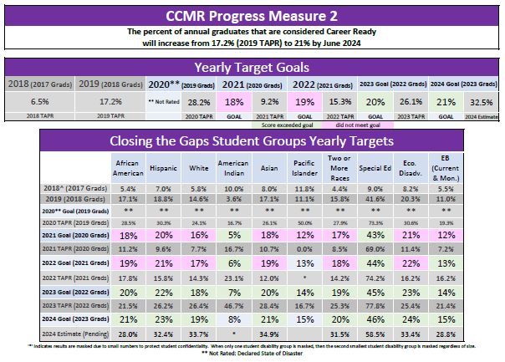
CCMR Progress Measure 2

Slide 17
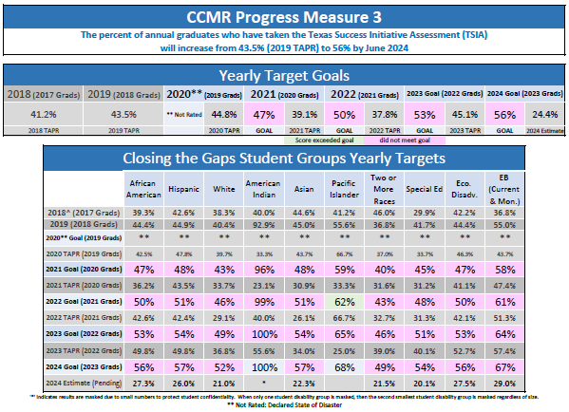
CCMR Progress Measure 3

Slide 18
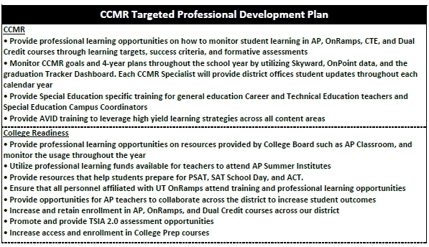
CCMR Professional Development Plan

Slide 19
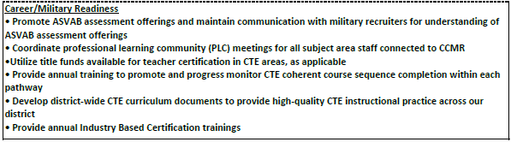
CCMR Professional Development Plan

Slide 20
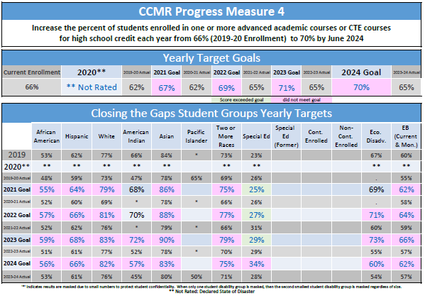
CCMR Progress Measure 4

Slide 21
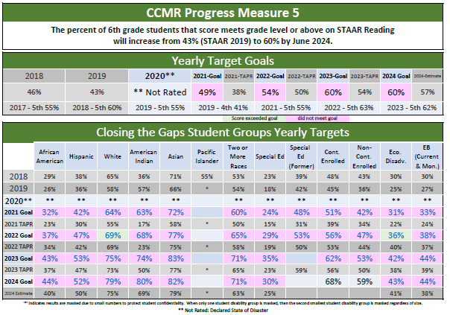
CCMR Progress Measure 5

Slide 22
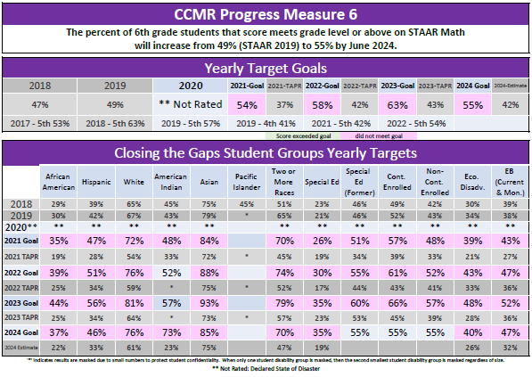
CCMR Progress Measure 6

Slide 23
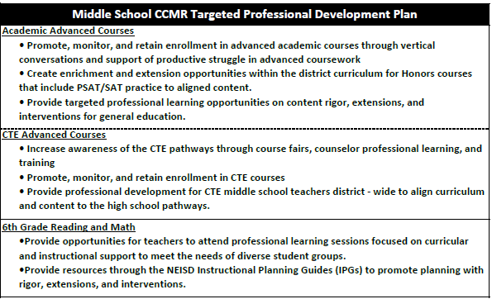
Middle School Professional Development

Slide 24
NEISD Curriculum & Instruction
Purposeful Planning and Decision Making

Slide 25
Establishing a District & Campus
Comprehensive Needs Assessment
Problem Statements &
Root Causes
District and Campus groups underwent a strategic development plan
Ongoing data review from multiple sources: State/local assessments; HB 3
Goal and Strategy Development
Goals must be developed to address/solve a problem
Addressing 1 need at a time
Purposeful collaboration amongst numerous departments

Slide 26
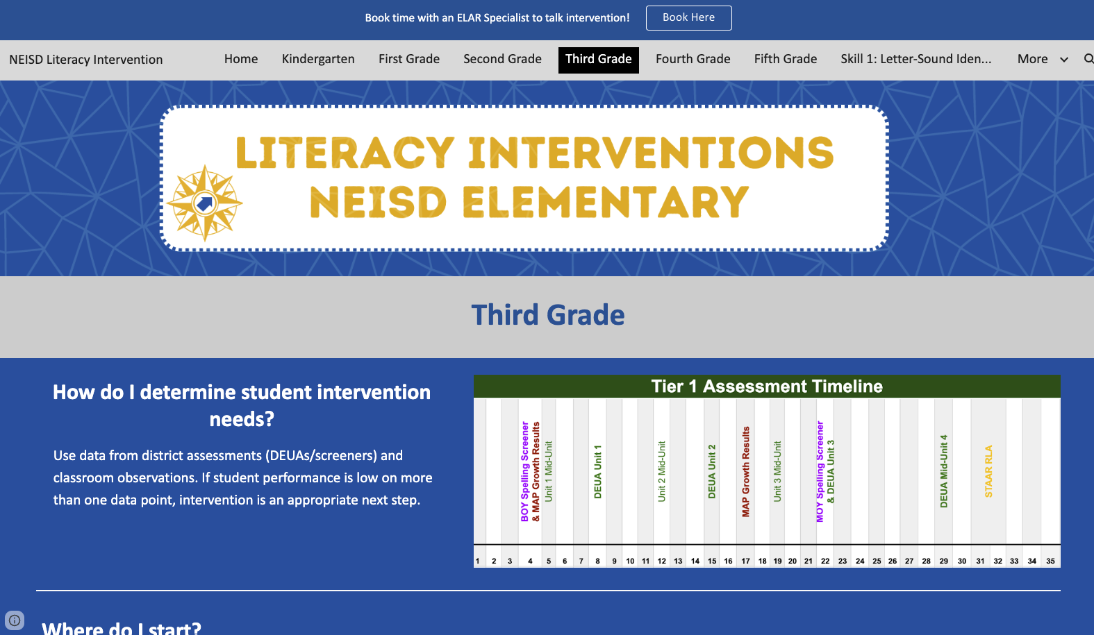
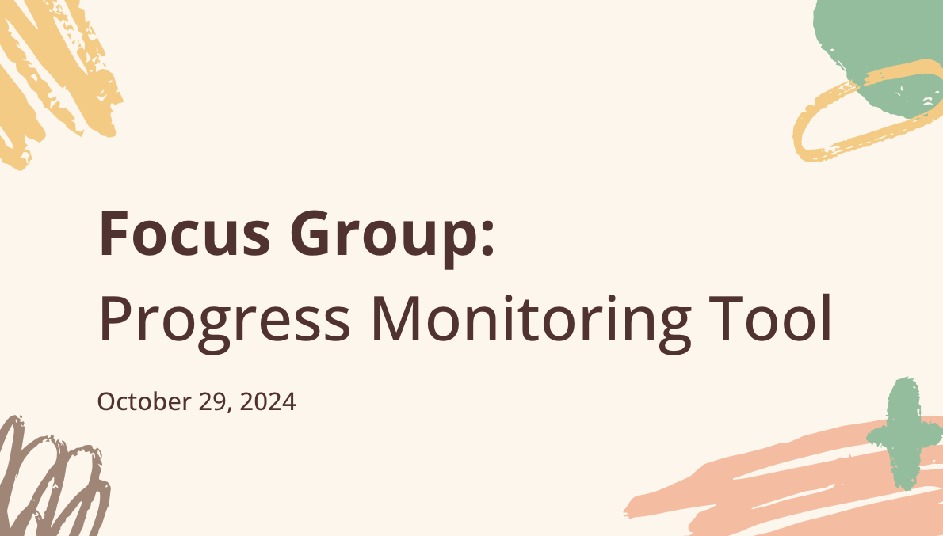


Elementary Mathematics

Slide 27
CCMR Achievement Across NEISD
SAT School Day: 4,022 students tested
ACT School Day: 1,109 students tested (highest #)
AP Qualifying Scores: Increase from 59% (10,844 tests) in 2022 to 66% (11,101 tests) in 2024
CTE IBCs: 1,572 (2022); 1,993 (2023); 2,152 (2024)
Notes:
Plan4Learning/Problem Statements & Root Causes/Principals Access to HB 3 Goals

Slide 28
Thank You
Questions?

