Slide 1


John Malcom Elementary School
TK & Kindergarten Roundup

Slide 2

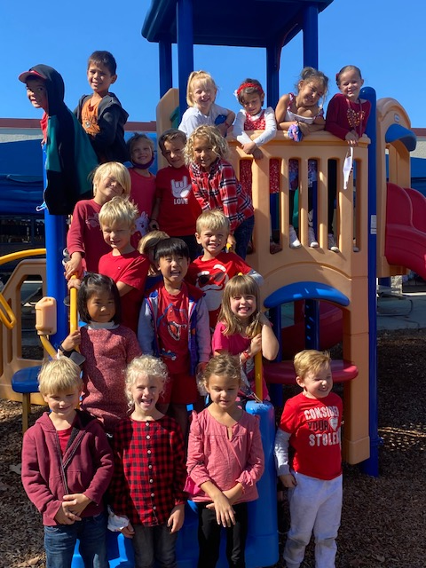
Today’s Agenda
Welcome to John Malcom Elementary – Principal, Laurie Lowy
Food and Nutrition Services
PTA
Friends of Malcom Foundation
Before and After School Care - YMCA
School and Your Child’s Health – District Nurse
Transitional Kindergarten (TK)
Kindergarten Readiness and Sample Schedule
Registration and Attendance

Slide 3
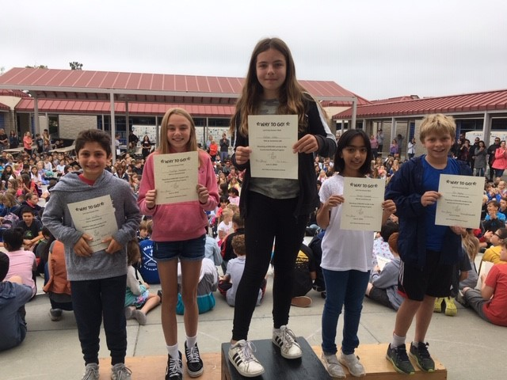
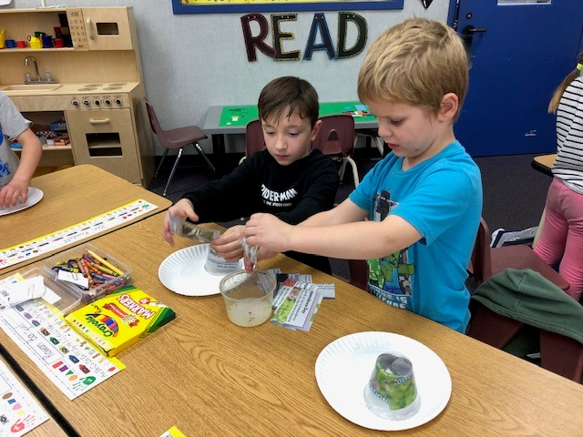
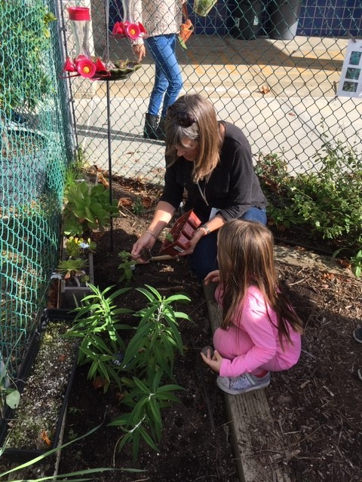
Joining our Mariner Crew
TK/Kindergarten to fifth grade journey
Partnerships with families
Volunteer Opportunities (PTA, Friends of Malcom Foundation, Art, Garden, Watch D.O.G.S., Innovation Lab, library & classroom volunteers, etc.)
Programs – music, art, WIN intervention/extension
First Day of school is TUESDAY,
August 18, 2026!

Slide 4
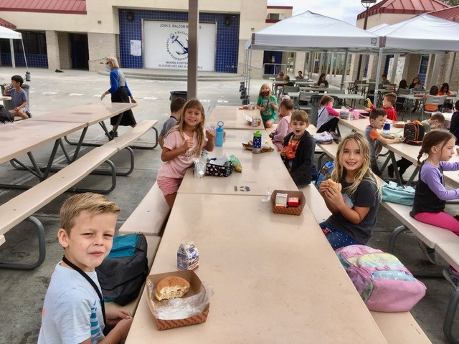
CUSD Food & Nutrition Services
Breakfast and lunch are available to ALL students at CUSD for FREE.
El desayuno y el almuerzo están disponibles GRATIS para TODOS los estudiantes de CUSD.
CUSD Food & Nutrition is
certified with Eat Real.
CUSD es el primer distrito del sur de California
en recibir una certificación Eat Real.

Slide 5
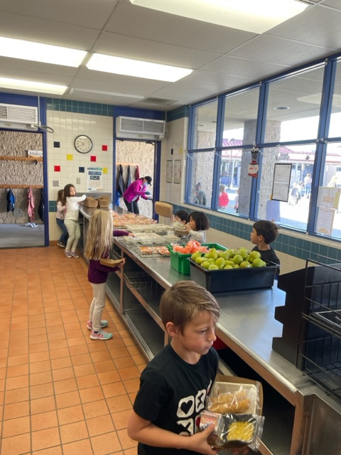
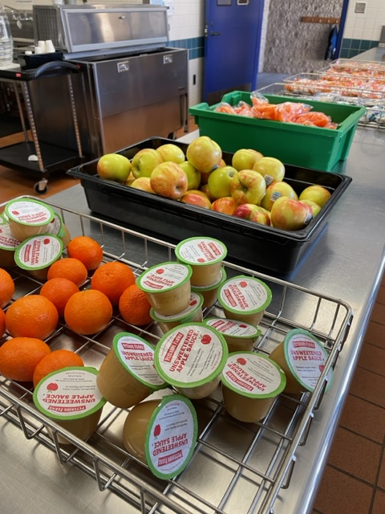
CUSD Food and Nutrition
Meals follow regulations from the Healthy Hunger Free Kids Act and include whole grains, protein, fruits, veggies, and milk.
Las comidas siguen las regulaciones de la Ley de Niños Saludables y Sin Hambre e incluyen cereales integrales, proteínas, frutas, verduras y leche.
Students can bring food from home if they prefer!

Slide 6

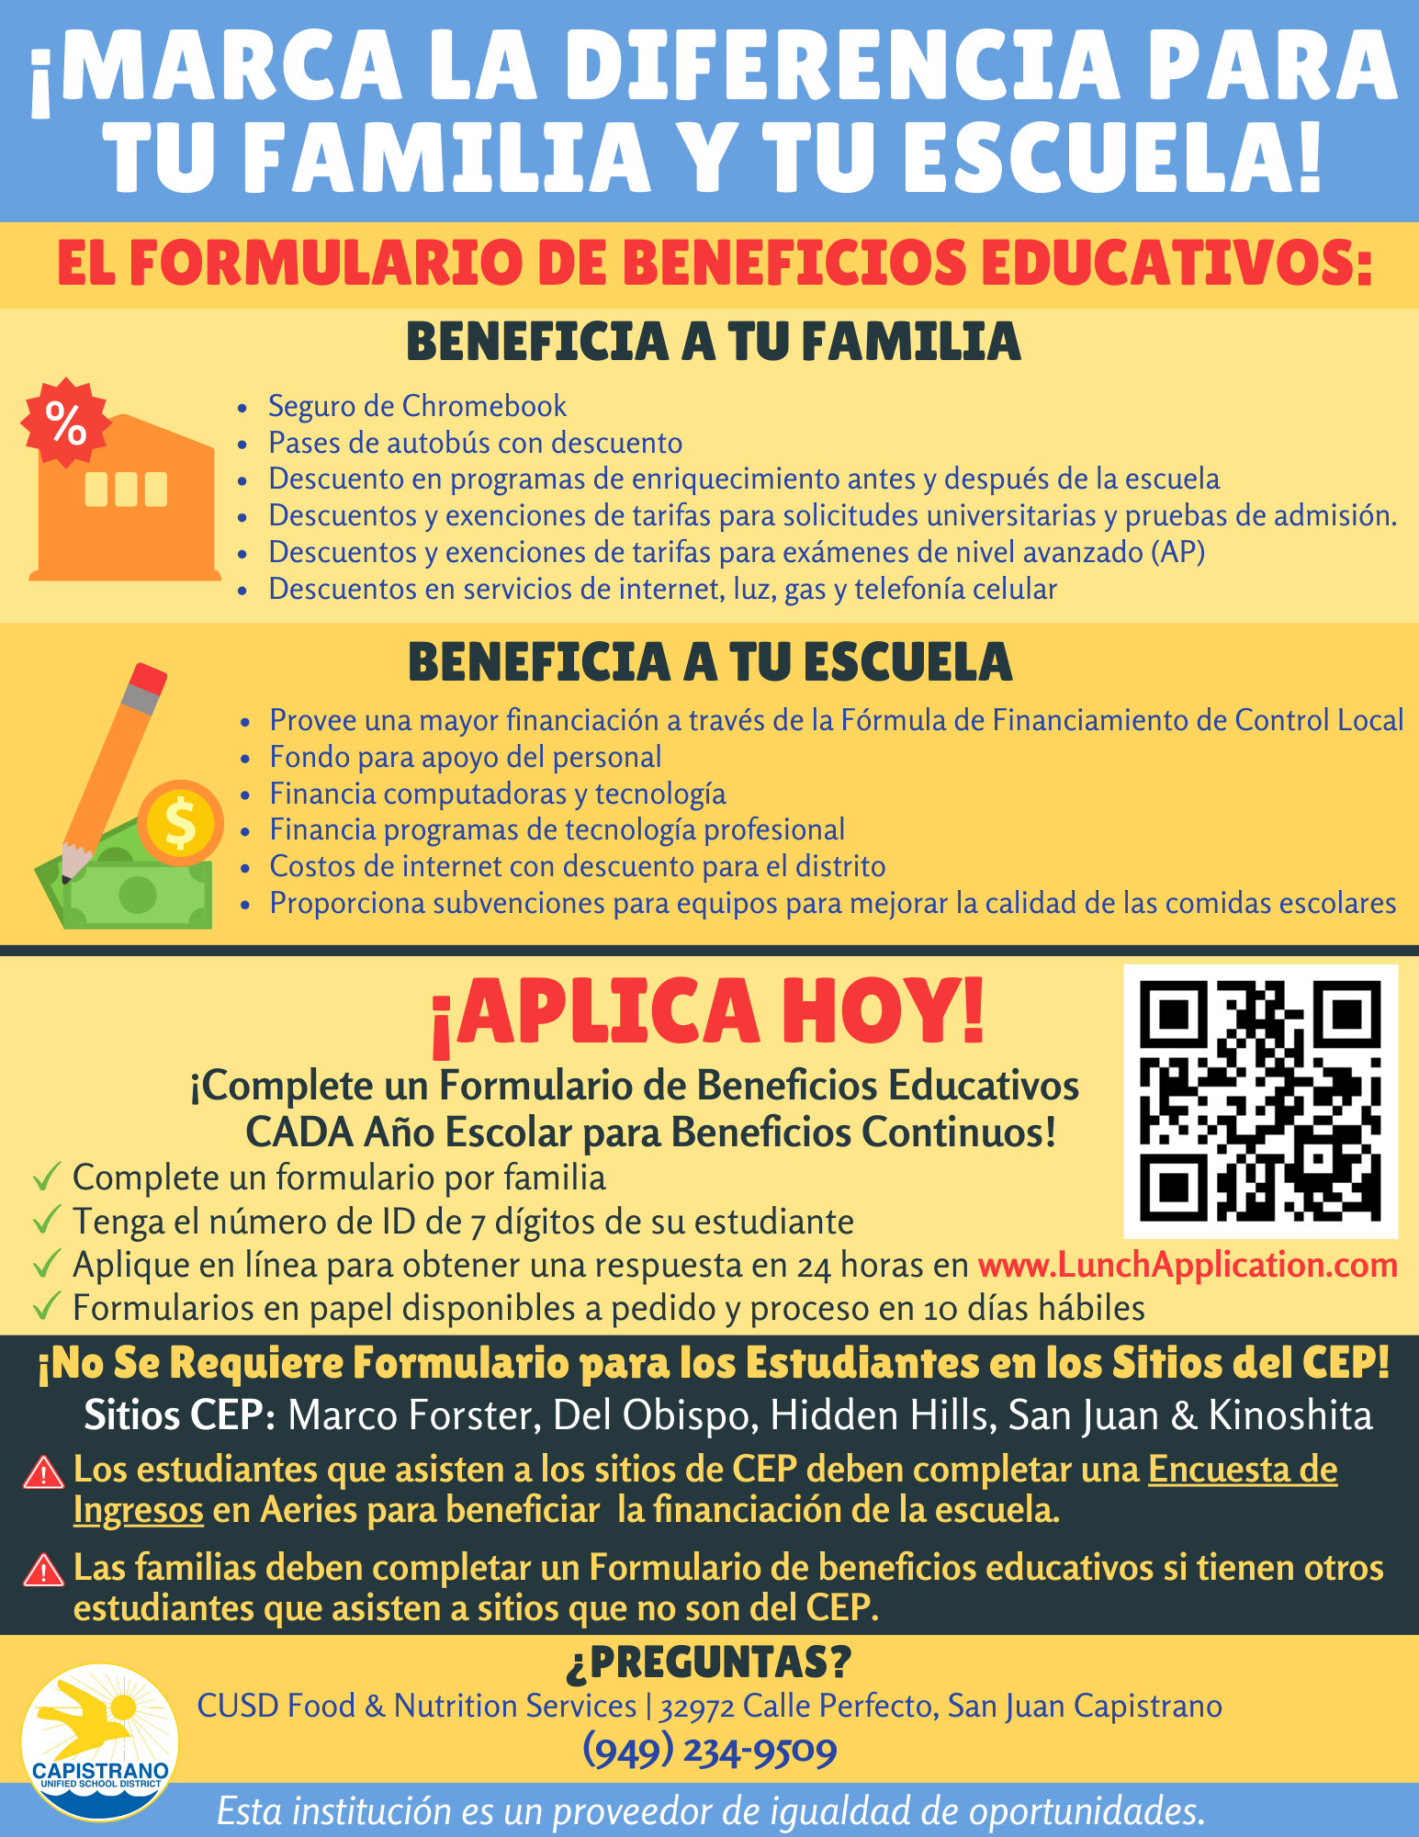
Education Benefit Form
Formulario de Beneficios Educativos
Submit an Education Benefit Form to see if your family qualifies for benefits.
Envíe un formulario de beneficios educativos para ver si su familia califica para recibir beneficios.
Submit yearly starting in August.
Enviar anualmente a partir de agosto.
Questions? ¿Preguntas? 949-234-9509.

Slide 7
FAQ / Preguntas Frecuentes
My student has a food allergy - what do I do? Mi estudiante tiene alergia alimentaria: ¿qué hago?
  Submit a Medical Statement to Request Special Meals. Must be signed by physician, physician assistant or nurse practitioner. Available at capistrano.healtheliving.net
  Presentar una Declaración Médica para Solicitar Comidas Especiales. Debe estar firmado por un médico, asistente médico o enfermera especializada. Disponible en capistrano.healtheliving.net
We are a vegetarian family - what do I do? Somos una familia vegetariana, ¿qué hago?
  Vegetarian options are available daily and are indicated on the menu.
  Las opciones vegetarianas están disponibles todos los días y están indicadas en el menú.
Our family does not eat pork - what do I do? Nuestra familia no come cerdo, ¿qué hago?
  Few items contain pork and are indicated on the menu.
  Pocos artículos contienen carne de cerdo y están indicados en el menú.

Slide 8
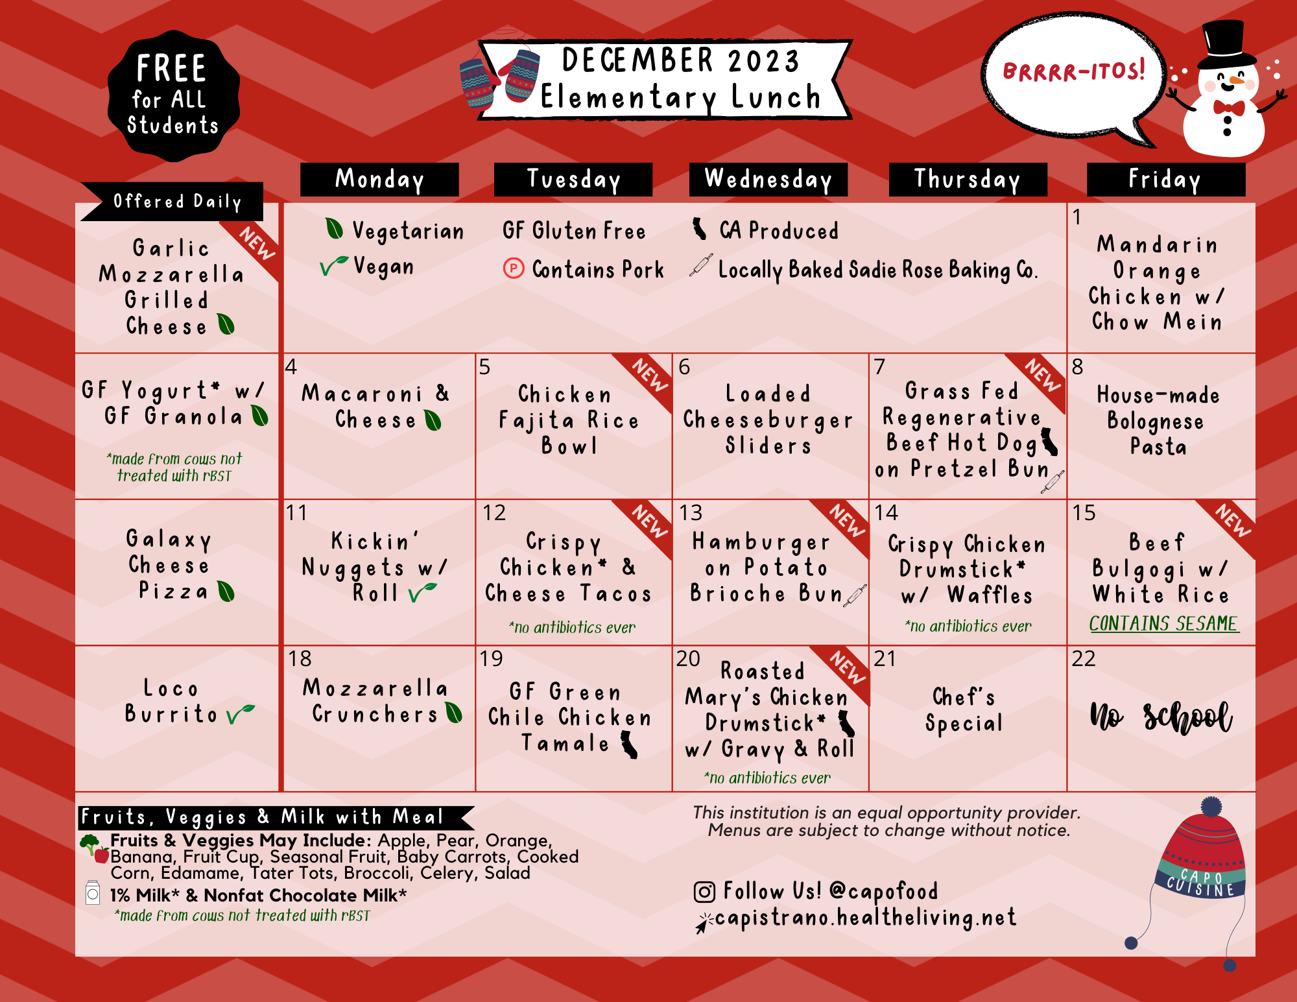
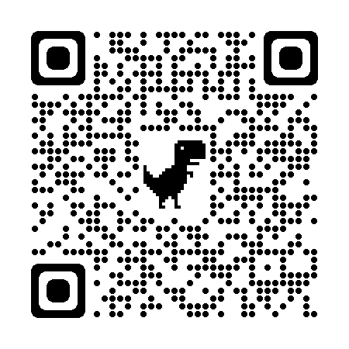
CUSD Food and Nutrition
Food & Nutrition Services Contact Information:
949-234-9509
Capistrano.healtheliving.net
sample menu

Slide 9

PTA – Parent – Teacher Association
President, Lauren Crowley
Programs (Reflections, Classroom Support, Field Trips, Assemblies)
Events (Welcome event, Trunk-o-Treat, Holiday Movie Night, Jog-a-thon, Carnival)
Volunteer Opportunities (PTA, Garden, Classroom, Library, Watch DOGS, Yearbook, Spiritwear)
Visit the John Malcom PTA website
https://www.malcompta.org/

Slide 10

Friends of Malcom Foundation
President – Gina Bowman
Friends of Malcom Foundation is an additional way to be involved at Malcom and meet new families (Valentines Dance, Pickleball Tournament, Gala)
Foundation provides specialized funding to support our school:
  Additional paraeducators on campus to reduce adult to student ratio
  STEAM Innovation Lab support
  Safety needs (fencing, walkie-talkie radios, etc.)
  Supplemental Programs (PE support)
For more information visit our website:​
www.friendsofmalcom.org/

Slide 11
Before and After School Care (6:45am-6pm)
•2, 3, or 5 Day Monthly Schedules
•Open During Holidays and Breaks
•Y Clubs: Science, Art, Drama, Cooking, Photography, Engineering, Fitness
•Service Learning Projects: Stockings for Troops and Adopt-a-Family
•Homework Help, Group Games, and Positive Social Interactions
•Licensed Childcare Facility with a 1:14 Ratio
Before and After School Care (6:45am-6pm)
•2, 3, or 5 Day Monthly Schedules
•Open During Holidays and Breaks
•Y Clubs: Science, Art, Drama, Cooking, Photography, Engineering, Fitness
•Service Learning Projects: Stockings for Troops and Adopt-a-Family
•Homework Help, Group Games, and Positive Social Interactions
•Licensed Childcare Facility with a 1:14 Ratio
Before and After School Care - YMCA
(6:45am-6:00pm)
•2, 3, or 5 Day, Monthly Schedules
•Open During Holidays and Breaks
•Y Clubs: Science, Art, Drama, Cooking, Photography, Engineering, Fitness
•Service Learning Projects: Stockings for Troops and Adopt-a-Family
•Homework Help, Group Games, and Positive Social Interactions
•Licensed Childcare Facility with a 1:14 Ratio

Slide 12
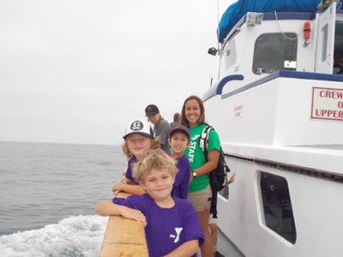
YMCA Summer Program (6:45am-6:00pm)
3 or 5 day Monthly or Weekly Options
Weekly Bus Field Trips
On Site Vendors
Daily Activities
Great Transition into the School and Making Friends

Slide 13
Before and After School Care - YMCA
YMCA OF ORANGE COUNTY
LAGUNA NIGUEL FAMILY YMCA
30011 Ivy Glenn Drive, Suite 109
Laguna Niguel, CA 92677
(949) 363-7085
Director: Janet Pena Ortiz
Jpenaortiz@ymcaoc.org

Slide 14

School and Your Child’s Health
La escuela y la salud de su hijo
Kindergarten Orientation
Orientación de Kindergarten

Slide 15
Health at School
La salud en la escuela
When to keep your child home
Cuándo debe quedarse su hijo en casa
Temperature of 100.4
Temperatura de 100.4
Vomiting and/or diarrhea
Vómitos y/o diarrea
Undiagnosed rash
Sarpullido no diagnosticado
Unusually red eyes with drainage (not allergy related)
Ojos anormalmente enrojecidos con secreción (no relacionados con la alergia)
Other symptoms of illness/ cold symptoms (cough, sore throat, congestion, etc.)
Otros síntomas de enfermedad o de resfriado (tos, dolor de garganta, congestión, etc.)
Notes:
Must be fever (without fever reducing medicine), vomiting, diarrhea free for 24 hours before returning to school.

Slide 16

Medication at School
Medicamentos en la escuela
Requires doctor’s order/parent consent form
Requiere la orden de un médico o un formulario de consentimiento de los padres
Should be dropped off by parent to front office
Debe ser entregado por los padres a la oficina de la escuela
Must be in original container with pharmacy label
Debe estar en el envase original con la etiqueta de la farmacia
Kept in a locked cabinet in the health office
Guardado en un gabinete cerrado con llave en la enfermería
de la escuela

Slide 17
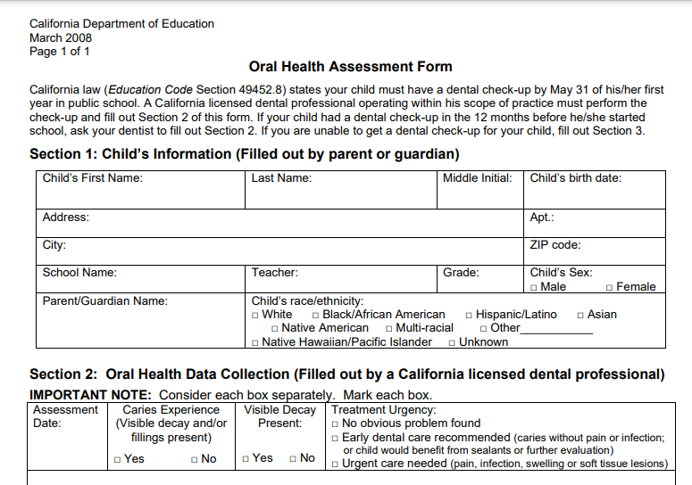
Kindergarten Oral Health Assessment
Evaluación de la salud dental al ingresar a kindergarten
Complete before May 31, 2026
Completar antes del 31 de mayo de 2026
KINDERGARTEN ONLY
California law requires that the oral health assessment be completed by May 31 in either Kindergarten or 1st grade, whichever is your child’s first year in public school (Ed. Code Section 49452.8)
La ley de California exige que la evaluación de la salud dental sea completada antes del 31 de mayo, ya sea en Kindergarten o en primer grado, cualquiera que sea el primer año que su hijo curse en una escuela pública (Código de educación, sección 49452.8)
Assessments that have happened within 12 months before your child enters school also meet this requirement.
Las evaluaciones efectuadas en los 12 meses anteriores al ingreso del niño a la escuela también cumplen este requisito.
Blank form is in kindergarten packet
El formulario en blanco está en el paquete de kindergarten

Slide 18

Immunizations
Vacunas
Students must be fully immunized before entering kindergarten
Los estudiantes deben estar completamente vacunados antes de entrar a kindergarten
You must show proof of immunization when registering your child
Debe presentar la prueba de vacunas cuando inscriba a su hijo
Exceptions include a permanent medical exemption or a temporary medical exemption- Updates to requirements January 1, 2021
Las excepciones incluyen una exención médica permanente o una exención médica temporal- Actualización de los requisitos del 1 de enero de 2021

Slide 19
TK -Kindergarten Immunization Requirements
Requisitos de vacunas para el TK -Kindergarten
Polio
Polio
DTAP
Difteria, tosferina y tétano
MMR
Sarampión, paperas y rubeola
Hep. B
Hepatitis B
Varicella
Varicela
4 Doses/dosis
5 Doses/dosis
2 Doses/dosis
3 Doses/dosis
2 Doses/dosis
3 doses ok if one dose was given on or after fourth birthday
3 dosis, si una se ha administrado durante o después del cuarto cumpleaños
4 doses ok if one dose was given on or after fourth birthday
4 dosis, si una se administró en el cuarto cumpleaños o después
Must be given on or after first birthday
Debe administrarse en o después del primer cumpleaños

Slide 20
Regarding Medical Exemptions for Immunizations
Respecto a las exenciones médicas para las vacunas
The California Immunization Registry Medical Exemption web site is a secure site for physicians to issue and manage standardized medical exemptions for children in school or child care. Parents use the same site to request medical exemptions from vaccination for their children. Schools and child care facilities can monitor and get updates for medical exemptions issued for children in attendance. The school will not be able to print a copy of the actual medical exemption so it still must be printed by the Physician’s office and delivered to the school.
El sitio web del Registro de Vacunas de California para exenciones médicas es un sitio seguro para que los médicos emitan y gestionen exenciones médicas estandarizadas para los niños que asisten a la escuela o a centros de cuidado de niños. Los padres utilizan este mismo sitio para solicitar exenciones médicas de vacunas para sus hijos. Las escuelas y los centros de cuidado de niños pueden controlar y obtener actualizaciones de las exenciones médicas emitidas para los niños que asisten a dichos lugares. La escuela no puede imprimir una copia de la exención médica real, de manera, que deberá ser impresa por el consultorio médico y presentada en la escuela.
Visit/visite https://cair.cdph.ca.gov/exemptions/home for more information/para obtener más infomación

Slide 21

Hearing and Vision
Audición y visión
Students will have their hearing and vision screened in kindergarten
A los estudiantes se les examinará la audición y la visión en el kindergarten.
This is a state mandated requirement
Este es un requisito exigido por el Estado
Subsequent screenings are done in 2nd, 5th and 8th grade
Se realizan exámenes posteriores en 2.º, 5.º y 8.º grado

Slide 22
Specialized Health Needs
Necesidades de Salud Especializadas
Action Plans
Planes de Acción
Food Allergy Action Plan / Plan de acción para las alergias alimenticias
Insect Allergy Action Plan / Plan de acción para las alergias a los insectos
Asthma Action Plan / Plan de acción para el asma
Forms are available from school health office
Los formularios están disponibles en la enfermería de la escuela
Contact district nurse for other medical needs or accomodations
Comuníquese con la enfermera del distrito para otras necesidades médicas o adaptaciones

Slide 23
Who is in the Health Office?
¿Quién está a cargo de la enfermería de la escuela?
Jesus Hernandez, LVN
7:45-2:15 M,T, W F
7:45-1:30 Thurs

Slide 24

We look forward to supporting your child!
¡Nos complace poder ayudar a su hijo
Melissa Goldbeck RN, MSN
megoldbeck@capousd.org

Slide 25
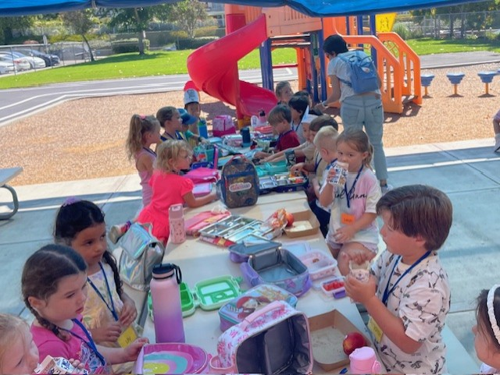
What is Transitional Kindergarten (TK)?
Transitional Kindergarten (TK) was first introduced via The Kindergarten Readiness Act of the 2010 Senate Bill 1381 (originally for students who turned 5 years old on or between September 2 and December 2 (just missing the Kindergarten cutoff)
Is considered the first year of a two-year Kindergarten program

Slide 26
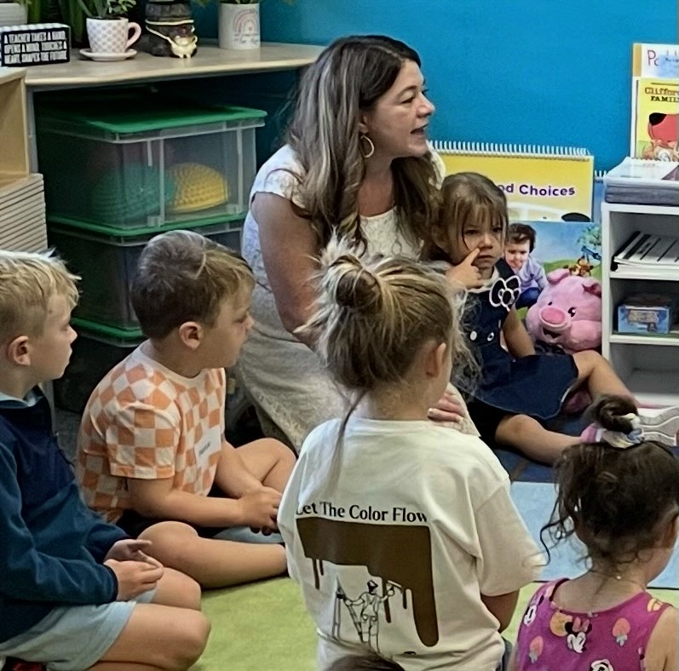
Universal Transitional Kindergarten (UTK)
In July 2021, Governor Newsom signed AB 131, which adopts Universal TK by 2025-26. The purpose of changing TK was to ensure that all 4 year-old children would have a free year of school the year prior to Kindergarten. AB 131 changed the eligibility for TK over a 4-year period:
2022-23: 5th birthday on or between Sept. 2 - February 2
2023-24: 5th birthday on or between Sept. 2 – April 2
2024-25: 5th birthday on or between Sept. 2 – June 2
2025-26: 4th birthday by Sept. 1st
TK is considered to be the
"bridge between preschool and Kindergarten!"

Slide 27
TK or Kindergarten?
For the 2026-27 school year: A child who turns 4 by September 1, 2026 is eligible for TK.
  *The District does not implement early admittance into TK and will not accept any child who is younger than the TK eligibility dates.
  Children who turn 4 on or after September 2, 2026 are eligible for preschool.
Children who turn 5 years old by September 1st are eligible for Kindergarten
  Children who turn 5 years old between June 1 and September 1st can apply for TK instead of Kindergarten, but admittance will be dependent on space in the program
  Obligation is to place all TK-eligible students first; Kinder-eligible students will be placed in late May/early June* (*Timelines subject to change)

Slide 28
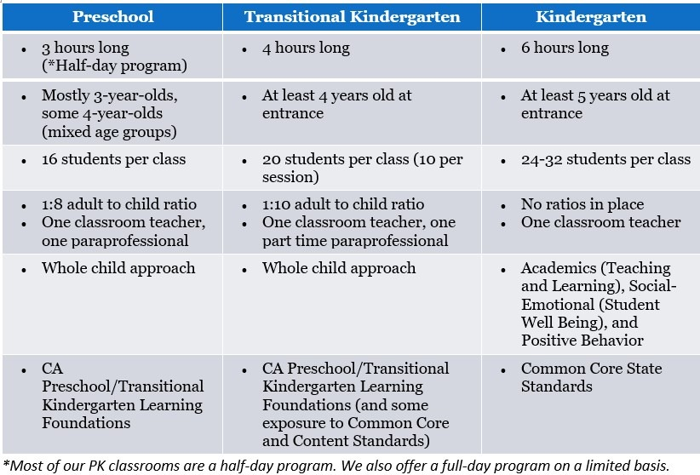
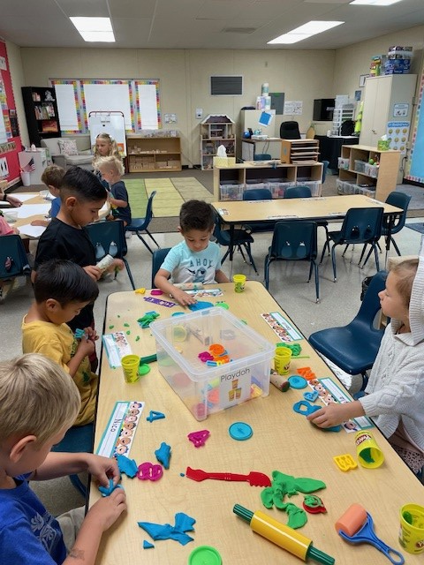
Differences between PK, TK, and K
TK emphasis:
Play based
Focus on readiness skills

Slide 29
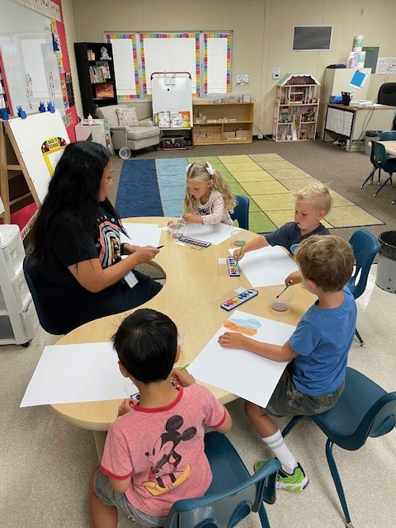
How is TK Structured?
Class is approximately 4 hours per day
Early Bird/Late Owl model (about 2 hours of overlap with whole group M,T,W,F)
  Early Birds 7:45AM-11:38AM
  Late Owls 9:15AM-1:08PM
  Thursdays - all TK students come to school 7:45AM-11:38AM
Taught by a certificated teacher with 24 ECE units
Includes one part-time paraprofessional
Class size: 20 students max. per class. 10 students per session. 1:10 adult to student ratio.

Slide 30
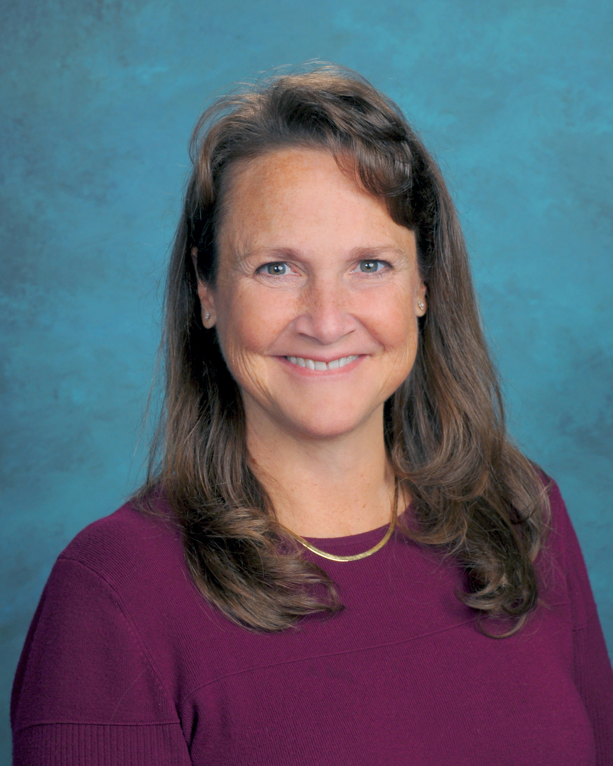
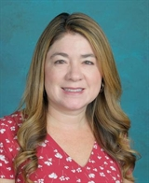
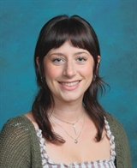
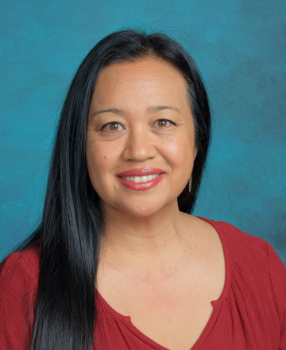
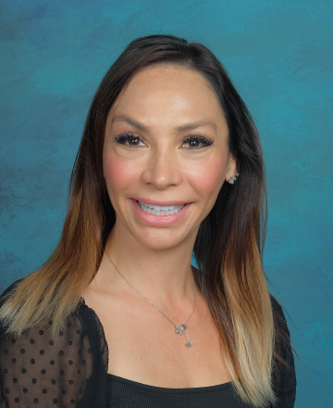
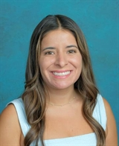
Your TK TEAM
Laurie Lowy​
Principal
Melissa Kruger
Teacher
Dana Phillips
Paraeducator
Christina Hare
Teacher
Norin Frankhouse
Paraeducator
Dezirae Soria
Counselor

Slide 31
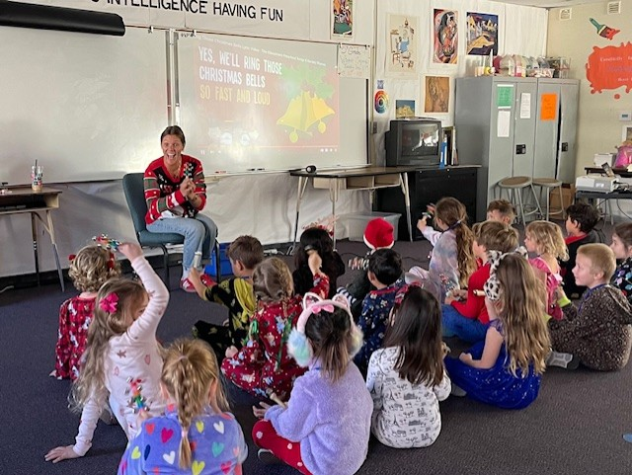
Daily Routines in TK
Routines include:
Circle Time /Calendar
Free Play/Free Choice
Small group instruction (Centers)
Whole group instruction
Phonemic Awareness, Language and Literacy,
Math Instruction, Social-Emotional Development
Music & Movement
Snack/Lunch and Recess/Outdoor Play
Weekly: music time!

Slide 32
BE READY for TK! Have your child practice the following at home:
Personal Hygiene Skills:
Being completely independent in bathroom (i.e. pull down/pull up clothing, wipe independently, etc.)
Practicing good hygiene skills- hand washing, covering mouth/nose, and using a tissue
Motor Skills:
Opening and closing full-sized backpack, lunch box, and reusable water bottle
Carrying own backpack, lunchbox, or any personal belongings
Putting on and taking off their shoes, sweaters, and jackets
Social Skills
Asking for help when it's needed
Listening to stories read by an adult
Separating from adult/saying goodbye

Slide 33
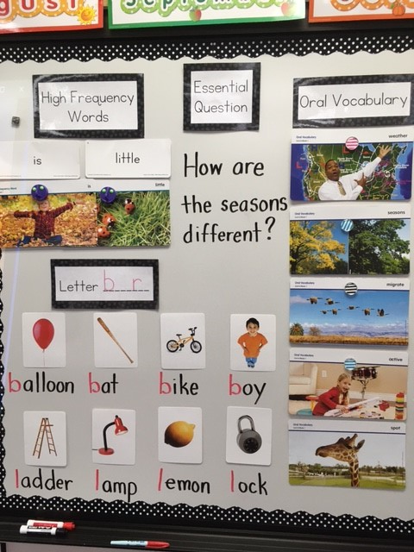
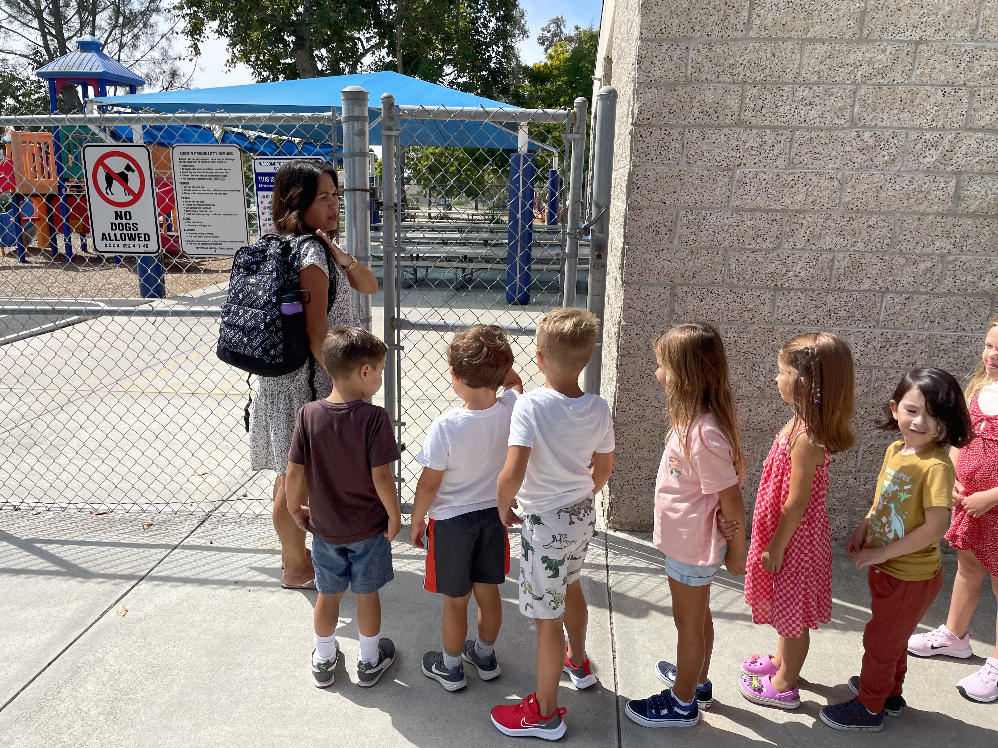
Our Kinder Program

Slide 34
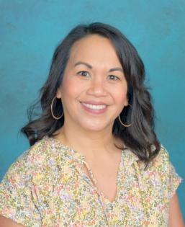
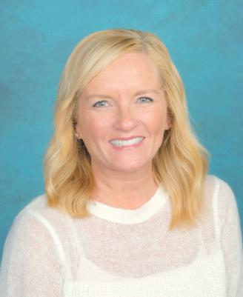
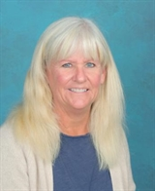
Your Kindergarten TEAM
Laurie Lowy
Principal
Melanie Foote
Teacher
Shelbi Lewis
Teacher
Judy Eckrote Teacher
Dezirae Soria
Counselor

Slide 35
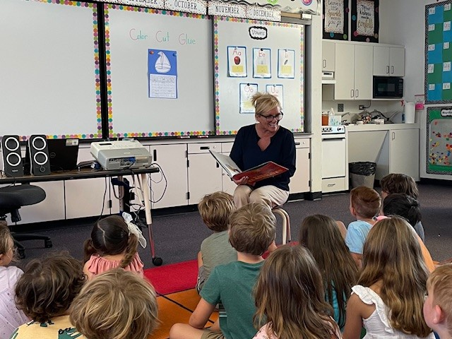
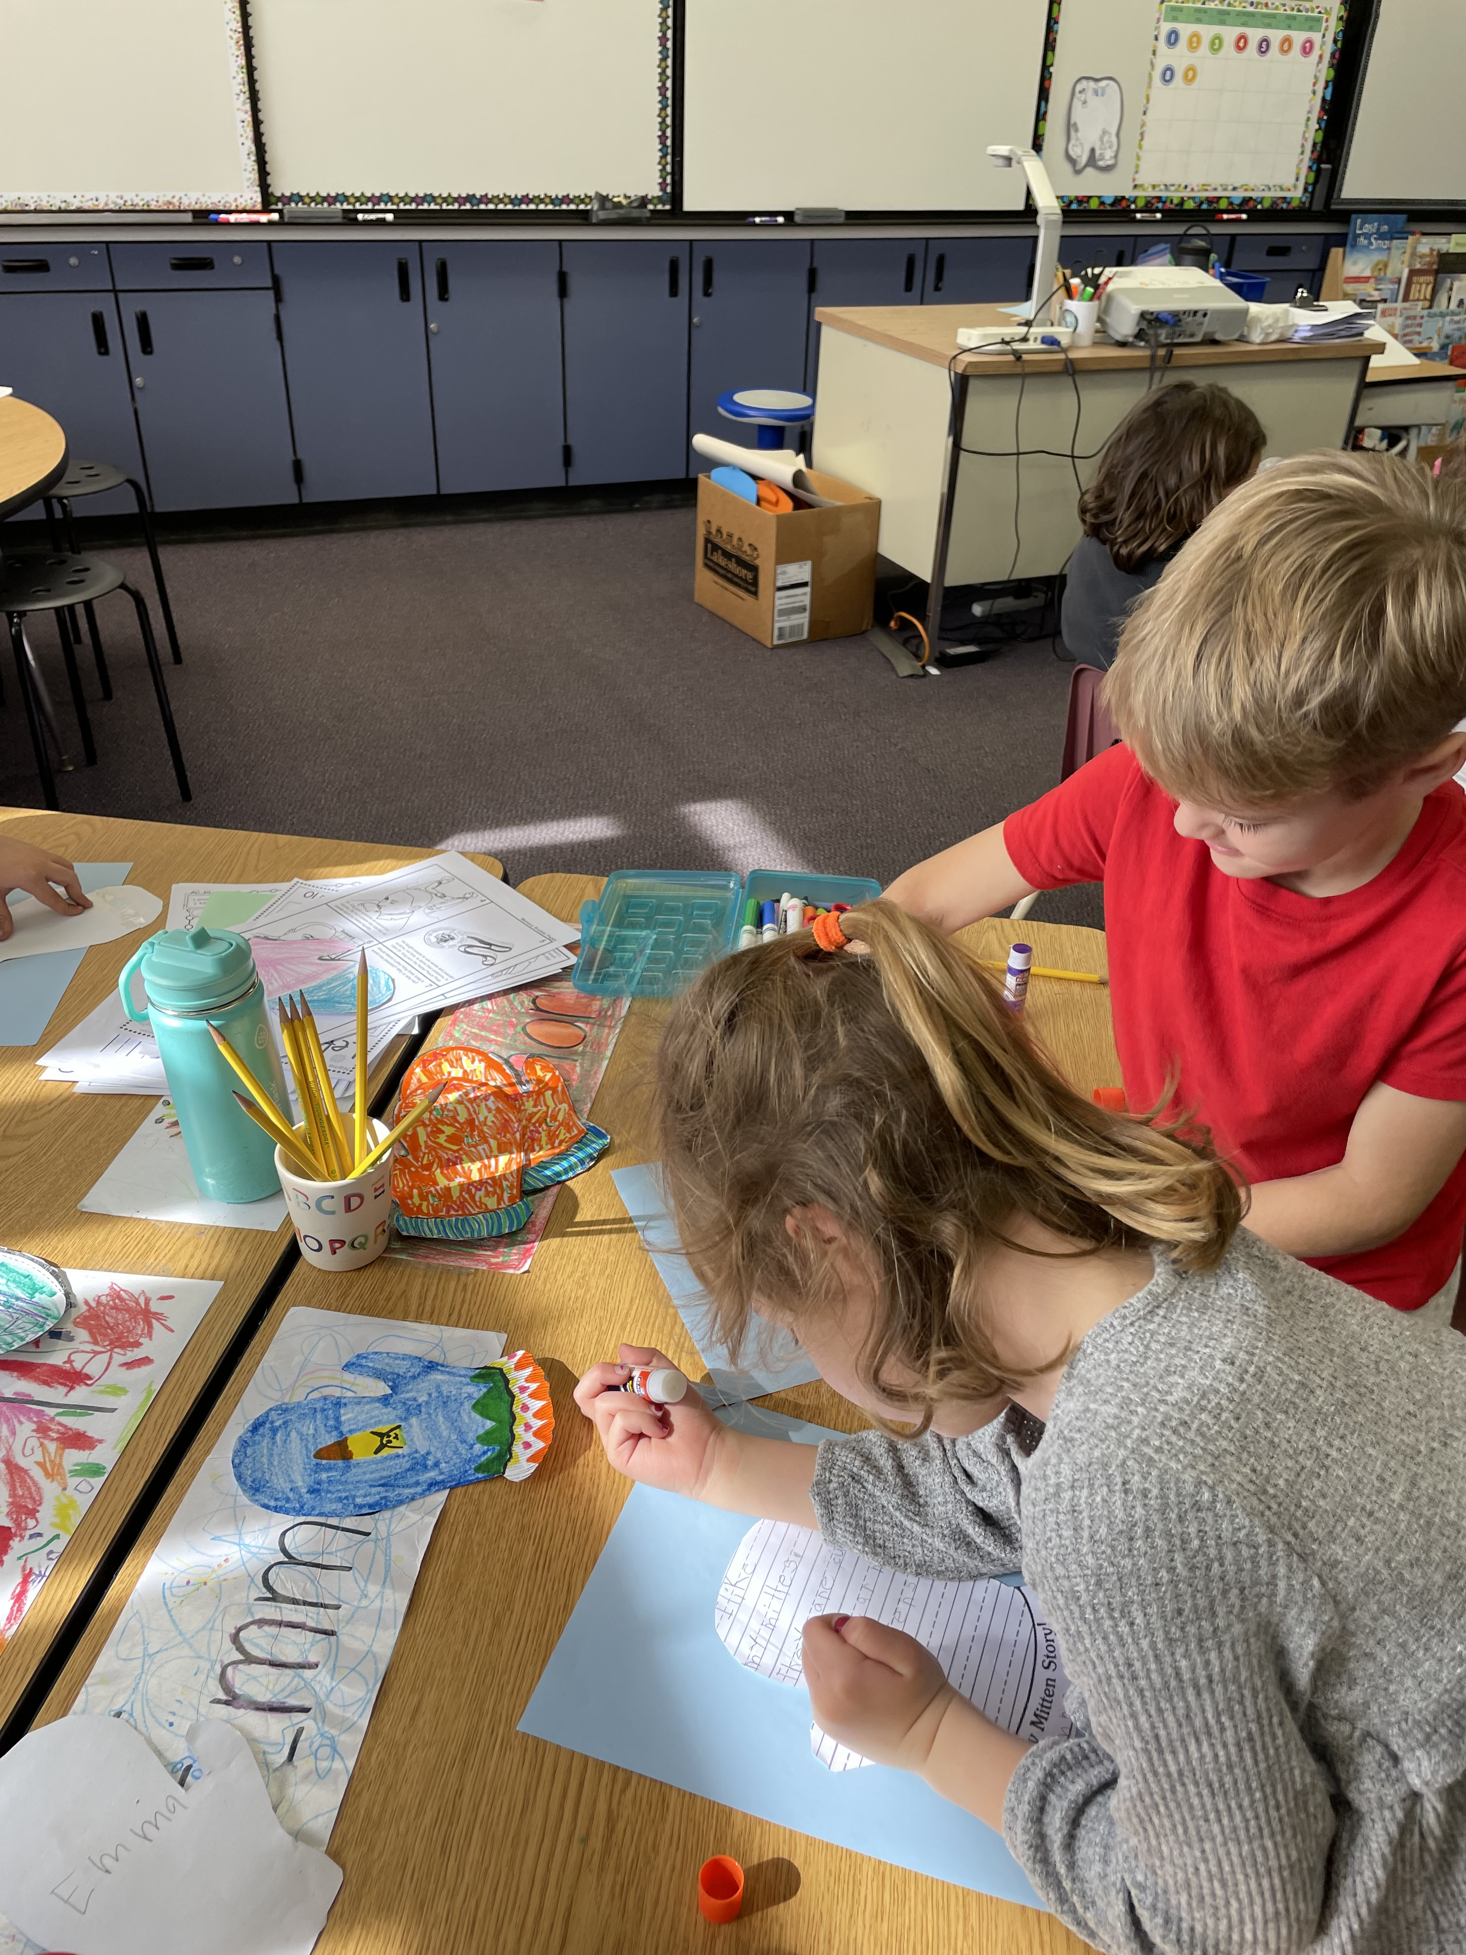
Kindergarten Readiness
Prior to entering Kindergarten, your child should be able to do the following:

Slide 36
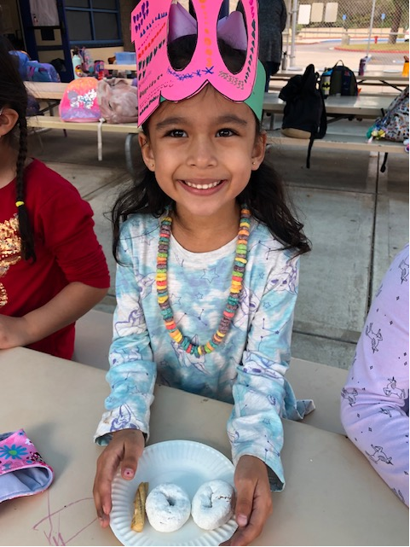
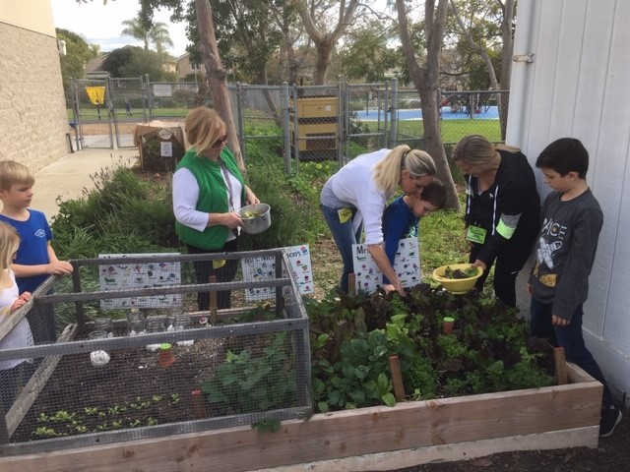
Social Skills and Behavior
Your Kindergarten child should be able to:
Separate from a parent or caregiver and stay with another adult.
Cooperate and share with others.
Play and work independently.
Keep their hands and bodies to themselves.
Show respect to classmates and adults.

Slide 37
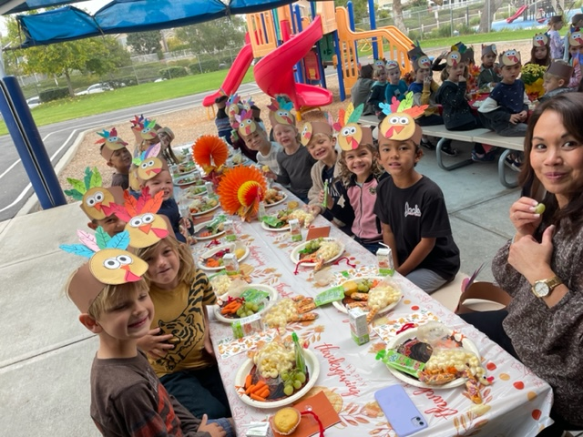
Listening and Speaking Skills
Your Kindergarten child should be able to:
Remain seated and listen for 10-15 minutes.
Follow simple two-step directions.
Verbally express their personal needs.
Engage other children and adults in conversation.

Slide 38
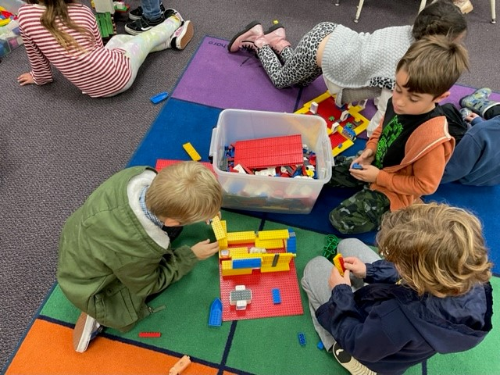
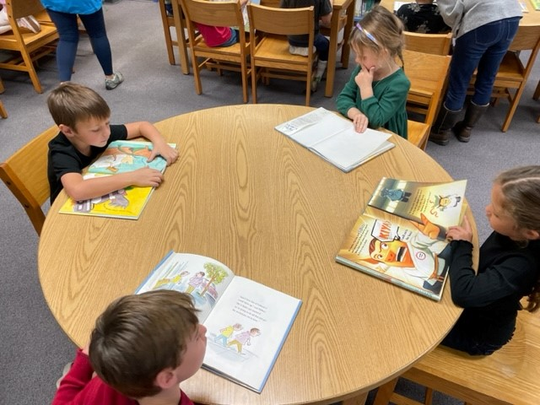
Motor Skills
Your Kindergarten child should be able to:
Use and hold pencils, crayons, markers, and scissors.
Use proper pencil grip – Tripod or alternative.
Carry, open, and close their full-size backpack.
Dress themselves (zip, button, and snap).
Tie shoes or close velcro by themselves.
Open and close their lunch box and reusable water bottle

Slide 39
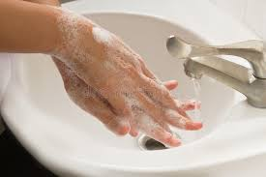
Personal Hygiene
Your Kindergarten child should be able to:
Attend to bathroom needs with total independence.
Wash and dry hands.
Use a tissue to blow and wipe nose.

Slide 40
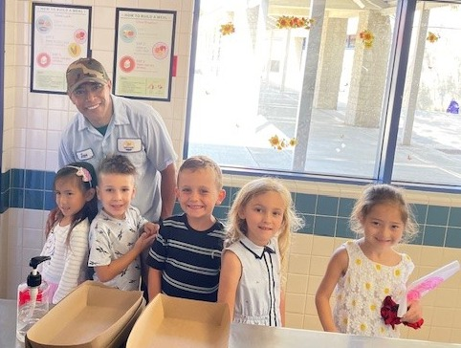
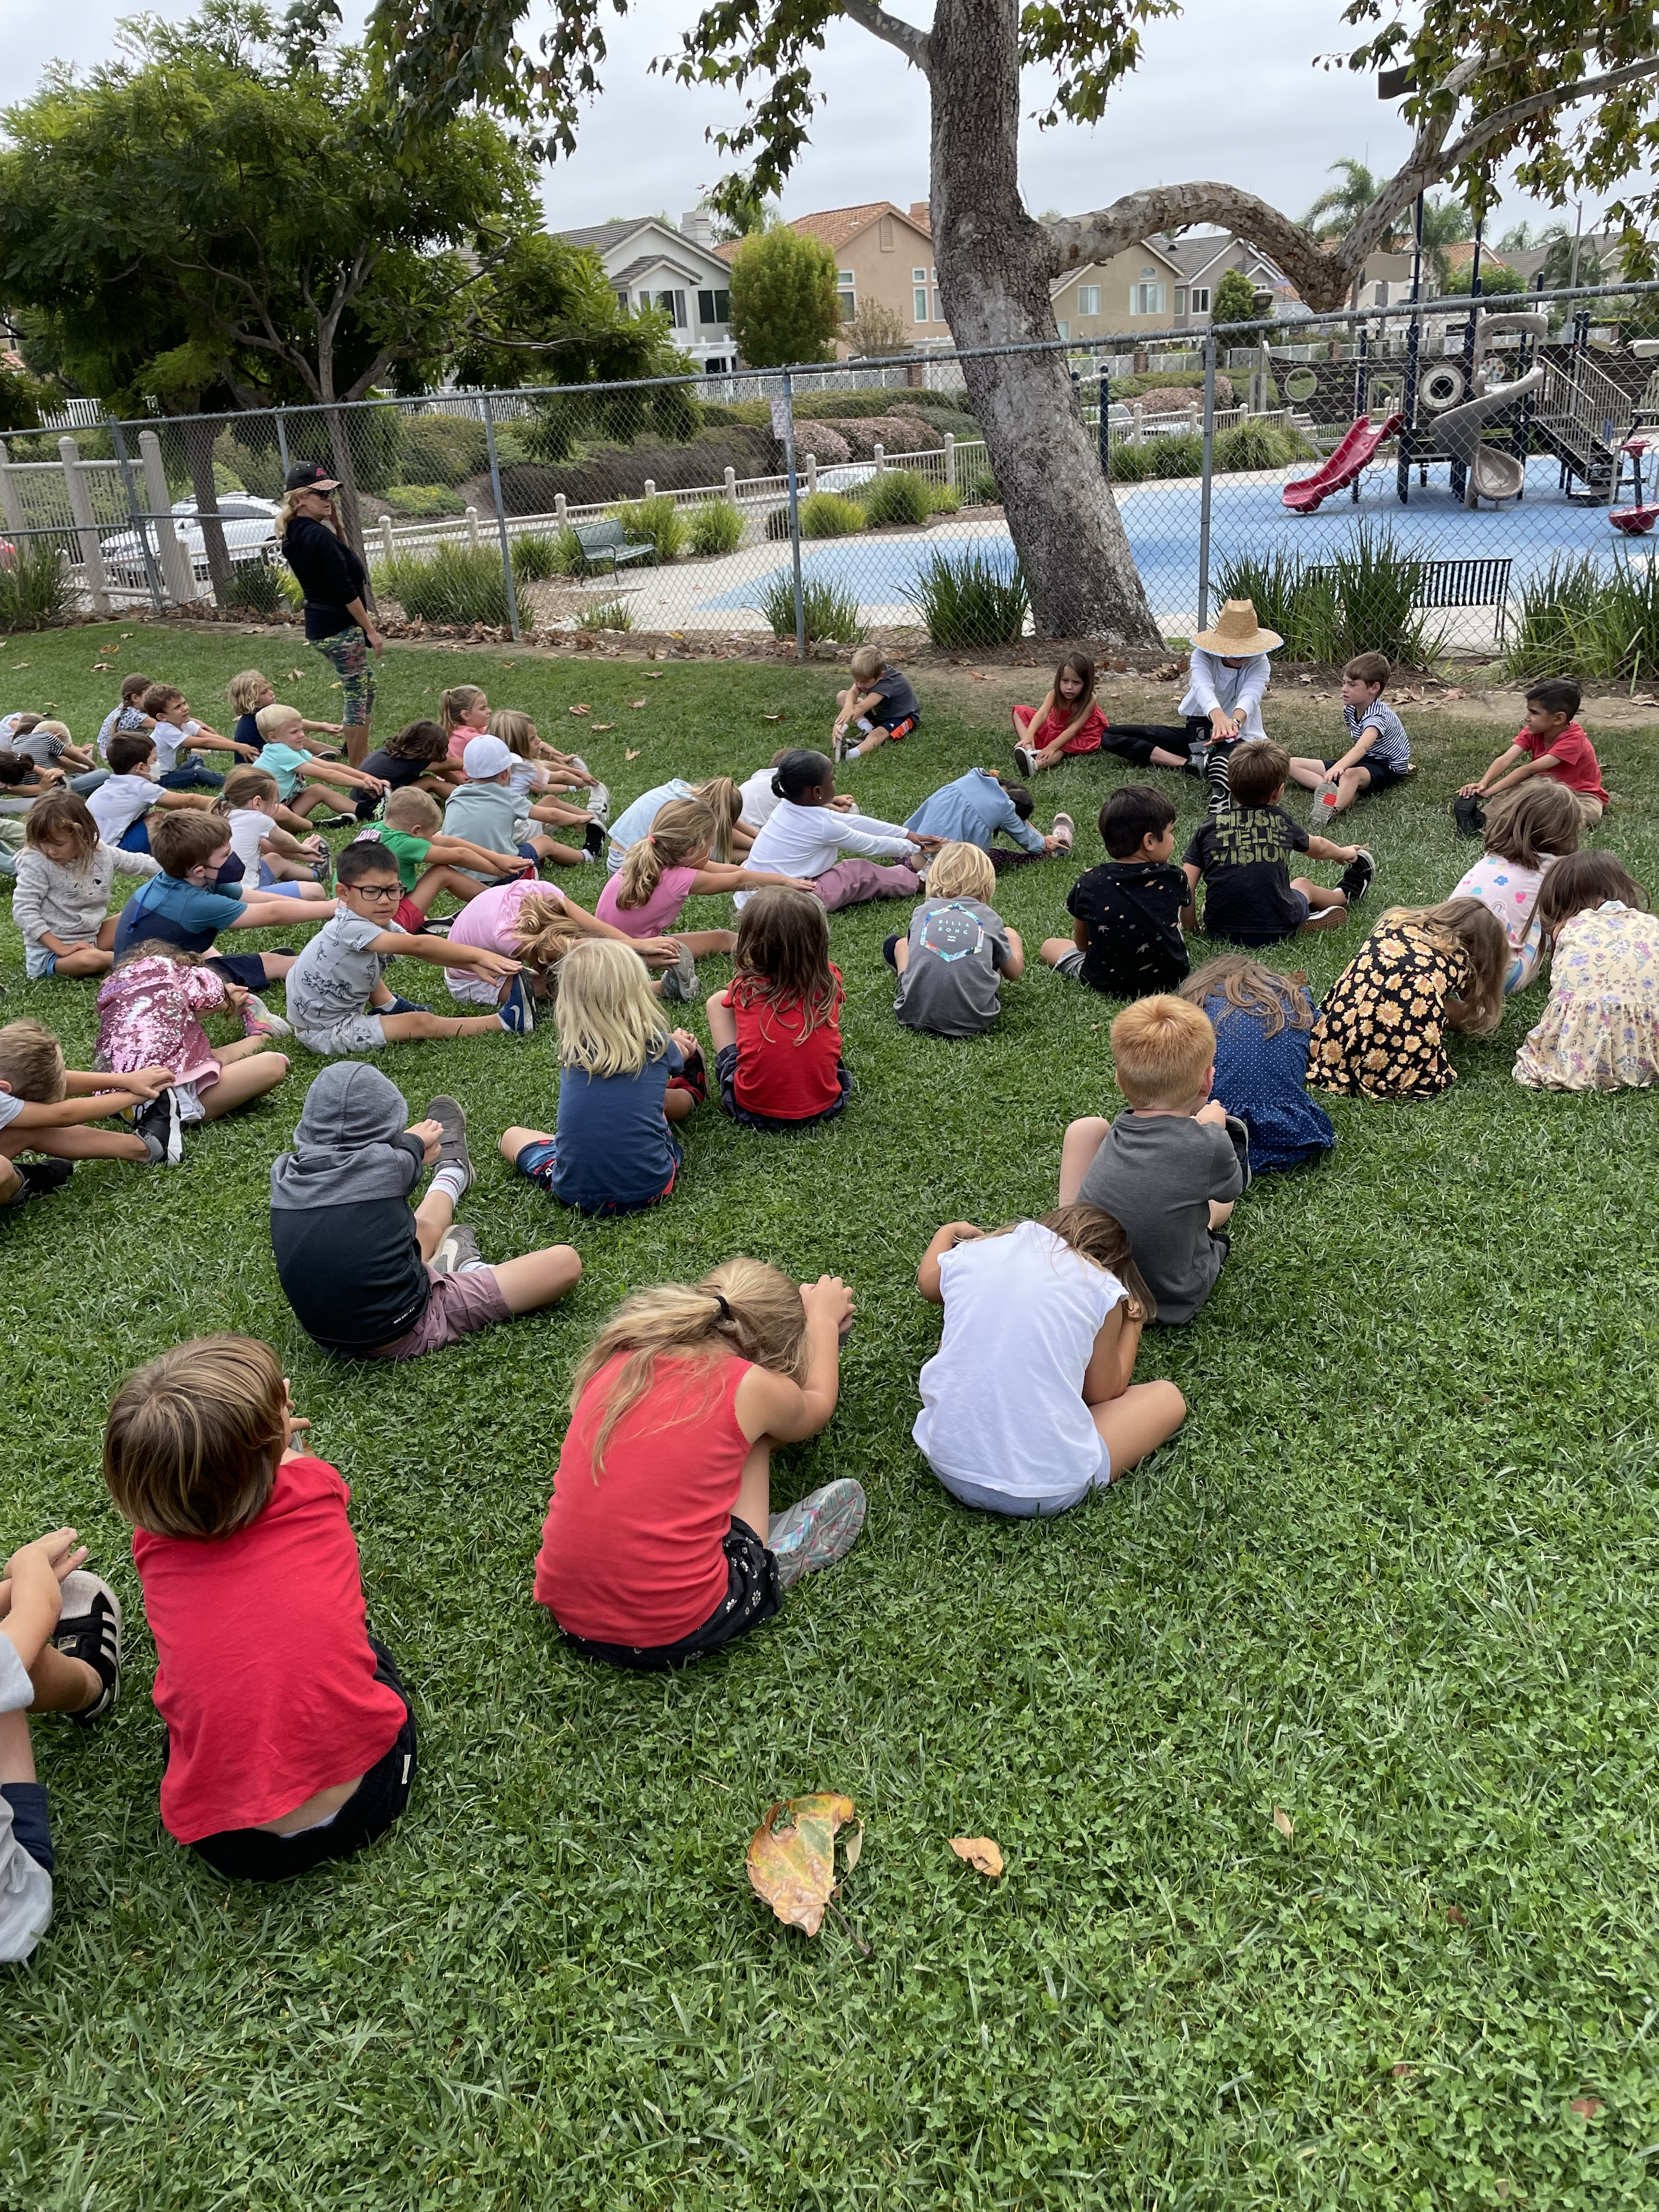
What a KINDERGARTEN Day Looks Like
7:45 – 9:20 Math and English Language Arts (ELA)
9:20 – 9:40 Breakfast/snack and RECESS daily
9:40 – 10:40 English Language Arts and WIN Time
10:40 – 11:20 LUNCH and RECESS daily
11:20 – 12:50 Technology/Science/Social Studies
12:50 – 1:10 RECESS (M,T,W,F)
1:10 – 1:55 Social Development / Closing / Dismissal
NOTE: Thursday early dismissal – 12:40 PM
Weekly: Music time!

Slide 41
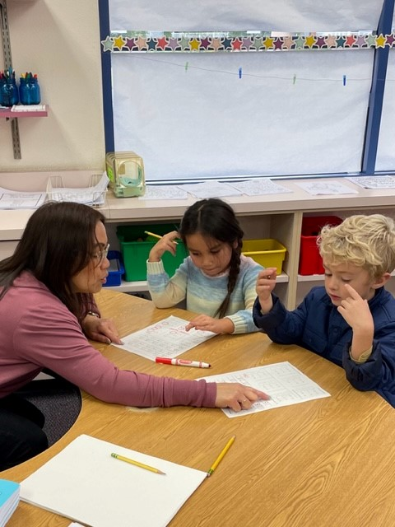
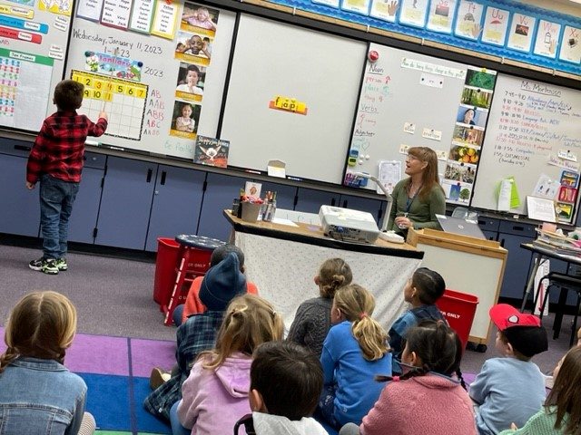
The Kindergarten Year
Class sizes – 32 students : 1 teacher
Core subjects (English Language Arts, Math, Science, Social Studies)
What I Need Time (WIN – intervention and extension 3 days per week)
1:1 touch screen Chromebooks to support iReady and Amplify practice time
Periodic/weekly: music, art, technology

Slide 42
First day of TK and Kindergarten is a Parent-Student Orientation
Tuesday, August 18, 2026
Parents: Plan on attending the first day of school with your child for a 75 minute orientation – time to be announced in August
This will be a shortened day where you and your child will meet the teacher and learn more about the classroom and procedures.
NOTE: First full day of school is Wednesday, 8/19/26.

Slide 43
HELPFUL TIPS BEFORE SCHOOL...
Label your child's belongings with first and last name (backpack, jacket, lunch box, water bottle, etc.).
Students wear shoes appropriate for school and playing outside (sneakers).
Students need a full-sized backpack for school.
Read the Malcom Minute – comes out via email on Wednesdays starting in late July.

Slide 44
REQUIRED REGISTRATION AND ENROLLMENT PAPERWORK
The following documentation is required to finalize enrollment:
AIR online confirmation page
Verification of residency (need 2 – mortgage verification, rental agreement and current utility bill)
Proof of student's age
Student's immunization record
Copy of parent/guardian ID

Slide 45
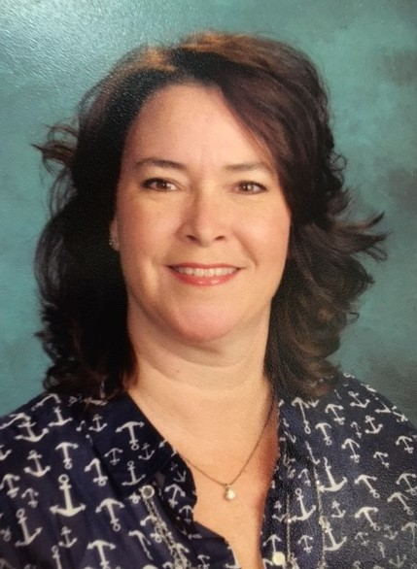
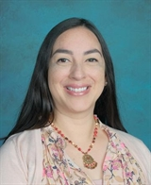
Questions Regarding Registration:
School of Choice Window: January 5 – February 1, 2026
John Malcom Elementary
32261 Charles Road
Laguna Niguel, CA 92677
Front office: 949-248-0542
Janine Lewis
Office Manager JMLEWIS@capousd.org
Sarah Caballero
Attendance & Registration SLCABALLERO@capousd.org
Register soon for the 26-27 school year !
Registration based on space availability!

Slide 46


