Slide 1

Winship-Robbins School District
2018-2019 Adopted BUDGET REPORT
Dr. Laurie Goodman
Superintendent/Principal

Slide 2
Winship-Robbins Elementary School District
TABLE OF CONTENTS
2018-2019 Adopted Budget Report
Budget Introduction Page 3
General Fund Revenue Assumptions Page 4
State Priorities Page 5
General Fund Revenue Sources Pages 6 - 7
General Fund Expenditures Pages 8 - 10
General Fund Balance Page 11
Revenues Versus Expenditures Page 12
Other Funds Page 13
Multi-Year Assumptions and MYP Pages 14 - 15
CBEDS- ADA Trend Page 16

Slide 3
Winship-Robbins Elementary School District
INTRODUCTION
2018-2019 Adopted Budget Report
The County Office, under AB1200, requires districts to document and include written budget assumptions in the budget package submitted for approval to the district Board of Trustees. Each district should advise the Board, by way of budget documents, accompanied by a brief narrative, of the financial condition of the district. This report will provide the required information for the Board to certify the district’s ability to meet its financial obligations.
The Adopted Budget Report is presented by fund and major object account classification, reflecting 2017-2018 “Estimated Actuals” in columns A-C and the 2018-2019 “Proposed Adopted Budget” in columns D-F. The final column reflects the percentage of variance between the 2017-2018 Estimated Actuals and the proposed 2018-2019 Adopted Budget.
This report contains information and estimates that reflect the information contained in the Governor’s May Revision State Budget proposal.

Slide 4
Winship-Robbins Elementary School District
General Fund Revenue Assumptions
2018-2019 Adopted Budget Report
Local Control Funding Formula
Based on Projected 2018-2019 ADA of 132.51 (which includes .84 County Operated ADA)
Funded using Target Formula for the first time in 2018-2019 fiscal year
Property Taxes = $721,261– $682,276 In-Lieu = $38,985
State Aid = $1,224,944
Other State and Federal Funding
Unrestricted Lottery = $146 per Annual ADA
Restricted Lottery = $48 per Annual ADA
Federal No Child Left Behind (Title I $24,493 & Title II $1,963)
REAP funding is projected at $39,201

Slide 5
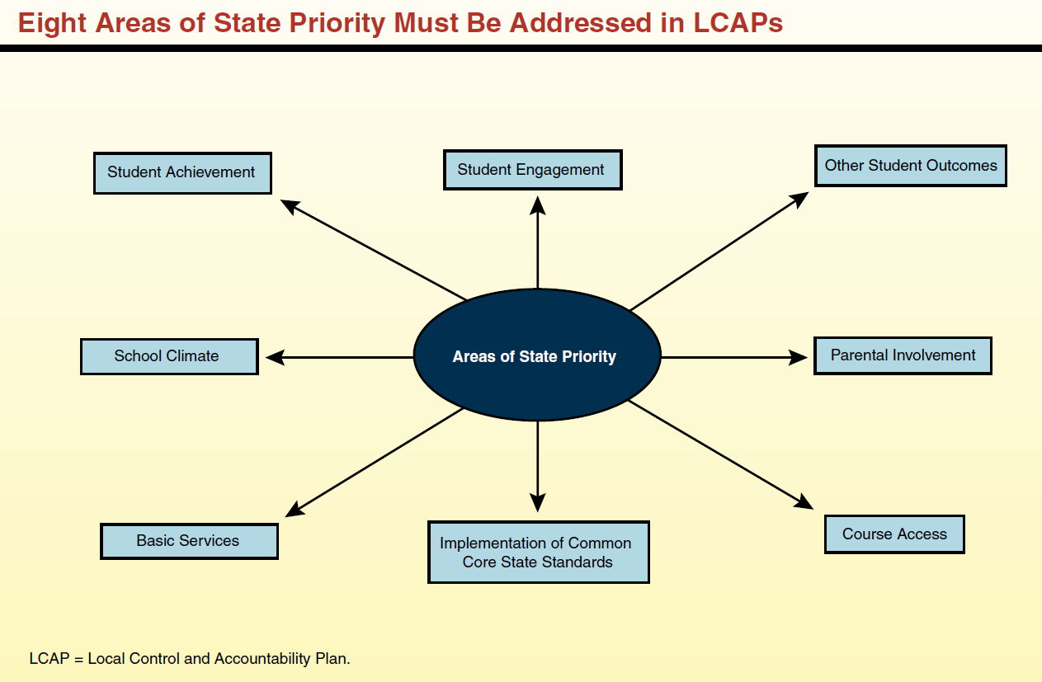
Eight State Priorities
2018-2019 ADOPTED BUDGET REPORT
Schools Services of California

Slide 6
Winship-Robbins Elementary School District
GENERAL FUND REVENUE SOURCES
2018-2019 Adopted Budget Report
The largest part of the revenue (57%) comes from Local Control Funding and is to be aligned to meet the eight state priorities. These priorities are on the previous slide.
The district will continue to receive federal funds for specific purposes and must continue to follow federal regulations.
Other state funds consist of child nutrition, mandated costs, lottery and miscellaneous other awards.
Local resources include interest, donations, local grants, special education funds, and charter fiscal oversight fees.

Slide 7
Winship-Robbins Elementary School District
GENERAL FUND REVENUE SOURCES
2018-2019 Adopted Budget Report
Local Control Funding Formula $1,455,093
This revenue source is based on 18-19 projected ADA x grade level based funding rates less charter transfer ADA. Supplemental funds are calculated based on percentages of unduplicated student counts which include low income students, foster youth, and English learners. Additionally, the district is funded using a COLA due to the district being funded with the Target Formula for the first time since the implementation of the LCFF. Currently, LCFF funding for Winship-Robbins is based on a projected P2 ADA of 132.51, which includes 0.84 of County Office Operated ADA, with an averaged unduplicated percentage of 88.97%, and a COLA rate of 3.00%.
Federal Revenues $150,657
This revenue source includes Title I, Title II, REAP, and Child Nutrition funding.
Other State Revenues $83,562
This revenue includes Unrestricted and Restricted Lottery, Mandated Costs, and Child Nutrition.
Other Local Revenue $863,635
This revenue includes Interest, Rental Income, and Charter Fiscal Oversight revenue.

Slide 8
Winship-Robbins Elementary School District
GENERAL FUND EXPENDITURES
2018-2019 Adopted Budget Report
Salaries and benefits represent 58% of the District’s total budget.

Slide 9
Winship-Robbins Elementary School District
GENERAL FUND EXPENDITURES
2018-2019 Adopted Budget Report
    CERTIFICATED SALARIES - $604,210
          Salary projections are based on 9 certificated FTE; and 1 management FTE, (.7 FTE Principal; .3 FTE Superintendent).
          CLASSIFIED SALARIES - $379,177
          Salary projections are based on 10.58 FTEs and known staffing needs, including extra-duty and overtime.
          .
          EMPLOYEE BENEFITS - $335,620
          Benefits are based on projections that reflect a increase in salary expenditures and thus result in a increase in benefit expenditures of $23,261. 2018-2019 STRS rate is 16.28%. 2018-2019 PERS rate is 18.062%.
    BOOKS AND SUPPLIES - $207,732
    Projected instructional materials and supplies expenses include core and supplemental instructional materials, custodial and maintenance supplies, and technology related expenditures. This expenditure is reduced by $49,782 primarily due to the removal of one-time supply and instructional material purchases.
    SERVICES, OTHER OPERATING EXPENSES - $274,088
    Projected services and other operating expenses include professional development for classroom staff, classroom on-line instructional and intervention programs, maintenance, custodial repair, drinking water delivery, and servicing expenses and utilities. This expenditure is reduced by $49,782 primarily due to the removal of several one-time, service expenditures related to maintenance and repairs such as wall repairs, tree removal, tree trimming, etc., as well as Superintendent search services and Educator Effectiveness professional development services.

Slide 10
Winship-Robbins Elementary School District
GENERAL FUND EXPENDITURES
2018-2019 Adopted Budget Report
    CAPITAL OUTLAY - $422,477
    Projected Capital Outlay is a direct result of planned Prop 39 projects, the Corp Yard project, and new HVAC project for Building A. This expenditure increased by $353,504 primarily due to the net effect of removing the one-time Capital Projects that were completed in 2017-18 like the Robbins’ Restroom Rehab, the Robbins’ Bus Pad, and the Winship Well project, and then budgeting the Robbins’ Corp Yard project, Robbins’ HVAC project, and the final Prop 39 projects in 2018-19.
    OTHER OUTGO - $40,205
    Includes portable lease payments as well as Special Education Excess Cost.
    INTERFUND TRANSFERS IN/OUT - $16,405
    This transfer out of General Fund is to the Child Development fund. The increase of $6,798 is due to the expected staffing in the preschool program in 2018-19.
    CONTRIBUTIONS TO RESTRICTED PROGRAMS $235,318
    Contributions to restricted programs are projected to total $235,318 and include contributions to Shady Creek, Title I, Child Nutrition, Special Education, and Routine Restricted Maintenance. The decrease of $20,675 in contributions is primarily related to expected reductions in contributions to Special Ed services, the Child Nutrition program, as well the Routine Restricted Maintenance program. The district refined position control in two of the three programs and services in 2018-19, which led to a slightly decreased contribution needed.

Slide 11
Winship-Robbins Elementary School District
GENERAL FUND BALANCE
2018-2019 Adopted Budget Report
The estimated ending balance for the 2018-2019 year is $2,593,180. Of this amount, $113,996 has been designated for economic uncertainties as required by the State of California.

Slide 12
Winship-Robbins Elementary School District
REVENUES vs. EXPENDITURES
2018-2019 Adopted Budget Report

Slide 13
Winship-Robbins Elementary School District
OTHER FUNDS
2018-2019 Adopted Budget Report
Child Development Fund – 2018-2019 ending fund balance is projected to be $5,017.55
Deferred Maintenance Fund – 2018-2019 ending fund balance is projected to be $18,729.43
Special Reserve Fund - 2018-2019 ending fund balance is projected to be $391,917.23
Capital Facilities Fund (Developer Fees) - 2018-2019 ending fund balance is projected to be $12,554.68
County Schools Facilities Fund - 2018-2019 ending fund balance is projected to be $1,427.69

Slide 14
Winship-Robbins Elementary School District
MULTI-YEAR PROJECTION (MYP) ASSUMPTIONS
2018-2019 Adopted Budget Report
Winship-Robbins Local Control Funding for the future two years has been calculated using projected ADA of 136.46 in 19/20 and 140.53 in 20/21 (which includes 0.84 of County Operated ADA in each year). All one-time revenues and expenditures have been removed related to Mandated Costs and Prop 39 funds.
Expenditure adjustments are as follows:
Object 1000 Step and Column were projected for both 2019/20 & 2020/21.
Object 2000 Step and Column were projected for both 2019/20 & 2020/21.
Object 3000 Increased to cover the above salary adjustments, and increased to cover the increases in PERS & STRS in 19/20 and 20/21. PERS rates are projected to be 20.8% for 19/20, and 23.5% for 20/21. STRS rates are projected to be 18.13% for 19/20 and 19.10% for 20/21.
Object 4000 Fiscal year 19/20 increased with CPI rate of 3.36%. Removed one-time 18/19 expenditures. Fiscal year 20/21 increased with CPI rate of 3.23%.
Object 5000 Fiscal year 19/20 increased with CPI rate of 3.36%. Removed one-time 18/19 expenditures. Fiscal year 20/21 increased with CPI rate of 3.23%.
Object 6000 The Corp Yard, HVAC project, and Prop 39 projects are projected to be completed by the end of 18/19.
Other Outgo Other Outgo reduced in 19/20 due to final portable lease payment made in 18/19.
Transfers-Out No adjustments.
Contributions Contribution to Routine Restrict Maintenance as required by statute; contribution to balance special education and contribution to balance nutrition services.
Other Sources/Uses No adjustments.

Slide 16
Winship-Robbins Elementary School District
CBEDS – ADA TRENDS
2018-2019 Adopted Budget Report

