Slide 1

NEISD- High School, College & Career Readiness Lesson Justification
“We shouldn't just live for today; we should prepare for tomorrow.”
-Kent Conrad
- Since 2015
On June 20, 2015, the Texas Education Agency enacted HB 18. This legislation stipulates that each school district must provide instruction to students in grade seven or eight on preparing for high school, college, and a career. The instruction must include information regarding the following:
Creation of a High School Personal Graduation Plan
Distinguished Level of Achievement
Each Endorsement
College Readiness Standards
Potential career choices and the education needed to enter those careers
In NEISD, these six lessons are the start of what eighth grade students will be taught in their preparation for the next four years and their life beyond high school. Campus counselors will be continuing this instruction with course selection in January and February.

Slide 2

YOUR Future News
“We shouldn't just live for today; we should prepare for tomorrow.”
-Kent Conrad
- Since 2015
NEISD- High School, College & Career Readiness Lessons
Table of Contents
Lesson 1: The Uncharted Journey
Lesson 2: Creating Your Map
Lesson 3: Your Next Stop
Lesson 4: Trip Itinerary
Lesson 5: Future Stops
Lesson 6: College Costs and College Prep
Think of your life as a voyage. You have already traveled to many destinations. Right now, the rest of life’s journey is uncharted. These lessons will help you think about the places where you would like to go in the future. What will be the significant events in your life? Who will be on the journey with you? So far, most major life decisions have been decided for you by those who have been entrusted with your care. Increasingly, you will be making the decisions that will shape your life. The kind of work you choose will influence the lifestyle you lead – where you live, what you wear, and what kind of transportation you use. If you want to be the one to decide what the destinations of your future will be, pay attention and participate fully, because it is your future that is being defined.

Slide 3
YOUR Future News
“We shouldn't just live for today; we should prepare for tomorrow.”
-Kent Conrad
Lesson 1
NEISD- High School, College & Career Readiness Lessons
Why is work important?
Work takes on different meanings for different people. For some, it is viewed as the means by which money is earned so that satisfaction can be found in other life roles. For others, it is viewed as a way to express interests and skills and to attain values – that is, to find self-actualization. Still, for others, it is a commitment to a higher purpose, a way in which to contribute to society or establish meaning in life.

Slide 4
YOUR Future News
“We shouldn't just live for today; we should prepare for tomorrow.”
-Kent Conrad
Lesson 1
NEISD- High School, College & Career Readiness Lessons
There is a high correlation between having career plans and completing either high school or college. We also know that career plans may change, but are sometimes related to the original plan. For example, if a student takes an interest inventory and expresses high interest in one cluster of occupations and chooses a college major based on that cluster, there is a greater chance that if that student changes majors, the new one will be within the same general cluster or one that is closely related.

Slide 5
YOUR Future News
“We shouldn't just live for today; we should prepare for tomorrow.”
-Kent Conrad
Lesson 1
NEISD- High School, College & Career Readiness Lessons
In addition, it is difficult for persons of all ages, but especially difficult for middle and high school students, to plan for and move from Point A to Point Z. It is much easier to plan to move to Point A to B, then B to C, or from step 1 to 2, etc.
In other words, we are most comfortable moving a small step at a time toward a long-term goal. For this reason, it is highly recommended a student create a tentative plan so that specific short-term goals may be set, even though that plan and those goals may evolve with time and experience.

Slide 6
YOUR Future News
“We shouldn't just live for today; we should prepare for tomorrow.”
-Kent Conrad
Lesson 1
NEISD- High School, College & Career Readiness Lessons
What is Kuder® ?
Kuder® is a career planning program that provides evidence-based career assessment, educational planning, and guidance resources for students. The goals of the program include guiding students and parents through successful eighth-grade and post-high school transitions, increasing completion and graduation rates, and providing career planning, guidance, and developing resources to last a lifetime.
Once you register as a user, your account is good forever!

Slide 7
YOUR Future News
“We shouldn't just live for today; we should prepare for tomorrow.”
-Kent Conrad
Lesson 1
NEISD- High School, College & Career Readiness Lessons
Register your Kuder® Future Planning Account
Go to www.neisd.net
Log into Launchpad
Click on the KUDER App in the CTE Folder
If you have had an account in the past three years, your should automatically be directed to your account. If you are new to Kuder, you will be asked a few registration questions.
*Note: A few students had data lost in the migration, if that was you create a new account… sorry!

Slide 8
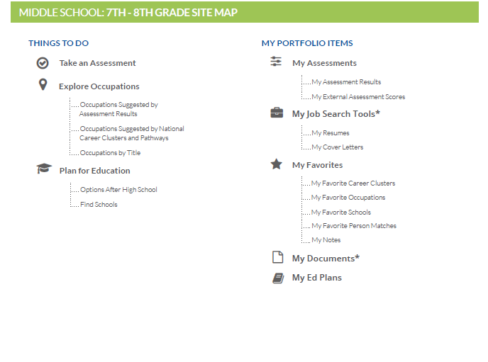
YOUR Future News
“We shouldn't just live for today; we should prepare for tomorrow.”
-Kent Conrad
Lesson 1
NEISD- High School, College & Career Readiness Lessons
Kuder® Middle School: 7th-8th Grade Site Map

Slide 9
YOUR Future News
“We shouldn't just live for today; we should prepare for tomorrow.”
-Kent Conrad
Lesson 1
NEISD- High School, College & Career Readiness Lessons
The Uncharted Journey -Conclusion
You have completed step 1 in your journey toward the future. In the next lesson you will complete 2 career assessments, or maps to help determine what career options might be most appropriate for you.
You will then begin working on your high school graduation plan, and endorsement choices.
Finally, you will be looking at what post high school education is needed for the careers you are interested in, and what those careers might look like.

Slide 10
Lesson 1 teacher notes
Every student will need internet access.
Some students may already have an account through their CTE or SPED connection. Have them verify their account by logging in. In lesson 2 all students will complete 2 assessments unless they completed them on or after July 2016. These students can help other students.
You may want to register as a student first to see how the process works and how long it will take.
Remind students this account belongs to them forever!
Optional worksheet on the following slide and in resource section.

Slide 11
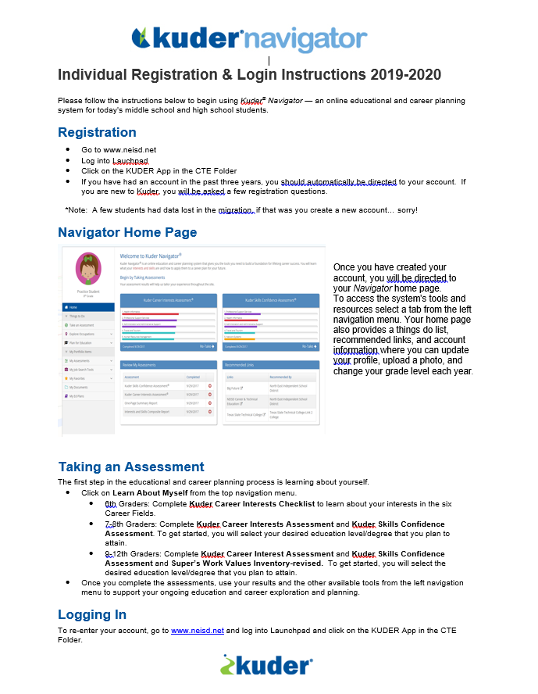

Slide 12


YOUR Future News
“We shouldn't just live for today; we should prepare for tomorrow.”
-Kent Conrad
- Since 2015
NEISD- High School, College & Career Readiness Lessons
Table of Contents
Lesson 1: The Uncharted Journey
Lesson 2: Creating Your Map
Lesson 3: Your Next Stop
Lesson 4: Trip Itinerary
Lesson 5: Future Stops
Lesson 6: College Costs and College Prep
Think of your life as a voyage. You have already traveled to many destinations. Right now, the rest of life’s journey is uncharted. These lessons will help you think about the places where you would like to go in the future. What will be the significant events in your life? Who will be on the journey with you? So far, most major life decisions have been decided for you by those who have been entrusted with your care. Increasingly, you will be making the decisions that will shape your life. The kind of work you choose will influence the lifestyle you lead – where you live, what you wear, and what kind of transportation you use. If you want to be the one to decide what the destinations of your future will be, pay attention and participate fully, because it is your future that is being defined.

Slide 13
YOUR Future News
“We shouldn't just live for today; we should prepare for tomorrow.”
-Kent Conrad
Lesson 2
NEISD- High School, College & Career Readiness Lessons
Career assessment is a process of looking at your interests, skills, personality traits, and values. By completing career assessments, you are likely to discover which careers might fit you best.
Complete the Kuder Career Interest Assessment- Choose what activity you like to do the most, second, and finally least. When you are finished, your highest interests will be matched with careers that you may enjoy.
Complete the Kuder Skills Confidence Assessment- Rate how confident you are that you can accomplish each activity. When you are finished, review the skills you have and explore careers that need those skills.

Slide 14
YOUR Future News
“We shouldn't just live for today; we should prepare for tomorrow.”
-Kent Conrad
Lesson 2
NEISD- High School, College & Career Readiness Lessons
Go to www.neisd.net
Log into Launchpad, Click on the Kuder App in the CTE Folder
Click on Take an Assessment at the left side of the home page
Click My Assessments and Take or Retake an Online Assessment (middle of the page)
Complete the Career Interest Assessment- 9 minutes
Complete the Skills Confidence Assessment- 7 minutes

Slide 15
YOUR Future News
“We shouldn't just live for today; we should prepare for tomorrow.”
-Kent Conrad
Lesson 2
NEISD- High School, College & Career Readiness Lessons
After you have completed your 2 assessments:
Click on the My Assessment tab on the left side of home page
Click on My Assessments
Click on One-Page Summary Report
Look at all the GREAT information you received based on your responses!
Turn this in to your teacher

Slide 16
YOUR Future News
“We shouldn't just live for today; we should prepare for tomorrow.”
-Kent Conrad
Lesson 2
NEISD- High School, College & Career Readiness Lessons
Creating Your Map -Conclusion
You have completed step 1 and 2 in your journey toward the future. You have registered your Kuder® Account and thought about why it is important to plan for your future. You have also completed 3 career assessments, or maps to help determine what career options might be most appropriate for you.
In the next lessons you will begin working on your high school graduation plan and endorsement choices.
In the last lesson, you will be looking at what post-high school education is needed for the careers you are interested in, and what those careers might look like.

Slide 17
Lesson 2 teacher notes
Every student will need internet access and the ability to PRINT
Some students may already have an account through their CTE or SPED connection. Have them verify its existence by logging in. In this lesson all students will complete 2 assessments unless they completed them on or after July 2016. Keep in mind that Special Ed. & CTE use Kuder regularly. When there are some of these students, please have them log in and still print the one-page summary report to turn in.
You may want to log in again and complete the assessments first to see how the process works and how long it will take.
Remind students this account belongs to them forever!
Assigning a grade for completing these assessments might be something your campus considers.

Slide 18
YOUR Future News
“We shouldn't just live for today; we should prepare for tomorrow.”
-Kent Conrad
- Since 2015
NEISD- High School, College & Career Readiness Lessons
Table of Contents
Lesson 1: The Uncharted Journey
Lesson 2: Creating Your Map
Lesson 3: Your Next Stop
Lesson 4: Trip Itinerary
Lesson 5: Future Stops
Lesson 6: College Costs and College Prep
Think of your life as a voyage. You have already traveled to many destinations. Right now, the rest of life’s journey is uncharted. These lessons will help you think about the places where you would like to go in the future. What will be the significant events in your life? Who will be on the journey with you? So far, most major life decisions have been decided for you by those who have been entrusted with your care. Increasingly, you will be making the decisions that will shape your life. The kind of work you choose will influence the lifestyle you lead – where you live, what you wear, and what kind of transportation you use. If you want to be the one to decide what the destinations of your future will be, pay attention and participate fully, because it is your future that is being defined.

Slide 19
YOUR Future News
“We shouldn't just live for today; we should prepare for tomorrow.”
-Kent Conrad
Lesson 3
NEISD- High School, College & Career Readiness Lessons
The Foundation High School Program (FHSP) is a flexible graduation program that allows students to pursue their interests. The program is in place for all students who entered high school, beginning in the 2014-2015 school year and thereafter.
English (4 credits) • English I • English II • English III • an advanced English course
Mathematics (3 credits) • Algebra I • Geometry • an advance math course
Science (3 credits) • Biology • Integrated Physics & Chemistry or an advanced science course • and advance science course
Social Studies (3 credits) • World History or World Geography • U.S. History • U.S. Government (one-half credit) • Economics (one-half credit)
Languages Other Than English (2 credits) • 2 credits in the same language
Physical Education (1 credit) Fine Arts (1 credit) Electives (5 credits)

Slide 20
YOUR Future News
“We shouldn't just live for today; we should prepare for tomorrow.”
-Kent Conrad
Lesson 3
NEISD- High School, College & Career Readiness Lessons
The Foundation High School program contains four parts:
1. A 22-credit foundation program which is the core of the Texas graduation requirements.
2. Five endorsement options that allow students to focus on a related sequence of courses
- The same 22 credits as in #1, plus 1 additional math credit, 1 additional science credit and 2 additional elective credits for a total of 26 credits.

Slide 21

YOUR Future News
“We shouldn't just live for today; we should prepare for tomorrow.”
-Kent Conrad
Lesson 3
NEISD- High School, College & Career Readiness Lessons
3. A higher performance category called Distinguished Level of Achievement
The Distinguished Level of Achievement must be earned to be considered for automatic admission to a Texas public university under Texas Education Code 51.803.
The student must complete: • Foundation High School Program(FHSP) requirements • 4 credits in math including Algebra II • 4 credits in science • at least 1 endorsement •accumulate 26 total credits

Slide 22
YOUR Future News
“We shouldn't just live for today; we should prepare for tomorrow.”
-Kent Conrad
Lesson 3
NEISD- High School, College & Career Readiness Lessons
Performance Acknowledgments that note outstanding performance
- Including: • dual credit courses • bilingualism and biliteracy • PSAT, ACT’s Aspire, SAT or ACT • Advanced Placement (AP) • earning a nationally or internationally recognized business or industry certification or license

Slide 23
YOUR Future News
“We shouldn't just live for today; we should prepare for tomorrow.”
-Kent Conrad
Lesson 3
NEISD- High School, College & Career Readiness Lessons
House Bill 5 and Multidisciplinary Endorsement
Brochure- Explore Your Future With The Foundation High School Program
http://www.lmci.state.tx.us/shared/FHSEB/PDFS/MultiDisc.pdf (right click and open Hyperlink)

Slide 24
YOUR Future News
“We shouldn't just live for today; we should prepare for tomorrow.”
-Kent Conrad
Lesson 3
NEISD- High School, College & Career Readiness Lessons
Optional Day 2 of Lesson 3:
STEM Endorsement Brochure
http://www.lmci.state.tx.us/shared/FHSEB/PDFS/STEM.pdf
Business & Industry Endorsement Brochure
http://www.lmci.state.tx.us/shared/FHSEB/PDFS/BusAndInd.pdf
Public Services Endorsement Brochure
http://www.lmci.state.tx.us/shared/FHSEB/PDFS/PubService.pdf
Arts and Humanities Endorsement Brochure
http://www.lmci.state.tx.us/shared/FHSEB/PDFS/ArtsAndHumanities.pdf
(right click and open each Hyperlink above)

Slide 25
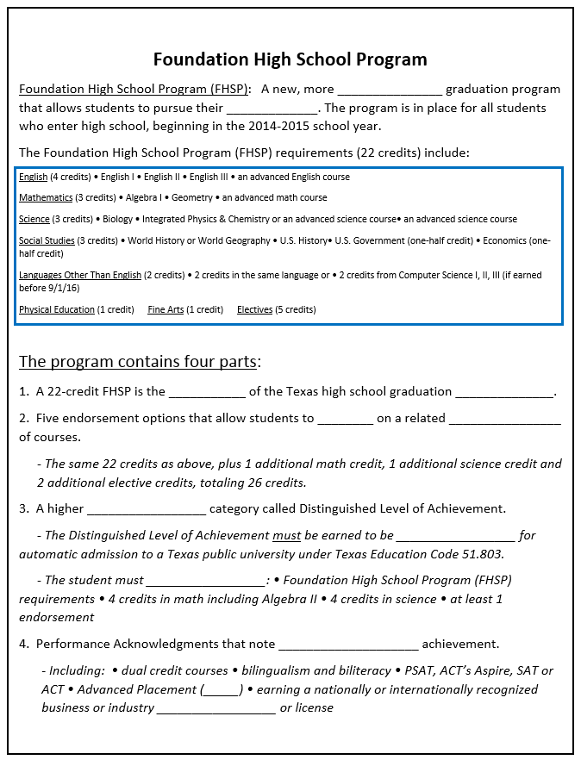
Notes page to copy for students
English (4 credits) • English I • English II • English III • an advanced English course
Mathematics (3 credits) • Algebra I • Geometry • an advance math course
Science (3 credits) • Biology • Integrated Physics & Chemistry or an advanced science course • and advance science course
Social Studies (3 credits) • World History or World Geography • U.S. History • U.S. Government (one-half credit) • Economics (one-half credit)
Languages Other Than English (2 credits) • 2 credits in the same language
Physical Education (1 credit) Fine Arts (1 credit) Electives (5 credits)

Slide 26
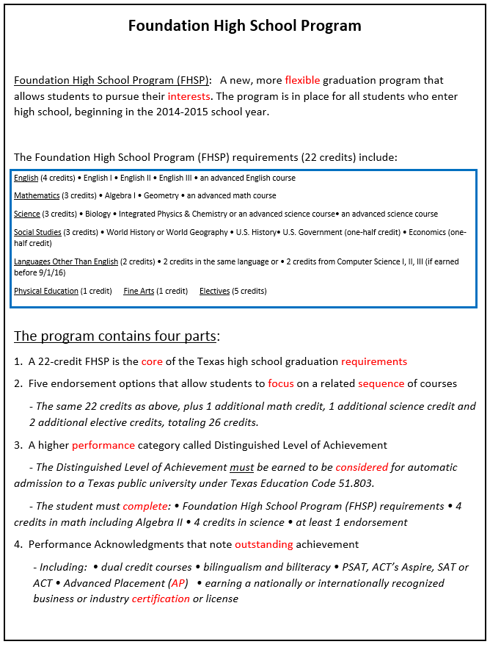
Notes page for teacher resource
English (4 credits) • English I • English II • English III • an advanced English course
Mathematics (3 credits) • Algebra I • Geometry • an advance math course
Science (3 credits) • Biology • Integrated Physics & Chemistry or an advanced science course • and advance science course
Social Studies (3 credits) • World History or World Geography • U.S. History • U.S. Government (one-half credit) • Economics (one-half credit)
Languages Other Than English (2 credits) • 2 credits in the same language
Physical Education (1 credit) Fine Arts (1 credit) Electives (5 credits)

Slide 27
YOUR Future News
“We shouldn't just live for today; we should prepare for tomorrow.”
-Kent Conrad
Lesson 3
NEISD- High School, College & Career Readiness Lessons
Your Next Stop-Conclusion
You have completed steps 1, 2 and 3 in your journey toward the future. You have registered your Kuder® account and thought about why it is important to plan for your future. You have also completed 3 career assessments, or maps to help determine what career options might be most appropriate for you. In this lesson you begin thinking about your high school graduation plan, and endorsement choices. Next up is your high school four-year plan!

Slide 28
Lesson 3 teacher notes
You will need the ability to show the links in the PowerPoint.
Please check the hyperlinks ahead of time to ensure they work
Make enough copies of the House Bill 5 notes for each student to have a copy
Confer with your lead counselor about the second day of lesson #3
If you decide to go with a second day, the note page can be used for these links as well

Slide 29
YOUR Future News
“We shouldn't just live for today; we should prepare for tomorrow.”
-Kent Conrad
- Since 2015
NEISD- High School, College & Career Readiness Lessons
Table of Contents
Lesson 1: The Uncharted Journey
Lesson 2: Creating Your Map
Lesson 3: Your Next Stop
Lesson 4: Trip Itinerary
Lesson 5: Future Stops
Lesson 6: College Costs and College Prep
Think of your life as a voyage. You have already traveled to many destinations. Right now, the rest of life’s journey is uncharted. These lessons will help you think about the places where you would like to go in the future. What will be the significant events in your life? Who will be on the journey with you? So far, most major life decisions have been decided for you by those who have been entrusted with your care. Increasingly, you will be making the decisions that will shape your life. The kind of work you choose will influence the lifestyle you lead – where you live, what you wear, and what kind of transportation you use. If you want to be the one to decide what the destinations of your future will be, pay attention and participate fully, because it is your future that is being defined.

Slide 30
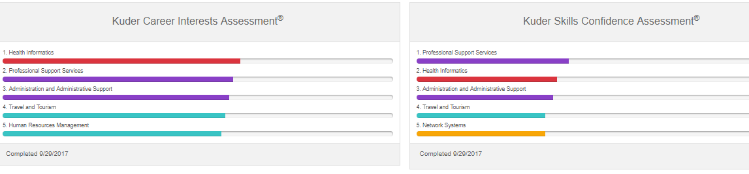
YOUR Future News
“We shouldn't just live for today; we should prepare for tomorrow.”
-Kent Conrad
Lesson 4
NEISD- High School, College & Career Readiness Lessons
Your teacher is handing out your one-page summary report from lesson #2, or you may access it from Kuder App in CTE Folder.
Look under the career interests section and read about the career clusters that match you best.

Slide 31
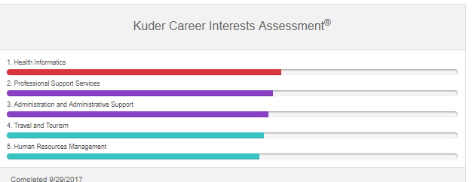
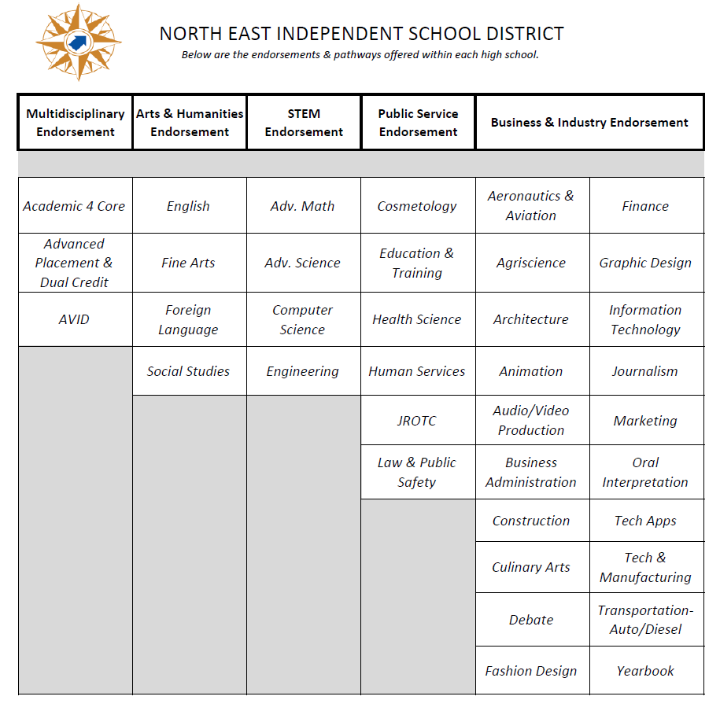
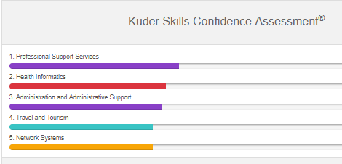
YOUR Future News
“We shouldn't just live for today; we should prepare for tomorrow.”
-Kent Conrad
Lesson 4
NEISD- High School, College & Career Readiness Lessons
Now it is time to select your Endorsement! Compare the career clusters with programs of study offered in NEISD. If you see a match or something related, you have found your Endorsement! Remember, you can always select Multidisciplinary Studies if you want to take classes from many different programs of study.
Compare

Slide 32
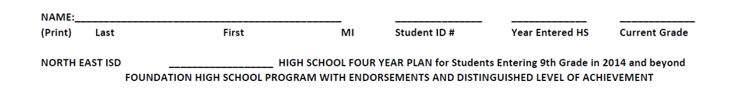
YOUR Future News
“We shouldn't just live for today; we should prepare for tomorrow.”
-Kent Conrad
Lesson 4
NEISD- High School, College & Career Readiness Lessons
On your 4-year planning sheet, please complete the following information:

Slide 33
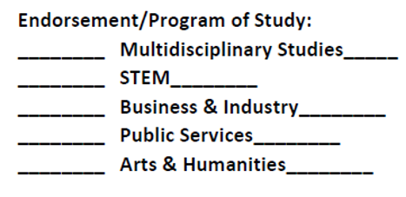
YOUR Future News
“We shouldn't just live for today; we should prepare for tomorrow.”
-Kent Conrad
Lesson 4
NEISD- High School, College & Career Readiness Lessons
On your four-year planning sheet, please mark at least one Endorsement you are interested in. Remember to consider your Kuder® results.

Slide 34
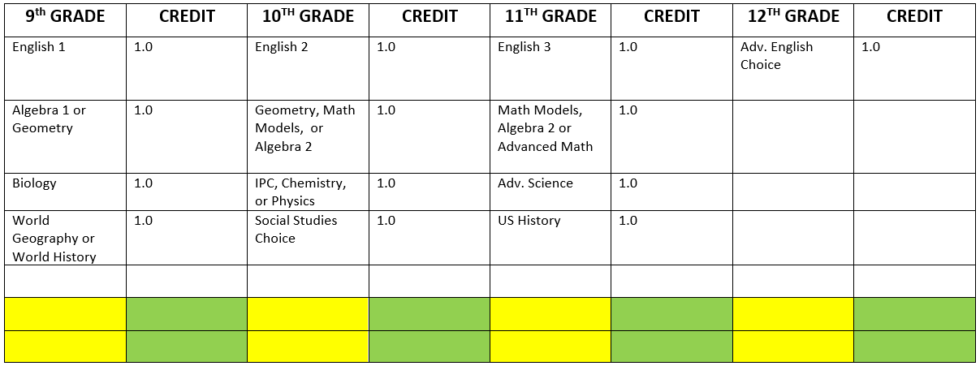
YOUR Future News
“We shouldn't just live for today; we should prepare for tomorrow.”
-Kent Conrad
Lesson 4
NEISD- High School, College & Career Readiness Lessons
Find that Endorsement on the NEISD Endorsement Guide. Next, find the Program of Study you are interested in (ex. Accounting) and fill in the courses you will be taking in the boxes marked in yellow shown below. Also mark the credit value in the green boxes shown below.
REMEMBER: You are looking for 4 total credits! (.5 +.5=1)
You do NOT have to fill every box!

Slide 35
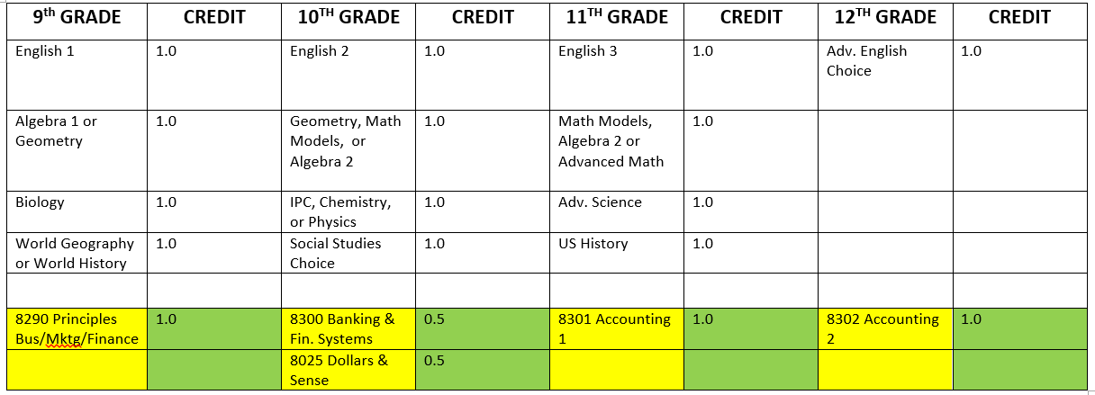
YOUR Future News
“We shouldn't just live for today; we should prepare for tomorrow.”
-Kent Conrad
Lesson 4
NEISD- High School, College & Career Readiness Lessons
Example (Business & Industry Endorsement/Accounting Program of Study):

Slide 36
YOUR Future News
“We shouldn't just live for today; we should prepare for tomorrow.”
-Kent Conrad
Lesson 4
NEISD- High School, College & Career Readiness Lessons
Keep in mind as an incoming 9th grade student you have the opportunity to apply for one of our NEISD magnet programs. Click on the individual name to learn more about each area.
Agriscience Magnet Program (AMP)
Career & Technical Education Center (CTEC)
Design and Technology Academy (DATA)
Engineering & Technologies Academy (ETA)
Hallmark University (Aviation Mechanics Program) 11-12 grades only
International School of the Americas (ISA)
MacArthur High School University Prep (MacUP)
North East School of the Arts (NESA)
Science, Technology, Engineering and Mathematics Academy (STEM)

Slide 37
YOUR Future News
“We shouldn't just live for today; we should prepare for tomorrow.”
-Kent Conrad
Lesson 4
NEISD- High School, College & Career Readiness Lessons
Magnet Application Deadlines and Information
If you find yourself interested in applying to one of the magnet programs please follow this link: https://www.neisd.net/magnetprograms
You will find the online application form at the link above. January 30, 2019 is the application deadline for the 2019-2020 academic school year.

Slide 38
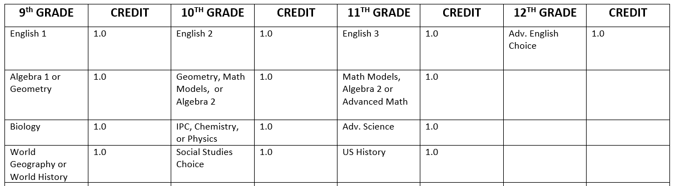
YOUR Future News
“We shouldn't just live for today; we should prepare for tomorrow.”
-Kent Conrad
Lesson 4
NEISD- High School, College & Career Readiness Lessons
If you finish selecting your endorsement courses, you can start circling the courses in places where you have some choices. For example, Algebra 1 or Geometry during your 9th grade year.

Slide 39
YOUR Future News
“We shouldn't just live for today; we should prepare for tomorrow.”
-Kent Conrad
Lesson 4
NEISD- High School, College & Career Readiness Lessons
You are NOT going to finish this plan today, but you are well on your way to planning a high school program that will help you to meet the goals you have set for yourself! Congratulations!
In January of your 8th grade year, you will be meeting with the counselors to plan the final choices for your 9th grade year. This four-year plan will be very helpful in helping to make your choices. Yes, you can change your mind and select different courses!
You will turn in this page today, and your counselor will have it for you when you get Course Selection Sheets for high school.
However, take your Kuder® report home. Do not forget your access to Kuder® is open to you forever!

Slide 40
YOUR Future News
“We shouldn't just live for today; we should prepare for tomorrow.”
-Kent Conrad
Lesson 4
NEISD- High School, College & Career Readiness Lessons
Trip Itinerary-Conclusion
You have completed steps 1, 2, 3 and 4 in your journey toward the future. You have registered your Kuder® Account, completed 3 career assessments, or maps to help determine what career options might be most appropriate for you, learned about your high school graduation plan, endorsement choices, and finally started planning your high school four-year plan!
In the last lesson, you will be looking at what post high school education is needed for the careers you are interested in and what those careers might look like.

Slide 41
Lesson 4 teacher notes
“We shouldn't just live for today; we should prepare for tomorrow.”
-Kent Conrad
Ensure you have your students’ one-page summary reports or access to computers so they can look them up.
Make classroom sets of the NEISD Endorsement and Program of Study Guide.
Make enough copies for each student to have their own four-year plan.
Collect each student’s plan and submit them to the lead counselor at the end of the day for use with course selection later.

Slide 42

YOUR Future News
“We shouldn't just live for today; we should prepare for tomorrow.”
-Kent Conrad
- Since 2015
NEISD- High School, College & Career Readiness Lessons
Table of Contents
Lesson 1: The Uncharted Journey
Lesson 2: Creating Your Map
Lesson 3: Your Next Stop
Lesson 4: Trip Itinerary
Lesson 5: Future Stops
Lesson 6: College Costs and College Prep
Think of your life as a voyage. You have already traveled to many destinations. Right now, the rest of life’s journey is uncharted. These lessons will help you think about the places where you would like to go in the future. What will be the significant events in your life? Who will be on the journey with you? So far, most major life decisions have been decided for you by those who have been entrusted with your care. Increasingly, you will be making the decisions that will shape your life. The kind of work you choose will influence the lifestyle you lead – where you live, what you wear, and what kind of transportation you use. If you want to be the one to decide what the destinations of your future will be, pay attention and participate fully, because it is your future that is being defined.

Slide 43

YOUR Future News
“We shouldn't just live for today; we should prepare for tomorrow.”
-Kent Conrad
Lesson 5
NEISD- High School, College & Career Readiness Lessons
We are almost near the end of our journey into your future. Today you will have the opportunity to log back into Kuder® (Kuder app. in CTE Folder) and start looking at some of the occupations suggested by your assessment results. This information is found on the second tab on the left. As you are researching information and find something you really like, mark it with a star ( ) to save it to your My Favorites located at the left side of your home page. Also, complete your commitment contract to turn in at the end of class!

Slide 44
Kuder Career Research Activity

Slide 45
Lesson 5 teacher notes
“We shouldn't just live for today; we should prepare for tomorrow.”
-Kent Conrad
Ensure students have access to computers
Make enough copies for each student to have their own career research commitment sheet
Collect each student’s commitment and follow campus directive on what to do with them.

Slide 46

YOUR Future News
“We shouldn't just live for today; we should prepare for tomorrow.”
-Kent Conrad
- Since 2015
NEISD- High School, College & Career Readiness Lessons
Table of Contents
Lesson 1: The Uncharted Journey
Lesson 2: Creating Your Map
Lesson 3: Your Next Stop
Lesson 4: Trip Itinerary
Lesson 5: Future Stops
Lesson 6: College Costs and College Prep
Think of your life as a voyage. You have already traveled to many destinations. Right now, the rest of life’s journey is uncharted. These lessons will help you think about the places where you would like to go in the future. What will be the significant events in your life? Who will be on the journey with you? So far, most major life decisions have been decided for you by those who have been entrusted with your care. Increasingly, you will be making the decisions that will shape your life. The kind of work you choose will influence the lifestyle you lead – where you live, what you wear, and what kind of transportation you use. If you want to be the one to decide what the destinations of your future will be, pay attention and participate fully, because it is your future that is being defined.

Slide 47
Lesson 6 teacher notes
COLLEGE COSTS
We are at the last stop of our journey into your future. Continuing education beyond high school can be expensive, but a student’s choices can have a significant impact on that cost. Students will examine the differences in cost between two-year and four-year educational institutions and between private and public schools. Some students may choose to minimize costs by living at home and attending community college before they transfer to a four-year college to complete their education. Others may opt to move away from home to attend schools they believe will most effectively allow them to attain their career goals.
It is never too early to have students practice working with a budget that has limited resources and excess wants.

Slide 48
Lesson 6 teacher notes
COLLEGE COSTS
Ensure students have access to the internet.
Make sure every student has a Navigate Exploring College and Careers Handbook pages 17-21. (sent to your campus Fall 2018)
Each student will research the four types of college costs.
Complete form “What expenses should I expect when I go to college?”
Complete form “College Life on a Budget”
Tell students to research the cost of attending each school that they identified at https://bigfuture.collegeboard.org Cost information can be found by clicking “Paying” on the left side of the school profile.
NOTE- 1. Could be completed at home… 2. Great extension lessons if campus chooses.

Slide 49
YOUR Future News
“We shouldn't just live for today; we should prepare for tomorrow.”
-Kent Conrad
Lesson 5
NEISD- High School, College & Career Readiness Lessons
College Costs
You have completed steps 1, 2, 3, 4, 5, and 6 in your journey toward the future.
1. Registered your Kuder® Account
2. Completed 2 career assessments
3. Learned about your high school graduation program and endorsement choices
4. Started planning your high school four-year plan
5. Looked at what post-high school education is needed for the careers you are interested in, what you need to be college ready, and what those careers might look like.
6. Determined college costs for different types of colleges and worked on a budget for college life.
GREAT JOB & WAY TO GO!

Slide 50

Lesson 6 teacher notes
COLLEGE Prep
Ensure students have access to the internet.
Make sure every student has created a student account at College Board. (Go to https://www.collegeboard.org or https://pages.collegeboard.org/account-help) to create the account.
Tell students that once they create an account, they can use it throughout their high school years to utilize personalized practice (through Khan Academy) for the PSAT/NMSQT and SAT.
The PSAT is the Preliminary SAT which provides practice for the SAT and serves as a qualifying test for scholarships. The SAT is one of the college entrance exams necessary to attend college.

Slide 51


Lesson 6 teacher notes
COLLEGE Prep
Khan Academy has partnered with College Board to provide quality practice and explanation videos for the PSAT/SAT.
https://collegereadiness.collegeboard.org/sat/practice/khan-academy
For college planning resources including preparation for the PSAT, SAT, ACT, TSI, or AP exams, students should visit the College & Career Readiness – College Planning site at https://www.neisd.net/Page/782.

Slide 52

YOUR Future News
“We shouldn't just live for today; we should prepare for tomorrow.”
-Kent Conrad
- Since 2015
NEISD- High School, College & Career Readiness Lessons
Lesson 1: The Uncharted Journey
Lesson 2: Creating Your Map
Lesson 3: Your Next Stop
Lesson 4: Trip Itinerary
Lesson 5: Future Stops
Lesson 6: College Costs and College Prep

