Slide 1

Welcome to TK!
Green Valley
2026-2027
Mrs. Roy
Mrs. Boyle
Mrs. Tan

Slide 2
TK Curriculum
We align with the California Transitional Kindergarten Preschool Foundations (PTKLF)
Handwriting Without Tears, Kimochis and Integrated Perceptual Movement (IPM)
Social Emotional Readiness
Self-Regulation Skills
Social Understanding And Awareness
Teamwork/Cooperation Skills
Work Habits
Independence Skills
Problem Solving Skills
Approaches To Learning
demonstrating curiosity, actively exploring their environment through senses, asking questions, seeking information, showing persistence in tasks, self-regulation, flexibility in problem-solving, and expressing interest in new experiences and people,
Fine/Gross Motor Skills
Pencil/Crayon/Marker Grip
Various Forms Of Art
Scissor Skills
Playdough
Fine motor tools (tweezers, pipettes, chopsticks, etc)
Bouncing A Ball
Throwing, Catching, Balancing, And Other Pe Activities
Math Concepts
Number Sense
Counting
Shapes 2D and 3D
Patterns
1:1 Correspondence Hands On Learning
Science/
Social Studies
Understanding the world around us Community Building Hands On Learning
Language Arts
Letters
Phonics
Concepts Of Print
Language Development
Storytelling
Read Alouds
Hands On Learning

Slide 3

Play-Based Learning
The classroom is their curriculum. We use play as the primary method to
learn and develop skills.
Child-Centered
Exploratory
Enhances Social Interaction
Integrates Skills
Critical Thinking
Promotes Social/Emotional Development
Teaches Lifelong Learning Skills
Play to Learn Preschool

Slide 4
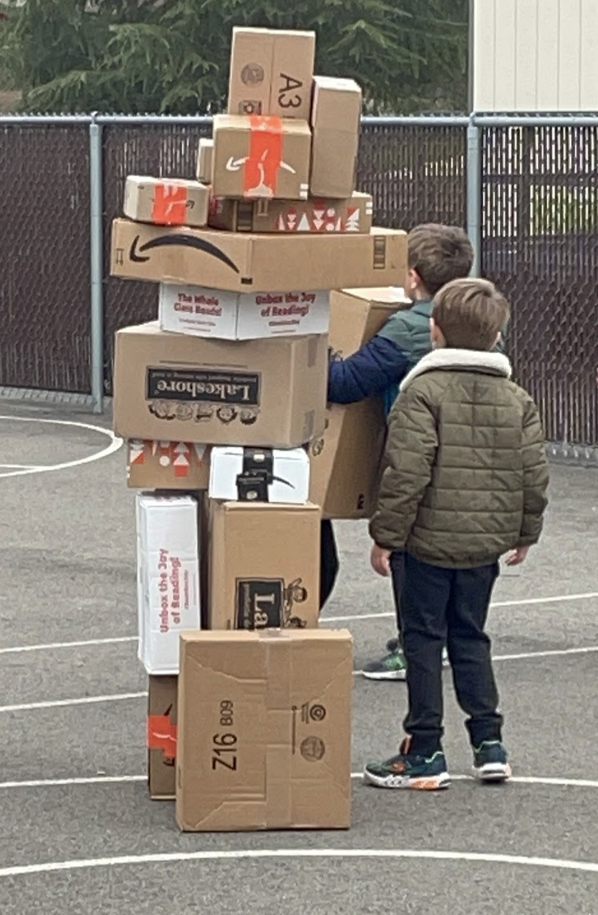
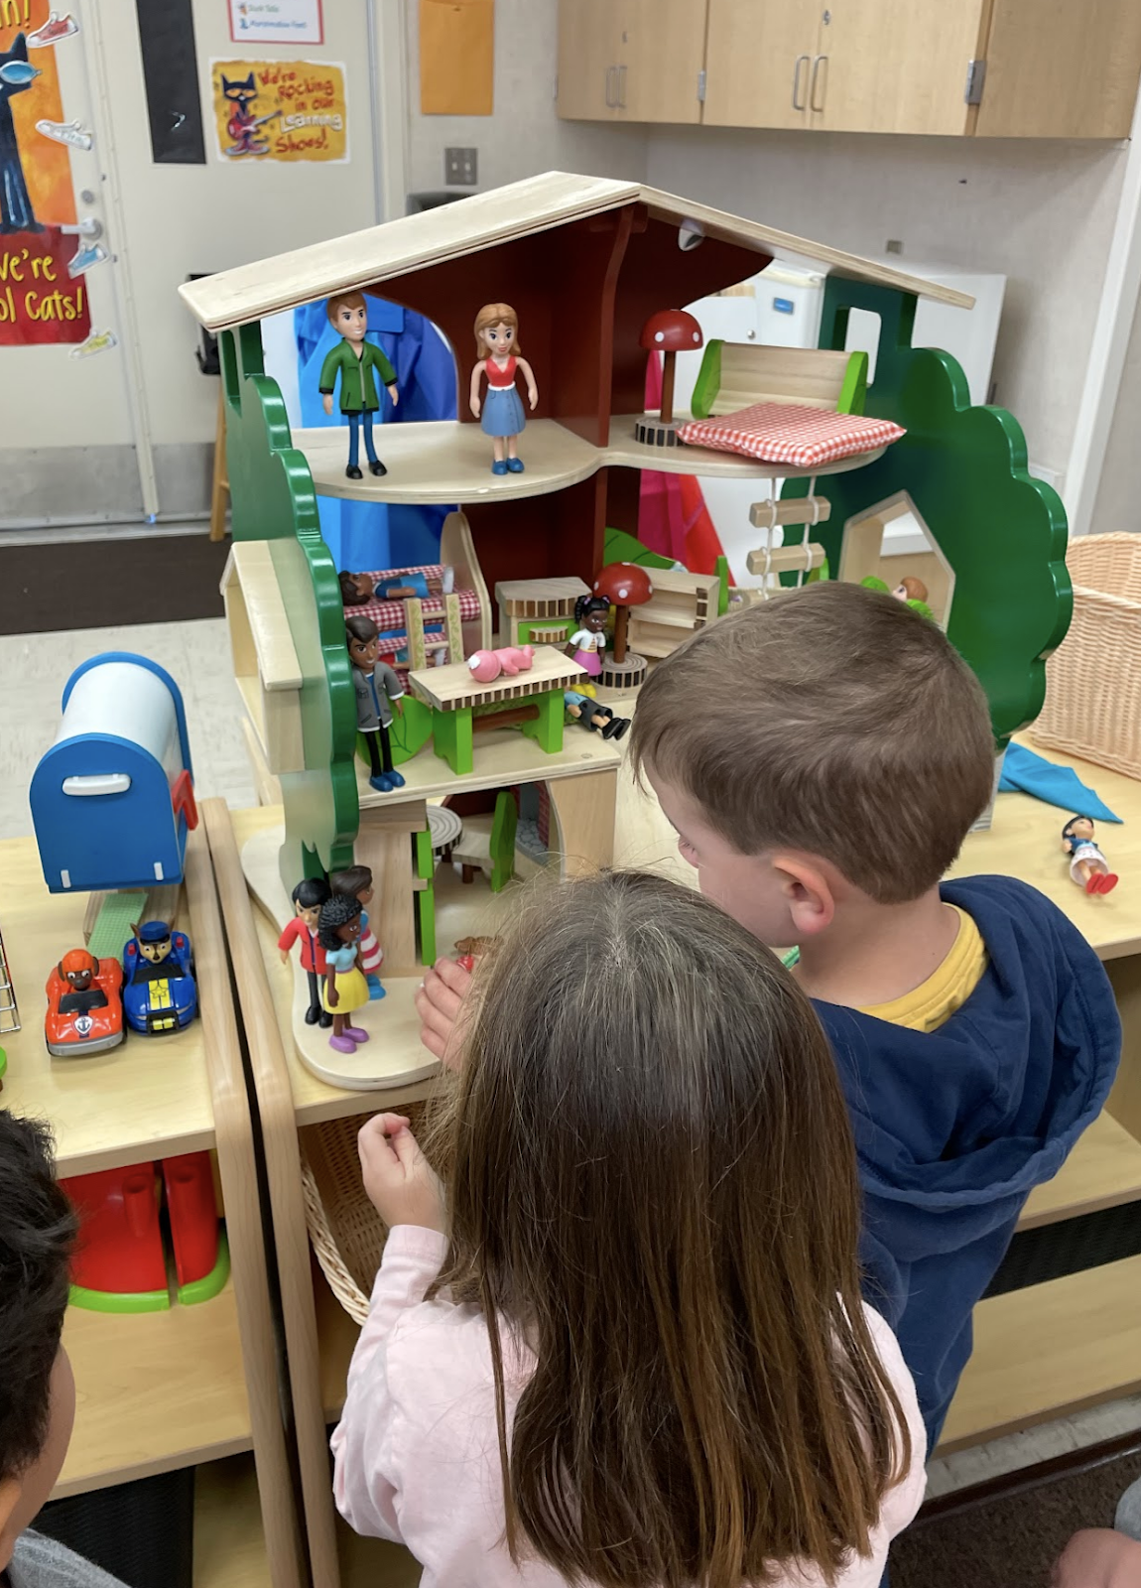
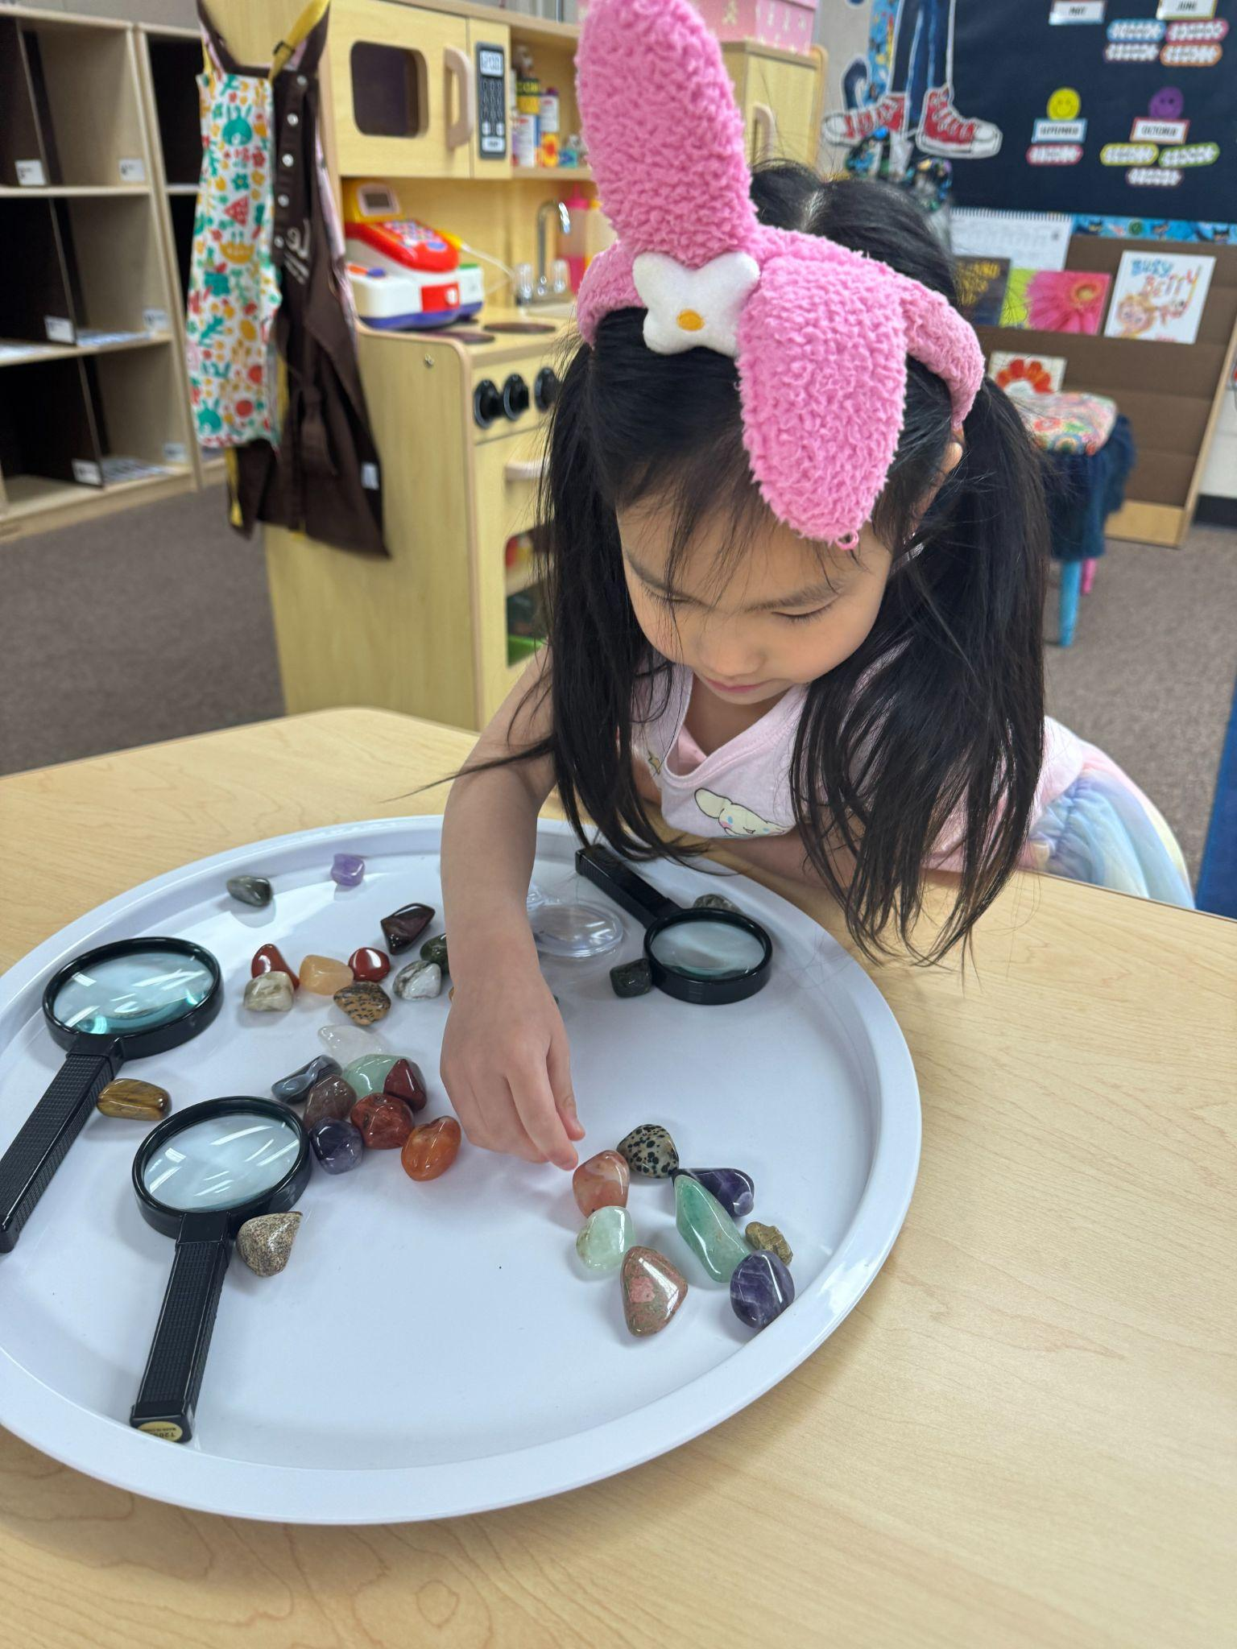
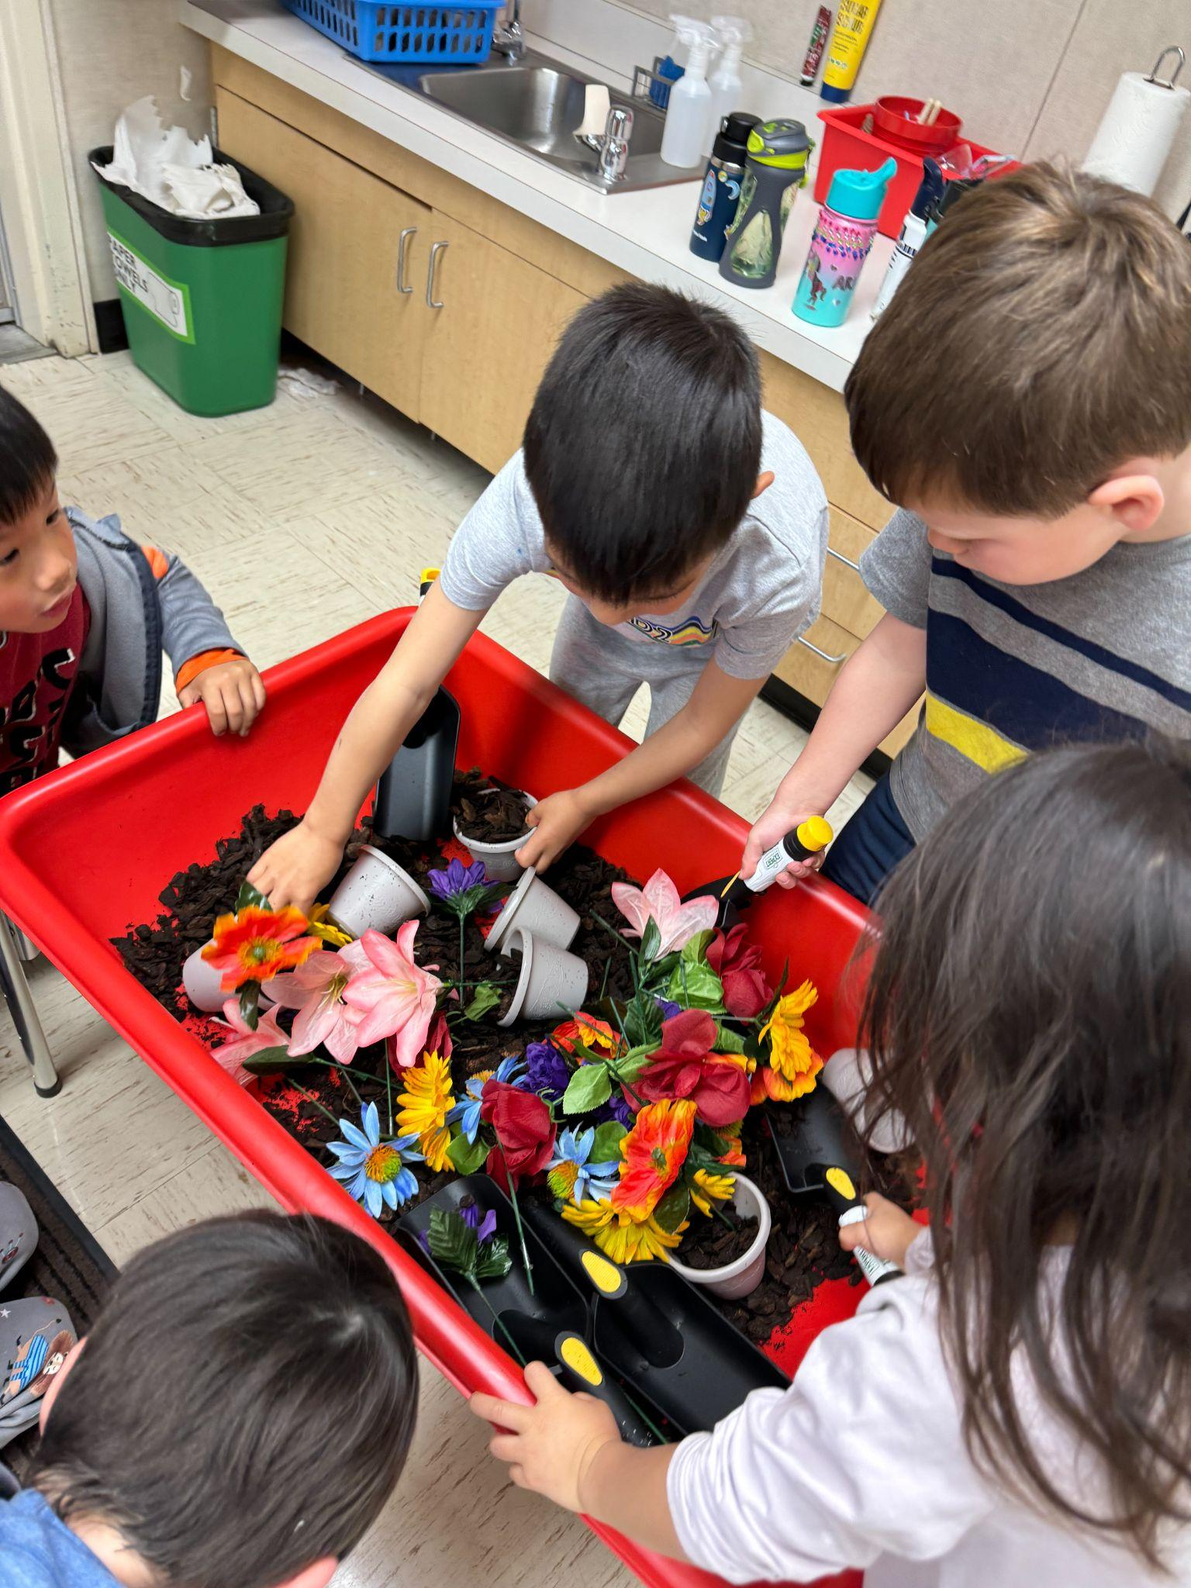
Play-Based Learning
What Does It Look Like?

Slide 5



What Does Your Child Need?
WATER BOTTLE: Well-sealed, reusable water bottle with a straw or spout filled with water only.
SNACK: Small, healthy, and packed in containers that your child can open independently. NO NUts Please!! (lunch will not be provided by TK).
A full change of clothes for bathroom accidents or messy play
TK TOTE BAG
Your Child’s name written on EVERYTHING!

Slide 6

Arrival PROCEDURES
AM begins at 8:00
PM begins at 11:30
ON WEDNESDAY…ALL TK ATTEND FROM 8 TO 11:30
ATTENDANCE IS TAKEN IN THE FIRST 10 MINUTES, IF THE GATE IS CLOSED YOU AND YOUR CHILD HAVE TO GO TO THE OFFICE TO CHECK IN AND GET A TARDY SLIP.
Notes:
The skills on the left are developed when your child gets to practice the skills on the right during their time in tk.

Slide 7



A typical day in tk
TK AM – 8:00 AM to 11:30 AM (Mon-Fri)
TK PM – 11:30 AM to 3:00 PM (Mon, Tues, Th, Fri)
8:00 AM-11:30 AM (Wed. ONLY)
Morning Meeting
Carpet and Calendar Time
Learning and Exploring Centers
Recess/Snack
Story and Music/Movement
Craft or Project
Free Choice
Closing/Dismissal

Slide 8




DISMISSAL PROCEDURE
AM TK will be dismissed at 11:30 from the K3 door. AM parents enter through the TK gate and wait by the front door (Kids Country and Larsons will know this procedure).
PM TK will arrive and line up in the hallway next to the TK yard (there will be a sign). Parents or caregivers will stay with their child until the teacher picks them up. At 3 PM TK will be dismissed at the K3 TK door.
**Per school rules, please leave the TK yard after you pick up your child and remember the TK playground is closed after dismissal.**

Slide 9

Call the school attendance line to report your child’s absence from school.
Please email and let us know if your child will be absent.
GOING TO BE ABSENT?

Slide 10
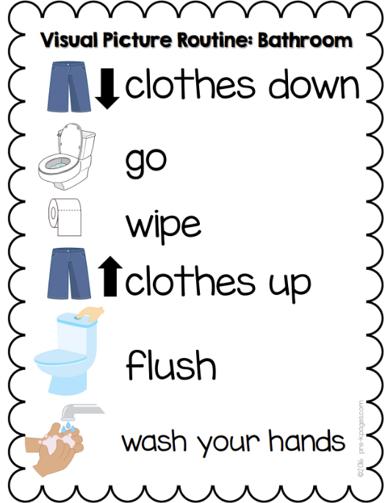
Toilet Learning
Our shared goal is to set all of our students up for success in being fully independent in their toilet learning.
A child is completely trained when they can:
Recognize that they need to go to the bathroom
Is able to wait/hold until getting to the bathroom
Does not need to wear pull-ups during the day
Does not need an adult to remind or assist in any part of the process

Slide 11
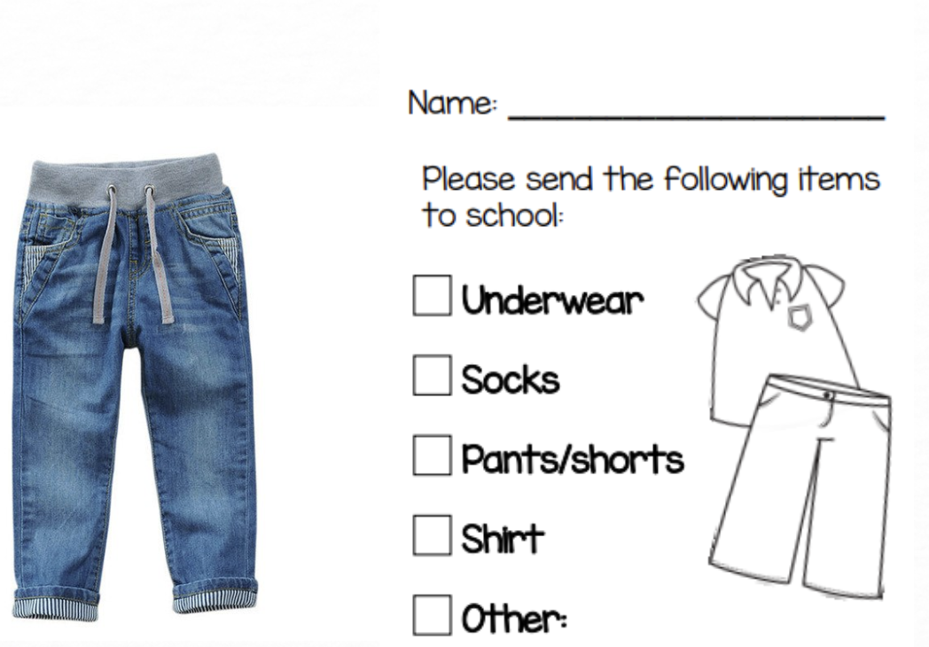

Accidents Happen!
Treat accidents with a casual, matter-of-fact and respectful manner.
Maintain a positive and reassuring attitude.
Ensure clothing is not impeding access.
Partner with your school team for a plan.
Send a change of clothes and shoes to school clearly labeled with your child’s first and last name.
Take note of accidents to identify patterns.
Provide reminders to use the bathroom.

Slide 12







CONFERENCES
Parent/teacher Fall conferences will be
October 5th - 9th
Report cards go home twice a year:
January and June

Slide 13

COMMUNICATION
We will send home Monday Folders each week. Please empty the contents and send it back the following days!
Make sure to sign up for the “Colts Connection” for important schoolwide information.
We will send out emails or letters to parents to keep you updated for special events and happenings.
https://gves.srvusd.net/ for more Green Valley school information.

Slide 14
Classroom Fund
Please consider donating to our TK class!
Funds for this will go directly towards your child's learning this year. This is how we fund for any supplies in our classroom! Look around! This is entirely funded by teacher and parent donation to the classroom fund specifically!
We are asking for $150 per child.
THANK YOU!!

Slide 15

QUESTIONS?
There are no silly questions!

Slide 16

Thank You!
LOOKING FORWARD TO A GREAT YEAR!
Love, Your TK Team!

