Slide 1
8th Grade Catalina Trip-Parent Meeting
November 13, 2025

Slide 2
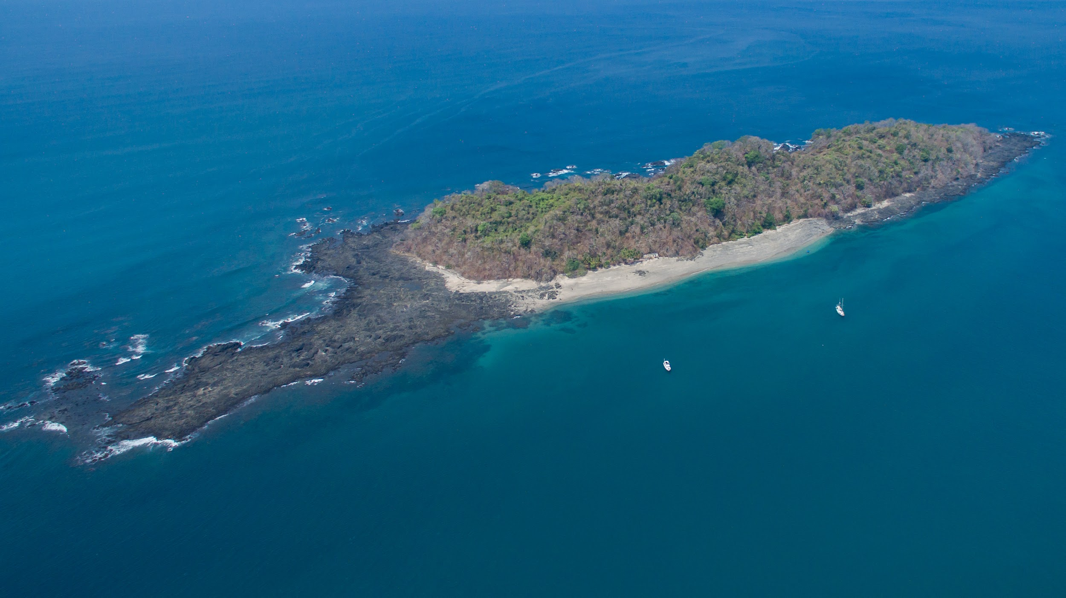
Catalina Island

Slide 3
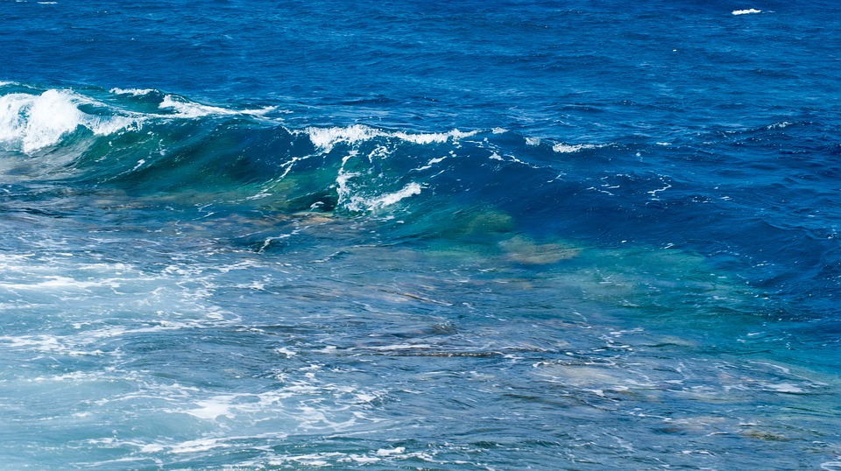
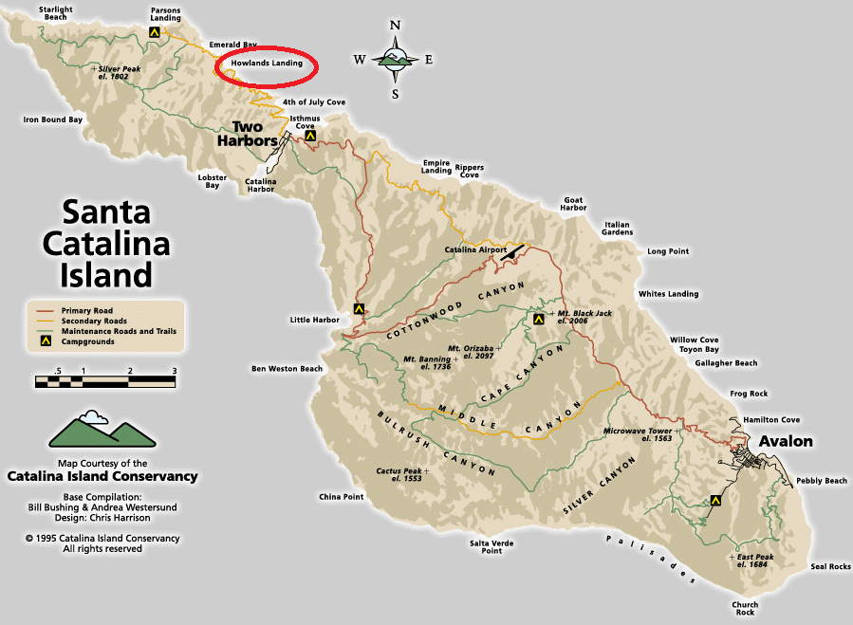
Howland’s Landing

Slide 4
C.E.L.P
To give students a positive view of themselves
To develop knowledge and respect for the outdoor world
To give students skills in communication, teamwork, and friendship building that will help them throughout life
To inspire youth to live more sustainably and take responsibility for their future

Slide 5
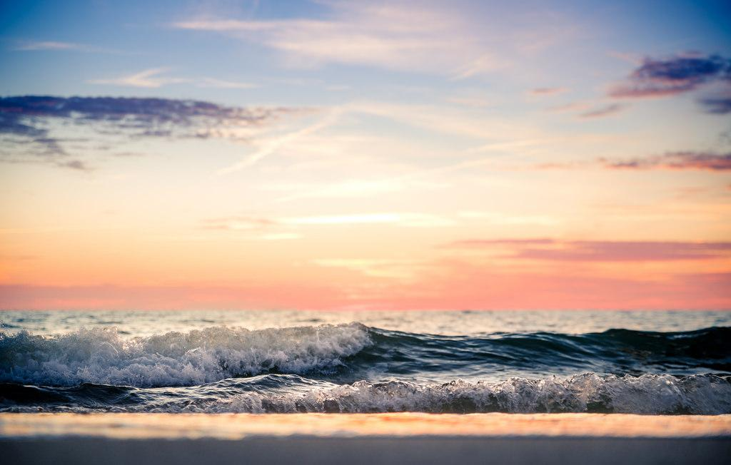
Catalina Trip
May 18th - May 21st
Be at school at 3:15am
Bus Ride to San Pedro – approx. 4hrs
Ferry to Catalina Island – approx. 1hr 30 min
Have lots of fun Monday - Thursday
Leave Catalina to San Pedro on Boat
Bus Ride Home - approx. 8:00 pm

Slide 6
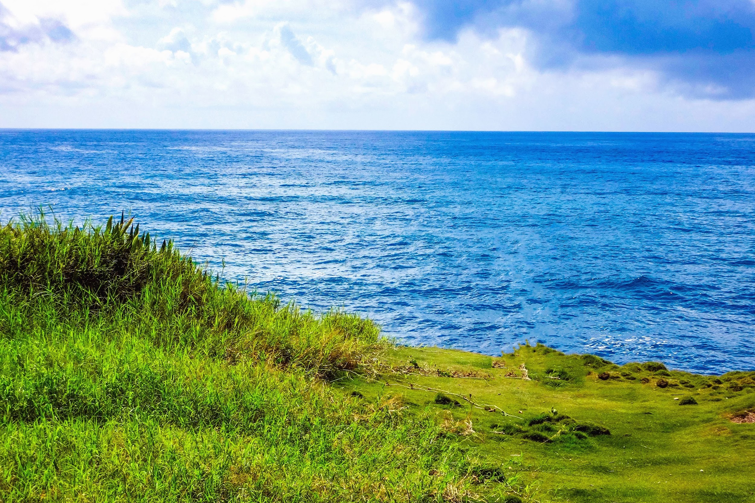

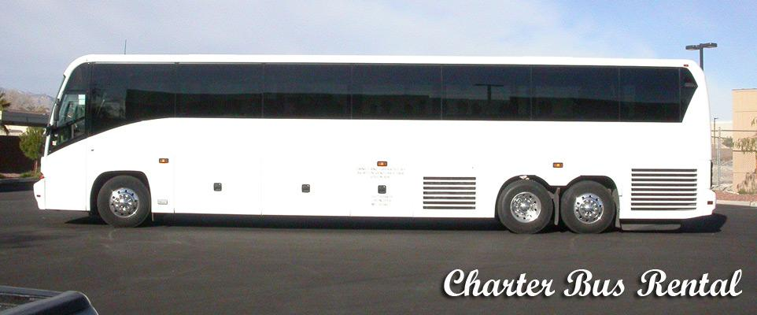
Transportation

Slide 7
Typical Camp Day Schedule
Wake 6:30 – 7:00
Breakfast 7:20 – 8:00
First Program 8:00-11:30
Lunch 11:30-12:00
Free time 12:00-2:00
Second Program 2:00-5:30
Dinner 5:30-6:00
Night Program 6:00-8:30
Free Time 8:30-9:00
Lights Out 9:00-10:00

Slide 8
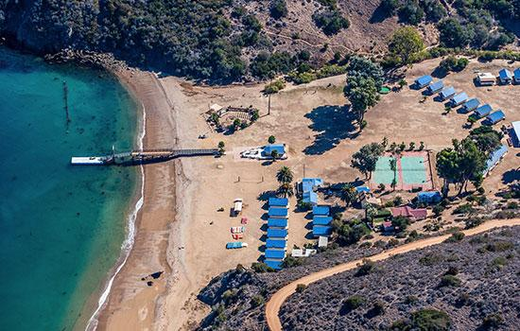

Slide 9
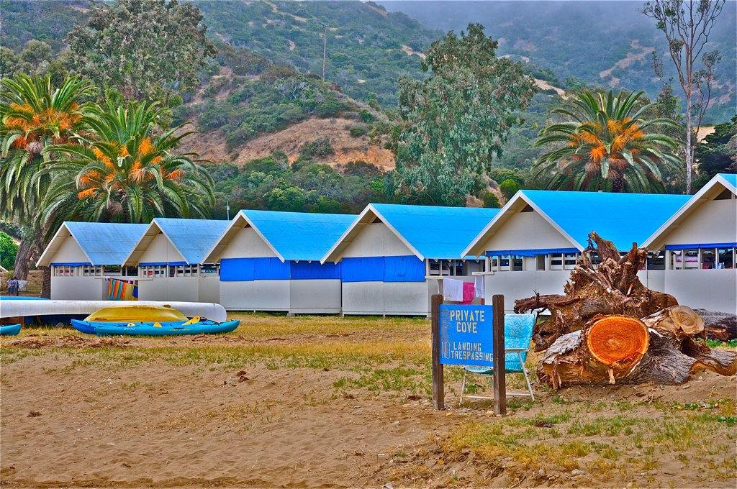

Slide 10
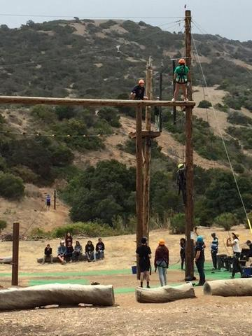
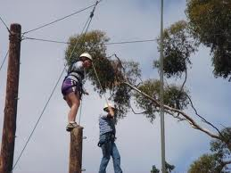
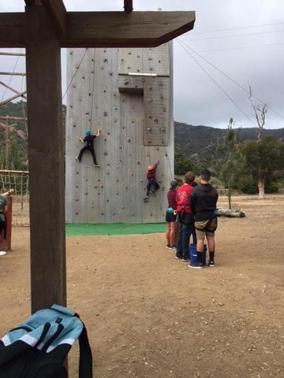
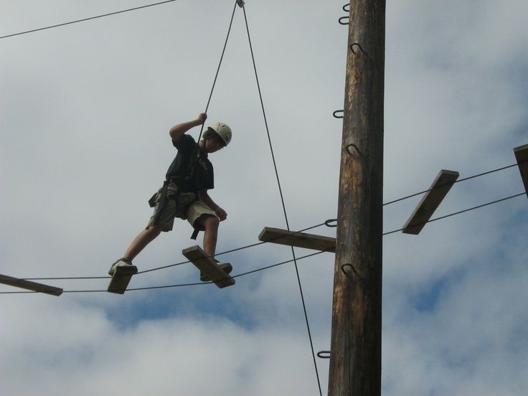
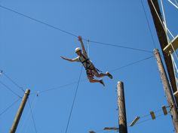
Ropes Course and Rock Wall

Slide 11
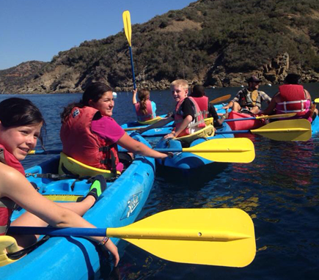
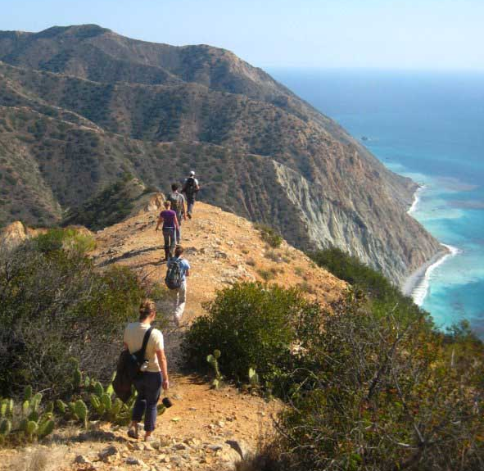
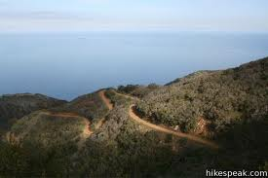
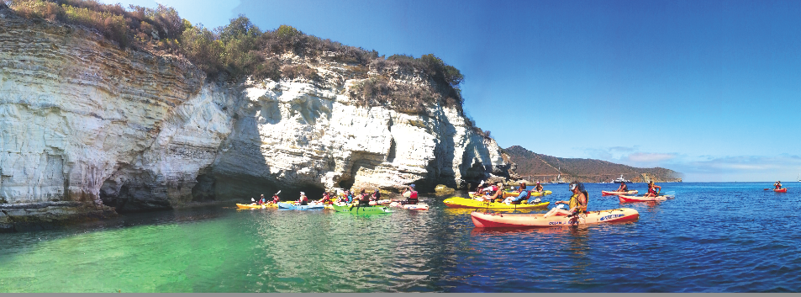
Kayaking & Hiking

Slide 12
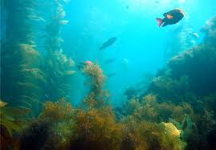
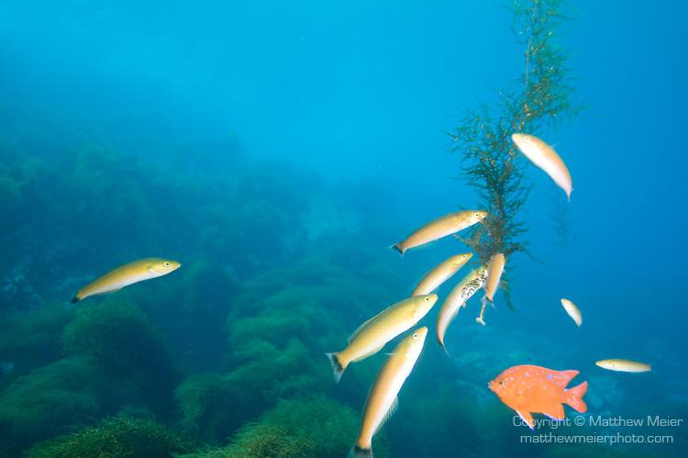
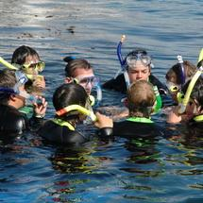
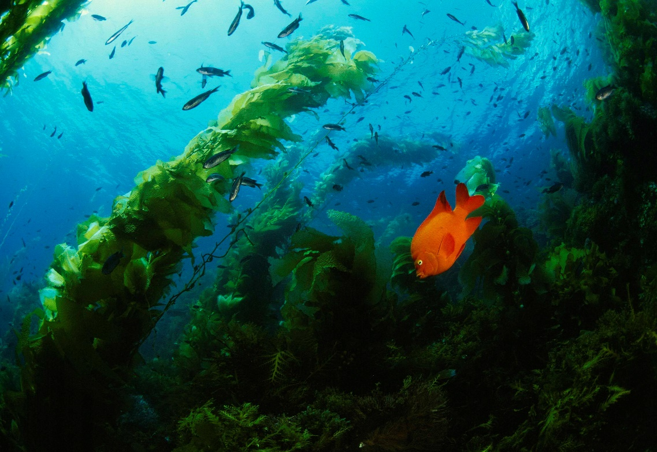
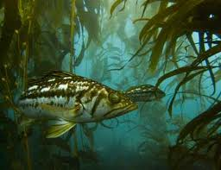
Snorkeling

Slide 13
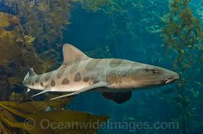
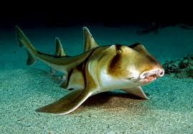
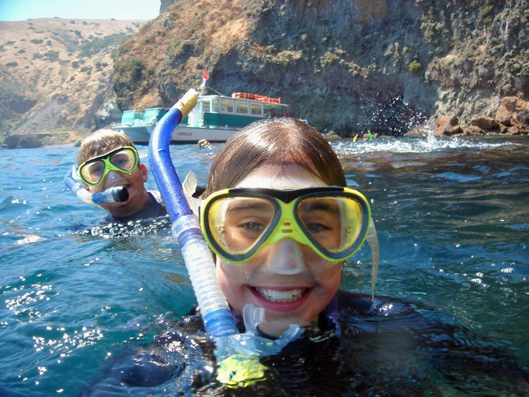
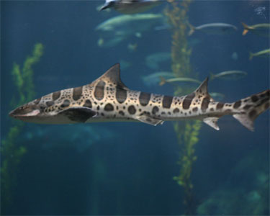
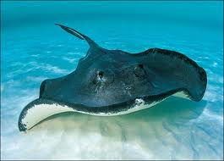
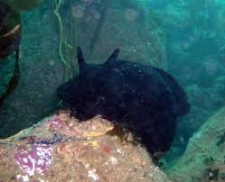
Snorkeling

Slide 14
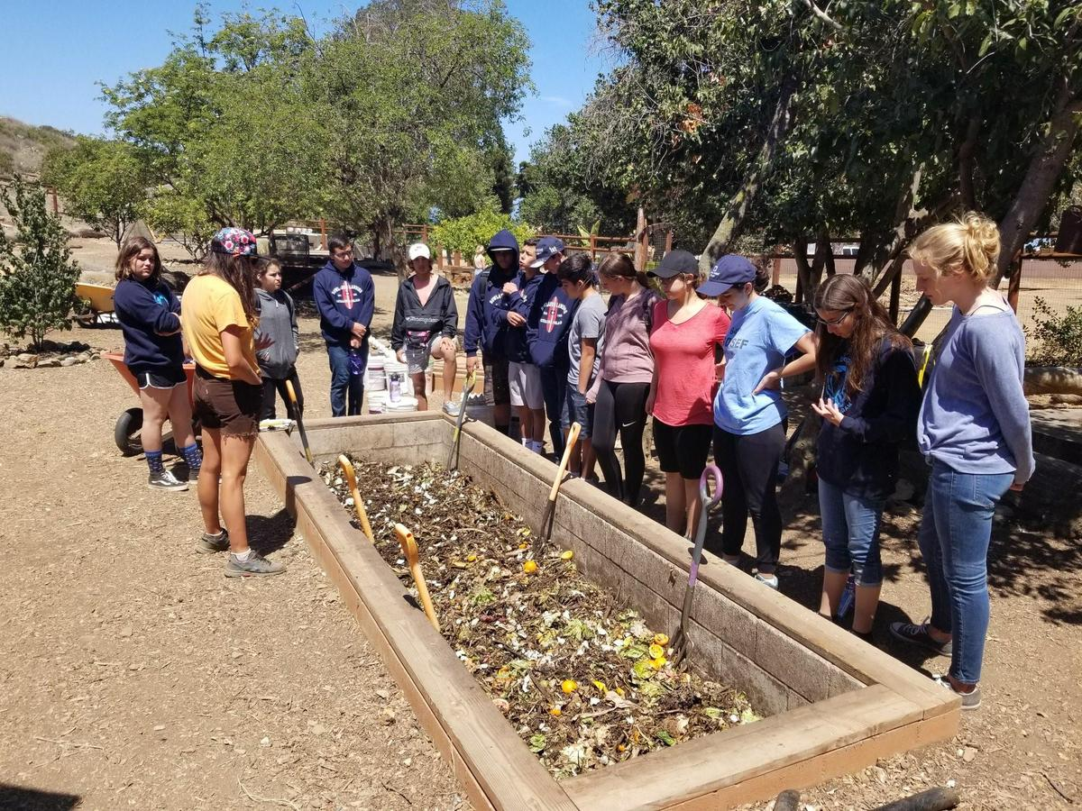
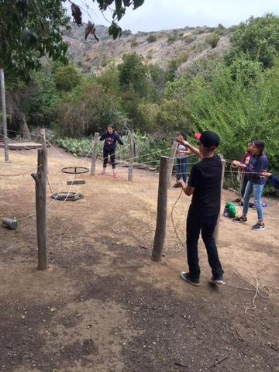
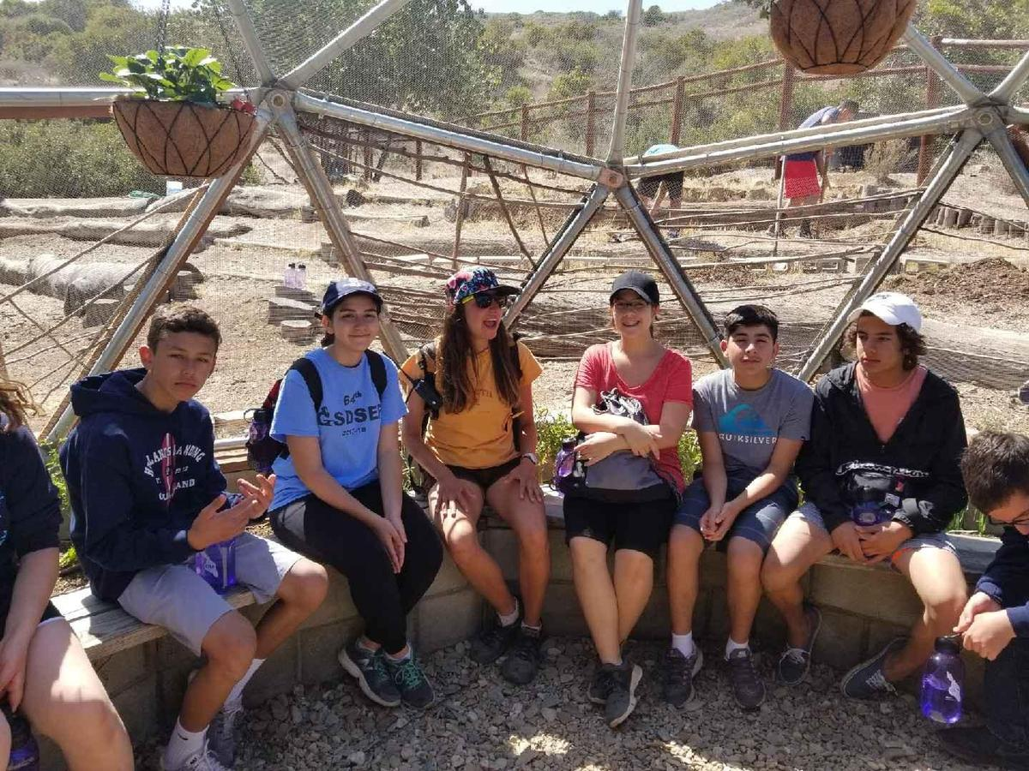
Sustainability & Team Building

Slide 15
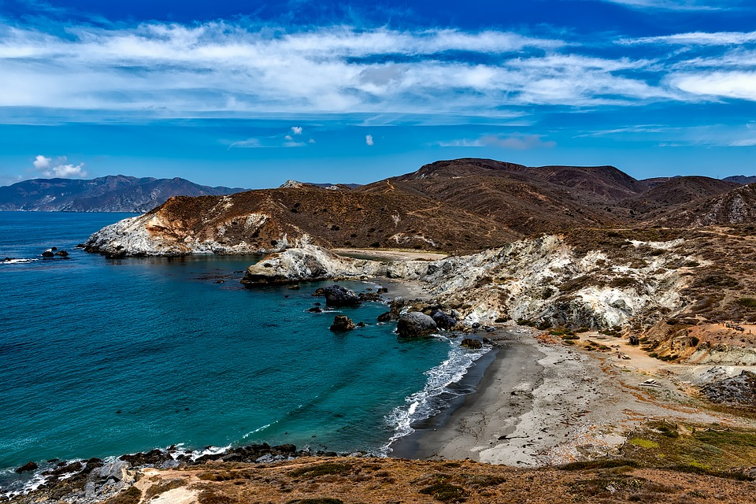
More Activities
Shoreline Investigation
Eco Hike
Sustainable Living
Team Building Activities
Pimovit Campfire/Skits
Night Sky
Garden and Composting
Free Time

Slide 16
Frequently Asked Questions
Will students be forced to participate in activities?-Students will be asked to complete a minimal level of participation Ex:put on wetsuit and get ankle deep in water
How will medication be administered-Students will be given medication by a staff member, a log will be kept to ensure medication is administered.

Slide 17
Frequently Asked Questions
Can students call home?-Students will only be allowed to contact home in case of emergencies.
Are phones allowed?-No, cell phones are not allowed on the campgrounds.
How many adults monitor each group?-2 adults will monitor each group. One staff member from McCabe/Corfman and one camp counselor from CELP per group of 12-15

