Slide 1
Infofinder le
NORTH EAST ISD
TRANSPORTATION DEPARTMENT
QUICK REFERENCE

Slide 2
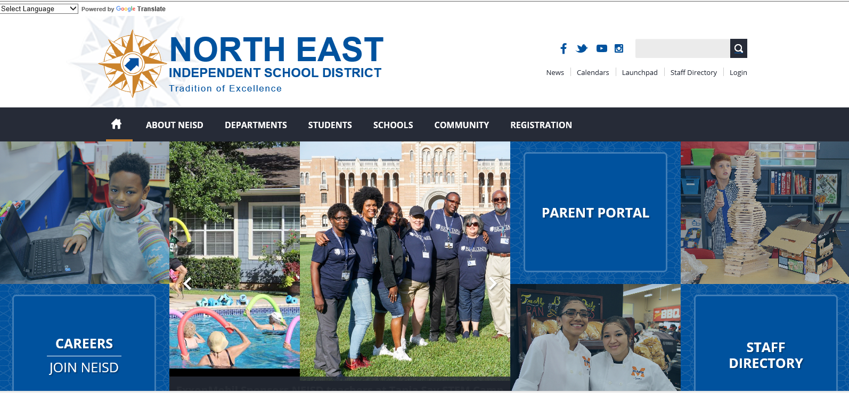
Select “Launchpad” on the NEISD home page

Slide 3
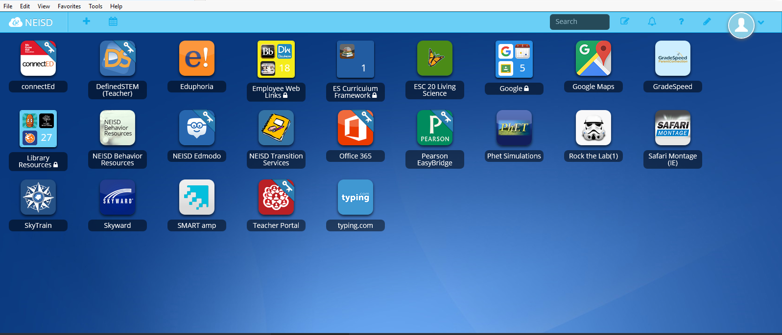
Select “Employee Web Links”

Slide 4
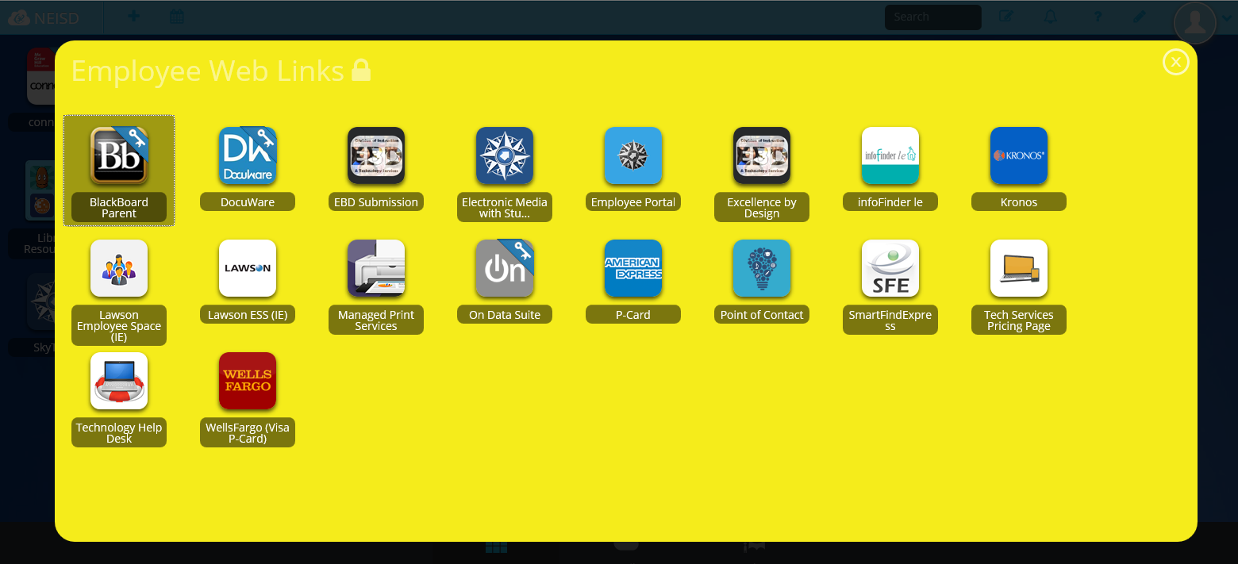
Select “infoFinder le”

Slide 5
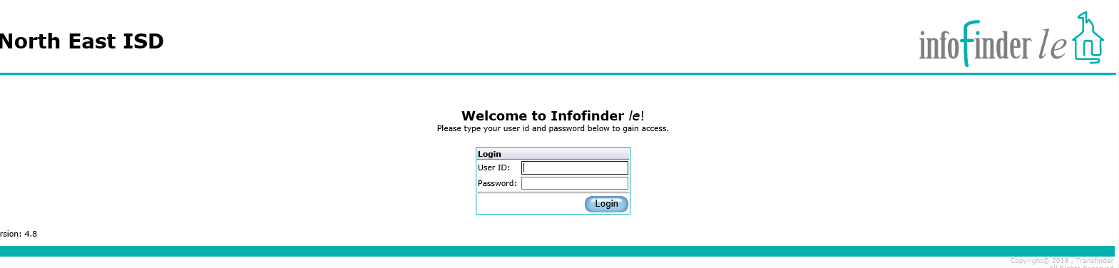
Enter your User ID: this is the first initial and last name that is used to log into your computer every day.
Enter password (all lower case) for the Password.
If you are an Admin Assistant or Bookkeeper and the above does not work please contact Anita Mills by either email (amills3@neisd.net) or call 210-356-9223 and ask to be set up.
Any teachers that need to be set up please have the Admin Assistant or Bookkeeper notify Anita to set you up.
Schools that allow teachers to enter their own trips will need to log in as the “School Name” with the password as admin.

Slide 6
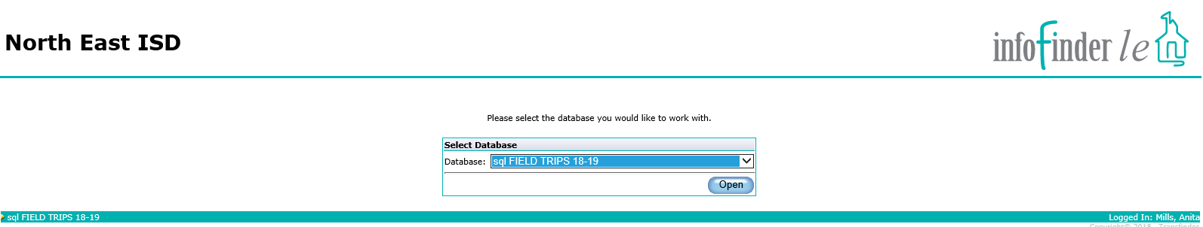
Select Database: SQL FIELD TRIPS (Current school year)

Slide 7
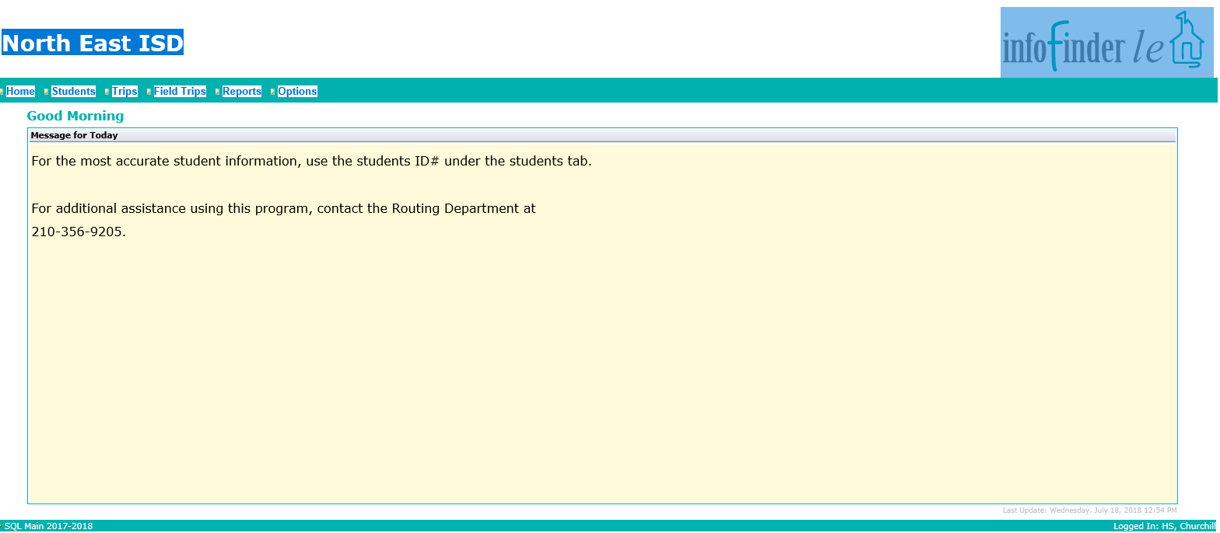
Select “Field Trips” Tab
Options is where you change your password

Slide 8
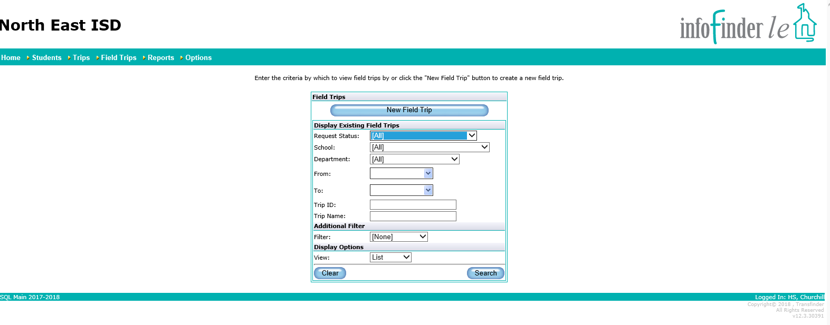
Select New Field Trip for entering new trip
Select Search to see what trips are entered and status of trip(s) entered

Slide 9
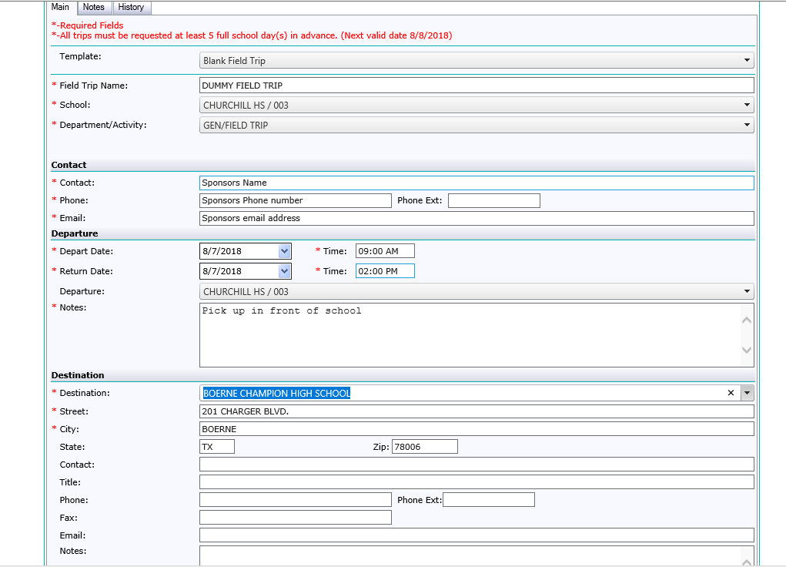
This is the type of trip being taken – Athletics, AVID, General, SAF/CAF
Add special instructions if making extra stops or different drop off or if nothing put None or N/A
Destinations are still being put in – send me your destination then it will be on drop down

Slide 10
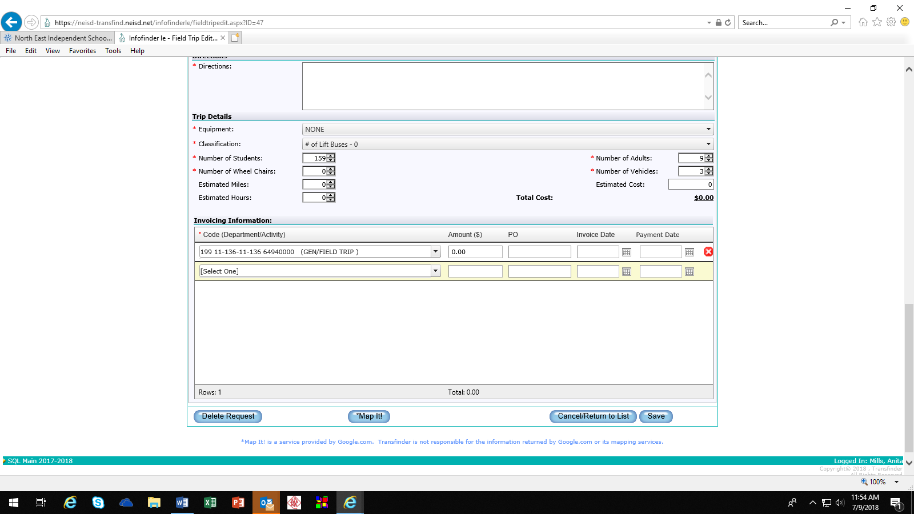
Add special instructions for drop off location, if making extra stops or N/A
Select Classification for lift buses – 0 – 5 or Campus Drivers
Vehicles = Buses
Remember the formula –
ES = 65
MS = 55
HS = 50
Passengers (This is for regular buses)
This is where you will select the budget code
If the budget code you need is not in the drop down menu please let Anita Mills know.
Remember to SAVE when you are finished

Slide 11
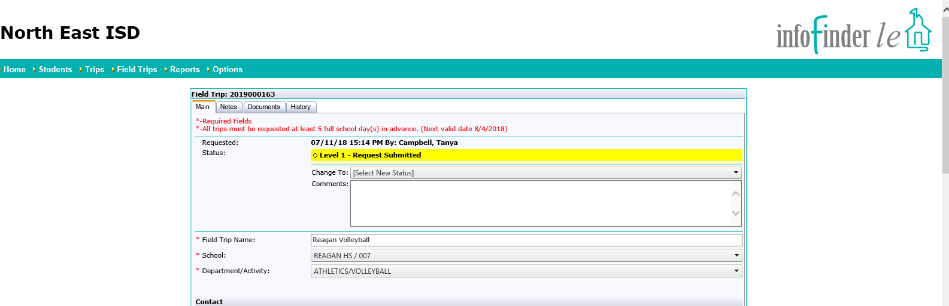
PRINCIPAL / ASSISTANT PRINCIPAL APPROVAL PROCESS
Must login to infofinder le to approve a trip
Change to: is the line where approval process happens.
Select small arrow for drop down menu to approve or deny trip.
Scroll to bottom of page and select SAVE. Trip has now been approved.

Slide 12
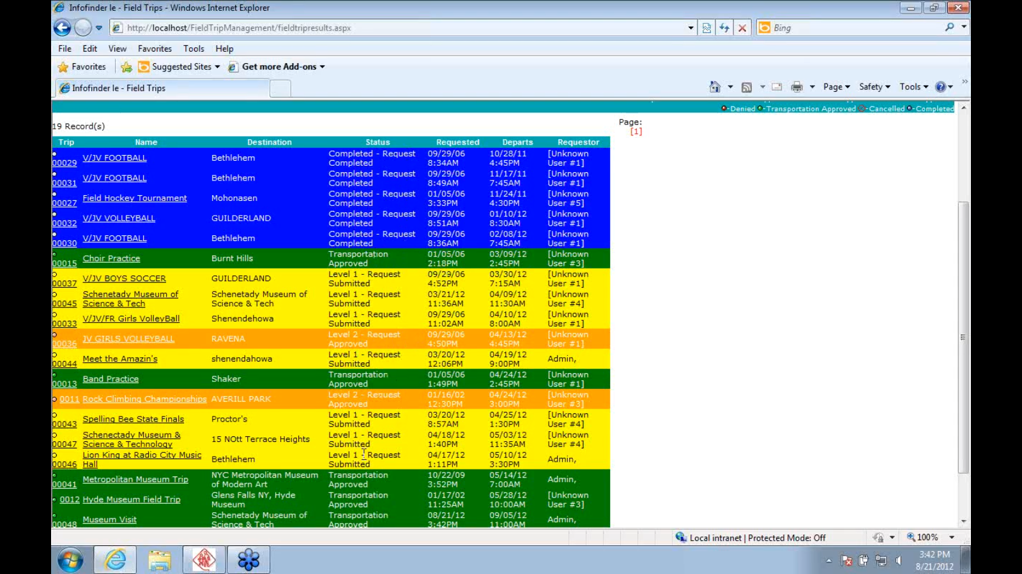
Yellow = Waiting on campus approval or someone higher
Orange = Trip approved by Principal
Green = transportation scheduled
White = Canceled trip
Blue = Trip completed / billed

