Slide 1

Winship-Robbins School District
2025-2026 Adopted BUDGET REPORT
Dawn Carl
Superintendent/Principal

Slide 2
Winship-Robbins Elementary School District
TABLE OF CONTENTS
2025-26 Adopted Budget Report
Budget Introduction Page 3
General Fund Revenue Assumptions Page 4
State Priorities Page 5
General Fund Revenues Pages 6 - 7
General Fund Expenditures Pages 8 - 10
General Fund Balance Page 11
Revenues Versus Expenditures Page 12
Other Funds Page 13
Multi-Year Projection Pages 14 - 15
Enrollment- ADA Trend Page 16

Slide 3
Winship-Robbins Elementary School District
INTRODUCTION
2025-2026 Adopted Budget Report
The County Office, under AB1200, requires districts to document and include written budget assumptions in the budget package submitted for approval to the district Board of Trustees. Each district should advise the Board, by way of budget documents, accompanied by a brief narrative, of the financial condition of the district. This report will provide the required information for the Board to certify the district’s ability to meet its financial obligations.
The Adopted Budget Report is presented by fund and major object account classification, reflecting 2024-2025 “Estimated Actuals” in columns A-C and the Proposed 2025-2026 “Budget” in columns D-F. The final column reflects the percentage of variance between the 2024-2025 Estimated Actuals and the proposed 2025-2026 Budget.
This report contains information and estimates that reflect the information contained in the Governor’s May Revision State Budget proposal.

Slide 4
Winship-Robbins Elementary School District
General Fund Revenue Assumptions
2025-2026 Adopted Budget Report
Local Control Funding Formula
Based on Prior Year ADA of 104.97 for 25/26
Property Taxes = $1,117,664– $1,079,127 In-Lieu = $38,537
State Aid = $1,325,975
Education Protection Account = $245,974
Other State and Federal Funding
Unrestricted Lottery = $191 per Annual ADA
Restricted Lottery = $82 per Annual ADA
Federal No Child Left Behind (Title I $12,637 & Title II $2,042)
REAP funding is projected at $16,426

Slide 5
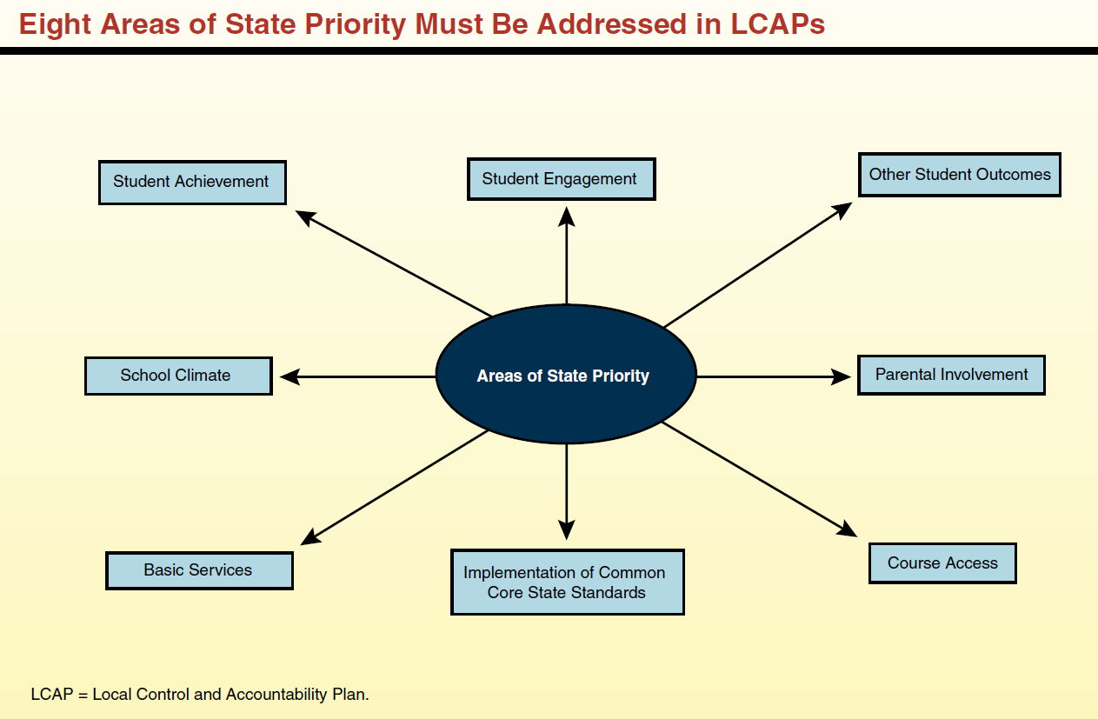
Eight State Priorities
2025-2026 ADOPTED BUDGET REPORT
Schools Services of California

Slide 6
Winship-Robbins Elementary School District
GENERAL FUND REVENUE SOURCES
2025-2026 Adopted Budget Report
The largest part of the revenue (48%) comes from Local Control Funding and is to be aligned to meet the eight state priorities. These priorities are on the previous slide.
The district will continue to receive federal funds for specific purposes and must continue to follow federal regulations. Federal funds consist of Title I, Title II, and REAP.
Other state funds consist of Mandated Costs, Lottery, Expanded Learning Opportunity Program (ELOP), Child Nutrition, Prop 28, Special Education Mental Health, Special Education Early Intervention Preschool, and California Community Schools Partnership Program (CCSPP).
Local resources include leases, interest, donations, local grants, and charter fiscal oversight fees.

Slide 7
Winship-Robbins Elementary School District
GENERAL FUND REVENUE SOURCES
2025-2026 Adopted Budget Report
Local Control Funding Formula $1,610,486
This budget source is based on the Prior Year ADA of 104.97 for 25/26. The LCFF calculator reflects a 2.30% COLA.
Federal Revenues $31,105
This revenue source includes Title I, Title II, and REAP. The $33,248 reduction in revenue is due to removal of carryover for REAP and Title II.
Other State Revenues $463,275
This revenue includes Unrestricted and Restricted Lottery, Mandated Costs, ELOP, Prop 28, Special Education Mental Health, Special Education Early Intervention Preschool, CCSPP, & STRS on Behalf. The $490 net decrease in revenue is due to the removal Cal SHAPE grant funds and Lottery carryover and an increase to STRS on Behalf.
Other Local Revenue $1,222,417
This revenue includes Interest, Rental Income, and Charter Fiscal Oversight revenue. The $121,598 increase is due to an increase in Charter Fiscal Oversight revenue.

Slide 8
Winship-Robbins Elementary School District
GENERAL FUND EXPENDITURES
2025-2026 Adopted Budget Report
Salaries and benefits represent 70% of the District’s total budget.

Slide 9
Winship-Robbins Elementary School District
GENERAL FUND EXPENDITURES
2025-2026 Adopted Budget Report
    CERTIFICATED SALARIES $848,185
          Salary projections are based on 9 certificated FTE; and 1 management FTE, (.7 FTE Principal; .3 FTE Superintendent). The expenditure has an increase of $14,809 due to step and column increases.
          CLASSIFIED SALARIES $785,369
          Salary projections are based on 14 FTEs and known staffing needs, including extra-duty and overtime. The expenditure has an increase of $62,886 due to the addition of 0.97 classified FTE & step and column increases.
          EMPLOYEE BENEFITS $634,255
          Benefits are based on projections that reflect the changes in the above salary expenditures. 25-26 STRS rate is 19.10% & 25-26 PERS rate is 26.81%. The increase of $44,660 due to changes listed in the above salary expenditures.
    BOOKS AND SUPPLIES $145,209
    Projected instructional materials and supplies expenses include core and supplemental instructional materials, custodial and maintenance supplies, and technology related expenditures. This expenditure is reduced by $78,660 due to the removal expenditures related to one-time funds for AMIM & Medical Mini Grant. Additionally, carryover for Lottery and REAP was removed.
    SERVICES, OTHER OPERATING EXPENSES $645,773
    Projected services and other operating expenses include professional development for classroom staff; online instructional and intervention programs; Expanded Learning Opportunity Program (ELOP) services; maintenance, custodial, and repair services; nutrition; drinking water delivery; and utilities. Overall, this expenditure reflects a net decrease of $3,622, primarily due to reduced travel and conference costs under the California Community Schools Partnership Program (CCSPP) and the removal of expenditures associated with the Learning Recovery Emergency Block Grant. However, costs related to Unrestricted and ELOP services have increased.

Slide 10
Winship-Robbins Elementary School District
GENERAL FUND EXPENDITURES
2025-2026 Adopted Budget Report
    CAPITAL OUTLAY $100,000
    The $157,911 decrease is due to the completion of projects including the Winship House renovation, science room flooring installation, window replacements, tennis court resurfacing, and HVAC system replacement.
    OTHER OUTGO $88,308
    The decrease of $3,983 is directly related to the increase in Special Education Excess Costs.
    INTERFUND TRANSFERS IN/OUT $0
    No change.
    CONTRIBUTIONS TO RESTRICTED PROGRAMS $413,150
    Contributions to restricted programs include contributions to Child Nutrition, Special Education, Routine Restricted Maintenance, California Community School Partnership Program and Preschool.

Slide 11
Winship-Robbins Elementary School District
GENERAL FUND BALANCE
2025-2026 Adopted Budget Report
The estimated ending balance for the 2025-2026 year is $3,523,612. Of this amount, $162,355 has been designated for economic uncertainties as required by the State of California.

Slide 12
Winship-Robbins Elementary School District
REVENUES & TRANSFERS IN vs. EXPENDITURES & TRANSFERS OUT
2025-2026 Adopted Budget Report

Slide 13
Winship-Robbins Elementary School District
OTHER FUNDS
2025-2026 Adopted Budget Report
Student Activities Fund – 2025-2026 ending fund balance is projected to be $3,489.
Child Development Fund – 2025-2026 ending fund balance is projected to be $3,968.
Deferred Maintenance Fund – 2025-2026 ending fund balance is projected to be $20,718.
Special Reserve Fund - 2025-2026 ending fund balance is projected to be $437,498.
Capital Facilities Fund (Developer Fees) - 2025-2026 ending fund balance is projected to be $14,013.
County Schools Facilities Fund - 2025-2026 ending fund balance is projected to be $0

Slide 14
Winship-Robbins Elementary School District
MULTI-YEAR PROJECTION (MYP) ASSUMPTIONS
2025-2026 Adopted Budget Report
Winship-Robbins Local Control Funding for the future two years has been calculated using 3-Prior Year Average ADA of 99.17 in 26/27 and 97.82 in 27/28. No changes in Federal ,State, and Local revenues.
Expenditure adjustments are as follows:
Certificated Net Increase in 26-27 due to Step & Column increases while removing extra time salaries from Educator Effectiveness. Step and Column increase are projected for 27-28.
Classified Step & Column increases are projected for 26-27 & 27-28.
Benefits Increased to cover the changes listed above along with increases in PERS in 26/27 & 27/28. STRS rates are projected to be 19.10% in 26/27 & 27/28. PERS rates are projected to be 26.90% and 27.80% in 26/27 & 27/28, respectively.
Supplies Supplies decreased due to the removal of one-time Educator Effectiveness funds and Prop 28, while applying an applied rate of 2.98% to unrestricted supplies in 2026–27. For 2027–28, supplies increased by an applied rate of 2.77% for unrestricted supplies, with restricted supplies remaining flat.
Services Services for 26–27 increased by an applied rate of 2.98%, along with the removal of Educator Effectiveness-related services. For 27–28, services increased by an applied rate of 2.77%, while California Community Schools Partnership Program (CCSPP) services remained flat.
Capital Outlay Decreased in 26-27 due to completion of Asphalt repairs and flooring project in 25-26. No adjustments in 27-28.
Other Outgo No adjustments.
Transfers-Out No adjustments.
Contributions Contributions include Routine Restricted Maintenance, balancing Special Education, Child Nutrition Services, Preschool, and the California Community Schools Partnership Program (1/3 match requirement).
Other Sources/Uses No adjustments.

Slide 16
Winship-Robbins Elementary School District
Enrollment – ADA TRENDS
2025-2026 Adopted Budget Report
*For first 4 years, CBEDS enrollment used. For the current year, projected enrollment used.

