Slide 1

ACTIVITY FUND ACCOUNTING PROCEDURES 2025-2026 School Year
North East ISD
INFORMATION FOR SPONSORS
Notes:
Welcome to the new School Year with North East ISD. If you are watching this training, you may have been selected to be a Sponsor for a Campus or Student Activity Account, also known as CAF or SAF. This presentation will provide you with procedures for making deposits, fundraising and placing orders. For more in-depth information, please refer to the Sponsor Handbook located under the Budget and Finance webpage.

Slide 2
INTRODUCTION to the Sponsor Handbook
Employees shall be subject to disciplinary action as deemed appropriate by the Superintendent or designee for a violation of this policy, depending on the severity of the violation. Such consequences may include, but are not limited to, verbal or written counseling, reprimands, suspension with or without pay, SBEC notification for certificate revocation and termination. The District may undertake appropriate investigations of any potential violation of this policy by any employee and may take action based upon the preponderance of the evidence revealed by such investigation. Employees who violate this policy may also be subject to potential civil and/or criminal violations of local, state, and federal law, depending on the conduct involved. Additionally, Sponsors may be required to reimburse funds that are lost or stolen while in their possession.
Notes:
Read the slide.

Slide 3
INTRODUCTION to the Sponsor Handbook
The management of Activity Funds is addressed in the Board Policy CFD (Local) and Administrative Regulation CFD(R). Sponsors should become familiar with the policies and associated regulations.
You can find the policies and regulations on the NEISD internet
NEISD.net/About NEISD/Board of Trustees/Board Policies.
Following these procedures is required by CFD (Local).
Notes:
The management of Activity Funds is addressed in the Board Policy CFD (Local) and Administrative Regulation CFD(R). Sponsors should become familiar with these policies and associated regulations, as you are required to follow these regulations. If at any time you need any assistance with these Policies and Regulations, please reach out to your Campus Bookkeeper or the Budget and Finance department. We are here to assist you at any time.
You can find the policies and regulation on the NEISD internet under NEISD.net/About NEISD/Board of Trustees/Board Policies.
Following these procedures is required by CFD (Local).

Slide 4
INTRODUCTION to the Sponsor Handbook
CFD Local Policy:
Fiduciary Responsibility
The Superintendent, principal, and sponsor, as applicable, shall be responsible for the proper administration of District and campus activity funds and student activity funds, including the depositing and withdrawing of such funds, in accordance with state law and local policy, District-approved accounting practices and procedures, and the TEA Financial Accountability System Resource Guide.
Notes:
CFD Local Policy states:
Fiduciary Responsibility
The Superintendent, principal, and sponsor, as applicable, shall be responsible for the proper administration of District and campus activity funds and student activity funds, including the depositing and withdrawing of such funds, in accordance with state law and local policy, District-approved accounting practices and procedures, and the TEA Financial Accountability System Resource Guide.

Slide 5
INTRODUCTION to the Sponsor Handbook
CFD Local Policy states:
Student Activity Funds
The Superintendent or designee shall ensure that student activity accounts are maintained to manage all class funds, organization funds, and any other funds collected from students for a school-related purpose. The principal or designee shall issue receipts for all funds prior to their deposit into the appropriate District account at the District depository on the same day if possible.
Student activity funds shall be included in the annual audit of the District’s fiscal accounts. [See CFC]
Notes:
CFD Local Policy states:
Student Activity Funds
The Superintendent or designee shall ensure that student activity accounts are maintained to manage all class funds, organization funds, and any other funds collected from students for a school-related purpose. The principal or designee shall issue receipts for all funds prior to their deposit into the appropriate District account at the District depository on the same day if possible.
Student activity funds shall be included in the annual audit of the District’s fiscal accounts. [See CFC]

Slide 6
INTRODUCTION to the Sponsor Handbook
CFD Local Policy states:
Use and Expenditure
Funds collected by student groups shall be used only for purposes authorized by the organization or upon approval of the sponsor. The principal or designee shall approve all disbursements. All funds raised by student organizations must be expended for the benefit of the students.
Notes:
CFD Local Policy states:
Use and Expenditure
Funds collected by student groups shall be used only for purposes authorized by the organization or upon approval of the sponsor. The principal or designee shall approve all disbursements. All funds raised by student organizations must be expended for the benefit of the students.

Slide 7
INTRODUCTION to the Sponsor Handbook
CFD Local Policy:
District and Campus Activity Funds
The Superintendent shall establish regulations governing the expenditure of District and campus activity funds generated from vending machines, rentals, gate receipts, concessions, and other local sources of revenue over which the District has direct control. Funds generated from such sources shall be expended for the benefit of the District or its students and shall be related to the District’s educational purpose.
Approval
Approval from the immediate supervisor or designee shall be obtained prior to a disbursement being made to any employee, including the principal.
Notes:
CFD Local Policy states:
District and Campus Activity Funds
The Superintendent shall establish regulations governing the expenditure of District and campus activity funds generated from vending machines, rentals, gate receipts, concessions, and other local sources of revenue over which the District has direct control. Funds generated from such sources shall be expended for the benefit of the District or its students and shall be related to the District’s educational purpose.
Approval
Approval from the immediate supervisor or designee shall be obtained prior to a disbursement being made to any employee, including the principal.

Slide 8
TYPES OF ACTIVITY FUNDS

Slide 9

TYPES OF ACTIVITY FUNDS
Campus Activity Funds (CAF)
These funds belong to the campus and the District.
The account numbers are in the 900 and 1000 series.
The funds are treated just like Budget Funds; therefore, the money expended from these accounts must benefit the student/campus and must have a public purpose in the realm of education.
SAF/CAF purchase orders must be completed for purchases from CAF accounts for purchases over:
$1,500.00 for High Schools and
$500.00 for Elementary and Middle Schools.
State and District guidelines must be followed when expending monies from these accounts; therefore, using the district approved bid vendor list is very important.
Notes:
Campus Activity Funds or CAF accounts, as they are referred to, are Campus Funds and are treated just like Budgeted Funds. Examples of this type of account would be the Campus Fund, Campus Fund 1st grade, Fine Arts, PE. Typical deposits to this type of account would be monies from a Campus wide fundraiser, Textbooks, Parking, Counselors, Athletics, Coke commissions, etc. All purchase request must be on a completed SAF/CAF PO form, signed by the Principal and then given to the Campus Bookkeeper for processing. All purchases are required to be made from a District Approved Bid Vendor.

Slide 10

TYPES OF ACTIVITY FUNDS
Student Activity Funds (SAF)
These are funds in which the school holds in trust for the student groups.
The account numbers are in the 400 through 800 series.
The students in the SAF organization determine how the money is spent (NOT the sponsor) .
Meeting minutes approving each expenditure will be attached to all requests and signed by the SAF Officers (NO photocopies).
SAF/CAF purchase orders must be completed for purchases from SAF accounts for purchases over:
$1,500.00 for High Schools and
$500.00 for Elementary and Middle Schools.
State and District guidelines must be followed when expending monies from these accounts; therefore, using the district approved bid vendor list is very important.
Notes:
Student Activity Funds or SAF Accounts as they are called, are funds which the district holds in trust for the student groups. Examples of this type of account would be, PALS, Chess Club, Faculty Fund, Student Council, NJHS, Band, Spirit Club, Debate, Yearbook. Students accounts will have officers and the Students determine how the money is spent, not the sponsor. Meeting minutes approving each expenditure will be attached to all requests and signed by the SAF Officer’s prior to any purchase. No photocopies will be accepted. All purchase request must be on a completed SAF/CAF PO form attached to the signed student minutes, signed by the Principal and then given to the Campus Bookkeeper for processing. All purchases are required to be made from a District Approved Bid Vendor.

Slide 11
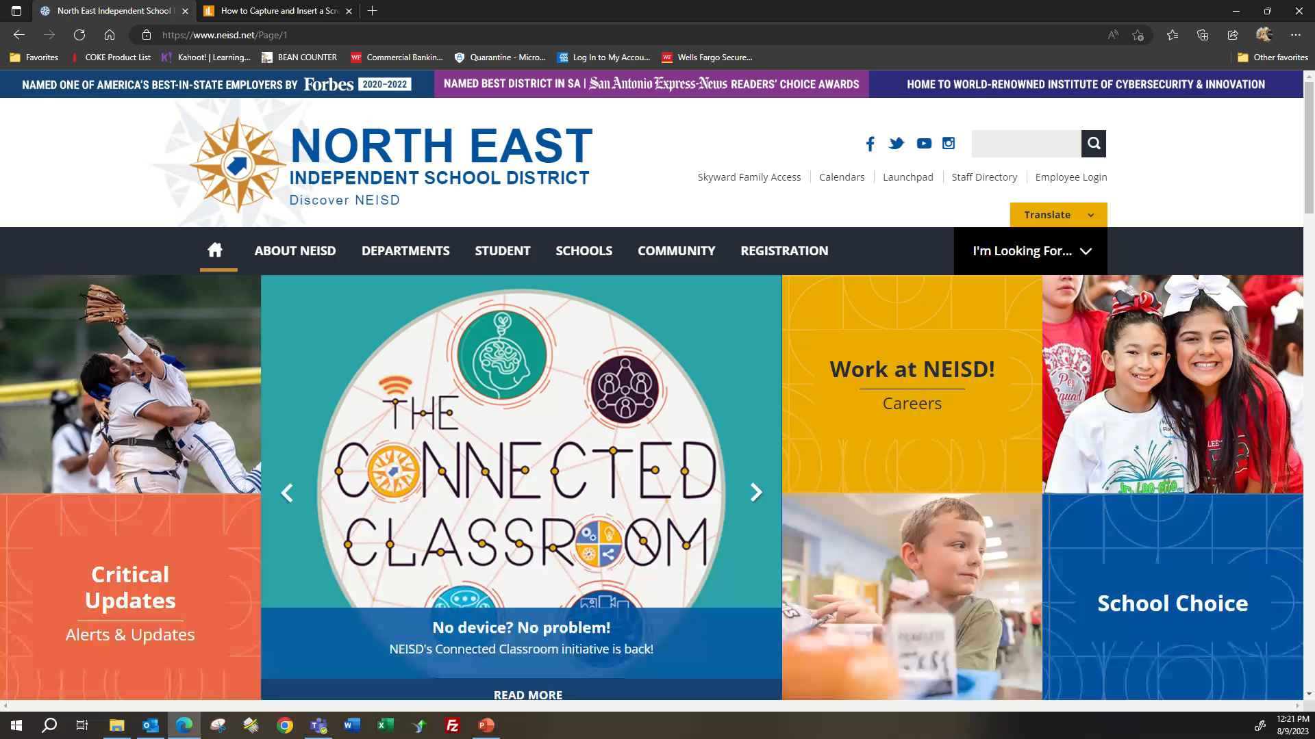
Notes:
The District Bid Vendor List is located under the Procurement & e-Commerce web page. In order to access this page, please be sure you are logged into your MyNEISD. Go to Departments, Purchasing & eCommerce, Scroll down and go to Purchasing – PO Code/Vendor List, then Click Here to view the PO/Vendor list.
This is a searchable PDF. On your keyboard, press Ctrl F and enter the Vendor Name you are searching for or the type of service or product you are looking for. Example of this would be, Whataburger. This will come up and show you what locations you may use. Only locations on this Vendor list can be used, so please be sure when placing an order, you have the right location. Another example would be Hobby Lobby. You can see they are a Bid Vendor, but are not EDGAR compliant, meaning you cannot use Federal Funds for these purchases. If you don’t know where you may purchase a product, you could search for an item: example, food. This will bring up vendors who are on the bid list and are “allowable” vendors. By pressing enter after your search, if there are any other vendors under this list with your description, the search will filter through each one until it reaches the end. You may always check with your Campus Bookkeeper if you are unable to locate a vendor for assistance. The is a living breathing document and can be updated at anytime, so please do not print this.

Slide 12
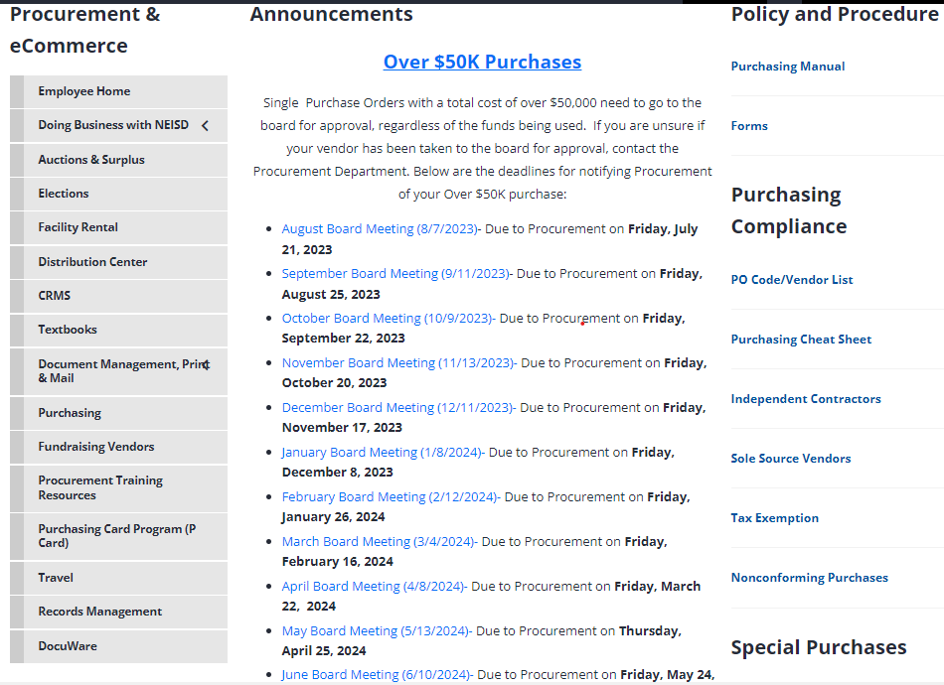
TYPES OF ACTIVITY FUNDS
Student Activity Funds (SAF)
Notes:
The District Bid Vendor List is located under the Procurement & e-Commerce web page. Go to Purchasing – PO Code/Vendor List.

Slide 13
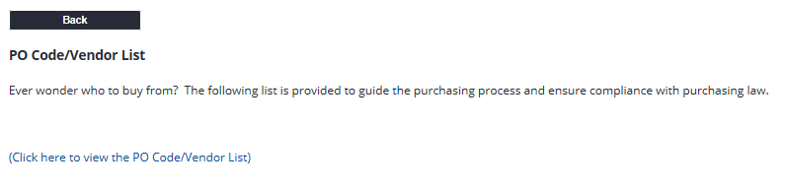
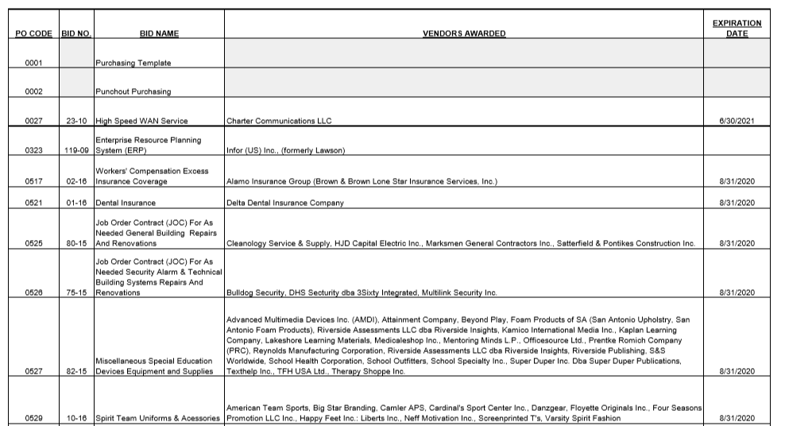

TYPES OF ACTIVITY FUNDS
Student Activity Funds (SAF)
Notes:
This is a searchable PDF. On your keyboard, press Ctrl F and enter the Vendor Name you are searching for or the type of service or product you are looking for. Example of this would be, Whataburger. This will come up and show you what location you may use. Another example would be Hobby Lobby. You can see they are a Bid Vendor, but are not EDGAR compliant, meaning you cannot use Federal Funds for purchases. If you don’t know where you may purchase a product, you could search for example, Art Supplies. This will bring up vendors who you can use. By pressing enter after your search, if there are any other vendors under this list with your description, the search will filter through each one until it reaches the end. You may always check with your Campus Bookkeeper if you are unable to locate a vendor for assistance. The is a living breathing document and can change at anytime, so never print this.

Slide 14
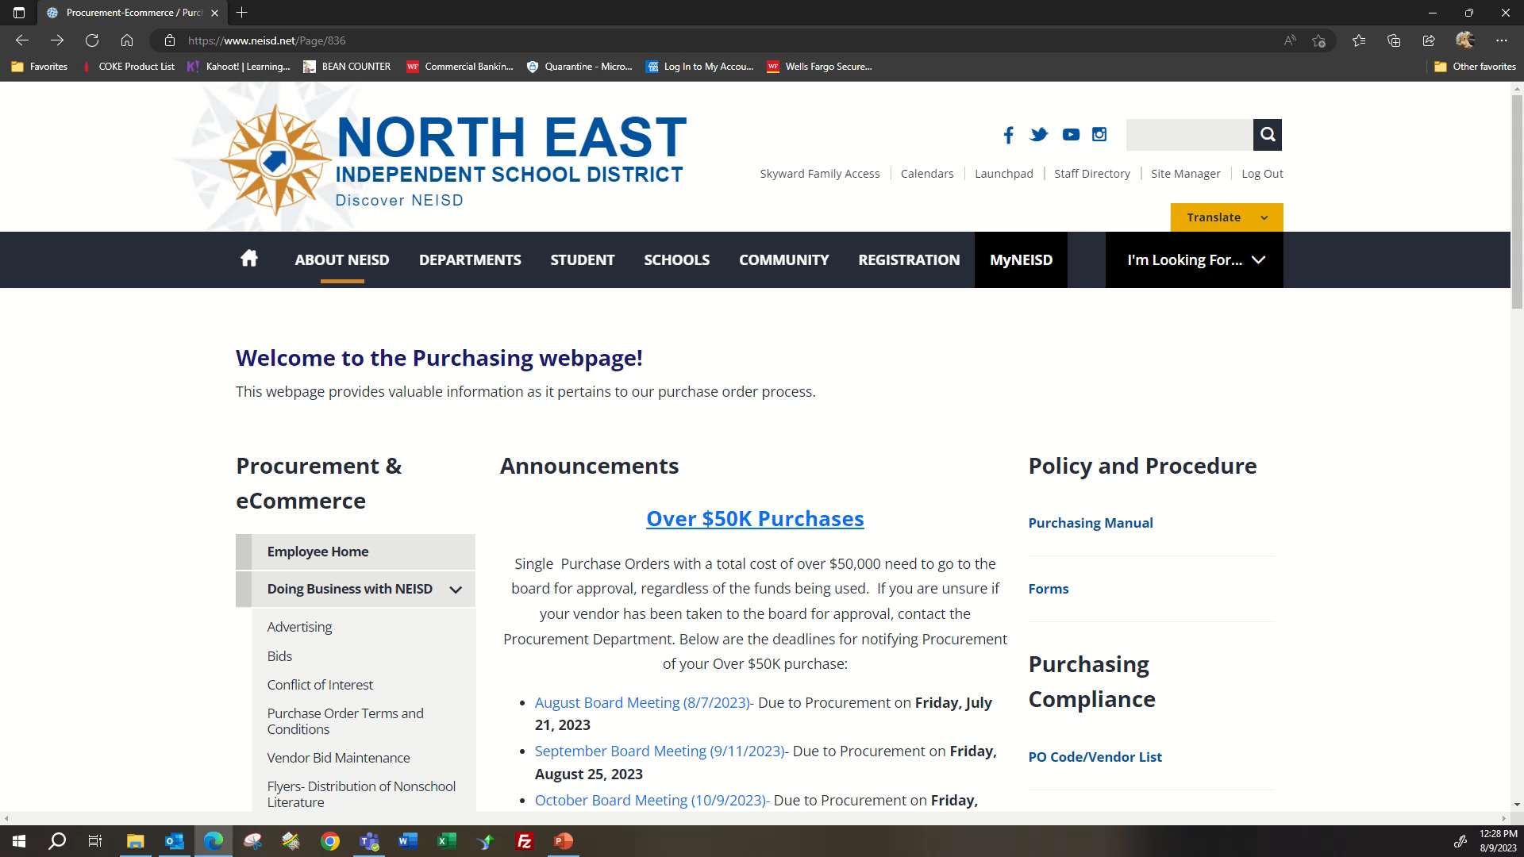
Notes:
All purchase request must be on a completed SAF/CAF PO form. If you are using a SAF account, you must attach the signed student minutes authorizing the purchase. This form will need to be signed by the Principal or Budget Manager and then given to the Campus Bookkeeper for processing. All purchases must be made from a District Approved Bid Vendor. You can find the fillable SAF/CAF PO form under the Procurement & e-Commerce web page. Go to Purchasing – Forms – CAF Purchases. Complete all of the information prior to providing this to your Principal or Budget Manager. This information includes, the Vendor where you are purchasing from, shipping address (must be shipped to the campus, not a home address), SAF/CAF Account you are using and product information, including cost of product. If you should need assistance completing this form, contact your Campus Bookkeeper or the Budget and Finance office for assistance.

Slide 15
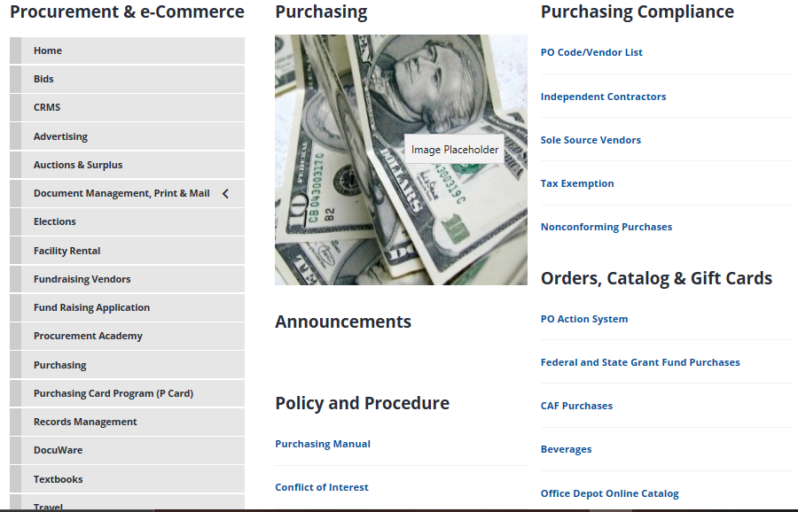
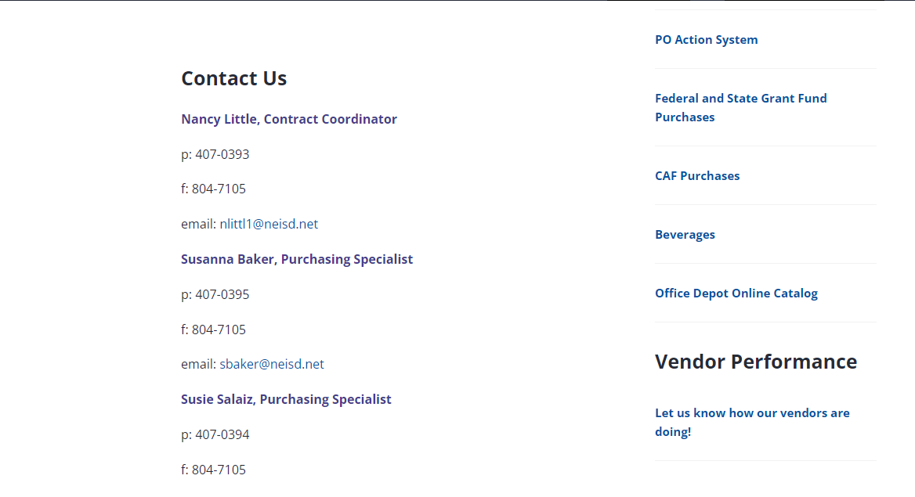
TYPES OF ACTIVITY FUNDS
Student Activity Funds (SAF)
Notes:
The SAF/CAF PO can be found under the Procurement & e-Commerce web page. Go to Purchasing – CAF Purchases.

Slide 16
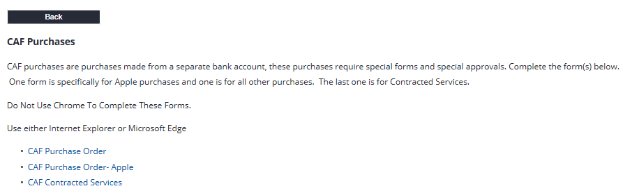
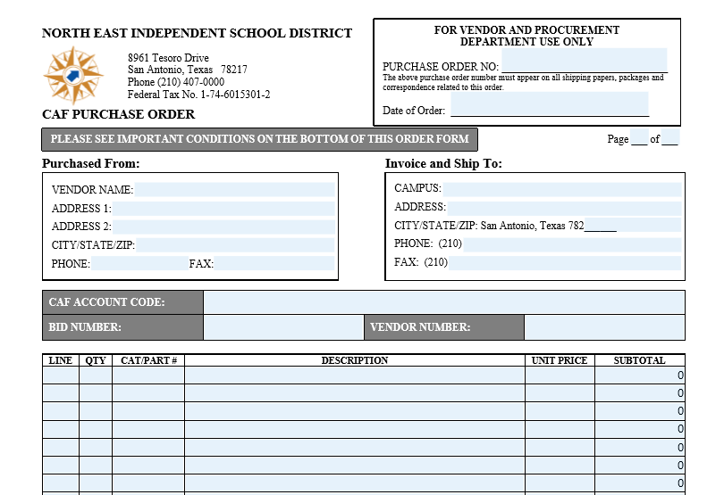
TYPES OF ACTIVITY FUNDS
Student Activity Funds (SAF)
Notes:
The SAF/CAF PO can be found under the Procurement & e-Commerce web page. Go to Purchasing – CAF Purchases.

Slide 17
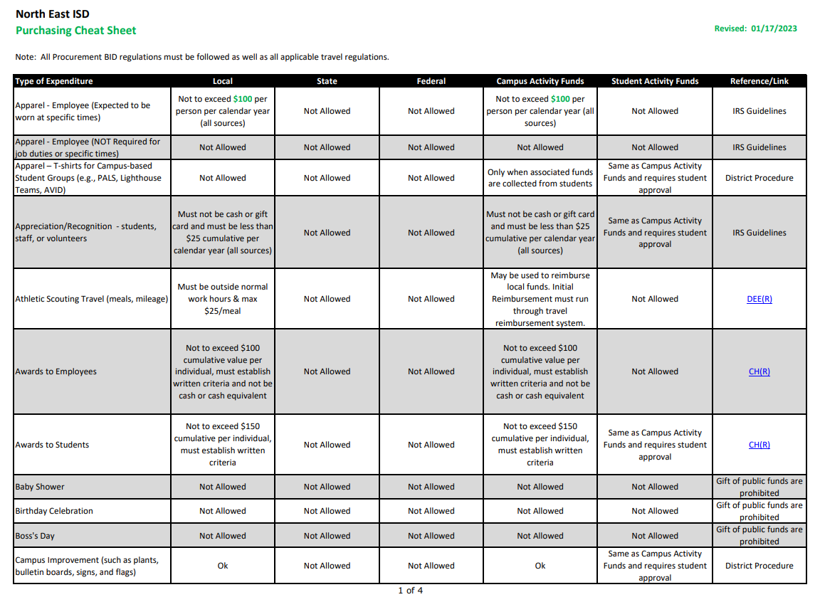
Purchasing Cheat Sheet
This Cheat Sheet was designed to assist you on the types of purchases allowed by each type of fund.
This can be found on the Procurement web page under Purchasing – Purchasing Compliance – Purchasing Cheat Sheet
Procurement-Ecommerce / Purchasing (neisd.net)
Notes:
The Purchasing Cheat Sheet was developed to guide you through what types of expenditures are “allowable” and those which are not based of what type of “Funding” source you are using. The reference box on the right will assist you with any guidelines associated with the type of purchase you are looking at making. This document is a “living” document and can be updated as needed, so always check the web page for the most current document or check with your campus bookkeeper for assistance.

Slide 18
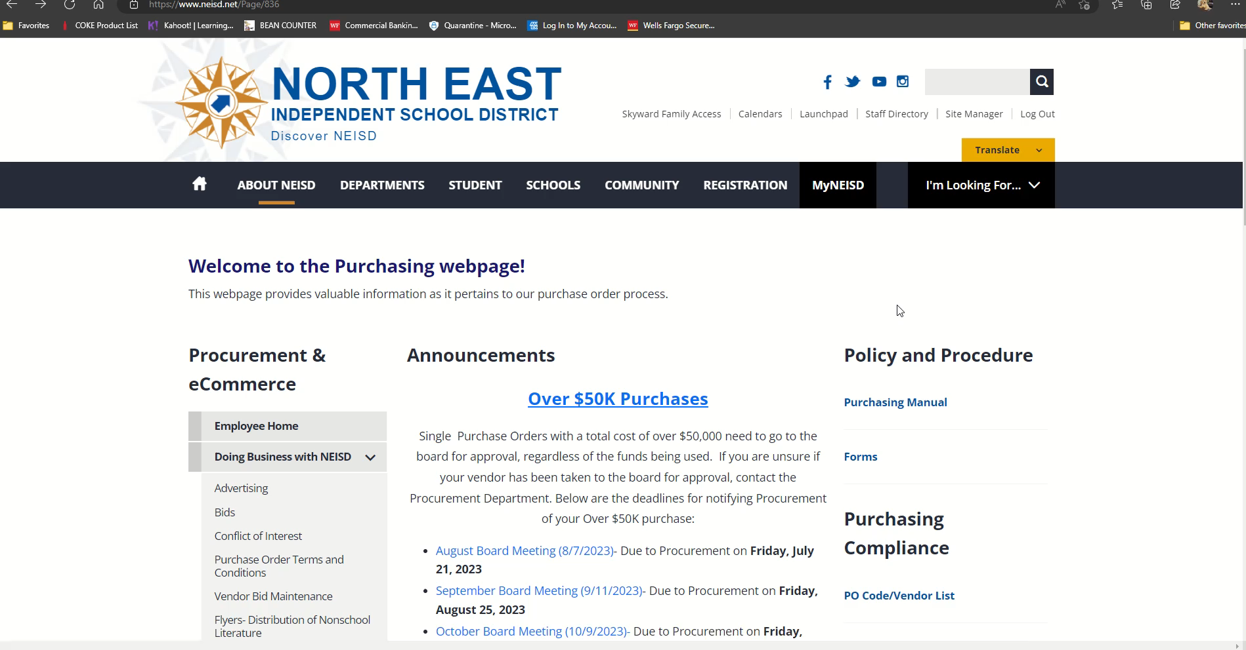
Notes:
You can find the Purchasing Cheat Sheet under the Procurement & eCommerce page.

Slide 19
CASH COLLECTION PROCEDURES

Slide 20
CASH COLLECTION PROCEDURES
All monies collected must be deposited into the SAF/CAF account in a timely manner. Sponsor’s will not accept checks which are postdated or over 30 days.
Cash must not be held and used toward expenses.
Payments to vendors must be made with a check issued by the Campus Bookkeeper. Employees will be reimbursed through the Employee Portal RFP system. NO checks will be issued to employees!
In the event a sponsor cannot prepare the funds for deposit, the money will be counted by the sponsor, secured in a locked/sealed bank bag, and given to the Bookkeeper to store in the vault until the deposit can be prepared. (Locking preferred or plastic sealable bags which can be obtained from the Bookkeeper or Office Depot).
Notes:
All monies collected must be given to the Campus Bookkeeper for deposit in a timely manner. A timely manner is defined as no more than the third day after the event has ended. Please do not accept Postdated checks or checks dated over 30 days.
Cash must not be held and used toward expenses.
Payments to vendors must be made with a check issued by the Campus Bookkeeper. Employees will be reimbursed through the Employee Portal RFP system. NO checks will be issued to employees from the Activity Fund! Employees must submit all receipts (purchased from a Bid Vendor) with dates and amounts at the time of the request. Sales tax will not be reimbursed.
In the event a sponsor cannot prepare the funds for deposit, the money will be counted by the sponsor, secured in a locked/sealed bank bag, and given to the Bookkeeper to store in the vault until the deposit can be prepared. (Locking preferred or plastic sealable bags which can be obtained from the Bookkeeper or Office Depot).

Slide 21


CASH COLLECTION PROCEDURES
When sponsors are collecting cash or checks, they must complete in its entirety, one of two available forms, Class Receipt Records or Cash Receipt Vouchers. These forms provide back-up documentation as to where funds originated.
In addition to using the Class Receipt Record, account sponsors may elect to use a substitute form of their own making, such as a spreadsheet; if the information requested on the Class Receipt Record is included.
If you have students who turn in cash, you must list the students just as you would a check. Do Not write “Cash” and the total amount received.
(example: Jon Doe – Cash - $10.00)
Notes:
As a sponsor, you must document all cash and checks received for the SAF or CAF account. If collecting funds from individuals for an item such as a band t-shirt, you would complete the Class Receipt Record. Here you would record the name of each individual you collected funds from, and the amount collected. If you collected cash, you would notate you collected cash and the amount. If you collected a check, you would notate the check number and the amount of the check. You may use your own Excel spreadsheet as long as you provide the same information as requested on the Class Receipt Record.
The Cash Receipts Voucher is to be used for monies collected when students are collecting funds for items sold in a School Store, selling flowers for Valentines Day, etc.
These forms will be part of your back-up documentation for all funds collected and turned into your campus bookkeeper.

Slide 22
CLASS RECEIPT RECORDS (The form is available on the intranet.)
Class Receipt Record is used when receiving funds from multiple individuals to maintain a record of who has paid.
Examples: T-shirt sales, field trips, library/textbook fines, uniform payments, dance tickets/bids, brochure sales, dues for faculty social accounts, etc.
Computer generated lists or handwritten ledger sheets as attachments are acceptable, provided all the information requested on the Class Receipt Record is furnished.
Notes:
Class Receipt Records are used when receiving collections from multiple individuals and it is necessary to maintain a record of who has paid.
Examples would be T-shirt sales, field trips, library/textbook fines, uniform payments, dance tickets/bids, brochure sales, dues for faculty social accounts, etc.
Computer generated lists or handwritten ledger sheets as attachments are acceptable, provided all the information requested on the Class Receipt Record is furnished.

Slide 23
1
All sections MUST be completed
School
SAF/CAF Account Number
SAF/CAF Account Name
Funds Collected for the event of:
Name, date check is written, payment type (cash or check #), and amount
Total of all items on list
Signature and date
Money Count – quantity not value
Total must equal Total of list (6)
2
3
4
5
6
7
8
Notes:
Class Receipt Record – All sections must be completed.
School (Madison)
SAF/CAF Account Number (461-901GEN)
SAF/CAF Account Name (Campus Fund)
Funds Collected for the event of: (UIL Band)
Name, date check is written, payment type (cash or ck #), and amount
Total of all items on list
Signature and date
Money Count – value not quantity
Total must equal Total of list (6)

Slide 24
CASH RECEIPT VOUCHER (The form is available on the intranet.)
Cash Receipt Voucher is used when receiving funds for activities when it is unnecessary to record each individual payee, only the number of each item sold.
Examples include:
sales at a table (Candy, Flower for Valentines)
book fairs
school store sales.
Notes:
Cash Receipt Vouchers are used when collecting money for activities when it is not feasible or necessary to record each individual payee, only the number of each item sold.
Examples include:
sales at a table (Candy, Flower sales for Valentines)
book fairs
school store sales.

Slide 25
1
All sections MUST be completed
School
SAF/CAF Account Number (ex: 461-901GEN)
SAF/CAF Account Name (ex: Campus Fund)
Funds Collected for the event of:
Item Sold, Number Sold, Price per Item and Total $$ Collected
Total of all items on list
Signature and date
Money Count – quantity not value
Total must equal Total of list (6)
2
3
4
5
6
7
8
Notes:
Cash Receipts Voucher
All sections MUST be completed
School
SAF/CAF Account Number (ex: 461-901GEN)
SAF/CAF Account Name (ex: Campus Fund)
Funds Collected for the event of:
Item Sold, Number Sold, Price per Item and Total $$ Collected
Total of all items on list
Signature and date
Money Count – value not quantity
Total must equal Total of list (6)

Slide 26
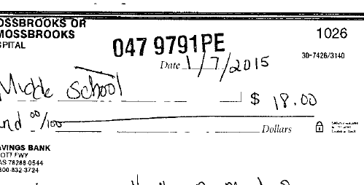
CASH COLLECTION PROCEDURES
The sponsor/teacher counts the money to ensure the total agrees with the total funds collected per the Class Receipt Record or Cash Receipt Voucher. Sponsors must complete the Money Count box on the form noting the breakdown of cash and coin by denomination.
Sponsors must ensure the 3-digit school org and account number are stamped in black in the upper middle section of all checks included in the deposit.
Checks must have complete name, full address (no PO Box) and phone number.
If the check should be returned due to non-sufficient funds (NSF), this identifies the campus and account where the funds were deposited. Example: 047 9791PE.
Notes:
Cash Collection Procedures
The sponsor/teacher counts the money to ensure the total agrees with the total collections per the Transmittal Form. Sponsors must complete the Money Count box on the form noting the breakdown of cash and coin by denomination.
Sponsors must ensure the 3 digit school org and account number are stamped in black in the upper middle section of all checks included in the deposit. If the check should be returned due to insufficient funds (NSF), it can be identified with the proper account. Example: 047 9791PE.

Slide 27
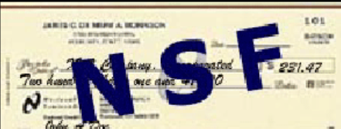
CASH COLLECTION PROCEDURES
Non-Sufficient Fund Checks (NSF)
NEISD uses Envision Payment Solutions to collect on checks returned by the bank.
Envision Payment Solutions notifies the check writer requesting the amount of the returned check plus a service fee of $30 plus tax.
An entry (debit or credit) will be posted to the SAF/CAF account where the deposit was made.
If funds are not collected and the student has outstanding returned check(s), keep track of those students and the amount owed to the District. (Deduct amount owed from any personal profit amount).
Sponsors or front office personnel Will Not accept funds to pay for any returned checks. All funds must be paid directly to Envision Payment Solutions .
Sponsors are not allowed to waive payment of returned checks, or the fees associated with it.
Do not accept checks from individuals with outstanding returned checks.
Notes:
Non-Sufficient Fund Checks (NSF)
NEISD uses Envision Payment Solutions to collect returned checks. Envision Payment Solutions notifies the check writer requesting remittance of the amount owed plus a service fee of $30 plus tax.
A Journal Entry will be posted to deduct these funds from the SAF/CAF account balance.
If funds are collected by Envision Payment Solutions , a Journal Entry will be posted to re-deposit these funds back to the SAF/CAF account.
If funds are not collected and the student has outstanding NSF checks, keep track of those students and the amount owed to the District. (Deduct amount owed from any personal profit amount).
Sponsors or front office personnel Will Not accept funds to pay for NSF checks. All funds must be paid directly to Envision Payment Solutions .
Per our contract with Envision Payment Solutions, the District will be charged the fees, if we accept payments for an NSF’s, in which Envision would have collected. Should the district incur any fees because the campus collected the funds from the check writer, the fees will be passed along to the SAF/CAF account in which these funds were collected.
Sponsors are not allowed to waive payment of NSF’s or the fees associated with the NSF.
Do not accept checks from individuals with outstanding NSF checks.

Slide 28

CASH COLLECTION “BEST PRACTICES”
DO NOT accept temporary checks – name, address and check number must be printed on check.
DO NOT accept checks over 30 days old or postdated checks.
DO NOT accept checks from individuals with outstanding returned checks. (Accept only cash or money order).
Notes:
Do Not Accept temporary checks – name, address and check number must be printed on check.
Do Not Accept Accept checks over 30 days old or post-dated checks.
Do Not Accept Accept checks from individuals with outstanding NSFs. (Accept only cash or money order).

Slide 29

THINGS TO REMEMBER
Money will not be kept in classrooms unless there is a safe.
Sponsors will be required to reimburse funds which are lost or stolen while in their possession.
Sponsors will be held accountable for timely deposits.
Deposits MUST be completed and given to the Campus Bookkeeper for deposit to the bank within 3 days after the event has ended.
Unprepared deposits should be in a locked/sealed bank bag (provided by the bookkeeper), logged in by the bookkeeper, signed and dated by the sponsor, and placed in the vault or safe until funds can be verified and entered into the SAF/CAF system and sent to the bank.
ALL FUNDS COLLECTED MUST BE DEPOSITED PRIOR TO LEAVING ON ANY DISTRICT HOLIDAY BREAK!! This includes Thanksgiving, Christmas and Spring Break. NO EXCEPTIONS!
Notes:
Things to Remember
Money will not be kept in classrooms unless there is a safe.
Sponsors will be required to reimburse funds which are lost or stolen while in their possession.
Sponsors will be held accountable for timely deposits.
Deposits MUST be completed and given to Campus Bookkeeper for deposit to the bank within 3 days after the event has ended.
Unprepared deposits should be in a locked/sealed in a bank bag (provided by the bookkeeper), logged in by the bookkeeper, signed and dated by the sponsor, and placed in the vault or safe until funds can be processed, entered into the SAF/CAF system and sent to the bank.
ALL MONIES MUST BE DEPOSITED PRIOR TO LEAVING ON ANY DISTRICT HOLIDAY BREAK!! This includes Thanksgiving, Christmas and Spring Break. NO EXCEPTIONS!

Slide 30
PAYMENTS FROM ACTIVITY FUNDS

Slide 31
PAYMENTS FROM ACTIVITY FUNDS
BOOKKEEPER WILL INPUT ALL CHECK REQUESTS
A SAF/CAF check request form must be filled out completely, attached to the supporting documentation, and given to the Bookkeeper.
The Bookkeeper cannot disburse funds without proper supporting documentation. Acceptable documentation is a vendors’ original detailed invoice (which includes an invoice number and date) and/or sales receipts, along with cash register tapes or packing slip.
Statements, Emails, and Sales Orders are examples of Not Acceptable forms of documentation for disbursement of funds.
All SAF accounts must have Officers. A signed copy of the secretary’s minutes authorizing the expenditures must be attached to the check request.
Checks will NOT be issued for Prepayment. An order must be physically shipped to and received by the campus before funds can be disbursed.
Notes:
Request for Payments from Activity Funds will be completed by the Campus Bookkeeper
A SAF/CAF check request form must be filled out completely, attached to the supporting documentation, and given to the Bookkeeper.
The Bookkeeper cannot disburse funds without proper supporting documentation. Acceptable documentation is a vendors’ original detailed invoice (which includes an invoice number and date) and/or sales receipts, along with cash register tapes or packing slip.
Statements, Emails, and Sales Orders are examples of Not Acceptable forms of documentation for disbursement of funds.
All SAF accounts must have Officers. A signed copy of the secretary’s minutes authorizing the expenditures must be attached to the check request.
Checks will NOT be issued for Prepayment. An order must be physically shipped to and received by the campus before funds can be disbursed.

Slide 32
PAYMENTS FROM ACTIVITY FUNDS
BOOKKEEPER WILL INPUT ALL CHECK REQUESTS
ALL payments to an employee of NEISD must be submitted for reimbursement through the Employee Portal RFP System. No checks will be issued to a NEISD Employee.
Employee reimbursements are paid each Friday. This Must be in the RFP system (with all supporting documentation) no later than Noon each Wednesday for approval for the employee to receive payment on Friday.
Student Groups giving donations MUST be donating to a 501(c)(3) organization. No donation can be made to an individual.
CAF accounts can not make donations or scholarships to any organization or individual
Notes:
ALL payments to an employee of NEISD must be submitted for reimbursement through the Employee Portal RFP System. No checks will be issued to a NEISD Employee.
Employee reimbursements are paid each Friday. This Must be in the RFP system (with all supporting documentation) no later than Noon each Wednesday for approval in order for the employee to receive payment on Friday.
Student Groups giving donations MUST be donating to a 501(c)(3) organization. No donation can be made to an individual.
CAF accounts can not make donations or scholarships to any organization or individual

Slide 33
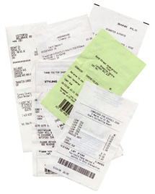
PAYMENTS FROM ACTIVITY FUNDS
Turn into the bookkeeper
copy any laser receipts (which may fade). Turn in the original and the copy as support;
tape numerous receipts on a piece of paper;
circle the total of each receipt, do not highlight; and
prepare a calculator tape showing the individual amounts and verify it equals the amount requested for reimbursement.
Review copied receipts and support documents for legibility.
ALL CHECK REQUESTS FROM AN ACTIVITY ACCOUNT IN EXCESS OF $2,000 MUST INCLUDE A COMPLETED DISBURSEMENT APPROVAL FORM, SIGNED AND DATED PRIOR TO PAYMENT BEING PROCESSED, UNLESS A SAF/CAF PURCHASE ORDER IS USED.
(The form is available on the intranet.)
Notes:
Turn into the bookkeeper
copy any laser receipts (which may fade). Turn in the original and the copy as support;
tape numerous receipts on a piece of paper;
circle the total of each receipt; and
prepare a calculator tape showing the individual amounts and verify that it equals the amount requested for reimbursement. (Less Sales Tax. The district does not reimburse Sales Tax).
Review copied receipts and support documents for legibility.
ALL REQUESTS FROM THE ACTIVITY FUNDS IN EXCESS OF $2,000 MUST INCLUDE A COMPLETED DISBURSEMENT APPROVAL FORM, SIGNED AND DATED PRIOR TO THE OBLIGATION OF THE FUNDS, UNLESS A SAF/CAF PURCHASE ORDER IS USED.
(The form is available on the intranet.)

Slide 34
PAYMENTS FROM ACTIVITY FUNDS CONTRACTED SERVICES
Teachers/sponsors are responsible for communicating with the Bookkeeper before committing to any contracted service. The Bookkeeper will determine if a contract is required, and if the vendor is active in the accounting system.
Payments for contracted services must be reported by NEISD to the IRS annually. Expenditures classified as “Contracted Services” – Reportable to the IRS include:
Catering/banquet services
Repairs: copiers, machinery, uniforms, mats, etc.
Business Services: printing, landscaping, framing, photo processing, etc.
Rentals: cars, vans, buses, costumes, facilities, machines, pagers, etc.
Presenters/Performers (includes disc jockeys, seminar and workshop speakers, dance clinic assistants, etc.)
Custom services: monogramming, sewing, choreography, engraving, custom T-shirts, T-shirt printing, and screen-printing, etc.
Notes:
Teachers/sponsors are responsible for communicating with the Bookkeeper before committing to any contracted service. The Bookkeeper will determine if a contract is required, and if the vendor is active in the accounting system.
Payments for contracted services must be reported by NEISD to the IRS annually. Expenditures classified as “Contracted Services” – Reportable to the IRS include:
Catering/banquet services
Repairs: copiers, machinery, uniforms, mats, etc.
Business Services: printing, landscaping, framing, photo processing, etc.
Rentals: cars, vans, buses, costumes, facilities, machines, pagers, etc.
Presenters/Performers (includes disc jockeys, seminar and workshop speakers, dance clinic assistants, etc.)
Custom services: monogramming, sewing, choreography, engraving, custom T-shirts, T-shirt printing, and screen-printing, etc.

Slide 35
PAYMENTS FROM ACTIVITY FUNDS CONTRACTED SERVICES
Continued – Contracted Services
Fine Arts Service Provider RFP Form can be found on the Procurement & eCommerce page under “Purchasing”- “Form”. This form is for the “one-time” individual who may come to assist as a Judge, an Accompanist, a Spotter, or One-time Clinician. The completed form may be used as an invoice after the service has been completed, the form is filled out completely and signed by the Campus Principal/Budget Manager.
Lodging, transportation, meals and miscellaneous costs associated with travel for individuals performing a service must be included in their fee and treated as a contracted service.
All contracts MUST be sent to Procurement for review. Sponsors CANNOT sign a contract. The exception to this is the above-mentioned Fine Arts Service form.
Notes:
Fine Arts Service Provider RFP Form can be found on the Procurement & eCommerce page under “Purchasing”- “Form”. This form is for the “one-time” individual who may come to assist as a Judge, an Accompanist, a Spotter, or One-time Clinician. The completed form may be used as an invoice after the service has been completed, the form is filled out completely and signed by the Campus Principal/Budget Manager.
Travel for individuals performing a service must be included in their fee and treated as a contracted service. This includes their lodging, transportation, meals and any miscellaneous cost associated with their travel.
All contracts MUST be sent to Procurement for review. Sponsors CANNOT sign a contract.
The exception to this is the above-mentioned Fine Arts Service form.

Slide 36
PAYMENTS FROM ACTIVITY FUNDS 3rd PARTY REIMBURSMENTS
All SAF/CAF expenditures are to be paid directly to an approved vendor or should be reimbursed to a district employee who paid an approved vendor.
Reimbursing parents, students, or 3rd parties is NOT allowed with any SAF or CAF accounts. Giving parents, students, or 3rd parties authority to purchase on behalf of the District puts the district in potential violation of the Texas Constitutional prohibition against gifts of public funds.
Notes:
All CAF expenditures are paid directly to an approved vendor or should be reimbursed to a district employee who paid an approved vendor.
Reimbursing parents, students, or 3rd parties is not allowed with SAF or CAF accounts. Giving parents, students, or 3rd parties authority to purchase on behalf of the District puts the district in potential violation of the Texas Constitutional prohibition against gifts of public funds.

Slide 37
PAYMENTS FROM ACTIVITY FUNDS STAFF APPRECATION BY STUDENT GROUPS
Student groups may use their funds to hold “staff” or “coach/sponsor” appreciation events solely under the following conditions:
The decision to hold any appreciation event must come directly from the students and cannot be mandated by campus administration or other personnel. Student minutes must be provided along with Officer signatures. No Photocopies!
Documentation must reflect the student approval and reason.
Per-person food costs for meals must not exceed $10 per person for breakfast, $16 for lunch, and $25 for dinner.
Gifts must be less than $25 per person.
No cash, cash-equivalents, or gift cards allowed.
Purchases must be made from an approved vendor.
Only two events allowed per student group per year if done for groups (e.g., custodians, teachers, all athletic coaches.) No more than one per month if done for individuals (e.g., teacher of the month, specific team coaches/sponsors.)
Notes:
Student groups may use their funds to hold “staff” or “coach/sponsor” appreciation events solely under the following conditions:
The decision to hold any appreciation event must come directly from the students and cannot be mandated by campus administration or other personnel. Student minutes must be provided along with Officer signatures. No Photocopies!
Documentation must reflect the student approval and reason.
Per-person food costs for meals must not exceed $10 per person for breakfast or $16 for lunch.
Gifts must be less than $25 per person.
No cash, cash-equivalents, or gift cards allowed.
Purchases must be made from an approved vendor.
Only two events allowed per student group per year if done for groups (e.g., custodians, teachers, all athletic coaches.) No more than one per month if done for individuals (e.g., teacher of the month, specific team coaches/sponsors.)

Slide 38
P-CARD and VISA

Slide 39
P-CARD and VISA USE
Obtain written approval by the Budget Manager to check out the P-Card using the Request to Use Purchasing Card form or for purchasing via the Marketplace or Amazon.
Ensure all purchases are tax exempt in the state of Texas by presenting the Texas Sales and Use Tax Exemption Certificate at point of purchase. If taxes are charged, the sponsor is responsible for getting this corrected or they will need to reimburse the District for the taxes charged within 30 days of point of sale.
The sponsor must turn in an itemized receipt and P-Card back to the Bookkeeper within 24 hour of checkout.
The AMEX card cannot be checked out over a weekend or a District holiday. The only exception is when traveling for District related purposes in which case the Visa card will be checked out.
All policies for the use and documentation of the AMEX and Visa P-Cards apply.
Notes:
You can use the Campus American Express P-Card for purchases.
The P-Card can be used for purchases on Amazon. Check with your campus bookkeeper to ensure this has been set up for your campus.
The card can ONLY be used at PSL 21 vendors.
All policies for the use & documentation of P-Cards transaction do apply.
P-Cards MUST be returned to the Campus Bookkeeper within 24 hours of checkout.
P-Cards cannot be checked out over a weekend or district holidays.

Slide 40
SALES TAX

Slide 41

TAX-FREE PURCHASES
Most items purchased for the school’s use are exempt from sales tax. A Texas Sales and Use Tax Exemption Certificate must be presented to the vendor in order to qualify for a tax exemption.
The Bookkeeper cannot pay sales tax to a vendor or reimburse an individual for sales tax paid if the district is not required to pay tax on the item or service.
Sales tax on meals for athletic teams, bands, etc. is exempt only if the school contracts for the meal and the meal is paid for by the school.
Individual members are not eligible under IRS regulations for a tax exemption from meals they purchase. Reimbursement is available for taxes paid on prepared food.
Notes:
Most items purchased for the school’s use are exempt from sales tax. A Texas Sales and Use Tax Exemption Certificate must be presented to the vendor in order to qualify for a tax exemption.
The Bookkeeper cannot pay sales tax to a vendor or reimburse an individual for sales tax paid if the district is not required to pay tax on the item or service.
Sales tax on meals for athletic teams, bands, etc. is exempt only if the school contracts for the meal and the meal is paid for by the school.
Individual members are not eligible under IRS regulations for a tax exemption from meals they purchase. Reimbursement is available for taxes paid on prepared food.

Slide 42

TAX-FREE PURCHASES
School districts are exempt from the state portion of hotel tax. A Texas Hotel Occupancy Tax Exemption Certificate (which can be found under Departments-Procurement-Travel-Hotel Accommodations page) must be submitted to the hotel. NEISD is required to pay the local taxes; reimbursement is available for the local taxes.
When renting vehicles, a Motor Vehicle Rental Exemption Certificate must be presented to the vendor to obtain the sales tax exemption.
Groups are required to use the district car rental vendors when renting vehicles.
Please note…. property damage coverage insurance (collision/comprehensive) should be purchased when renting vehicles.
Notes:
School districts are exempt from the state portion of hotel tax. A Texas Hotel Occupancy Tax Exemption Certificate (which can be found under Departments-Procurement-Travel-Hotel Accommodations page) must be submitted to the hotel. NEISD is required to pay the local taxes; reimbursement is available for the local taxes.
When renting vehicles, a Motor Vehicle Rental Exemption Certificate must be presented to the vendor to obtain the sales tax exemption.
Groups are required to use the district car rental vendors when renting vehicles.
Please note…. property damage coverage insurance (collision / comprehensive) should be purchased when renting vehicles.

Slide 43

TAX-FREE DAYS
The school district, the school, and each bona-fide student activity fund account are permitted TWO tax-free sales days per CALENDAR year.
Any student group which is recognized by the school and is organized by electing officers, holding meetings, and conducting business are bona-fide chapters of the school. Groups meeting for classroom instruction or team sports are not categorized as bona-fide chapters and do not qualify for the tax-free sales days.
For example:
The school district qualifies for a tax-free day.
The school-wide fundraiser qualifies for a tax-free day.
The Basketball Club qualifies, but the basketball team does not.
The Cheerleader Club qualifies, but the cheerleader team does not.
The French Club qualifies, but the French classes do not.
The Senior Class qualifies, but not a class which has seniors in it.
Sales must take place within a 24-hour period. If items are pre-sold, such as yearbooks, then delivery must take place within a 24-hour period. Items sold after the completion of the one-day event are taxable.
Notes:
The school district, the school, and each bona-fide student activity fund account are permitted TWO tax-free sales days per CALENDAR year.
Any student group which is recognized by the school and is organized by electing officers, holding meetings, and conducting business are bona-fide chapters of the school. Groups meeting for classroom instruction or team sports are not categorized as bona-fide chapters and do not qualify for the tax-free sales days.
For example:
The school district qualifies for a tax-free day.
The school-wide fundraiser qualifies for a tax-free day.
The Basketball Club qualifies, but the basketball team does not.
The Cheerleader Club qualifies, but the cheerleader team does not.
The French Club qualifies, but the French classes do not.
The Senior Class qualifies, but not a class which has seniors in it.
Sales must take place within a 24-hour period. If items are pre-sold, such as yearbooks, then delivery must take place within a 24-hour period. Items sold after the completion of the one-day event are taxable.

Slide 44

TAX-EXEMPT SALES
When items or services are sold, the sales are reported monthly to the State. There are tax-exempt and taxable sales.
The following items are automatically exempt from sales tax:
Ad Sales – in yearbooks, athletic programs, newspapers, posters
Admission – athletic, dances, dance performances, drama and musical performances
Admission – summer camps, clinics, workshops, project graduation
Admission – banquet fees, bids, prom, homecoming
Admission - tournament fees, academic competition fees
Cosmetology services (Products sold to customers are taxable)
Discount/Entertainment cards and books
Facility rentals for school groups
Food items sold during fundraisers
Labor - automotive, upholstery classes (parts are taxable)
Magazine subscriptions greater than six months
Parking permits
Notes:
These items are examples of what is exempt from sales tax.
Ad Sales – in yearbooks, athletic programs, newspapers, posters
Admission – athletic, dances, dance performances, drama and musical performances
Admission – summer camps, clinics, workshops, project graduation
Admission – banquet fees, bids, prom, homecoming
Admission - tournament fees, academic competition fees
Cosmetology services (Products sold to customers are taxable)
Discount/Entertainment cards and books
Facility rentals for school groups
Food items sold during fundraisers
Labor - automotive, upholstery classes (parts are taxable)
Magazine subscriptions greater than six months
Parking permits

Slide 45


TAXABLE SALES
Sales tax must be collected on items purchased by the school and resold to individuals, as this becomes their personal property. This also includes any type of “digital” download.
Sales tax will be deducted from the deposit amount based on the description provided to the bookkeeper when the funds and documentation are turned in.
Taxable Sales Examples:
Agenda Books
Agricultural Sales
Art Supplies
Artistic (CD's, Tapes, Videos, Digital Downloads)
Athletic Equipment and Uniforms
Auction Items Sold
Automotive Parts and Supplies
Book Covers
Books (when we are the seller)
Brochure Items (Catalog Sales)
Calculators
Calendars
Copier and Printing Fees
Cups
Decals
Directories
Flowers
Musical Recorders
PE (Uniforms, Supplies)
Reeds
Rentals (Equipment of any kind)
Rentals (Uniforms of any kind)
Spirit Items
Tangible Personal Property Merchandise
Yard Signs
Yearbooks
Notes:
Sales Tax must be collected on items purchased by the school and resold to individuals, as this becomes their personal property. Sales tax will be deducted from the deposited amount based on the description provided to the bookkeeper when the funds and documentation are turned in.

Slide 46
FUNDRAISING

Slide 47
FUNDRAISING / SALES ACTIVITIES
Fund raising events are required to be pre-approved with the appropriate campus administrator in accordance with campus policy. Only District approved fundraising vendors can be used. Always check the list located ON THE PROCURMENT PAGE, UNDER Fund Raising Vendors to verify a vendor is approved.
Before commencement of a sales event, the top section of a Sales Accountability Sheet (or another form provided by the school) shall be completed. Of particular importance are the signatures of the administrator, whether or not the sale is taxable, and the selling price of the item (pricing to cover the cost of product + profit + tax). This form is available on the intranet.
Each time funds are deposited from a sales event; the sponsor records the date and amount of the deposit on the Sales Accountability Sheet. At the end of the event, the total deposited per the Sales Accountability Sheet is compared to total expected revenue based on the number of items purchased for resale. Any differences are explained at the bottom of the Sales Accountability Sheet.
If applicable, a copy of a sales summary report shall be attached to the form and the completed Sales Accountability Sheet shall be given to the Bookkeeper to file.
Sales of entrance fees must use numbered tickets to account for the sales. These can be accounted for on a Ticket Sales Accountability Sheet.
Accurate and diligent bookkeeping is necessary for student profit amounts earned by individual student’s fundraising sales.
Notes:
Fund Raising events must be pre-approved by the appropriate campus administrator in accordance with campus policy. Before the commencement of a fund-raising event, the top section of a Sales Accountability Sheet must be completed and signed by the campus administrator.
When selling tickets for the entrance to an event, the tickets must be numbered to account for the sales. The sale of these tickets is then tracked using the Ticket Sales Accountability Sheet.
Accurate and diligent bookkeeping is necessary to ensure profits earned by individual student’s fundraising sales.

Slide 48
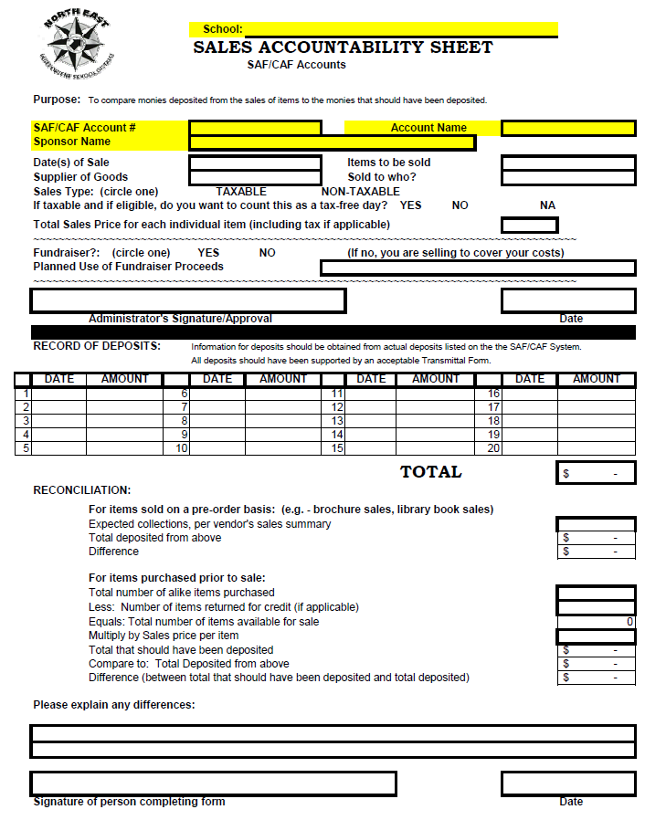
FUNDRAISING / SALES ACTIVITIES
Sales Accountability Sheet
Example
Notes:
The Sales Accountability Sheet must be completed and signed by the Sponsor who completed the form.

Slide 49
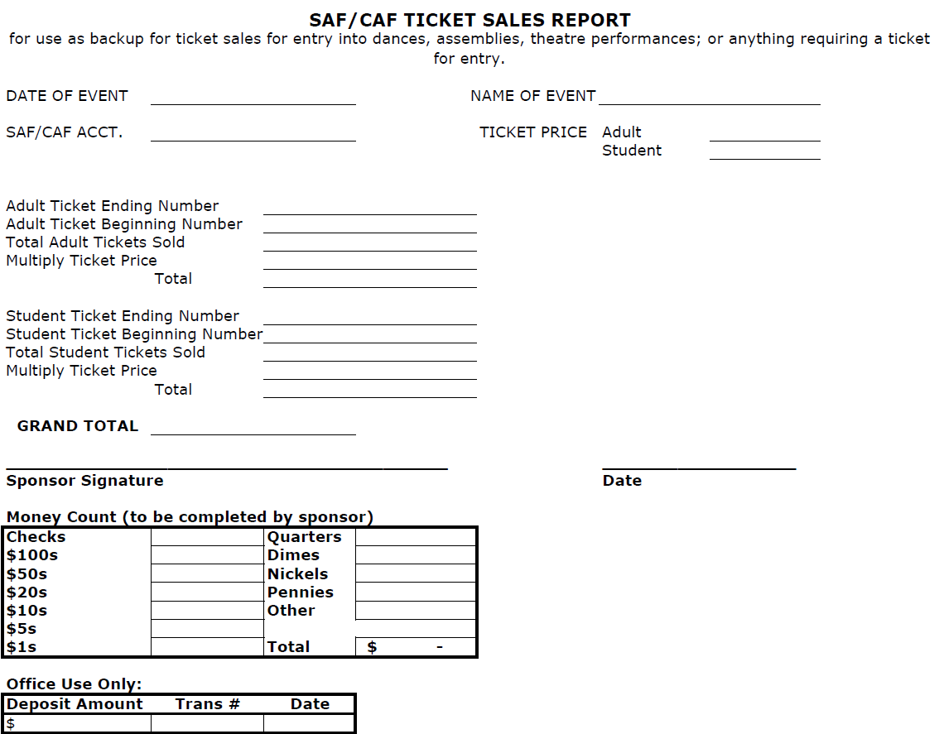
FUNDRAISING / SALES ACTIVITIES
Ticket Sales Accountability Sheet
Example
Notes:
The Ticket Sales Accountability Sheet must be completed and signed by the Sponsor who completed the form.

Slide 50
DONATION WEBSITES & CROWD SOURCE FUNDING

Slide 51
DONATION WEBSITES & CROWD SOURCE FUNDING
These Guidelines can be found under the Board of Trustees – NEISD Administrative Regulations – CDIB Donation Websites & Crowd Source Funding.
These guidelines apply to Crowd Source funding for classroom teachers and student activity clubs and organizations. All donated funds and donated property shall become property of the District or held in trust for District students. Websites by the District shall not be established for the personal benefit of a staff member or student.
Donation requests must be submitted and approved by the campus principal (on the Donation Website Request Form) before being posted to a website. All requests for technology items must be approved by the technology department before principal approval is made. The campus principal is responsible for reviewing the website for appropriateness, ensuring the donation requests meet the goals and objectives as it relates to the campus improvement plan and overseeing the website donation solicitation to ensure compliance with the following requirements:
Notes:
Donation Websites and Crowd Source Funds are a source of fundraising for SAF accounts. The guidelines for this type of funding can be found under the Board of Trustees – NEISD Administrative Regulations – CDIB Donation Websites & Crowd Source Funding. All donated funds and donated property shall become the property of the District or held in trust for District students. The websites shall not be established by the District for the personal benefit of a staff member or student. All donation requests must be submitted and approved by the campus principal before being posted to a website. All requests for technology items must be approved by the technology department before principal approval is made. The campus principal is responsible for reviewing the website for appropriateness, ensuring the donation requests meet the goals and objectives as it relates to the campus improvement plan and overseeing the website donation solicitation to ensure compliance with the following requirements:

Slide 52
DONATION WEBSITES & CROWD SOURCE FUNDING PROCEDURES
Include
Include district name, campus and teacher name on the website.
Set
Set donation period of 60 days or less.
Inform
Inform donors regarding any service fees that will be deducted from their online donation by the website being used.
Follow
Follow all applicable District purchasing requirements when spending funds collected.
Report
Report donations to the Budget Office when project is completed.
Non-Cash
Non-Cash items need to be added to CRMS when appropriate and reported to the Budget Office if greater than $5,000. Please work with your Campus CRMS manager and/or Campus Bookkeeper.
Notes:
The website must include the district name, campus and teacher name. You must set a donation period of 60 days or less. You must inform donors of any service fees that will be deducted from their online donation by the website being used. You must follow all applicable District purchasing requirements when spending funds collected. You must report donations to the Budget Office when the project is completed. Any Non-Cash items need to be added to CRMS when appropriate and reported to the Budget Office if greater than $5,000. Please ensure you work with your Campus CRMS manager and/or your Campus Bookkeeper.

Slide 53


DONATION WEBSITES & CROWD SOURCE FUNDING APPROVAL PROCEDURES
Principals must approve all project requests prior to posting (Donation Website Request Form)
Technology purchases must be approved by Technology Services
Principals must give written approval if donated items are transferred between campuses
This Photo by Unknown Author is licensed under CC BY-SA
Notes:
You must complete a Donation Website Request Form & Agreement and present this to your principal to sign and approve prior to posting to a website. This form is located under Budgets & Financial Analysis – Procedures & Resources – Process Donation. If you are planning on purchasing Technology products with theses funds, you must first get the approval from Technology Services. Once the products are purchased, they belong to the campus. If you transfer campuses and what to take these products with you, you must get the written approval from the Principal.

Slide 54

DONATION WEBSITES & CROWD SOURCE FUNDING DO NOT DO THESE THINGS
DO NOT Use photos of students
DO NOT Withdraw funds into personal bank accounts
DO NOT Mail donated items home
DO NOT Seek funding for personal or political reasons
DO NOT Seek funding for charities or non-District related third parties
DO NOT Make defamatory statements
DO NOT Endorse products
DO NOT Pressure parents for donations
Notes:
When creating the website, do not do the following:
Do not use photos of students
Do not withdraw funds into a personal bank account
Do not mail donated items to a home address, it must be sent to the campus
Do not seek funding for personal or political reasons
Do not seek funding for charities or no-District related third parties
Do not make defamatory statements
Do not endorse products
Do not pressure parents for donations

Slide 55


DONATION WEBSITES & CROWD SOURCE FUNDING APPROVED WEBSITES
donorschoose.org
pledgecents.com
Snap!raise.com
Read-a-thon.com
Wefund4you.com
Vertical Raise Fundraising
Adrenaline Fundraising (dbA “Raise365”)
InstaRaise
Additional websites may be added upon approval by Executive Staff. The most current list can be found at Approved Crowd Source Fundraising Websites
Just because a vendor is approved for fundraising doesn’t mean that they are approved for crowd-sourcing
Notes:
You may only use approved websites for crowd sourcing. The most current list may be found under the Procurement & eCommerce webpage, Fundraising-Crowd Source. Any additional websites may be added once approved by Executive Staff. Please keep in mind, just because a vendor is approved for fundraising, doesn’t mean they are approved for crowd-sourcing.

Slide 56
FINANCIAL ETHICS CAA(LOCAL)

Slide 57

FINANCIAL ETHICS Board Policy CAA (LOCAL)
Fraud shall include but not be limited to (cont’d):
Misappropriation of funds, securities, supplies, or other District assets, including employee time.
Improperly handling of money or reporting of District financial transactions.
Accepting or seeking anything of material value from contractors, vendors, or other persons providing services or materials to the District
Failure to provide financial records required by federal, state, or local entities.
Failure to disclose conflict of interest as required by law or District policy.

Slide 58

FINANCIAL ETHICS Board Policy CAA (LOCAL)
“All trustees, employees, vendors contractors, agents, consultants, volunteers, and any other parties who are involved in the District’s financial transactions shall act with integrity and diligence in duties involving the District’s fiscal resources”
“The District prohibits fraud and financial impropriety, as defined below, in the actions of its trustees, employees, vendors, contractors, agents, consultants, volunteers, and others seeking or maintaining a business relationship with the District.
Fraud shall include but not be limited to:
Forgery or unauthorized alteration of any document or account belonging to the district.
Forgery or unauthorized alteration of a check, bank draft, or any other financial document.

Slide 59

FINANCIAL ETHICS Board Policy CAA (LOCAL)
Each employee who supervises or prepares District financial reports or transactions shall set an example of honest and ethical behavior and shall actively monitor his or her area of responsibility for fraud and financial impropriety.

Slide 60

FINANCIAL ETHICS Board Policy CAA (LOCAL)
Fraud Detection:
If you suspect fraud, waste, or abuse contact:
Your bookkeeper,
Your principal, or
Internal Audit
Fraud hotline link: http://www2.neisd.net/ts/commresponse/internalaudit3.cfm
NEISD – Departments – Internal Audit
*You may remain anonymous by not disclosing your name, or you can ask that your identity be kept confidential. If you remain anonymous it may be more difficult to investigate your complaint. If you ask that your identity, be kept confidential, Internal Audit will protect your identity and disclose it only to the auditors or investigators assigned to review the complaint.

Slide 61

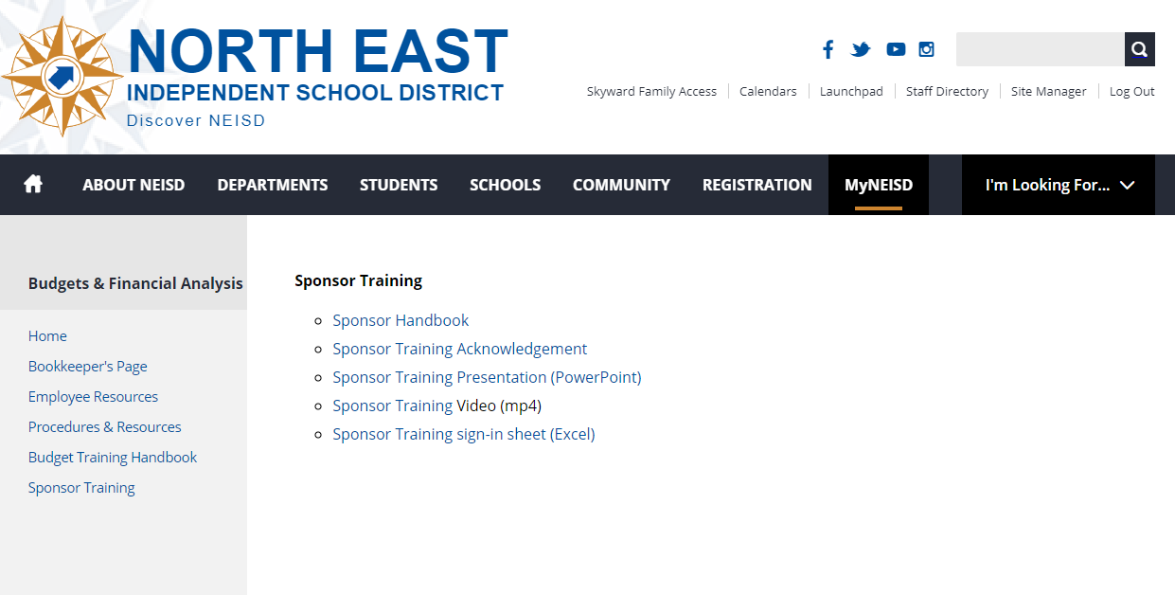
ACTIVITY FUND ACCOUNTING PROCEDURES
Information for Sponsors
Once you have downloaded the Sponsor Handbook, click on the Sponsor Handbook Acknowledgement and complete the Google Form.
This is located on the MyNEISD Departments page under
Budgets & Financial Analysis Web Page
Sponsor Training
Sponsor Handbook Acknowledgement
Notes:
For additional information, please refer to the Activity Fund Sponsor Handbook. This is located under Budgets & Financial Analysis Web Page – Procedures & Resources – Sponsor Manuals & Procedures.

Slide 62
ACTIVITY FUND ACCOUNTING PROCEDURES
Information for Sponsors
For additional, detailed information, please refer to the
Activity Fund Sponsor Handbook.
This is located on the MyNEISD Departments page under
Budgets & Financial Analysis Web Page
Sponsor Training
Sponsor Handbook
Notes:
For additional information, please refer to the Activity Fund Sponsor Handbook. This is located under Budgets & Financial Analysis Web Page – Procedures & Resources – Sponsor Manuals & Procedures.

Slide 63
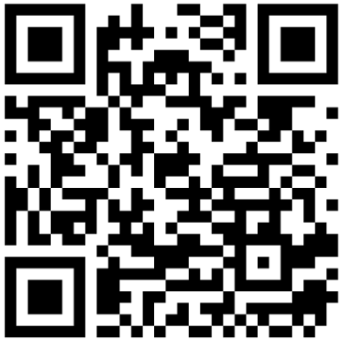
Please log into your district Google account and scan the QR Code to record the completion of Sponsor Training
Notes:
Thank you for becoming a Sponsor for NEISD. Please log in to your district Google account and scan the QR Code and complete the Google form to record the completion of your Sponsor Training. Have a wonderful school year.

Slide 64

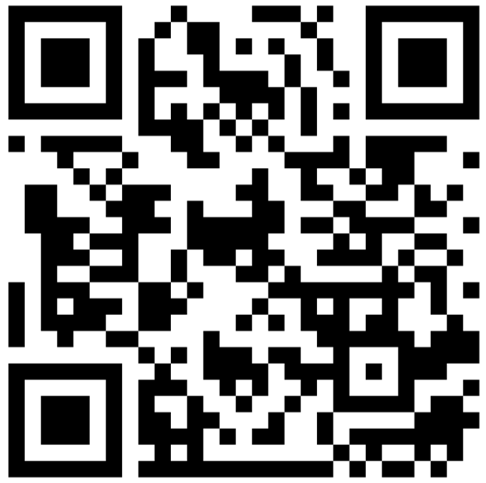
Questions?
Use the QR Code below to send your question to the Budget and Finance Team.
Notes:
If you have any questions, please scan the QR code to submit your question directly to our Budget and Finance Team.

Slide 65

Notes:
Thank you for volunteering your time to your campus/student organization. Wishing you a safe and wonderful school year!

