Slide 1
September 11, 2025
Provider Meeting

Slide 2



Jaye Wight
Cathy Prine
Jeff Spencer
Notes:
We asked and they said YES! Congratulations to Jaye, Cathy and Jeff for officially being hired with ACBDD. Jaye and Jeff will be working in our Maintenance department and Cathy will be our front desk receptionist. If you see any of them please congratulate them on their accomplishments

Slide 3


Melinda Shipman
Becky Kendzerski
Kassidy Keeting
Notes:
refer to sheet

Slide 4


Leading with Heart, Serving with Purpose
DSP Award Winners
Bright Beginnings Award- Christian Fleissner
Excellence in Direct Support Practice Award- John Peters
Community Champion Award- Trena Hall
Beyond the call of duty Award- Richard Sarlin
Lifetime Commitment Award- Debra Nelson
Mr or Mrs Sunshine Award- Jason Herr
Innovation Award- Shirley Beals
Advocacy Award- Rebecca Madison
DSP of the Year Award- Khaila Miller
QCO Department
Notes:
The DSP of the month end of year banquet has come to an end, but we wanted to share with everyone the winners in the 10 award categories. These winners were selected through nominations by peers, administrative staff and DSP of the month committee members. The nominations did not make the decisions easy.
We will continue DSP of the Month and we are starting fresh in September. Keep those nominations coming in. You can nominate an exceptional DSP on our website through the nominate a DSP link.

Slide 5
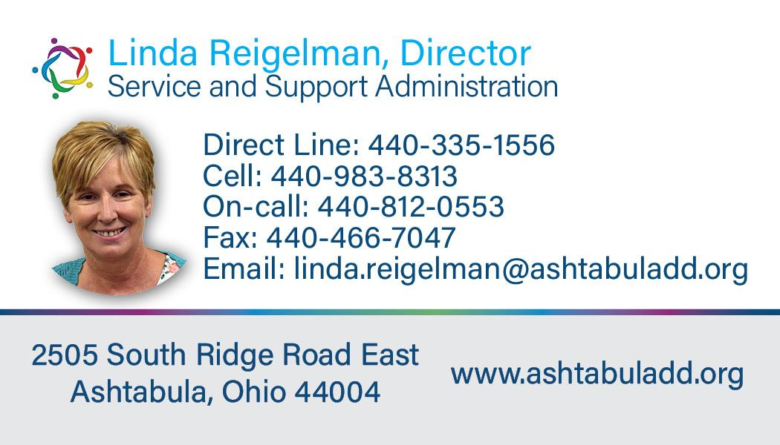
SSA Department

Slide 6

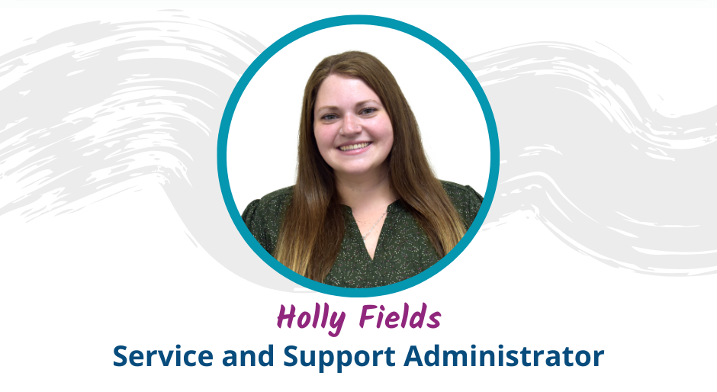
SSA Department

Slide 7
Accreditation
We are preparing for our upcoming Accreditation Review with the Ohio Department of Developmental Disabilities (DODD).
Accreditation ensures that our County Board is meeting the highest standards of service delivery, compliance, and accountability.
The review will focus on:
Quality of services and supports provided
Compliance with state rules and regulations
Effectiveness of provider and stakeholder collaboration
Outcomes for individuals and families
This process highlights our commitment to continuous improvement and excellence in supporting people with developmental disabilities.
SSA Department

Slide 8
Accreditation
How providers play a role:
DODD may review interactions with providers
They will be completing site visits and it is important that providers are responsive
Collaboration and Transparency
Make sure documentation is up-to-date and accurately reflects service delivery.
SSA Department
*Our goal is to demonstrate that we are working as a team- County board and providers together- to ensure quality services and strong outcomes for the individuals we serve.

Slide 9
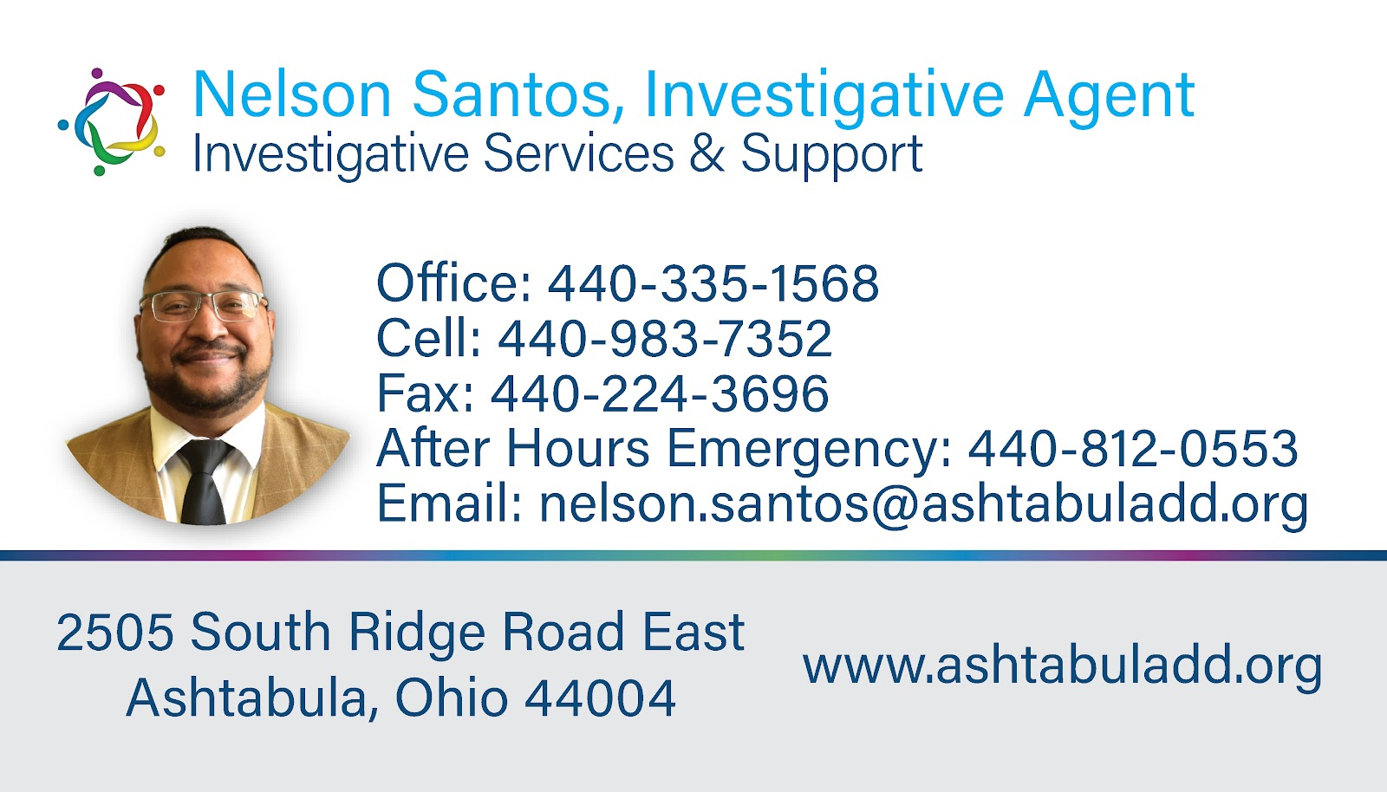
ISS Department

Slide 10
Choking Awareness & Prevention
Why it matters:
Individuals with developmental disabilities are at higher risk for choking due to:
  Difficulty chewing or swallowing (dysphagia)
  Certain medical conditions
  Medications causing dry mouth or reduced alertness
  Eating too quickly or taking large bites
Immediate Response is Critical
ISS Department

Slide 11
Prevention Strategies:
Supervision during meals when needed
Cut food into small pieces and avoid high-risk foods (e.g., popcorn, hot dogs, grapes, tough meats)
Encourage slow eating and thorough chewing
Support with positioning (upright posture while eating and drinking)
Provide individualized dietary plans and follow swallowing guidelines from healthcare providers
Emergency Response:
Know the signs of choking: coughing, gagging, inability to breathe or speak
Be trained in the Heimlich maneuver/abdominal thrusts and CPR
Call 911 immediately in an emergency
ISS Department

Slide 12


ISS Department
Questions

Slide 13
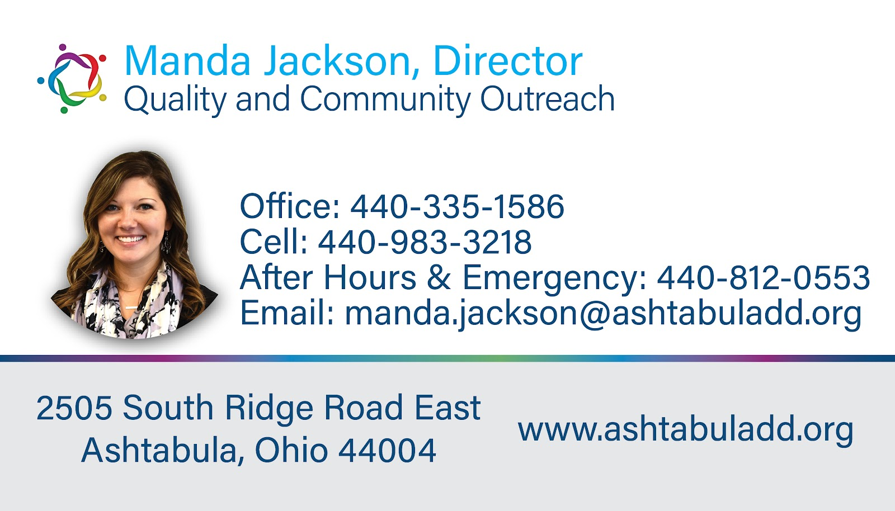
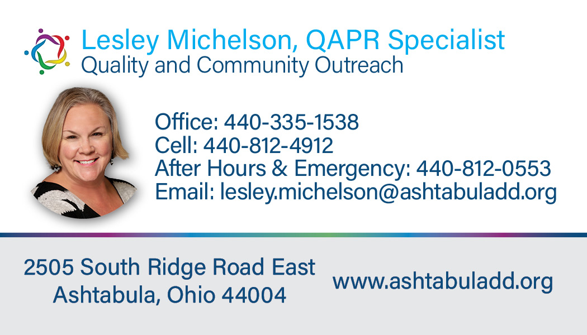
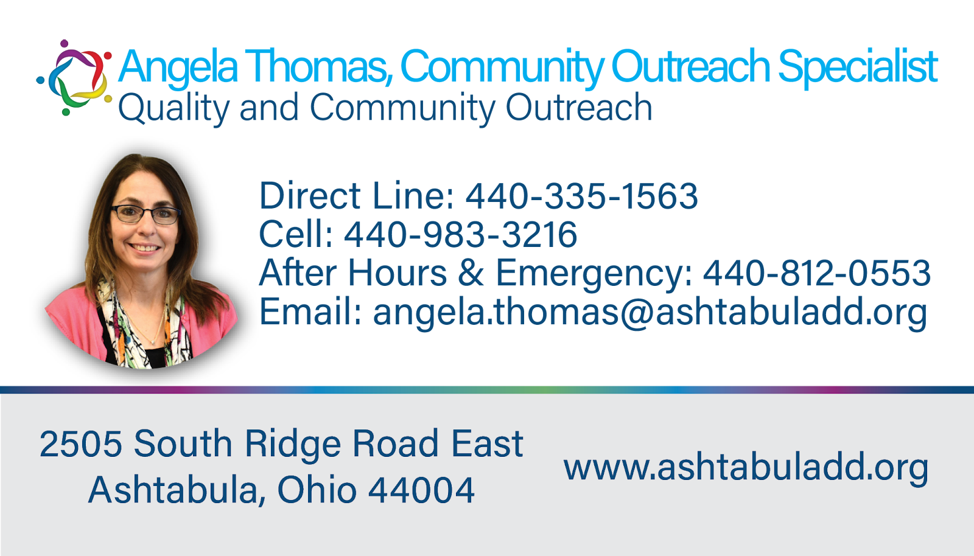
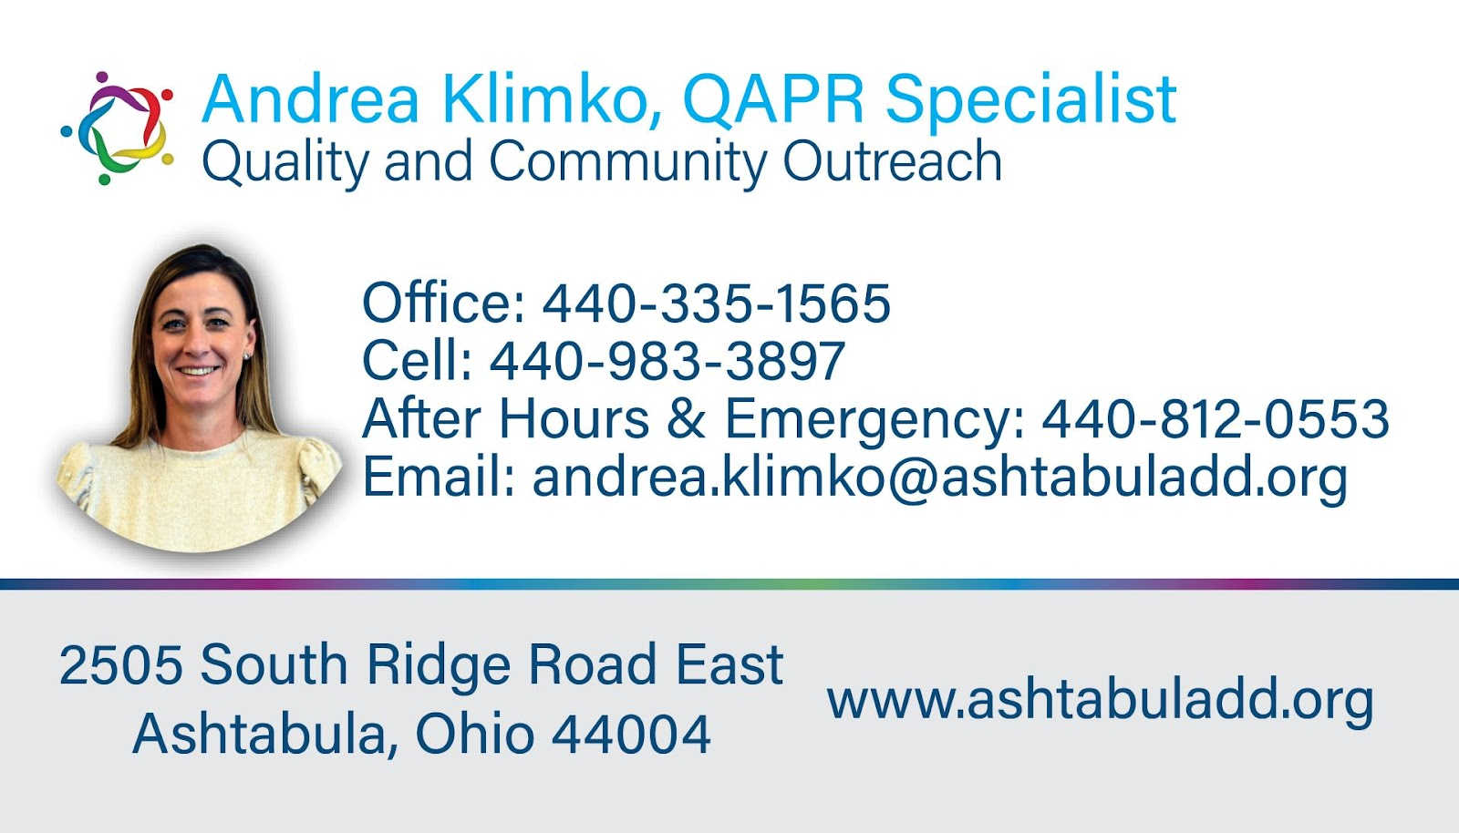

QCO Department

Slide 14

September is Ohio Preparedness Month
Be Ready. Be Safe. Be Prepared.
September is recognized statewide as Preparedness Month to raise awareness about the importance of emergency readiness.
Focus areas include:
  Emergency Planning – Know what to do before, during, and after an emergency.
  Communication Plans – Ensure families, staff, and providers have clear ways to connect.
  Emergency Kits – Stock supplies for homes, vehicles, and workplaces.
  Inclusive Preparedness – Plans should meet the needs of individuals with developmental disabilities.
QCO Department
Notes:
Ohio Preparedness Month gives everyone an opportunity to plan ahead and be ready when faced with an emergency. some things to consider for Ohio Preparedness Month:
Build an emergency kit, or update your current one.
Know where to get emergency communications.
Know what to do in a power outage.
Be aware of the weather risks that affect your area.

Slide 15
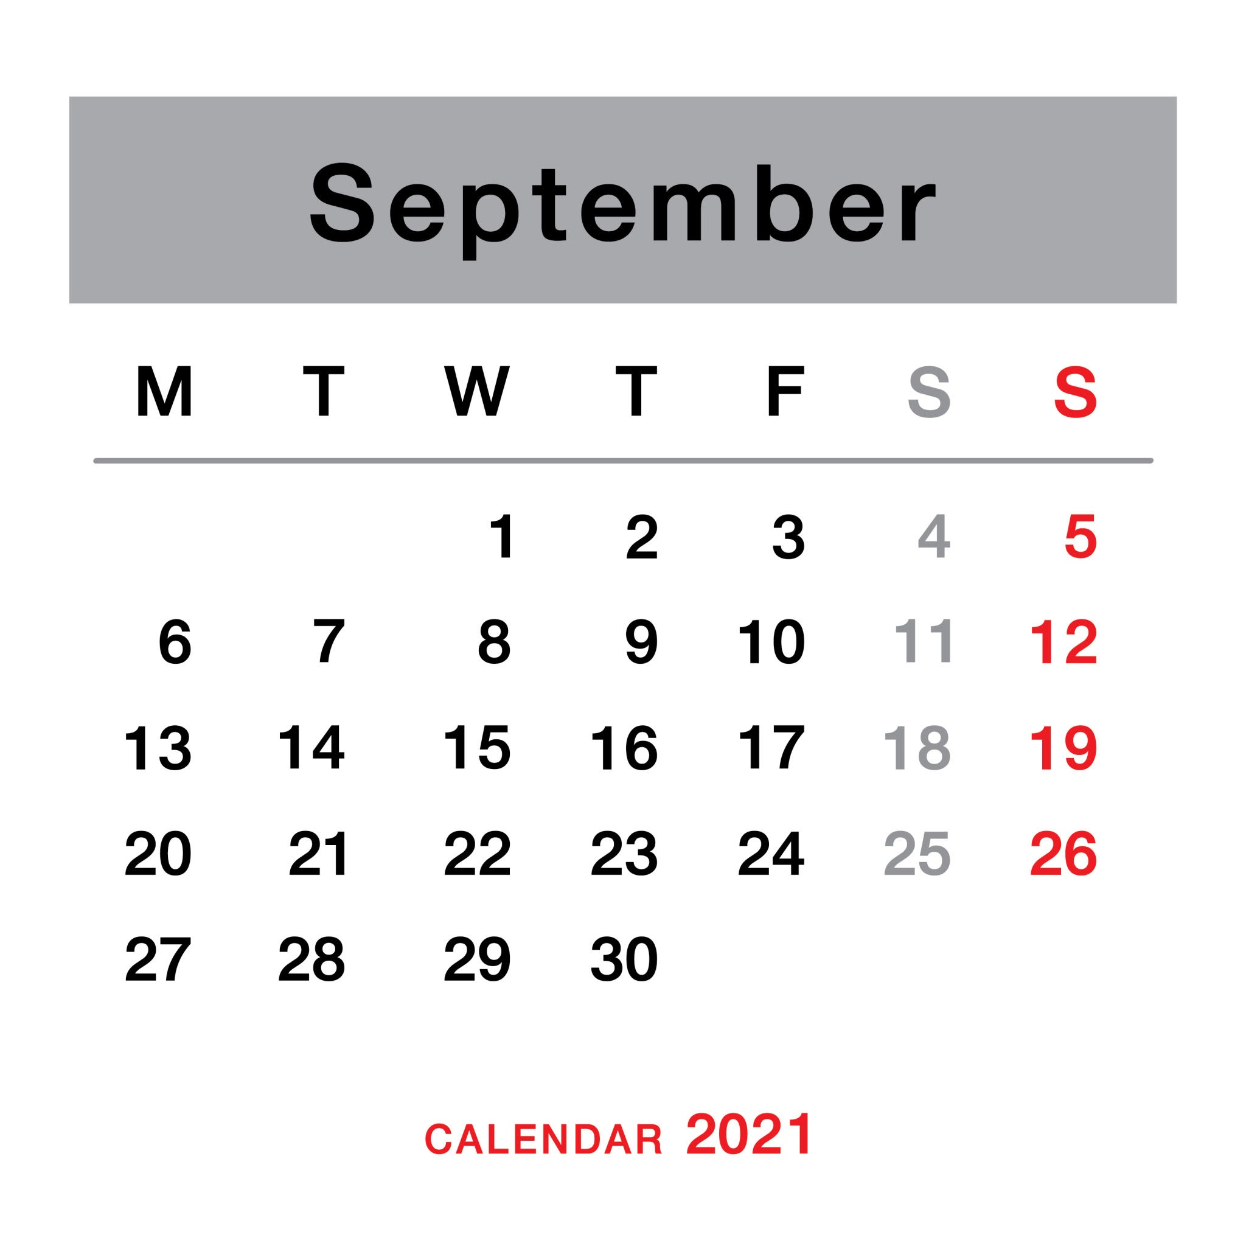
QCO Department
EVV Claims Denial-October 1, 2025
Open Working Session
September 16, 2025
1:00-3:00PM
Notes:
The October 1st deadline is coming very fast and surprisingly across the state of Ohio (as it stands) 38% of claims will be paid out. This means that 62% of claims could be subject to being denied. That is an alarming number of claims that will not be paid. Currently out of 41 providers in the last billing cycle there are 11 that are at 100% for matching claims, 2 providers that are above 90%, 6 Providers above 80%, 1 provider above 70%. The rest are 60% and below of matched claims. Lastly there are 8 providers with 100% unmatched claims.
We are offering this Open Working session to give you an opportunity to get this set up on your device and learn how to use the system to make sure you are compliant come October 1st.

Slide 16
QCO Department
Competency-Based Rate Add-On
Supporting DSP Skills, Growth, and Retention
What it is:
A wage add-on that increases reimbursement rates for waiver services delivered by Direct Support Professionals (DSPs) who have completed additional training and demonstrated core competencies.
The goal is to reward DSP professional development while improving service quality for people with developmental disabilities.
Who is eligible:
DSPs who:
  Work for an agency or as independent providers
  Have 2 or more years of work experience in this field or the equivalent of 4,160 hours
  Complete 60 hours of approved training (Competency-Based curriculum)
How it works:
Once a DSP is approved, providers can bill for the Competency Add-On rate when that DSP delivers services.
This results in a higher reimbursement rate, which is intended to be passed on to the DSP as a wage increase.
Notes:
The Medicaid maximum rate for the add-on is $0.54 for each 15-minute unit of routine HPC. The staff would receive 1.00 per hour increase and the agency will receive 2.16 reimbursement rate increase.
This add-on is state-funded, meaning DODD is paying the non-federal share.

Slide 17


1. Personal Recognition
Handwritten thank-you notes from supervisors or families
Personalized certificates or awards
2. Celebrations & Events
Host a DSP Appreciation Breakfast or Lunch
Surprise treat cart with snacks, drinks, or ice cream
Fun theme days during DSP Recognition Week
3. Thoughtful Gifts
Gift cards (coffee, gas, grocery, local restaurants)
Customized items (mugs, T-shirts, water bottles with DSP slogans)
Care packages with self-care items (candles, lotion, snacks)
4.. Family & Individual Involvement
Encourage individuals/families to make cards, drawings, or video thank-yous
Display a “Wall of Appreciation” with messages from coworkers, families, and individuals served
Recognize DSP’s All year Long
QCO Department

Slide 18
QCO Department

Slide 19
Benefits Analysis Information Sessions
Virtual Benefits Analysis Meeting
Date: 10/13/2025
Time: 10am-11am & 2pm-3pm
*Registration is required. Once registered, you will receive a Zoom link.
In person Benefits Analysis meeting
Date: 10/14/2025
Time: 11am-12pm & 5pm-6pm
Location: ACBDD Office, 2505 South Ridge Rd East
*Registration is requested.
Informational flyers went out 9/10/2025.
If you are interested and have questions, please contact Lesley Michelson at 440-812-4912 or Lesley.Michelson@ashtabuladd.org
QCO Department

Slide 20

Questions

Slide 21







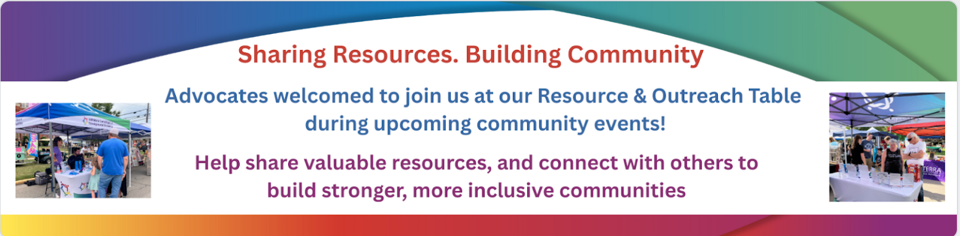
Community Inclusion Activities
QCO Department
21

Slide 22


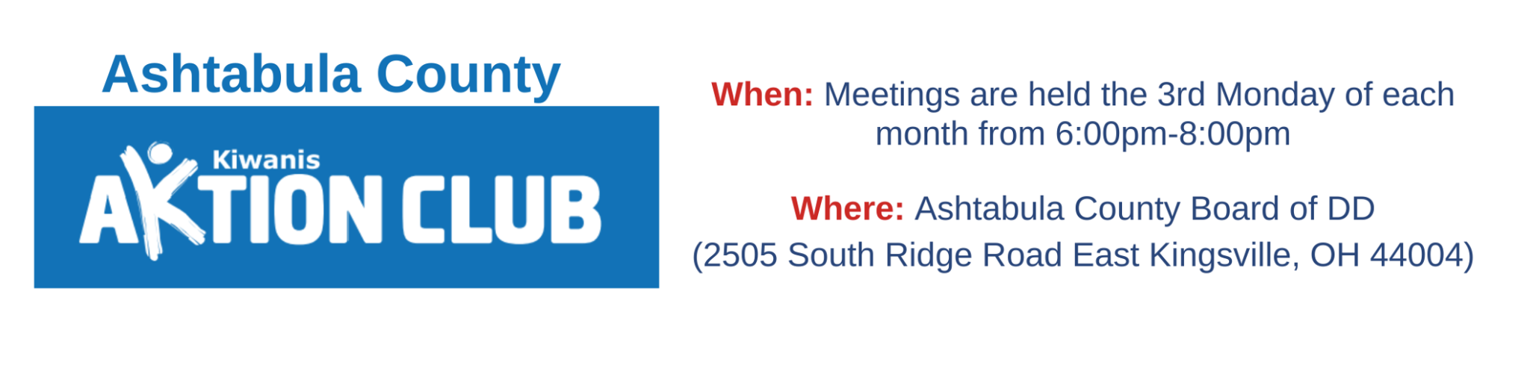





And So Much More!
QCO Department

Slide 23
Training Offered
MUI Refresher Training- September 30, 2025
Initial Medication Certification Category 1- September 22 & 23rd
Initial Provider Training- November 12, 2025
Annual Provider Training-October 8, 2025
CPR/First Aid Blended Learning- December 2, 2025
Initial Medication Administration Category 2 & 3- October 20, 2025
Renewal Medication Certification Category 1, 2 & 3 -October 21, 2025
AEGIS Crisis Prevention & De-Escalation-December 9, 2025
Provider Orientation- not scheduled
Provider Open Office Hours - Monthly on the first Tuesday
Open working session-EVV/Sandata- September 16, 2025
All classes listed above are open for registration on the Ashtabula County Board of Developmental Disabilities website under the Provider support tab. https://www.ashtabuladd.org/

Slide 24
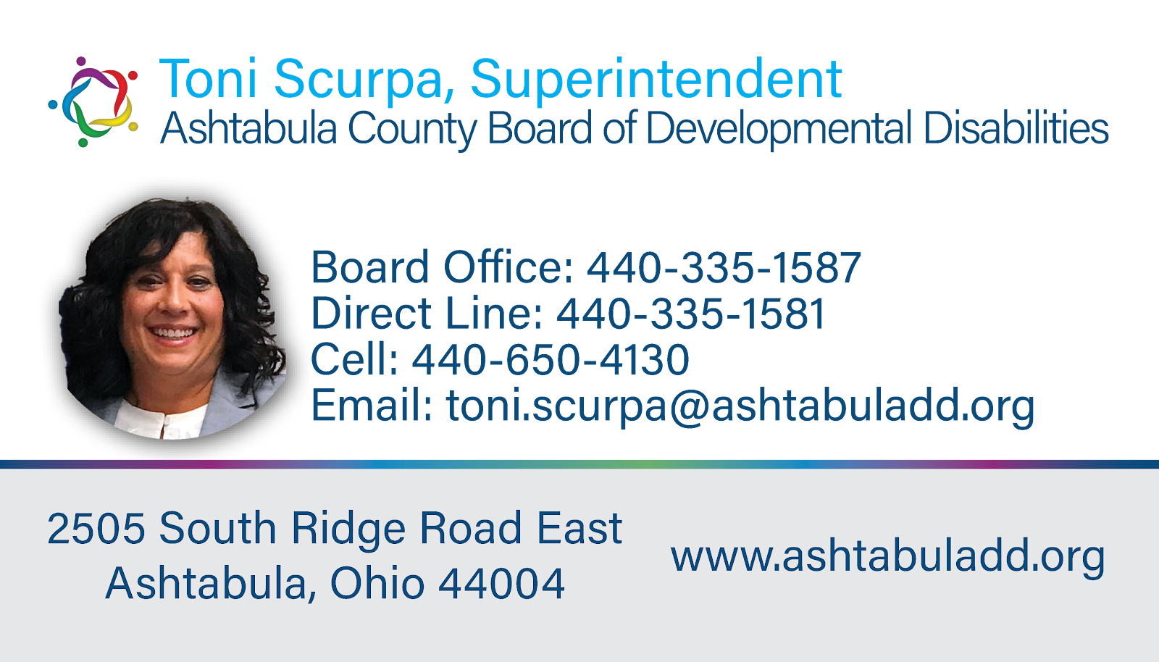
Superintendent Updates
Notes:
Welcome JAye and jeff
Inter RAi- We have 7 people selected in the initial phase to use this pilot program. We have 2 years to have everyone in this assessment
Levy upcoming- Voting is important-

Slide 25



Questions or Additional Comments?

Slide 26

Thank You!
Next Provider Meeting
October 9, 2025
Virtual Only

