Slide 1



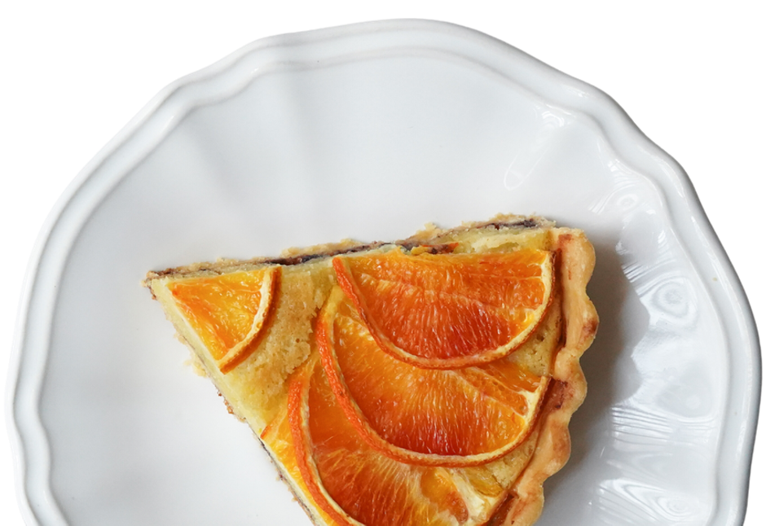
Weekly Wolfpack HOWL
Presented by ASB
11/12/2025

Slide 2


CalendAr
MONDAY | TUESDAY | WEDNESDAY | THURSDAY | FRIDAY
10 - NO late start today! Block Schedule 1-3-5 Food Drive Week 2 | 11 - NO SCHOOL!!! | 12 TODAY Block Schedule 2-4-6 Food Drive Collection | 13 Block Schedule 1-3-5 Career Speaker- Mike Twyman | 14 Block Schedule 2-4-6 Career Speaker- Zulema Reynoso Food Drive prize!
17 Food Drive Week 3 LAST WEEK to DONATE! | 18 Career Speaker- Michael Coblenz | 19 Career Speaker- Gavin Lanning Food Drive Collection | 20 | 21 Food Drive ENDS Top 7 and 8th grade homerooms get krispy kreme donuts!! Food Drive prizes!

Slide 3
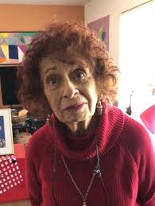
Ever had a krispy Kreme?
Top donating 7 and 8th grade homerooms for our food drive get krispy kreme donuts on November 21st!
…Was it krispy?

Slide 4

CALLING ALL ENVIRONMENTALISTS!
Our school is looking for student leaders who are focused on environmental issues. We will begin an initiative to further develop our recycling and conservation efforts.
Fill out this form if you are interested.
Students can also check in with Dr. Wild for more information.

Slide 5
November Homeroom:
The Attitude of Gratitude
Click here for slides
Notes:
Teacher will read November’s lesson topic

Slide 6

PTMS CAREER SPEAKERS - NOV ‘25
This year our speakers include:
A Professional Artist/Comic Book Illustrator
Helicopter Pilot in Law Enforcement
Computer Scientist
Human Resources Specialist
Software Engineer in the Defense Industry
Construction Entrepreneur
Sign up to hear our speakers using the survey on the next slide. All presentations take place during 7th Grade Homeroom.
*8th Graders will get a pass to eat during 7th Grade lunch.

Slide 7
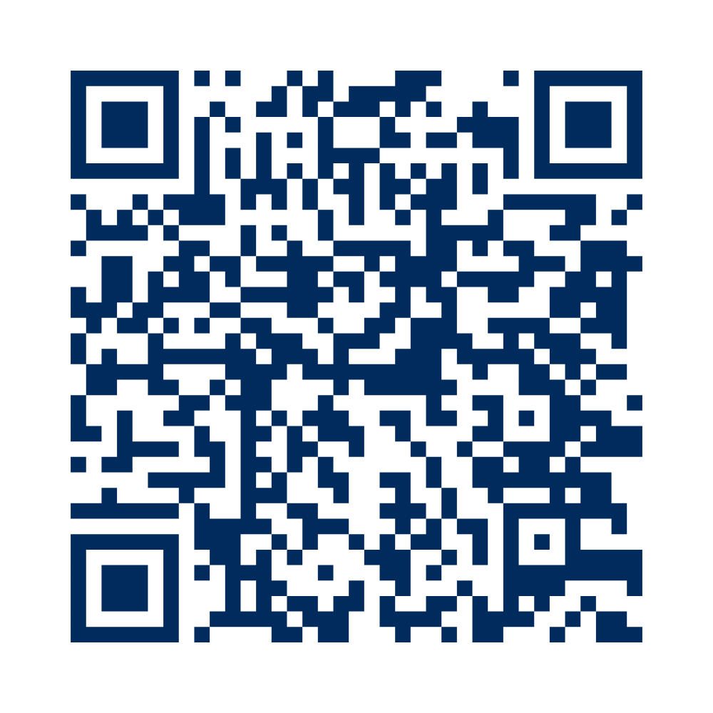
SIGN UP TO LISTEN TO THE CAREER SPEAKERS!
Fill out this form or scan this code:

Slide 8






PTMS Sports
CONGRATULATIONS!
To our co-ed golf team, our cross country program, and our 8th grade boys flag football team for winning the Big 8 Trophy for first place!
Winter Sports Registration
Registration opens 11/7/25.
Sports offered: Boys Basketball, Girls Field Hockey, Running Club, and Pickleball Club.
The Winter Season runs from Monday, December 1st to mid-February.

Slide 9


Slide 10






PTMS ESports will be hosting a Mario Kart Tournament open to any and all students at PTMS, starting in December
The winner of the tournament will earn a $10 Amazon Gift Card!
To sign up & get more details, fill out the form found on Mr. Torkelson’s website, the Wolfpack Connections Google Classroom, or click this link!

Slide 11


JSA-Jewish Student Association
Student organized
You don't have to be Jewish to join
Invite your
friends
The JSA meets every Wednesday starting on September 10. It will be after school between 2:50 - 3:30 in roon B227. The JSA focuses on teaching the Jewish community of our school more about Judaism and making connections with other Jews.

Slide 12


Slide 13

MAGIC: THE GATHERING CLUB
Want to learn a fun card game that lots of people know how to play and is used everywhere? Then look no further, this club will do just that!
Wednesdays at 8th grade lunch
Mr. Jenkins room, C219
We will supply the decks
You can make you own decks

Slide 14
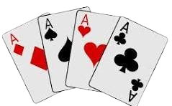
Card Game Club
Play fun card games such as Texas Hold’em, Blackjack, and Bluff to win CANDY! (you can also recommend a card game that you would like).
Wednesdays during lunch, room B121

Slide 15

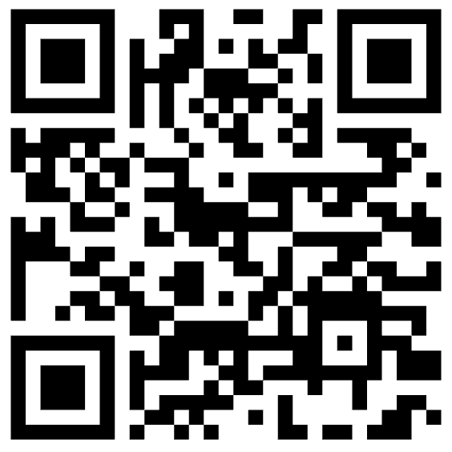
GUITAR CLUB
All Levels of Electric & Acoustic Players Welcome!
THURSDAYS
AT LUNCH
7th grade:
Mr. Hunt’s room B226
8th grade:
Mr. Johnson’s room M103
First informational meeting is this Thursday 8/28 at lunch!
Bring your guitar if you have one—limited loaner guitars will be available.
Use this link to sign up, or
Click here

Slide 16
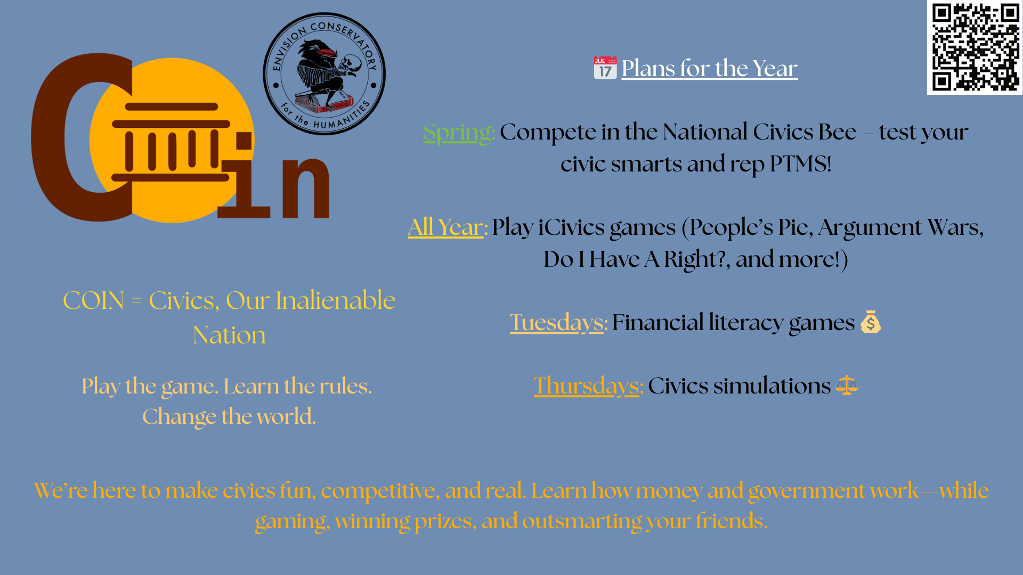

Slide 17

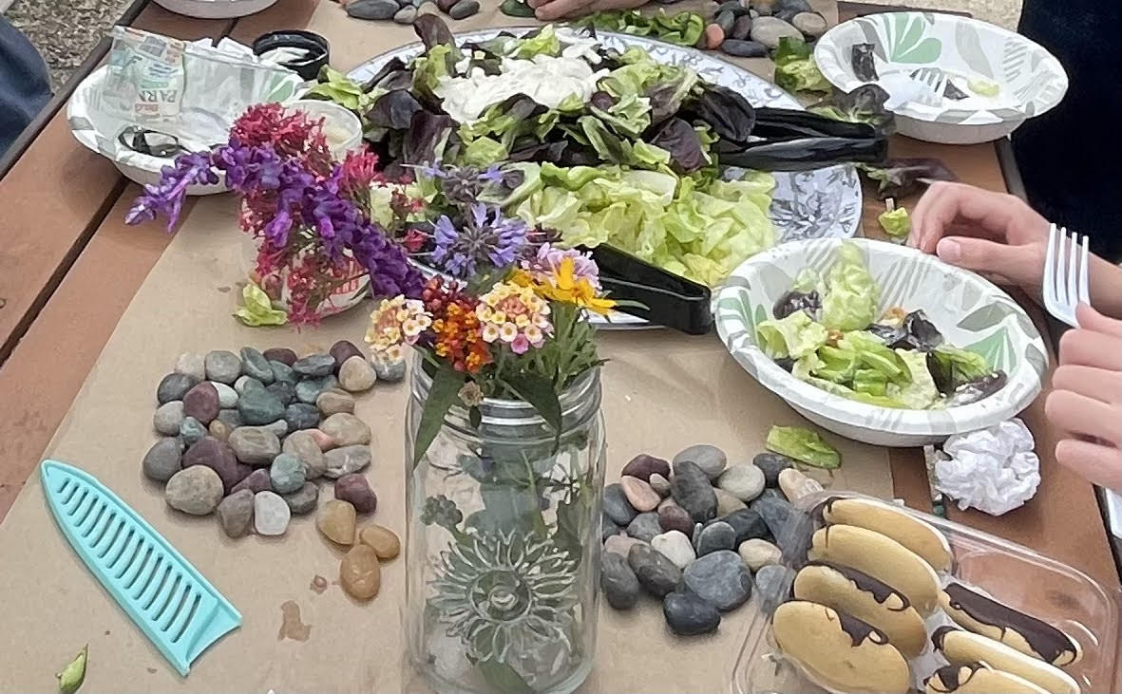
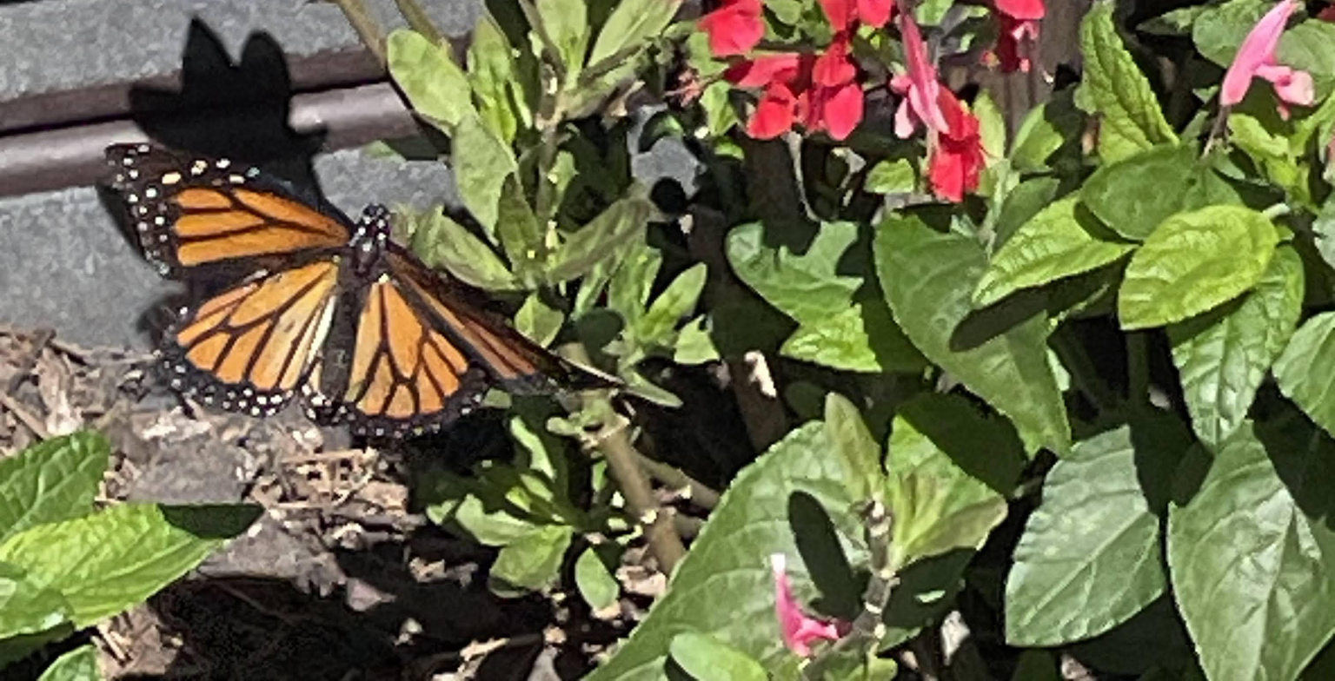
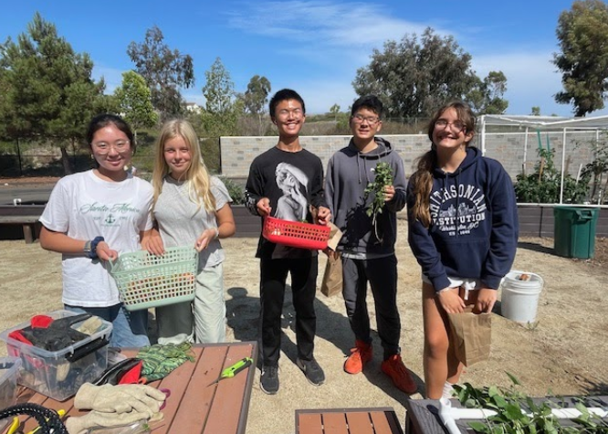
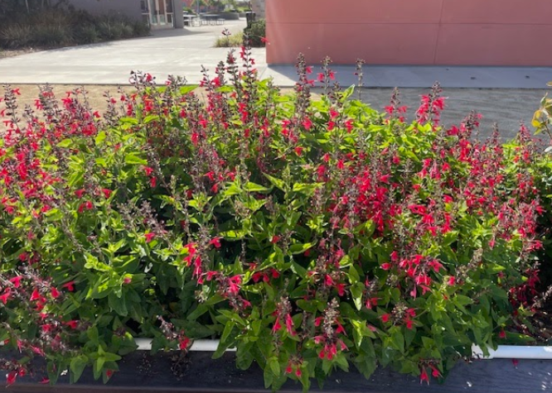
Garden Club
We are excited to introduce you to our Garden Club, established in 2022! The club gives students a fun, hands-on opportunity to learn about plants, sustainability, and caring for the environment—all while helping to grow and maintain our school garden.
Our garden is a Monarch Waystation Certified site, providing a habitat for monarch butterflies and supporting local pollinators. Students in the club plant a variety of flowers, fruits, and vegetables, and take pride in watching their work grow and thrive throughout the year.
The Garden Club meets every Monday after school for one hour, and all students are welcome to join—no gardening experience needed!
If you are interested in participating please use this Google Classroom code 3nye62u.

Slide 18

CHROMEBOOKS ARE FOR ACADEMIC PURPOSES ONLY
YES:
ASSIGNED SCHOOL WORK
WORD PUZZLES
WORLDGUESSR
CHESS
SORA
ART
NO:
GAMING
YOUTUBE
STREAMING
SIMULATIONS
ONLINE CHAT
BACKS TO THE WALL
UNASSIGNED LEARNING GAMES

Slide 19



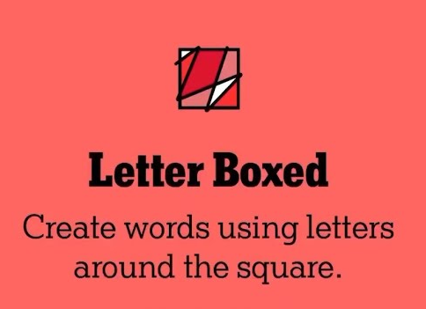
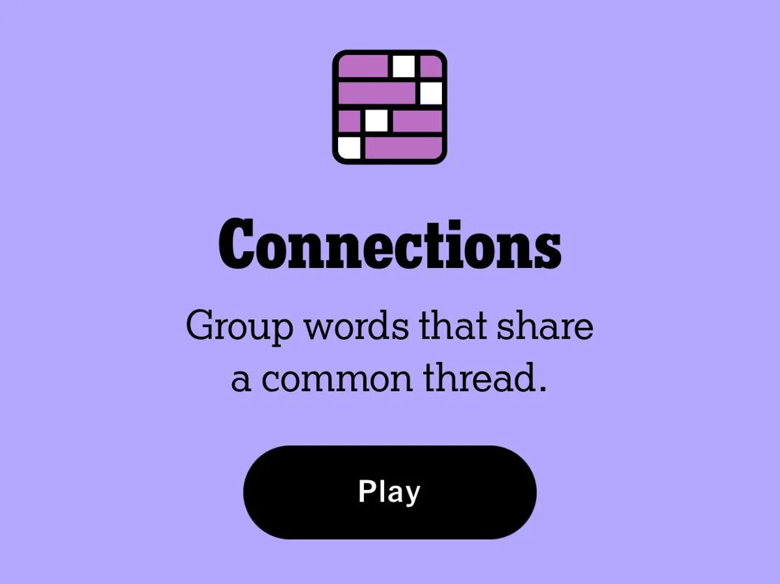
WHAT’S OKAY ON YOUR CHROMEBOOK
SORA
SCHOOL WORK
GEOGUESSR
CHESS (NO CHAT)
WORDLE AND OTHER NYT PUZZLES
ABIDING BY THE PTMS TECH CONTRACT AND THE SDUHSD ACCEPTABLE USE POLICY AT ALL TIMES

Slide 20



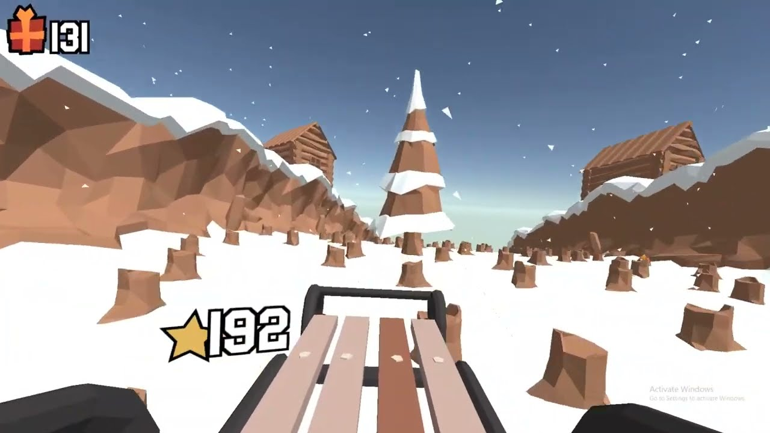

NO VIDEO GAMES ALLOWED
PLAYING OR WATCHING ELECTRONIC GAMES OR SIMULATIONS
—ON ANY DEVICE—
IS NOT ALLOWED
AT ANY TIME.
VIOLATIONS MAY RESULT IN:
CHROMEBOOK/DEVICE CONFISCATION
SCHOOL ACCOUNT DEACTIVATION
REFERRAL TO ASSISTANT PRINCIPAL AND/OR BEHAVIOR CONTRACT

Slide 21






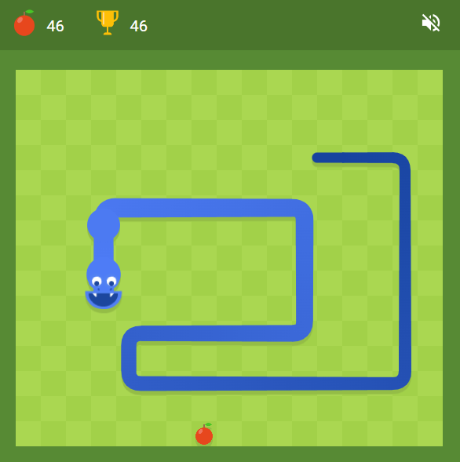
WHAT COUNTS AS A “VIDEO GAME”?
PLAYING AS A CHARACTER
ANIMATION + INTERACTIVE + TASK OR OBJECTIVE

Slide 22

NO ONLINE CHAT:
Unless it’s using your school Google account for a specific school assignment (not personal chat).

Slide 23




Birthdays
11/9 - 11/15
Shri A, Hayden B, Shaun T, Todd G, Terence L, Aiden P, Henry Y, Isabella B, Mila S, Victoria S, and Hyunmin W!

Slide 24

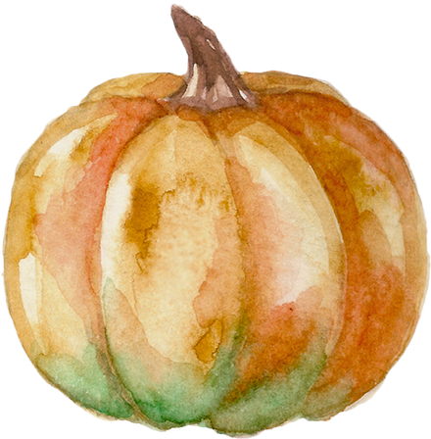
Thank you!
Follow PTMS ASB on Instagram to keep up with your school: @ptms.asb
takm8113@my.sduhsd.net
dux8940@my.sduhsd.net
epsteinh7844@my.sduhsd.net
careyj9565@my.sduhsd.net
Join the Wolfpack Connections Google Classroom with the code
2eovgmjr

