Slide 1
August 14, 2025
Provider Meeting

Slide 2



DSP of the Month!
Nate Prine
Christian Fleissner
Kallie Sparks
Notes:
DSP of the month for August
Christian Fleissner- Accessible Homes- Nominated by Marlin McPeters and Scott -”Christian is a young DSP just starting out in the workforce, and he’s already shown remarkable dedication and heart. He approaches every shift with a positive attitude and a deep sense of compassion. Christian serves each individual with respect and without judgment, and he never hesitates to stand up and advocate fearlessly for their rights. His commitment and integrity are truly inspiring.”
Nate Prine- Clearwater Homes- Nominated by Cathy Prine- “I want to nominate my brother Nate for an award because of the way he cares for our other brother. He takes his time with him, helps him with chores, and takes him places. He doesn’t rush or ignore him—he really pays attention.
Nate shows patience, kindness, and love every day. He helps without being asked and makes sure our brother feels supported and included. That means a lot to me, and I think it deserves to be recognized.
Kallie Sparks- LEEDA NE- Nominated by Rose Beal - “Kallie has always worked with the most behavioral clients we have. She still tries to get them out and doing things no matter what. She will go to their homes when she is not working just to do their hair. Kallie is very up beat and she helped one client lose 45 pounds for better health. She goes out of way to show that she is here to help and not just a paycheck.

Slide 3
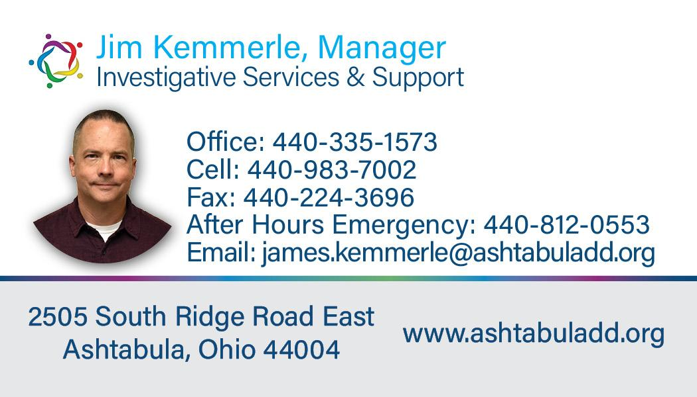
ISS Department

Slide 4
Category C Submission Process - Brittco
Examples of Category C MUIs
Law Enforcement: Any incident where the individual served is tased, arrested, charged, or incarcerated.
Unanticipated Hospitalization: A hospital stay lasting longer than twenty-four hours that wasn't scheduled or planned, and not directly related to a pre-existing condition specified in the service plan.
Unapproved Behavioral Support: The use of a prohibited behavioral intervention or a restrictive measure without proper approval from a human rights committee, which poses a risk to the individual's health and welfare.
ISS Department

Slide 5


ISS Department
Questions

Slide 6





QCO Department

Slide 7

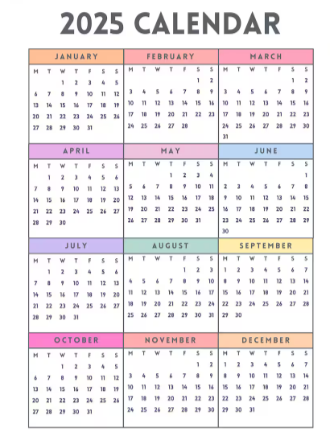
Provider meeting Updates/Changes
QCO Department
September & October- Virtual
November IN Person ONLY
December & January- Virtual
Notes:
Over the last year of holding Hybrid provider meetings we have seen a decrease in in-person attendance and have decided to move forward with a new schedule for provider meetings to hopefully better meet everyone’s needs and make the most of our time together. Starting in September every third month will be in person Only and all other meetings will be held virtually only. You should have seen updates made to your calendar invites. The time will remain 1:00-3:00PM for all the meetings. If you have any feedback regarding this change please feel free to contact Andrea Klimko. Thank you all for your continued support during this process.

Slide 8


DSP of the month Banquet Information
Award Categories
Bright Beginnings Award
Excellence in Direct Support Practice Award
Community Champion Award
Beyond the call of duty Award
Lifetime Commitment Award
Mr or Mrs Sunshine Award
Innovation Award
Advocacy Award
DSP of the Year Award
QCO Department
Notes:
DSP of the month has come to a close for 2024-2025 and we are looking forward to honoring the 36 DSP’s that were awarded DSP of the month over the last 12 months. This banquet is an invite only event; DSP’s of the month, their guests, those that nominated them and administrators from the agencies they represent have all been invited to attend.
If you have not received an invite and you think you should have please let Andrea Klimko know. Part of this evening will include awards in 8 separate categories and 1 DSP of the year award. The nomination form for these awards have been sent out. Please send in your nominations for each award prior to 8/20/25. Our committee will meet on 8/21/25 to select winners for each award.
Because there was some confusion in the selection process for the awards I wanted to clarify a few things. When you access the form each award will be listed with a description of the qualities that are expected for that award. Directly under each category is the list of all 36 DSP’s of the month. You do not have to select a winner for each category. You can select multiple categories for one person. Make sure that when you make your selection that you are giving us a detailed description why you think this person deserves that award. Please do not hesitate to contact Andrea Klimko if you have any questions regarding this process.
All DSP of the month nominations have been reset starting now for 2025-2026 DSP of the month winners. Don’t forget to continue to send in those nominations for the exceptional work that DSPs are doing!

Slide 9
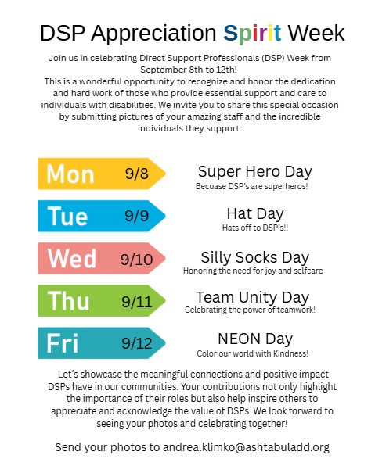
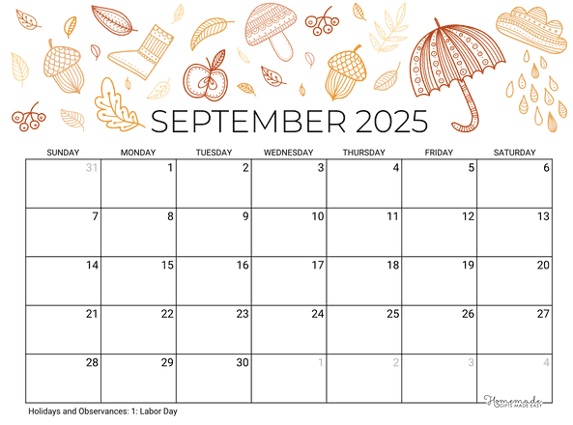
QCO Department
DSP appreciation events/Activities
Notes:
September is DSP appreciation month! We are looking forward to celebrating you all and all the exceptional staff that you have serving individuals with disabilities. In the last 2 years we have visited each provider agency and handed out lunches and gift bags to honor your staff for their hard work throughout the year. This year we are still planning to visit each provider location (if you have a local office to visit). Instead of handing out boxed lunches we are going to provide your staff with gift cards to purchase lunch when it works for them. We will have gifts and ACBDD swag to handout. We still encourage that you invite your staff to join us at your location so we can tell them in person how much ACBDD appreciates their hard work and dedication. Andrea Klimko will be reaching out to you to confirm your date and location for her to visit.
During the week of 9/8-9/12 we are asking everyone to participate in DSP appreciation SPIRIT week. We encourage all staff, individuals served and families to participate in this fun way to celebrate DSP’s and our appreciation for them. Please share photos with Andrea Klimko as you celebrate your DSP’s throughout the month.

Slide 10
QCO Department
Trainings and Resources to keep an eye out for
Tech Summit - September 12, 2025
https://nisonger.osu.edu/technology-project/techsummit2025/
OhioISP Gatherings-QIDPS- August 27, 2025 (Virtual Only)
https://dodd.ohio.gov/compliance/oisp/Support
2025 Provider Training series on CTLC tools -August 28, 2025
https://www.zoomgov.com/meeting/register/BMCfw2qpRk6KBSfqT3rLZA#/registration
August DSP Information Session- Understanding EVV- August 25,2025
https://www.zoomgov.com/webinar/register/WN_aFoi-CKKRg6camqhW4z4oQ#/registration
Notes:
-Tech Summit is scheduled for September 12th at the Conference Center in Dublin Oh. This is an opportunity for attendees to learn about current and new technology solutions for people with developmental disabilities. Registrations are still open and can be completed through the link provided.
-OhioISP gatherings are an opportunity for QIDPs and DODD to come together and discuss topics related to the OhioISP. This is a great opportunity to connect and collaborate with DODD. You can access all gathering meeting details on DODD’s website under Regional Support Gatherings tab.
-2025 Provider Training Series on Charting the Life Course Tools- The session will include information about Charting the LifeCourse principles and tools, including how the tools help everyone work together to build good lives for all. Registration can also be found in August 4 Memo Monday. If you need assistance with accessing this registration please contact Andrea Klimko.
The training can be counted toward annual training requirements for providers who assist with components of the quality care's person-centered philosophy.
-August DSP information Session- Understanding EVV- You are invited to join DODD to learn what this change means for you as a DSP. DODD staff and the Ohio Department of Medicaid (ODM) will explain what’s happening and how it might affect you and your DSP’s. They will also share helpful tools and information to make the change easier for providers.

Slide 11
Claims Denial - Electronic Visitation Verification Reminder
Attention: Provider Agencies, Independent Providers
As a reminder, effective October 1, 2025, claims requiring Electronic Visit Verification (EVV) without a matching EVV record will be denied. To avoid claim denials and non-payment, please ensure that each submitted claim requiring EVV has a corresponding EVV record in the DODD system. Denied claims will not be paid. Providers can view information for their submitted DODD waiver claims and matching EVV records on their Provider Weekly Report in eMBS. Providers will receive notifications bi-weekly for their claims and EVV matching rates. Please visit the Ohio Department of Medicaid EVV website for resources and tools. For immediate help, contact the EVV Provider Hotline at 855-805-3505.
QCO Department
Notes:
Please be prepared for the October 1, 2025 EVV live date. If you are currently still having issues with your claims being verified do not hesitate to reach out to someone at the county board or directly to Sandata to troubleshoot these concerns prior to the potential claims denial. We havde included a print out on who to contact at ODM based on your topic or question.
If you are not using EVV/Sandata you will want to start using this application as soon as possible.

Slide 12

Attention: Providers and Billing agents
QCO Department
DODD’s data warehouse will transition from Cognos system to Tableau on October 31, 2025.
Providers will be given further guidance on how to access Tableau prior to the October 31, 2025 transition date.
Notes:
The Data warehouse application Cognos system will be transferring to the Tableau system on October 31, 2025. This transition date has been extended from June,2025. DODD ensures that while at this time Providers and billing agents do not currently have access to this new system you will be provided this access prior to the launch date of October 31, 2025. While we do not have a lot of information to provide you at this time we just want to make you aware of the upcoming change.
Keep an eye out for upcoming training session and on information on how to get the appropriate staff logged into this system.

Slide 13
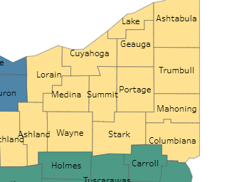
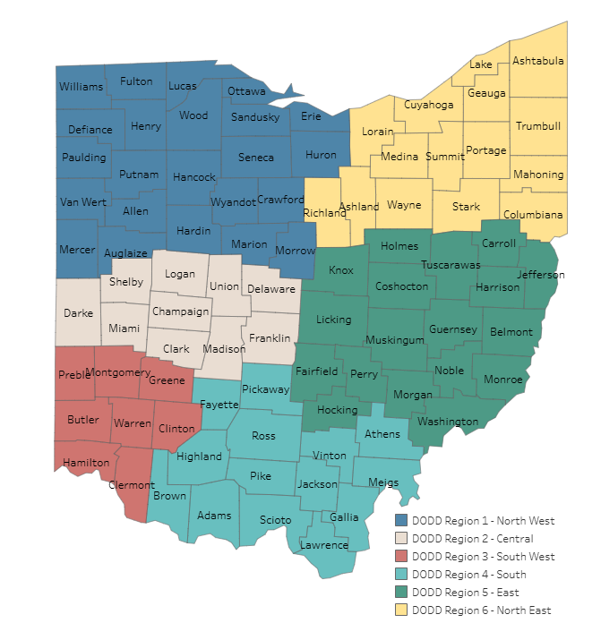
Region 6 SSA/QIDP Gathering Updates
8/27/2025 10am-10:45am SSA Only (Virtual)
8//27/2025 11am-11:45am QIDP Only (Virtual)
9/24/2025 10am-10:45am SSA Only (Virtual)
9/24/2025 11am-11:45am QIDP Only (Virtual)
10/22/2025 - 10am-12pm IN PERSON SSA and QIDP
QCO Department

Slide 14

Questions

Slide 15







Community Inclusion activities
QCO Department
15

Slide 16


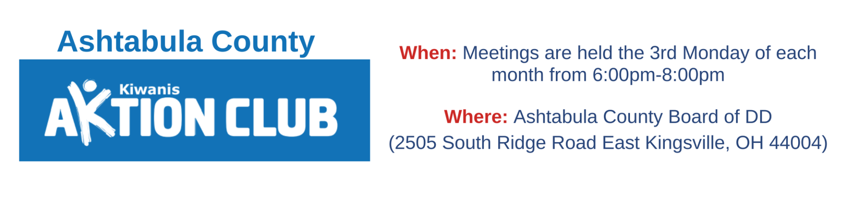



And So Much More!
QCO Department

Slide 17
Training Offered
MUI Refresher Training-
Initial Medication Certification Category 1-
Initial Provider Training- September 10, 2025
Annual Provider Training- August 13, 2025
CPR/First Aid Blended Learning- September 2, 2025
Initial Medication Administration Category 2 & 3- August 18, 2025
Renewal Medication Certification Category 1, 2 & 3 - August 19, 2025
AEGIS Crisis Prevention & De-Escalation- September 9, 2025
Provider Orientation- August 26, 2025
Provider Open Office Hours - Monthly on the first Tuesday
All classes listed above are open for registration on the Ashtabula County Board of Developmental Disabilities website under the Provider support tab. https://www.ashtabuladd.org/
Notes:
Highlight upcoming training dates. Registration is required and all appropriate documentation/ or pretraining requirements must be completed prior to the scheduled class date. Also reminder that Jenna Vanek is going to be the main point of contact for all training questions.

Slide 18

Superintendent Updates

Slide 19



Questions or Additional Comments?

Slide 20

Thank You!
Next Provider Meeting
September 11, 2025
Virtual Only

