Slide 1

Understanding California’s New Testing System
An Overview
March 2015

Slide 2

Overview of the Presentation
What is the new testing system?
Why is it necessary?
What do the new tests measure and how?
How can I help my child prepare?
Where can I go for more information?

Slide 3
California State Testing Programs
CELDT
PE Testing
CAASPP
CAHSEE
Grades 3-8 & 11
& Grades 5, 8, 10 Science
Grades 5, 7 & 9
Replaces previous
Standardized
Testing and Reporting (STAR) Program
Grades 10, 11 &12
English Learner Students

Slide 4
California Assessment of Student Performance and Progress (CAASPP)
Science
Grades 5, 8 & 10
Paper-based
English-Language Arts & Math
Computer Adaptive Test (CAT)
Wider range of test questions
Multiple-choice test questions
California Standards Tests (CSTs)
Smarter Balanced Tests – NEW!!
Grades 3-8 & 11
Aligned to old standards; will be replaced soon
Aligned to new standards

Slide 5



Highlighting the Differences
Old System
New System
WHAT
Content Standards for California Public Schools
HOW
ITEM TYPES
Multiple Choice
Short Answer
Drag and Drop
Hot Spots
Graphing
Essay
Multiple Choice
Essay

Slide 6
More About the Smarter Balanced Tests
Each subject area has two parts:
Computer-adaptive items
English-Language Arts (40-45 items)
Math (30-35 items)
Performance Task
Designed to show how students can integrate knowledge and skills across multiple areas
English-Language Arts (3 questions)
Math (6 questions)
Source: Smarter Balanced test blueprints

Slide 7
Computer-Adaptive Items
Testing system selects questions that are appropriately challenging for students based on student answers to previous questions.
When a student gets an answer correct, the next question is more difficult. When a student get an answer wrong, the next question is slightly easier.
Tailored or customized to the student’s ability level
No two students will receive the same test whereas under the STAR system, most students all received the same questions. This helps with test security too.
Helps keep students more engaged
Often takes fewer questions and less time to identify student skills

Slide 8
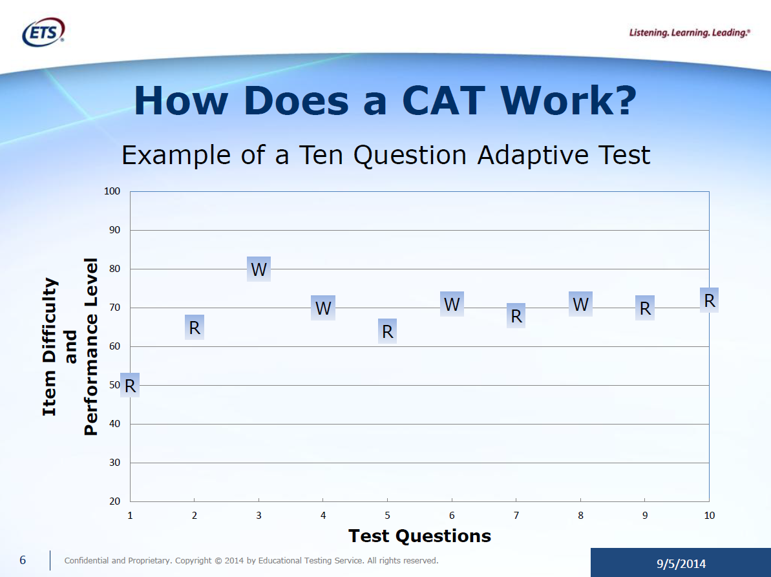

Slide 9
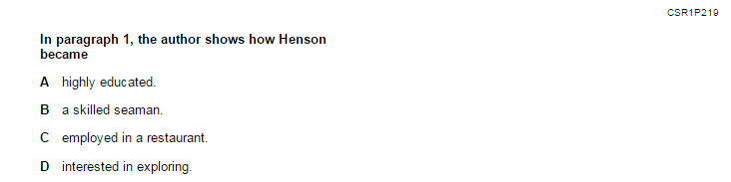
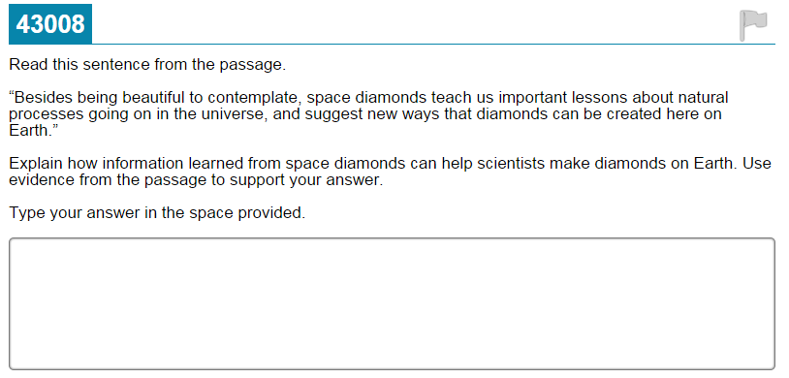
What is Different: English-Language Arts

Slide 10
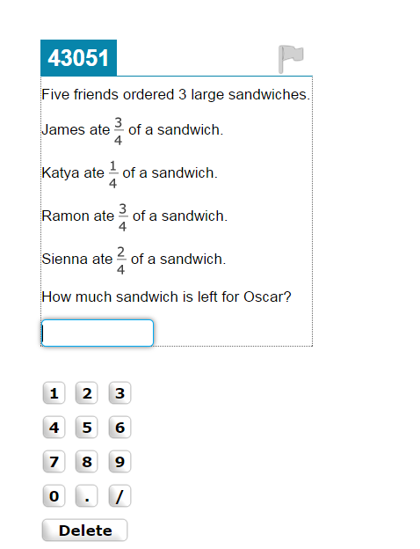
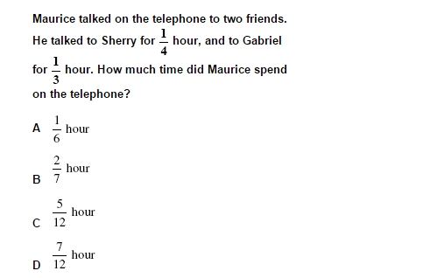
What is Different: Mathematics

Slide 11
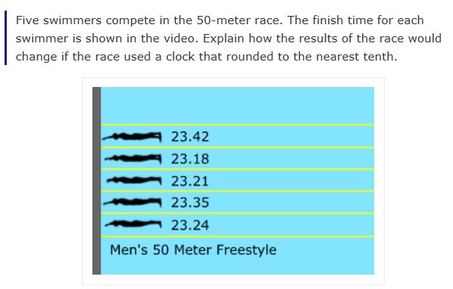
What is Different: Mathematics

Slide 12
What is a Performance Task?
Activity that requires students to use multiple pieces of information to respond to a series of questions on their own (i.e. not multiple choice where the student selects an answer from a set of choices)
Three steps:
Classroom activity delivered by teacher
Independent work
Development of response
The performance tasks are given via the computer, but they are not computer-adaptive; all students in a given grade get the same performance task.

Slide 13
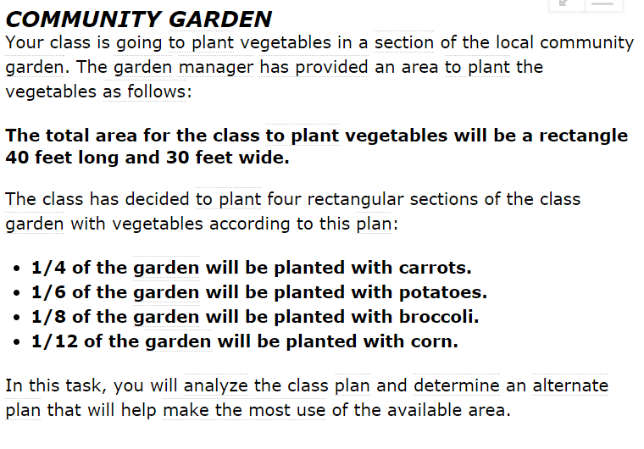
Example of a Performance Task Smarter Balanced Practice Test; Grade 5 Math - Problem

Slide 14
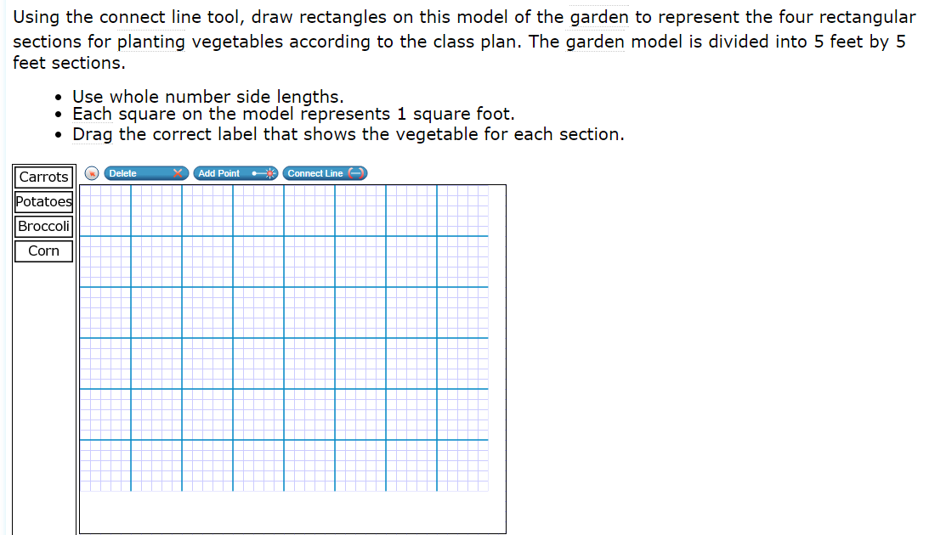
Example of a Performance Task Smarter Balanced Practice Test; Grade 5 Math – Question 1

Slide 15
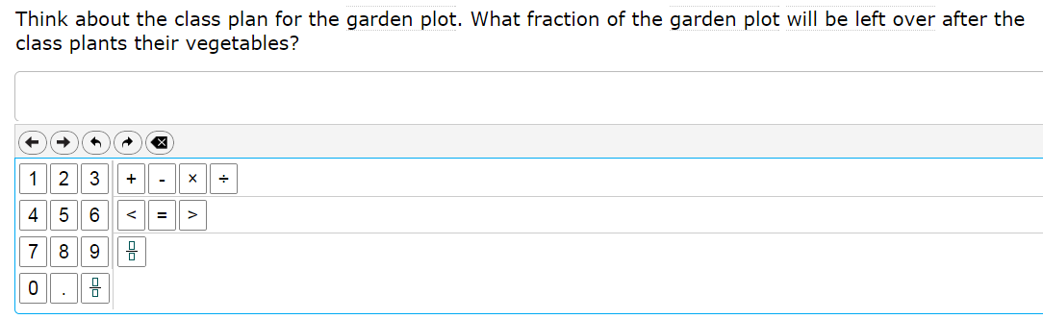
Example of a Performance Task Smarter Balanced Practice Test; Grade 5 Math – Question 2

Slide 16
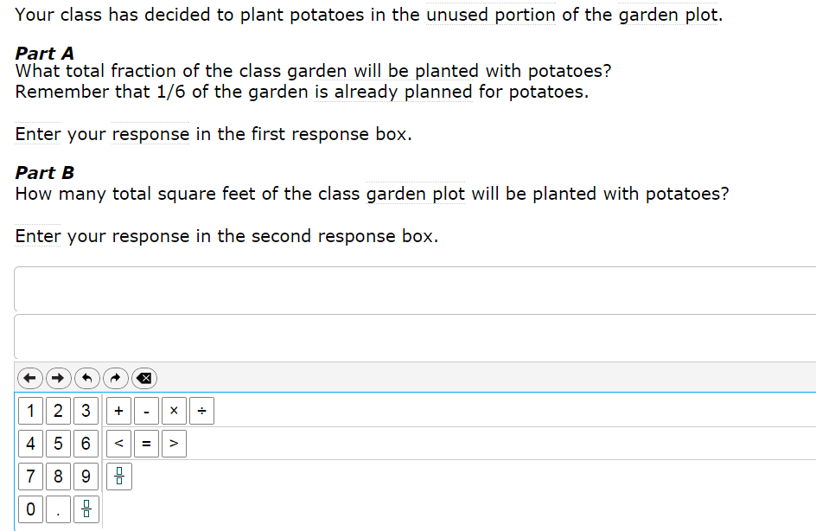
Example of a Performance Task Smarter Balanced Practice Test; Grade 5 Math – Question 3

Slide 17
Components of the Performance Tasks
Combines knowledge and skills across multiple content strands within a content area
Reflects a real-world task or scenario
Usually multi-step
Requires
Management of information and ideas
Demonstration of 21st Century skills needed for college and career (critical thinking, analysis and synthesis of information from multiple sources)

Slide 18
Spring 2014
Spring 2015
Field Test
Students tried out the technology and got familiar with new question types and the way that the testing system works.
No results because it was a “test of the test” or “trial run”
Operational Test
Results will be reported
District-level
School-level
Student

Slide 19
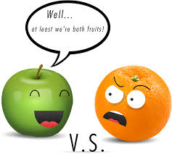
New Results
This year’s results will set a new baseline for progress students will make over time.
Results can not be compared to prior years.
More information about results will be provided in the future – the California Department of Education is still working out final details.

Slide 20

How Can You Help Your Child?
Discuss the new tests with your child. Make sure he or she is not scared or anxious about the new tests.
With older children, explain that the new tests were created to help him or her better prepare for college and career.
Explain to your child that the new tests will be more challenging for them, especially the first few times they take them.
Tell your child that you and his or her teacher have high expectations and that you are both there to help them every step of the way.
Review test results with your child, bringing your child’s teacher into the discussion as necessary.
Make sure your child gets a good night’s sleep and a nutritious breakfast before testing.
Source: National PTA “Parent’s Guide to New Assessments in California”

Slide 21
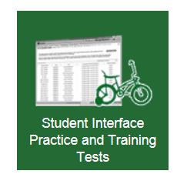
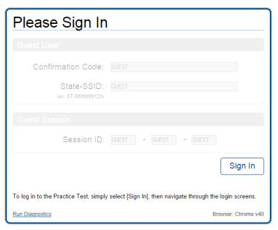
Take a Practice Test
The practice tests can be taken by parents, teachers, students, and others to review the type of test questions that students will see in different grades and subjects.
Practice tests are available at http://sbac.portal.airast.org/practice-test/.
Once on the website above, click on the green box near the bottom of the screen that says “Student Interface Practice and Training Tests”
Then click “Sign-in” on the next screen to get started.
Select a grade and then follow the instructions.

Slide 22
Testing Schedule
Individual schools schedule their own testing dates within the dates above
Our District will test between XXX and XXX
More information about when your child will test will be sent home by his or her principal

Slide 23
For Further Information
[Your District’s Testing Department Name]
[Your District’s Testing Web page]
California Department of Education’s CAASPP Web page
http://www.cde.ca.gov/ta/tg/ca/
Frequently Asked Questions about CAASPP
http://www.cde.ca.gov/ta/tg/sa/sbcommonqa.asp
Parent Fact Sheet from Smarter Balanced
http://www.smarterbalanced.org/wordpress/wp-content/uploads/2012/03/Smarter-Balanced-Parents-Factsheet.pdf
Smarter Balanced Assessment Consortium website
http://www.smarterbalanced.org

