Slide 1
SRVUSD Facilities Oversight and Advisory Committee (FOAC)
  Annual Report of the Fiscal Year Ended June 30, 2024
  & Projects Update

Slide 2
Committee Overview
Proposition 39, passed November 7, 2000, requires school districts establish a Citizen’s Oversight Committee to actively review and report on the proper expenditure of taxpayers’ money for school construction, and to inform the public concerning the expenditure of bond revenues.
The Committee shall have at least 7 members and meet at least four times per year.
The Committee is required to issue a report to the public at least once a year.

Slide 3
Committee Members
Kyle Levy (Chair)
Jane Joyce (Vice Chair) | Bridgit Pelley
Anthony Romanelli | Bette Felton
Madeline Serafin | Angie Toussaint-Billingsly

Slide 4
Measure D Overview
Passed with 56.8% on November 6, 2012 by voters living within district boundaries.
Authorized $260 million in bonds to be used for the construction, reconstruction, rehabilitation or replacement of school facilities.
      All bonds have been issued as of June 2019. The bonds generated additional interest income which has also been expended on Measure D-approved purposes.
Cumulative expenditures through June 30, 2024 are $264 million
More detailed information is available at https://www.srvusd.net/Departments/Facilities/Measure-D-Facilities-Bond/index.html

Slide 5
Audit and Reporting
Measure D financial activities are audited annually.
The audit for the 12 months ended June 30, 2023 was performed by the independent accounting firm Eide Bailly LLP.
    There were no adverse findings and the district met its requirements in accordance with the Generally Accepted Auditing Standards (GAAS) and the Governmental Auditing Standards.
    The FOAC reviewed and approved the June 30, 2023 audit report at its August 20, 2024 meeting.
The audit for the 12 months ended June 30, 2024 was performed by the independent accounting firm Crowe LLP.
    There were no adverse findings and the district met its requirements in accordance with the Generally Accepted Auditing Standards (GAAS) and the Governmental Auditing Standards.
    The FOAC reviewed and approved the June 30, 2024 audit report at its January 28, 2025 meeting.
All of the annual audit reports are available under the Fiscal Accountability section of the district's web page:
https://www.srvusd.net/Departments/Facilities/Measure-D-Facilities-Bond/Fiscal-Accountability/index.html

Slide 6
FOAC Areas Of Focus FY 2023/24
Elementary Schools
  Playground replacements and continued structural and function improvements including fencing and walkways
  Utilization of successful design ideas in play areas and controlled access points through main offices
Middle Schools
  Full completion of Stone Valley building
  Fencing and walkway upgrades.
High Schools
  Replacement of Cal High Press Box and Bleachers

Slide 7
Financial Summary – Elementary Schools
In Millions | Total to 6/30/2024 - Audited
Bella Vista | $ 32.4
Neil Armstrong | $ 1.7
Walt Disney | $ 0.8
Twin Creeks | $ 11.0
Vista Grande | $ 5.0
Rancho Romero | $ 4.4
Golden View | $ 9.9
Montevideo | $ 9.0
Green Valley | $ 6.2
Sycamore Valley | $ 6.7
Alamo | $ 1.4
Only campuses with significant impact on Measure D expenditures are included

Slide 8
Cumulative Financial Summary – Middle Schools
In Millions | Total to 6/30/2024 - Audited
Stone Valley | $ 38.4
Charlotte Wood | $ 10.6
Only campuses with significant impact on Measure D expenditures are included

Slide 9
Cumulative Financial Summary –
High Schools
In Millions | Total to 6/30/2024 - Audited
San Ramon Valley | $ 70.8
Dougherty Valley | $ 7.0
Monte Vista | $ 3.4
California | $ 10.3
Only campuses with significant impact on Measure D expenditures are included

Slide 10
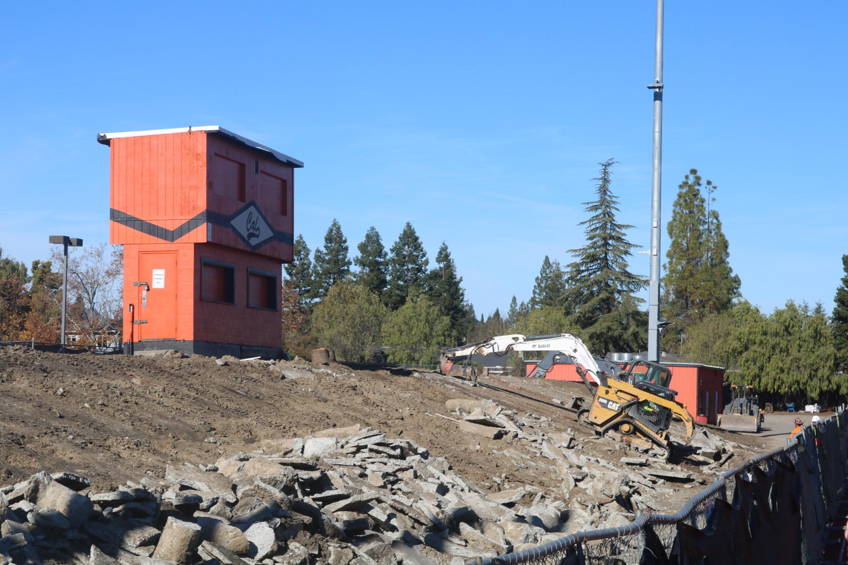
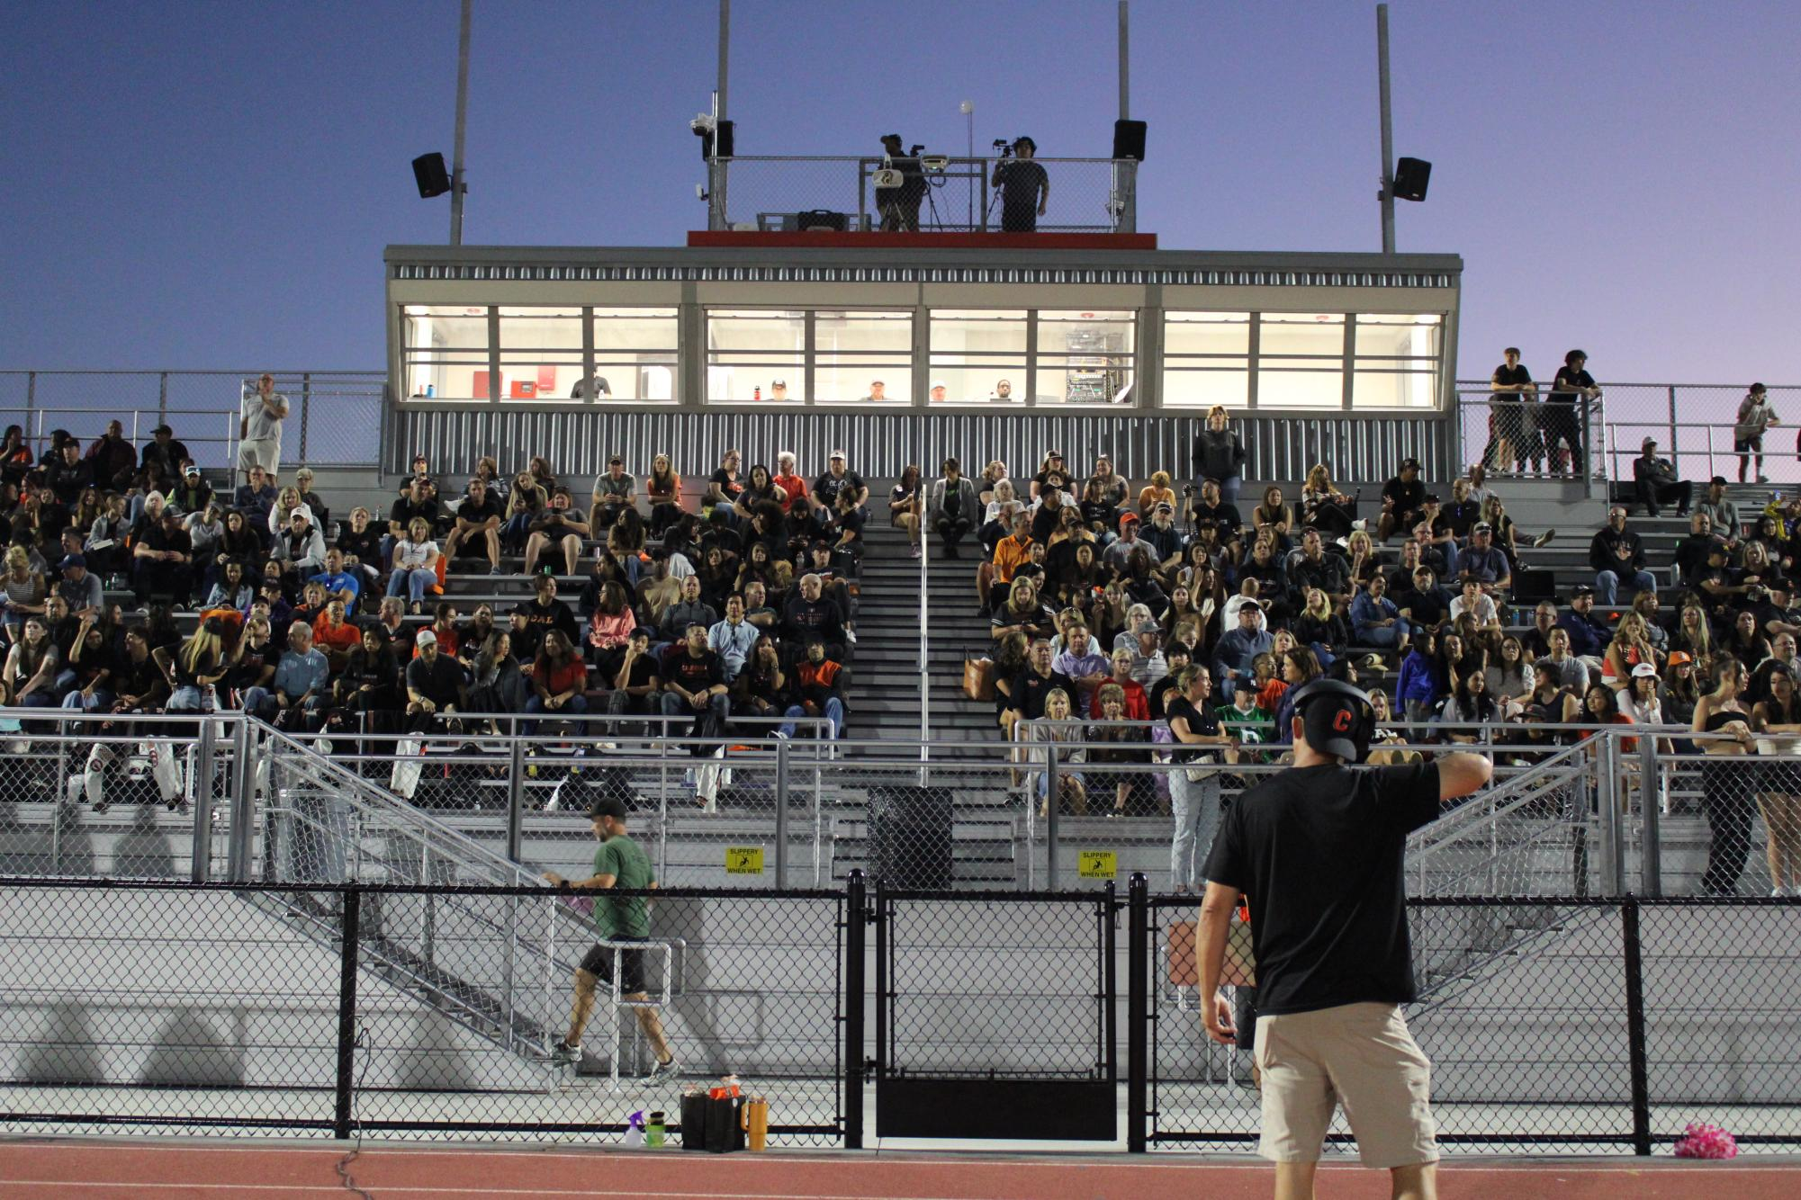
Projects – California High

Slide 11
Oversight Conclusions
The Committee believes bond funds have been expended for purposes consistent with Measure D.
Projects have proceeded as intended with any substantial issues and opportunities being presented to the Committee for review and comment before action was taken.
Explanations for changes were proactively provided.
Communication with District staff and Board liaisons continues to be very open and timely. The Committee appreciates all of the efforts of District staff to help support this Committee’s mission and objectives.

Slide 12
FOAC Areas Of Focus for FY 2024/25
Assessment of program progress against overall Measure D plans and overall review of success of Measure D, including drafting a Measure D FOAC Final Report.
Timely use of final remaining funds.
Safety of students and site staff.
Partner with Board and District to identify “advisory” projects and discuss potential role for a FOAC in upcoming Facilities Master Plan.

